Slide 1
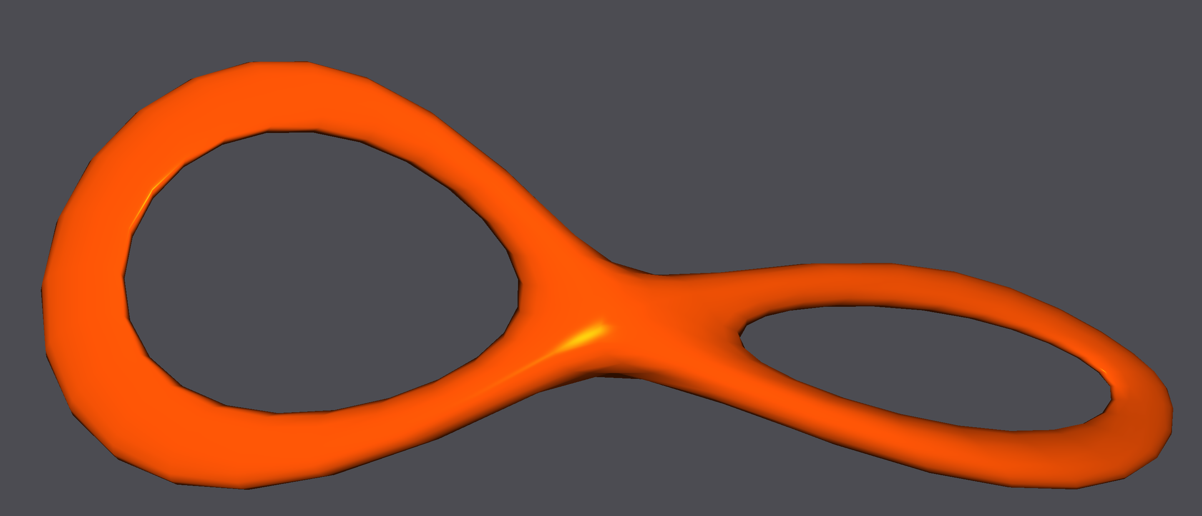
DGP 2019 Project Plasticity and explosions
Sébastien Gachoud
Ludo Hoffstetter
Simon Wicky EPFL

Slide 2
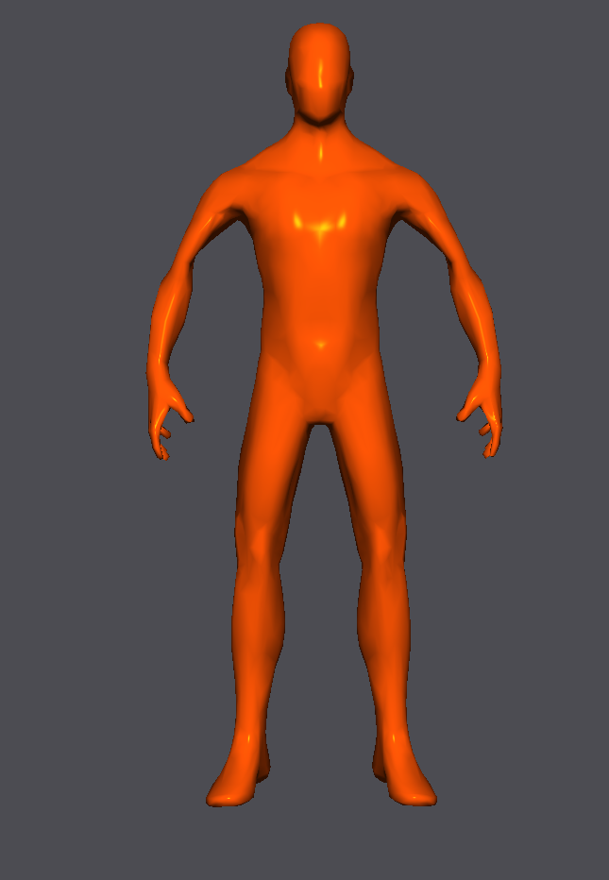
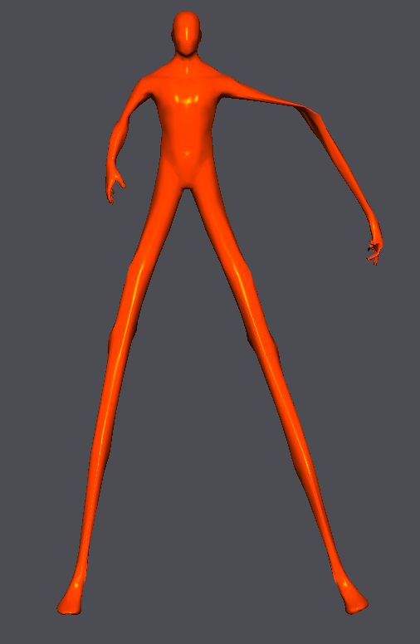
GOals
Add plasticity to the simulation
Deform the mesh if some constraint violation are too big
Explosions
Well, sort of
Point that set the vertices speed according to parameters

Slide 4
issues
You have to update the constraints
Update() methods after the local-global step.
Realism depends on the parameters of the plasticity
What is the violation threshold
How to modify the length if the constraint is violated

