Slide 1
PHP and MySQL for Dynamic Web Sites
4th Edition
Instructor’s Notes
Chapter 6: Database Design
Copyright © 2012 by Larry Ullman

Slide 2
Keys
Primary
  Must always have a value
  That value must never change
  That value must be unique for every record
Foreign
Notes:
Each table should have a primary key.
A foreign key is a primary key value from Table A stored in the related Table B.
Primary and foreign keys should almost always be unsigned integers.

Slide 3
Creating Indexes
Do index columns…
Don’t index columns…
Used in WHERE clauses
Used in ORDER BY clauses
Used in JOINs
That allow for NULL values
That have a very limited range of values
Notes:
Indexes improve the performance of SELECT queries; hurts the performance of INSERT and UPDATE queries.

Slide 4
JOINs
An SQL query that uses two or more tables
Produces a new, virtual table of results
Types:
  INNER
  OUTER
Normally use the primary key and foreign key columns as the basis of the JOIN
Notes:
JOINs are common in relational databases
Technically, you can perform a JOIN by joining one table with itself

Slide 5
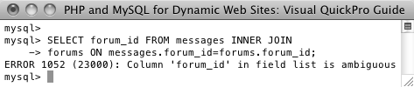
JOINs
SELECT what_columns FROM tableA JOIN_TYPE tableB JOIN_CLAUSE
Notes:
You almost always want to specify what columns to return, or else the result set will be unwieldy.
Use table.column when two tables may have the same column name to avoid ambiguity errors.
Use aliases to help reference columns and tables and to shorten the query.

Slide 6
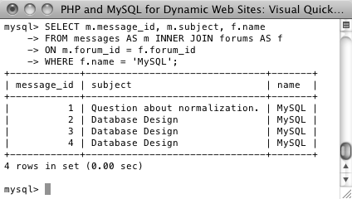
INNER JOINs
SELECT m.message_id, m.subject, f.name
FROM messages AS m INNER JOIN forums AS f
ON m.forum_id = f.forum_id
WHERE f.name = 'MySQL'
Notes:
INNER JOIN returns all of the records from the tables wherever a match is made.
The ON clause creates the JOIN condition.
Can also use USING when the columns being equated have the same name.

Slide 7
OUTER JOINs
OUTER JOINs return records that don’t match
Types:
  LEFT
  RIGHT
  FULL*
NULL is returned for columns without values
Notes:
The order in which the tables listed matter in LEFT and RIGHT OUTER JOINs.
a FULL JOIN returns all the records from both tables. FULL JOIN is not supported in MySQL.

Slide 8
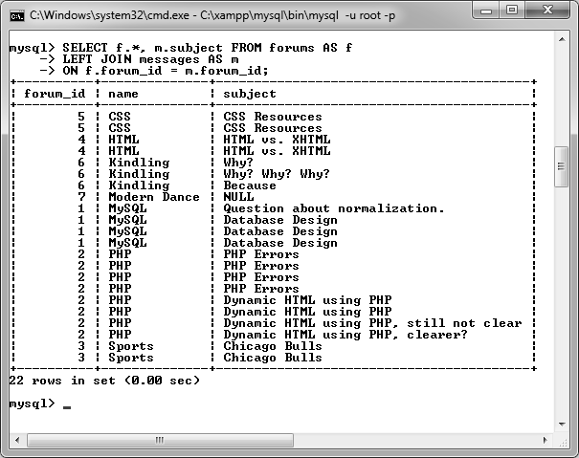
OUTER JOINs
SELECT f.*, m.subject
FROM forums AS f
LEFT JOIN messages AS m
ON f.forum_id = m.forum_id
Notes:
Notice that the “Modern Dance” forum does don’t have any subjects (i.e., threads).

Slide 9
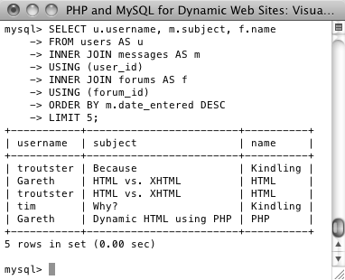
Three Table JOINs
SELECT u.username, m.subject, f.name
FROM users AS u
INNER JOIN messages AS m
USING (user_id)
INNER JOIN forums AS f
USING (forum_id)
ORDER BY m.date_entered DESC
LIMIT 5;
Notes:
This is an INNER JOIN on three tables, but you can use OUTER or a combination of INNER and OUTER.

Slide 10
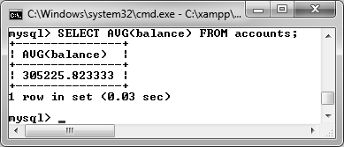
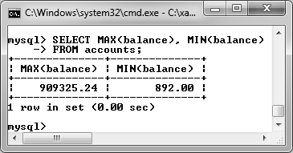
Grouping Results
SELECT AVG(balance) FROM accounts
SELECT MAX(balance), MIN(balance) FROM accounts
SELECT COUNT(*) FROM accounts
Notes:
Grouping returns a new value based upon a combination of the values in the results.

Slide 11
Grouping Functions
Function | Returns
AVG() | The average of the values
COUNT() | The number of values
GROUP_CONCAT() | The concatenation of the values
MAX() | The largest value
MIN() | The smallest value
SUM() | The sum of all the values
Notes:
Use these functions to group or aggregate results

Slide 12
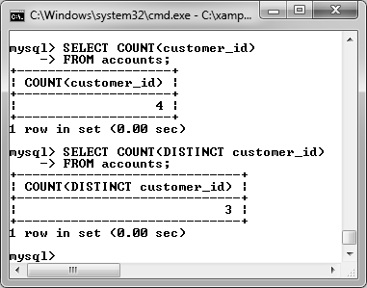
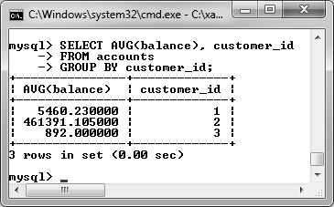
Grouping Results
SELECT COUNT(DISTINCT customer_ID) FROM accounts
SELECT AVG(balance), customer_id FROM accounts GROUP BY customer_id
Notes:
Use the DISTINCT keyword to only count or average unique values.
Use GROUP BY clause to group the results by a column.

Slide 13
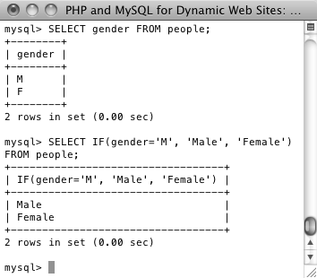
Advanced Selections
SELECT COALESCE(col1, col2) FROM table
SELECT IF (condition, return_if_true, return_if_false)
SELECT IF(gender='M', 'Male', 'Female')
FROM people;
Notes:
There are ways to make advanced selections, like putting conditional logic into the selection of columns/values.
COALESCE() returns the first non-NULL value.
IF returns one of two values depending upon the truth of the condition.

Slide 14
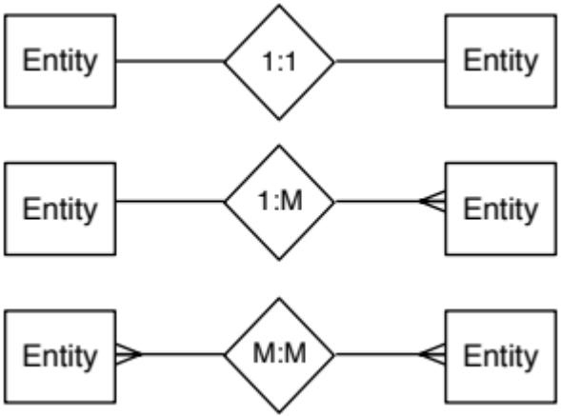
Relationships
one-to-one
one-to-many
many-to-many
Notes:
Relationships describe how the data in two tables relate to each other.
You should avoid many-to-many relationships between two tables, instead using an intermediary table.
Relationships are normally done through the keys.

Slide 15
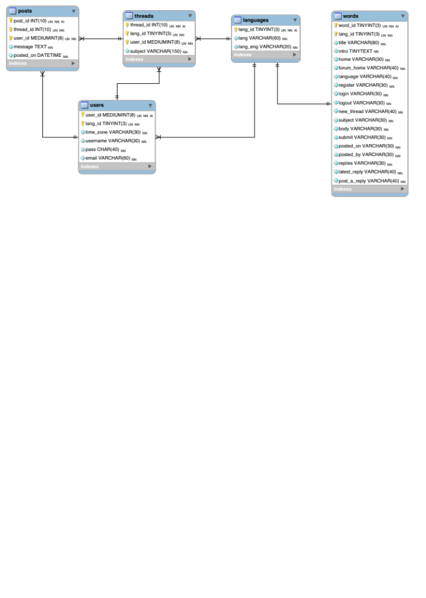
Database Schema
Notes:
This is the database schema for the site. The “languages” table also acts as a forums table, in that each forum is dedicated to one language.

Slide 16
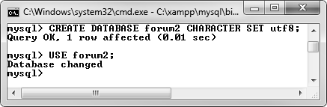
Creating the Database
Notes:
With a multilingual site, it’s very important that the right character set is used!

Slide 17
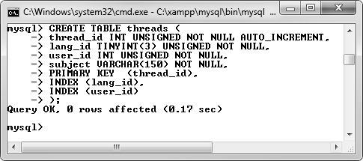
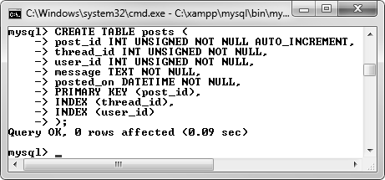
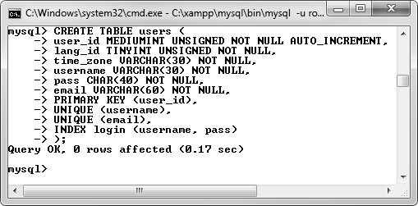
Forum Tables
Notes:
Posts go in threads. Posts will be displayed in order by date added.

Slide 18
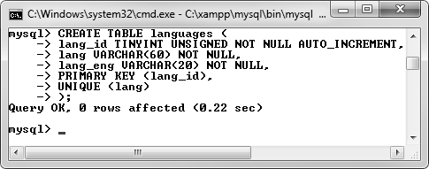
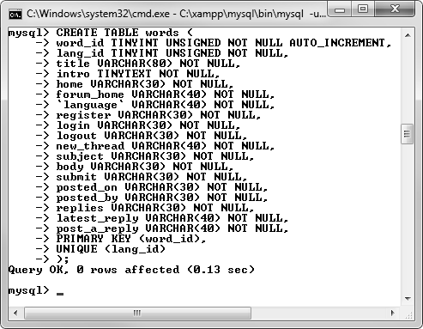
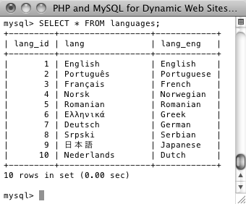
Handling Languages
Notes:
The words table stores different interface words in all the supported languages.

Slide 19
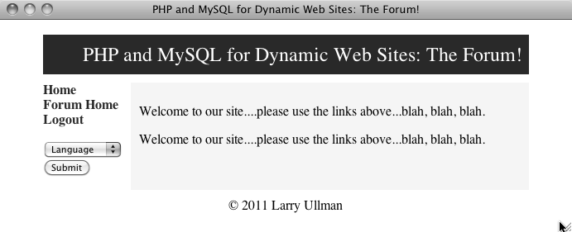
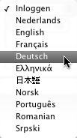
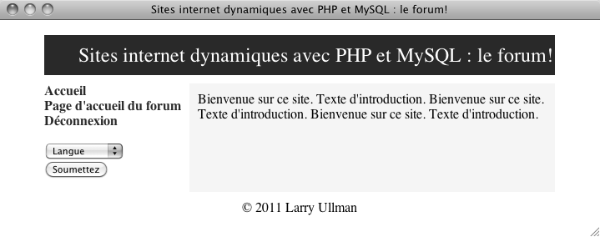
The Template
Notes:
The sidebar allows the user to select the preferred language.

Slide 20
Choosing a Language
if ( isset($_GET['lid']) &&
filter_var($_GET['lid'], FILTER_VALIDATE_INT, array('min_range' => 1))
) {
$_SESSION['lid'] = $_GET['lid'];
} elseif (!isset($_SESSION['lid'])) {
$_SESSION['lid'] = 1; // Default.
}
// Get the words for this language:
$q = "SELECT * FROM words WHERE lang_id = {$_SESSION['lid']}";
$r = mysqli_query($dbc, $q);
// Fetch the results into a variable:
$words = mysqli_fetch_array($r, MYSQLI_ASSOC);
Notes:
The language ID is stored in the session.
The language-specific words are fetched into the $words variable for use by the page.
This all happens in the header.

Slide 21
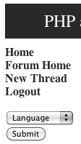
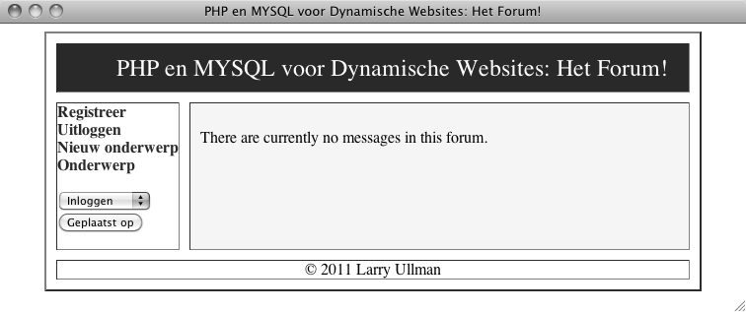
Using the Language
echo '<a href="index.php" class="navlink">' . $words['home'] . '</a><br />
<a href="forum.php" class="navlink">' . $words['forum_home'] . '</a><br />';
Notes:
The language interface words are used for links and such.

Slide 22
Verifying Login
if (isset($_SESSION['user_id'])) {
// If this is the forum page, add a link for posting new threads:
if (basename($_SERVER['PHP_SELF']) == 'forum.php') {
echo '<a href="post.php" class="navlink">' . $words['new_thread'] . '</a><br />';
}
// Add the logout link:
echo '<a href="logout.php" class="navlink">' . $words['logout'] . '</a><br />’;
} else {
// Register and login links:
echo '<a href="register.php" class="navlink">' . $words['register'] . '</a><br />
<a href="login.php" class="navlink">' . $words['login'] . '</a><br />’;
}

Slide 23
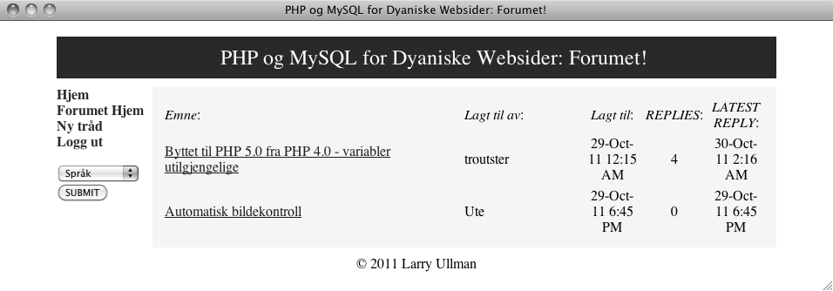
Forum Pages

Slide 24
Handling Timezones
if (isset($_SESSION['user_tz'])) {
$first = "CONVERT_TZ(p.posted_on, 'UTC', '{$_SESSION['user_tz']}')";
$last = "CONVERT_TZ(p.posted_on, 'UTC', '{$_SESSION['user_tz']}')";
} else {
$first = 'p.posted_on';
$last = 'p.posted_on';
}
Notes:
if the user is logged in, the dates and times will be shown in her timezone. PHP variables are used to change the query.

Slide 25
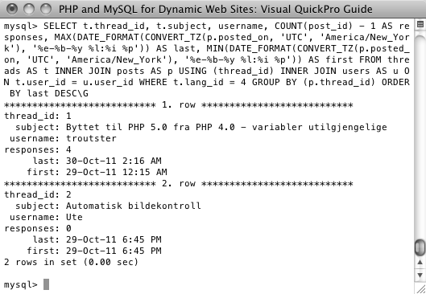
Complex Queries
Notes:
This query: converts timezones, uses three aggregate functions (COUNT, MAX, and MIN) and does a JOIN across three tables.
Remember the debugging steps: print out the query being executed and run it using another interface!

Slide 26
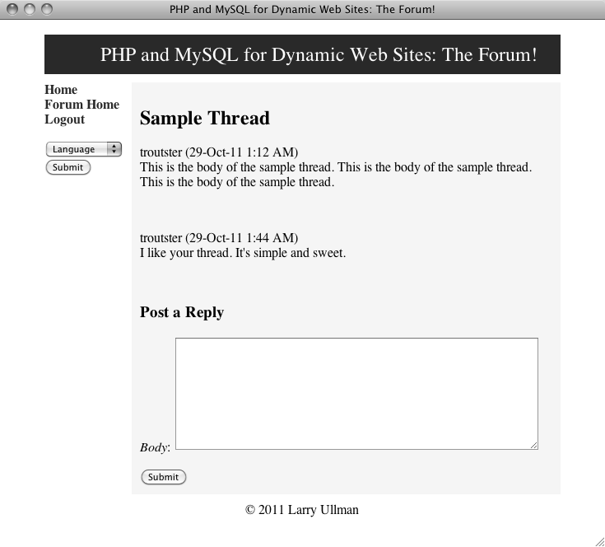
Viewing a Thread
Notes:
Also does timezone conversion. The “post” form is only provided if the user is logged in.

Slide 27
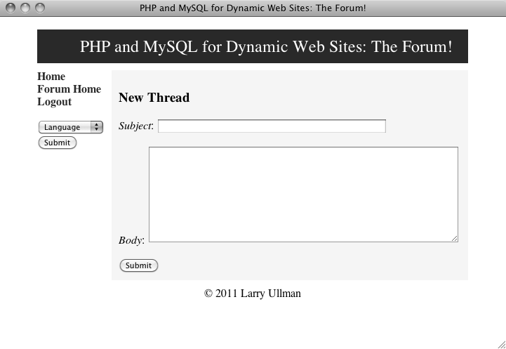
Creating a Thread
Notes:
New threads are just posts with the ability to set the subject.

