Slide 1
COVER
Cover
The room shapes this from the first sentence

Slide 2
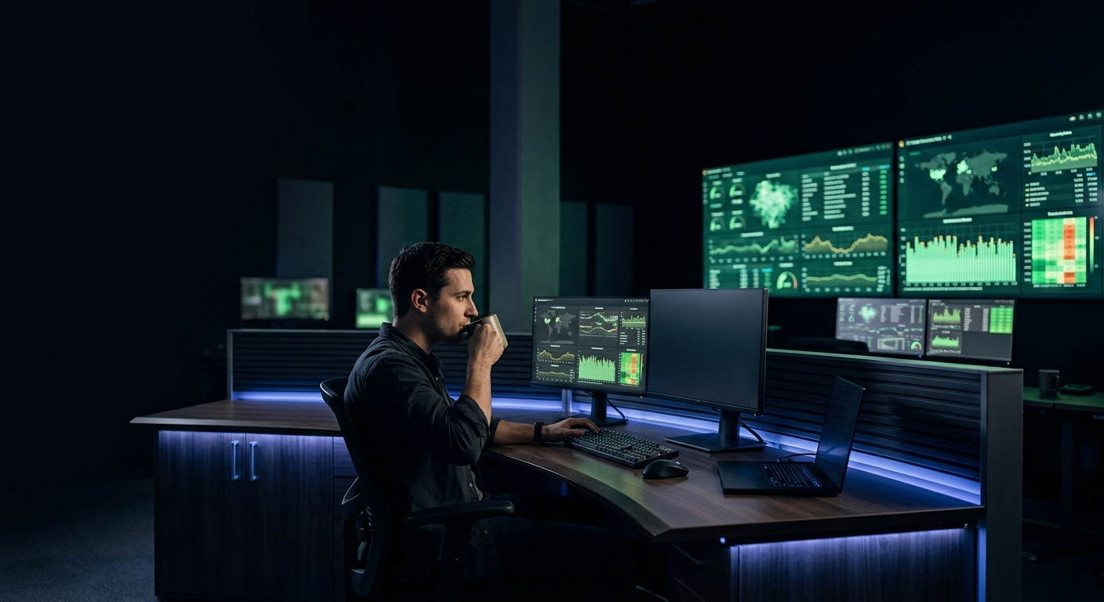
POSITIONING
Autopilot closes the loop from alert to fix without human triage.
Incidents resolve autonomously in production while your team stays asleep at three a.m.

Slide 3
EVIDENCE
Beta cohorts expand to 129 percent retention by Month 12.
Rapid time-to-resolution drives compounding account growth with zero regressions.

Slide 4
PRICING
Autopilot scales on a usage-based pricing model.
Pay only for resolved incidents and runtime execution without upfront platform lock-in.

Slide 5
RISKS
We are tracking two launch risks with clear mitigation owners
Operational guardrails and staging validation are prioritized ahead of general availability.

