Slide 1

Fetal Health Status Predictor
API development
BIS 634 Final Project
Fall 2022
Siyan(Amy) Guo
MS Health Informatics

Slide 2
Dataset & Motivation
2126 measurements extracted from cardiotocograms(CTGs) and classified by expert obstetricians
eg. baseline value, short-term abnormal variability, uterine contractions
fetal_health (1-Normal, 2-Suspect and 3-Pathological)
Motivations
INCREASE AWARENESS and FACILITATION on Fetal Health
"the U.S. fetal mortality rate was 5.70 fetal deaths at 20 or more weeks of gestation per 1,000 live births and fetal deaths, and often occurs at low resource setting and most of them can be prevented."
Data Source:https://www.kaggle.com/datasets/andrewmvd/fetal-health-classification
Reference: Gregory ECW, Valenzuela CP, and Hoyert DL. Fetal Mortality: United States, 2019. National Vital Statistics Reports. 2021;70(11):1-20.

Slide 3
Reading Dataset...
Acquired via file download on Kaggle Dataset
Data FAIRness:
Standard and aligned Data Format
Well-annotated with metadata
License-- License was not specified at the source, yet access to the data is public and a citation was requested
Data Source:https://www.kaggle.com/datasets/andrewmvd/fetal-health-classification
Reference: Gregory ECW, Valenzuela CP, and Hoyert DL. Fetal Mortality: United States, 2019. National Vital Statistics Reports. 2021;70(11):1-20.

Slide 4
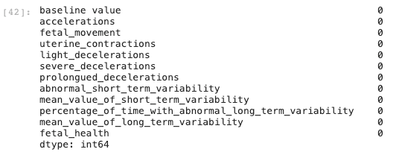

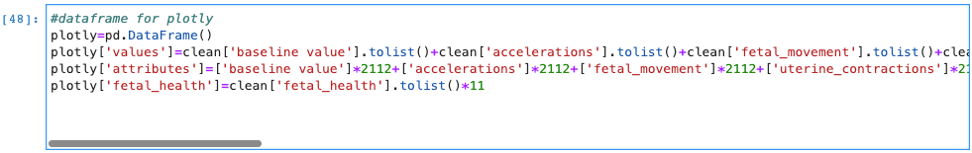
Data Cleaning & Preprocessing
01
Drop Irrelevant Columns (eg.histogram attributes)
02
Check for missing data
03
Drop Duplicates based on columns
04
Create Plotly dataframe
Data Source:https://www.kaggle.com/datasets/andrewmvd/fetal-health-classification

Slide 5
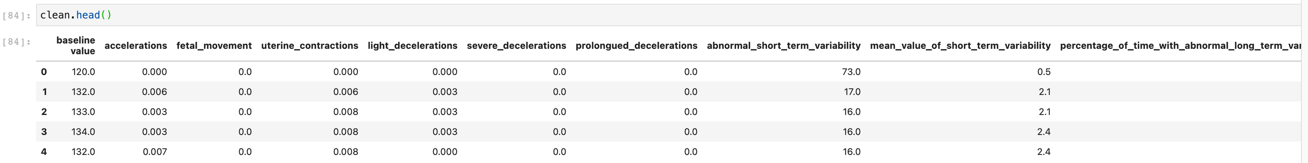
Cleaned Data

Slide 6
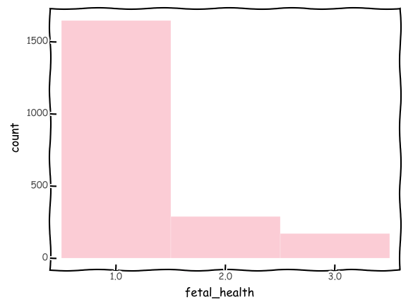
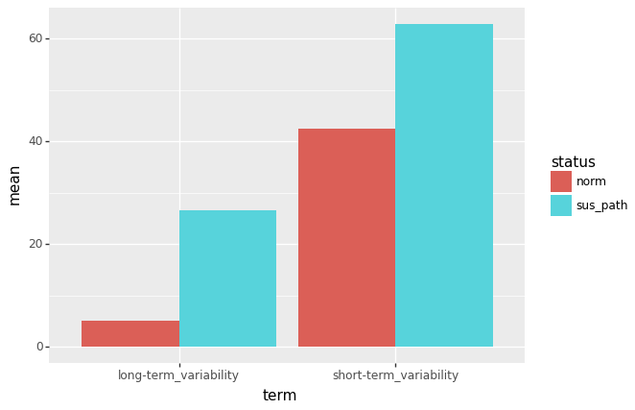
Summary Statistics Examples
Classifier Distribution (may be misleading)
Classifier Distribution Example

Slide 7
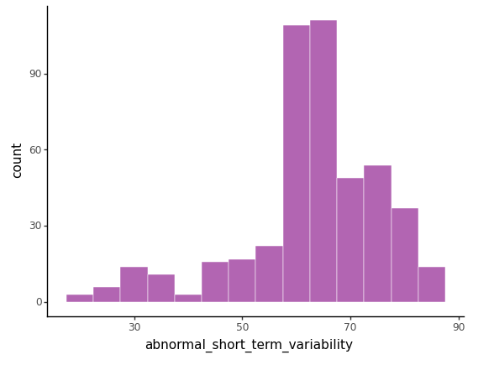
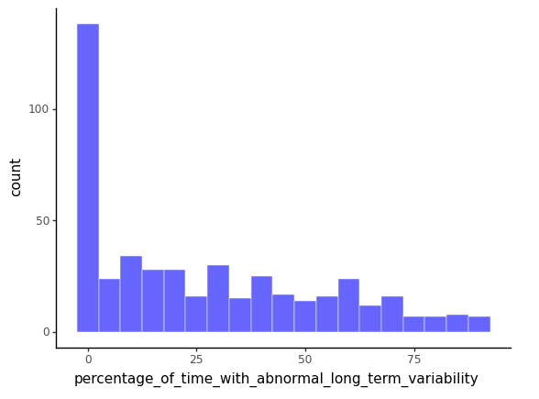
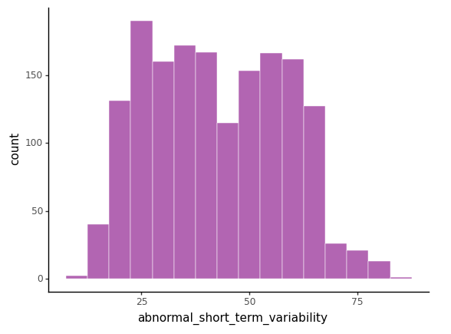
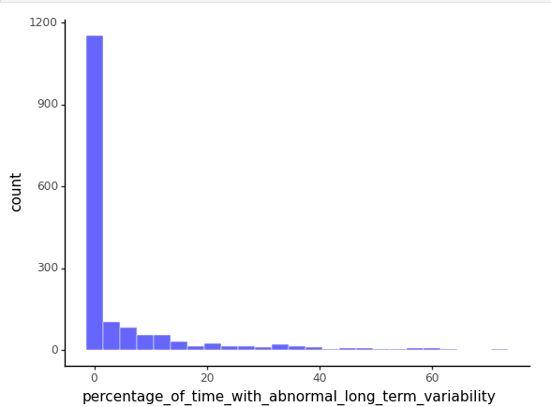
Misleading Summary Statistics
Suspect & Pathological
Suspect & Pathological
VS.
Normal
Normal

Slide 8
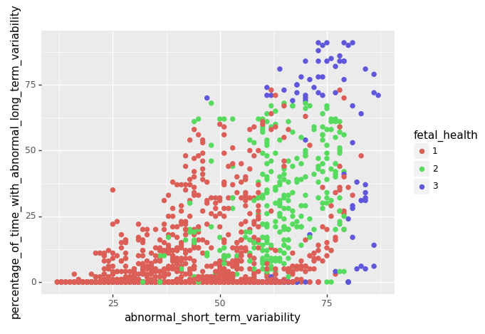
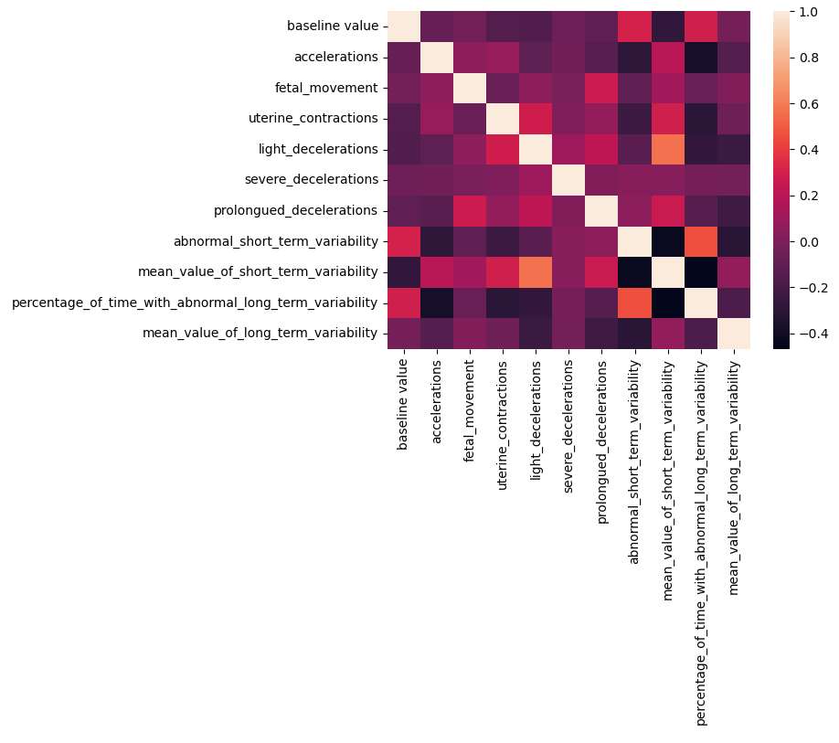
Interesting Analysis
Scatter Plot Example
Why these questions?
What were the results?
Any surprises?
How did you validate your analyses?
Pearson correlation heatmap
Notes:
Why these questions?
What were the results?
Any surprises?
How did you validate your analyses?

Slide 9
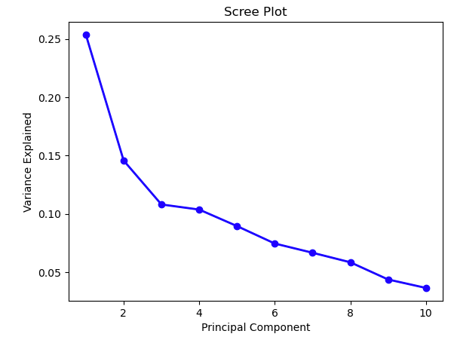
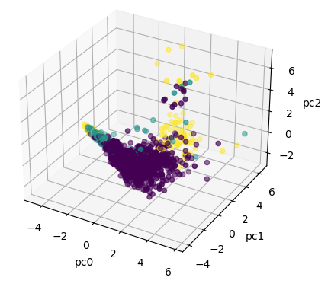
Interesting Analysis
PCA
Scree Plot
Why these questions?
What were the results?
Any surprises?
How did you validate your analyses?

Slide 10
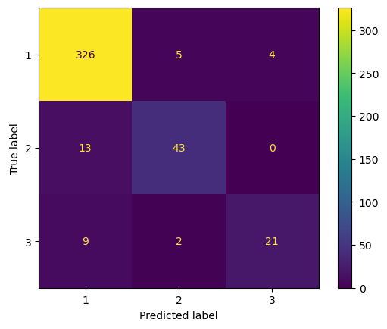
Interesting Analysis--KNN
Validation: Confusion Matrix
Why these questions?
What were the results?
Any surprises?
How did you validate your analyses?

Slide 11

Server API and WEB Front End

Slide 12


Surprising results and unexpected difficulties
Scree Plot and PCA
unable to visualize for 8 axes
PCA
Scree Plot
html format
"static" folder

Slide 13

THANKS FOR LISTENING!
ANY QUESTIONS?

