Slide 1
MMO Test Execution & Defect Report
{{Date}}

Slide 2
Legend:
Status:
SIT Execution Status Report | Executive Summary
Complete
On Track
At Risk
Off Track
As-of: {{Date}}
{{TTC}}*
{{ETC}}
{{PTC}}
{{FTC}}
{{IPTC}}
{{TB}}
Total Test Cases
Executed
Passed ({{PP}}%)
Failed ({{FP}}%)
In Progress
Open Defects
Status
Test Case and Defect Breakdown
Executive Summary:
{{AI_OVERALL_STATUS}}
{{AI_PDM_ITERATION_UPDATE}}
{{AI_PDM_DEFECT_SUMMARY}}
{{AI_BENEFITS_UPDATE}}
Defect Triage:
{{AI_DEFECT_TRIAGE}}
Review Summary
Workstreams | Planned* | Executed | Exec % | Passed | Pass % | Failed | Fail % | In Progress | Open Defects
PDM - Cursory | {{PDMCTTC}} | {{PDMCETC}} | {{PDMCEP}}% | {{PDMCPTC}} | {{PDMCPP}}% | {{PDMCFTC}} | {{PDMCFP}}% | {{PDMCIPTC}} | {{PDMCURSORYDEFOPEN}}
PDM - SIT | {{PDMSITTC}} | {{PDMSITETC}} | {{PDMSITEP}}% | {{PDMSITPTC}} | {{PDMSITPP}}% | {{PDMSITFTC}} | {{PDMSITFP}}% | {{PDMSITIPTC}} | {{PDMSITDEFOPEN}}
2026 Benefits - SIT | {{ACTIVEBENTTC}} | {{ACTIVEBENETC}} | {{ACTIVEBENEP}}% | {{ACTIVEBENPTC}} | {{ACTIVEBENPP}}% | {{ACTIVEBENFTC}} | {{ACTIVEBENFP}}% | {{ACTIVEBENIPTC}} | {{ACTIVEBENB}}
Enrollment - SIT | {{ENROTTC}} | {{ENROETC}} | {{ENROEP}}% | {{ENROPTC}} | {{ENROPP}}% | {{ENROFTC}} | {{ENROFP}}% | {{ENROIPTC}} | {{ENROB}}
EDI - SIT | {{EDITTC}} | {{EDIETC}} | {{EDIEP}}% | {{EDIPTC}} | {{EDIPP}}% | {{EDIFTC}} | {{EDIFP}}% | {{EDIIPTC}} | {{EDIB}}
Grand Total | {{TTC}} | {{ETC}} | {{EP}}% | {{PTC}} | {{PP}}% | {{FTC}} | {{FP}}% | {{IPTC}} | {{TB}}
*Test case planning and ADO upload is in progress; cases will be added to ADO in alignment with test execution window.
Executed — The test case has been run at least once; a result has been recorded (regardless of outcome).
Passed — The test case was executed and all steps/assertions met the expected results successfully.
Failed — The test case was executed but one or more steps/assertions did not match the expected results, indicating a defect or issue.
In Progress – The test case is currently in-progress awaiting to clear pending dependencies
Notes:
Total > Executed > In Progress> Pass > Fail > Defect

Slide 3
Legend:
Status:
PDM Testing Execution Report | Testing Status
Complete
On Track
At Risk
Off Track
As-of: {{Date}}
{{AI_PDM_CURSORY_STATUS}}
Overall Testing Execution Summary
Phase* | Iteration | Planned TCs | Executed | Execution % | Passed | Pass % | Failed | Fail % | In Progress | Blocked | Not Started | Defects
Cursory | 2 | {{PDMIT2TTC}} | {{PDMIT2ETC}} | {{PDMIT2EP}}% | {{PDMIT2PTC}} | {{PDMIT2PP}}% | {{PDMIT2FTC}} | {{PDMIT2FP}}% | {{PDMIT2IPTC}} | {{PDMIT2BTC}} | {{PDMIT2NSTC}} | {{PDMIT2DEFOPEN}}
Cursory | 2.1 | {{PDMIT21TTC}} | {{PDMIT21ETC}} | {{PDMIT21EP}}% | {{PDMIT21PTC}} | {{PDMIT21PP}}% | {{PDMIT21FTC}} | {{PDMIT21FP}}% | {{PDMIT21IPTC}} | {{PDMIT21BTC}} | {{PDMIT21NSTC}} | {{PDMIT21DEFOPEN}}
Cursory | 3 | {{PDMIT3TTC}} | {{PDMIT3ETC}} | {{PDMIT3EP}}% | {{PDMIT3PTC}} | {{PDMIT3PP}}% | {{PDMIT3FTC}} | {{PDMIT3FP}}% | {{PDMIT3IPTC}} | {{PDMIT3BTC}} | {{PDMIT3NSTC}} | {{PDMIT3DEFOPEN}}
SIT | -- | {{PDMSITTC}} | {{PDMSITETC}} | {{PDMSITEP}}% | {{PDMSITPTC}} | {{PDMSITPP}}% | {{PDMSITFTC}} | {{PDMSITFP}}% | {{PDMSITIPTC}} | {{PDMSITBTC}} | {{PDMSITNSTC}} | {{PDMSITDEFOPEN}}
SIT Review Summary – Test Cases
Workstream | Planned TCs* | Target Completion Date | Executed | Passed | Failed | In Progress | Blocked | Not Started | Defects
PDM | {{PDMSITTC}} | 10/15/2026 | {{PDMSITETC}} | {{PDMSITPTC}} | {{PDMSITFTC}} | {{PDMSITIPTC}} | {{PDMSITBTC}} | {{PDMSITNSTC}} | {{PDMSITDEFOPEN}}
Grand Total | {{PDMSITTC}} | -- | {{PDMSITETC}} | {{PDMSITPTC}} | {{PDMSITFTC}} | {{PDMSITIPTC}} | {{PDMSITBTC}} | {{PDMSITNSTC}} | {{PDMCB}}*
*Cursory Review validates that the data in PDM is matching with the source; no further validation on data quality is done
**Test case planning is still in progress; expect planned test case count to increase in coming weeks
***Defects included from previous iterations
Executed — The test case has been run at least once; a result has been recorded (regardless of outcome).
Passed — The test case was executed and all steps/assertions met the expected results successfully.
Failed — The test case was executed but one or more steps/assertions did not match the expected results, indicating a defect or issue.

Slide 4
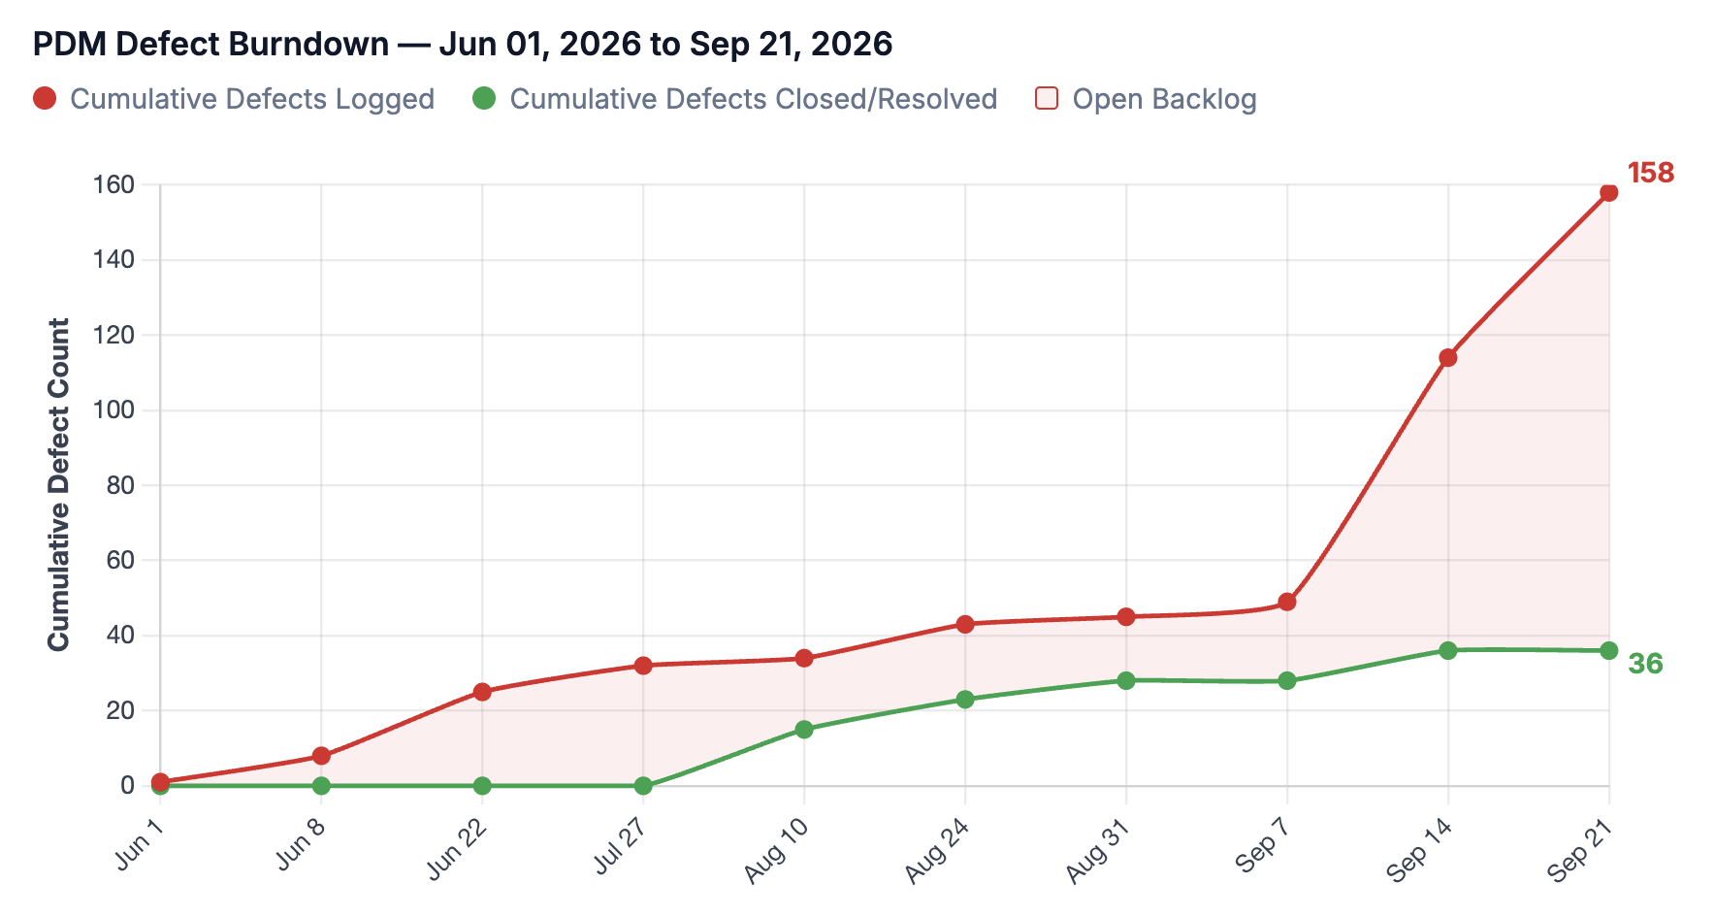
Legend:
Status:
PDM Testing Defect Report | Testing Status
Complete
On Track
At Risk
Off Track
As-of: {{Date}}
{{AI_PDM_DEFECT_STATUS}}
Overall Testing Defect Summary
Iteration | Total | Open (Active/New) | Closed | Resolved
Iteration 2 | {{PDMIT2DEFTOTAL}} | {{PDMIT2DEFOPEN}} | {{PDMIT2DEFCLOSED}} | {{PDMIT2DEFRESOLVED}}
Iteration 2.1 | {{PDMIT21DEFTOTAL}} | {{PDMIT21DEFOPEN}} | {{PDMIT21DEFCLOSED}} | {{PDMIT21DEFRESOLVED}}
Iteration 3 | {{PDMIT3DEFTOTAL}} | {{PDMIT3DEFOPEN}} | {{PDMIT3DEFCLOSED}} | {{PDMIT3DEFRESOLVED}}
SIT | {{PDMSITDEFTOTAL}} | {{PDMSITDEFOPEN}} | {{PDMSITDEFCLOSED}} | {{PDMSITDEFRESOLVED}}
TOTAL | {{PDMDEFTOTAL}} | {{PDMCB}} | {{PDMDEFCLOSEDTOTAL}} | {{PDMDEFRESOLVEDTOTAL}}
Key Insights on Defects:
{{AI_PDM_DEFECT_INSIGHTS}}
Key Insights on PDM Defect Burndown:
{{AI_PDM_BURNDOWN_INSIGHTS}}

Slide 5
Legend:
Status:
Benefits Testing Execution Report | SIT Testing Status
Complete
On Track
At Risk
Off Track
As-of: {{Date}}
{{AI_BENEFITS_STATUS}}
Overall Testing Execution Summary
Phase | Planned TCs* | Executed | Execution % | Passed | Pass % | Failed | Fail % | In Progress | Blocked | Not Started | Defects
SIT – Priority Benefit | {{BENEPBTTC}} | {{BENEPBETC}} | {{BENEPBEP}}% | {{BENEPBPTC}} | {{BENEPBPP}}% | {{BENEPBFTC}} | {{BENEPBFP}}% | {{BENEPBIPTC}} | {{BENEPBBTC}} | {{BENEPBNSTC}} | {{BENEPBDEF}}
SIT – 2026 Benefits | {{BENE26TTC}} | {{BENE26ETC}} | {{BENE26EP}}% | {{BENE26PTC}} | {{BENE26PP}}% | {{BENE26FTC}} | {{BENE26FP}}% | {{BENE26IPTC}} | {{BENE26BTC}} | {{BENE26NSTC}} | {{BENE26DEF}}
Benefits SIT Review Summary – Test Cases
Benefit Type | Planned TCs* | Target Completion Date | Executed | Passed | Failed | In Progress | Blocked | Not Started | Defects
Signature HMO | {{BENESIHMTTC}} | 10/15/2026 | {{BENESIHMETC}} | {{BENESIHMPTC}} | {{BENESIHMFTC}} | {{BENESIHMIPTC}} | {{BENESIHMBTC}} | {{BENESIHMNSTC}} | {{BENESIHMDEFOPEN}}
Access PPO | {{BENEACPTTC}} | 10/15/2026 | {{BENEACPETC}} | {{BENEACPPTC}} | {{BENEACPFTC}} | {{BENEACPIPTC}} | {{BENEACPBTC}} | {{BENEACPNSTC}} | {{BENEACPDEFOPEN}}
Premium PPO | {{BENEPRPTTC}} | 10/15/2026 | {{BENEPRPETC}} | {{BENEPRPPTC}} | {{BENEPRPFTC}} | {{BENEPRPIPTC}} | {{BENEPRPBTC}} | {{BENEPRPNSTC}} | {{BENEPRPDEFOPEN}}
MMEGWP PPO CWRU MAPD | {{BENEMMEGWPTTC}} | 11/30/2026 | {{BENEMMEGWPETC}} | {{BENEMMEGWPPTC}} | {{BENEMMEGWPFTC}} | {{BENEMMEGWPIPTC}} | {{BENEMMEGWPBTC}} | {{BENEMMEGWPNSTC}} | {{BENEMMEGWPDEFOPEN}}
Classic HMO NEOH | {{BENENEOHTTC}} | 11/30/2026 | {{BENENEOHETC}} | {{BENENEOHPTC}} | {{BENENEOHFTC}} | {{BENENEOHIPTC}} | {{BENENEOHBTC}} | {{BENENEOHNSTC}} | {{BENENEOHDEFOPEN}}
Grand Total | {{ACTIVEBENTTC}} | -- | {{ACTIVEBENETC}} | {{ACTIVEBENPTC}} | {{ACTIVEBENFTC}} | {{ACTIVEBENIPTC}} | {{ACTIVEBENBTC}} | {{ACTIVEBENNSTC}} | {{ACTIVEBENB}}
*Test case planning and ADO upload is in progress; cases will be added to ADO in alignment with test execution window.
Note: Additional 2026 Benefit plans are still pending test execution and are not yet reflected in these totals; they will be incorporated as testing begins.
Executed — The test case has been run at least once; a result has been recorded (regardless of outcome).
Passed — The test case was executed and all steps/assertions met the expected results successfully.
Failed — The test case was executed but one or more steps/assertions did not match the expected results, indicating a defect or issue.
In Progress – The test case is currently in-progress awaiting to clear pending dependencies
Link to detailed list of defects in ADO: ADO Benefit Defects

Slide 6
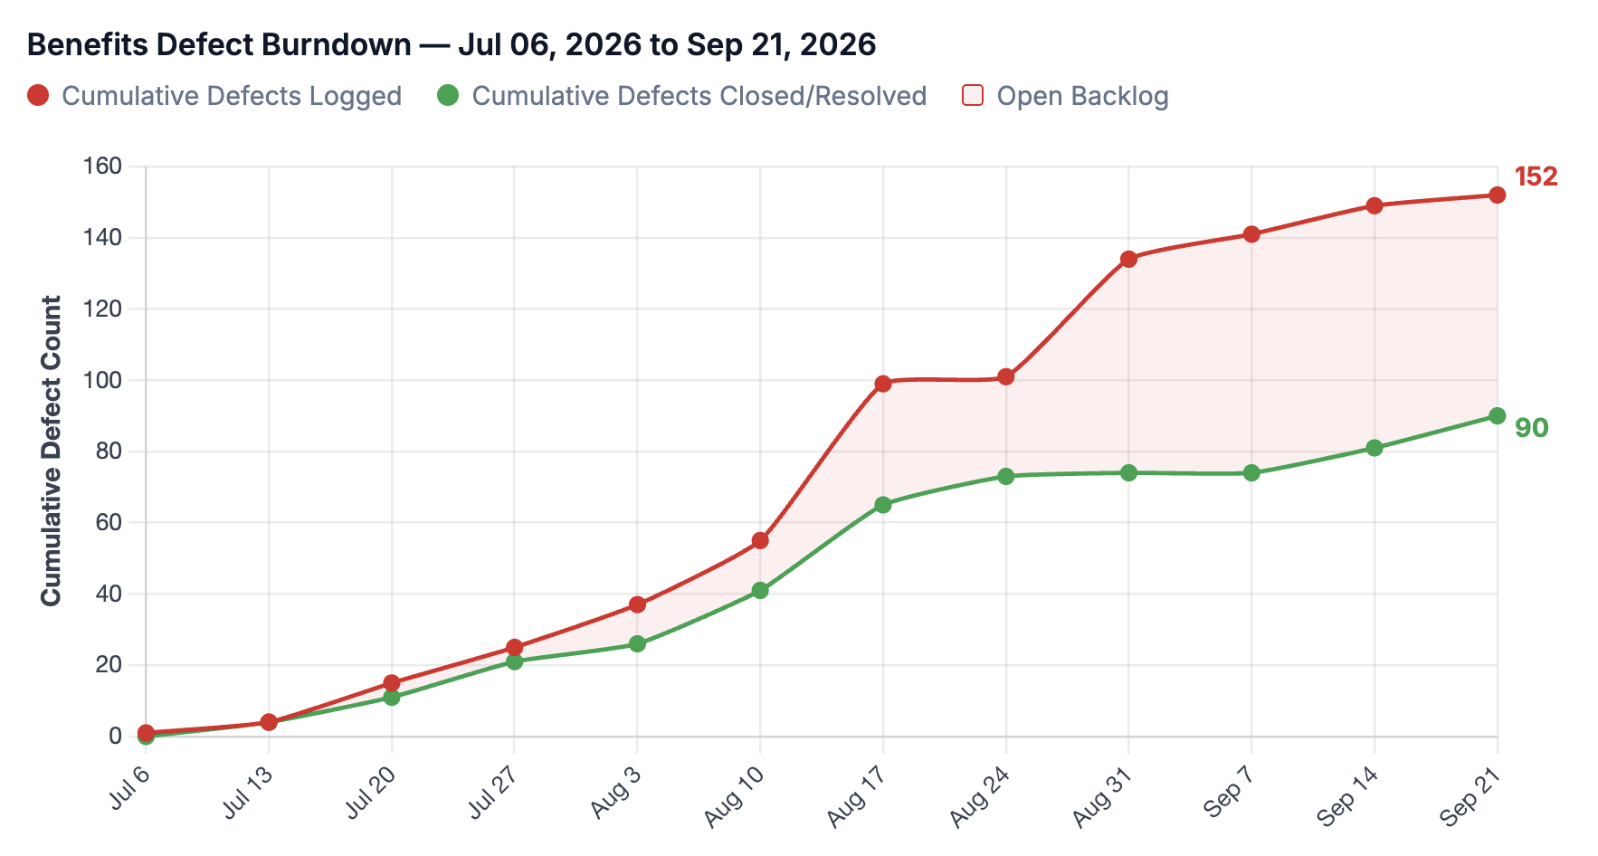
Legend:
Status:
Benefits Testing Defect Report | Testing Status
Complete
On Track
At Risk
Off Track
As-of: {{Date}}
{{AI_BENEFITS_DEFECT_STATUS}}
Overall Testing Defect Summary
Plan | Total | Open (Active/New) | Closed | Resolved
Signature HMO | {{BENESIHMDEFTOTAL}} | {{BENESIHMDEFOPEN}} | {{BENESIHMDEFCLOSED}} | {{BENESIHMDEFRESOLVED}}
Access PPO | {{BENEACPDEFTOTAL}} | {{BENEACPDEFOPEN}} | {{BENEACPDEFCLOSED}} | {{BENEACPDEFRESOLVED}}
Premium PPO | {{BENEPRPDEFTOTAL}} | {{BENEPRPDEFOPEN}} | {{BENEPRPDEFCLOSED}} | {{BENEPRPDEFRESOLVED}}
Classic HMO NEOH | {{BENENEOHDEFTOTAL}} | {{BENENEOHDEFOPEN}} | {{BENENEOHDEFCLOSED}} | {{BENENEOHDEFRESOLVED}}
MMEGWP PPO CWRU MAPD | {{BENEMMEGWPDEFTOTAL}} | {{BENEMMEGWPDEFOPEN}} | {{BENEMMEGWPDEFCLOSED}} | {{BENEMMEGWPDEFRESOLVED}}
TOTAL | {{BENEDEFTOTAL}} | {{ACTIVEBENB}} | {{BENEDEFCLOSEDTOTAL}} | {{BENEDEFRESOLVEDTOTAL}}
Key Insights on Defects:
{{AI_BENEFITS_DEFECT_INSIGHTS}}
Key Insights on Benefits Defect Burndown:
{{AI_BENEFITS_BURNDOWN_INSIGHTS}}

Slide 7
Legend:
Status:
Enrollment Testing Execution Report | SIT Testing Status
Complete
On Track
At Risk
Off Track
As-of: {{Date}}
{{AI_ENROLLMENT_STATUS}}
Overall Testing Execution Summary
Phase | Planned TCs* | Executed | Execution % | Passed | Pass % | Failed | Fail % | In Progress | Blocked | Not Started | Defects
SIT | {{ENROTTC}} | {{ENROETC}} | {{ENROEP}}% | {{ENROPTC}} | {{ENROPP}}% | {{ENROFTC}} | {{ENROFP}}% | {{ENROIPTC}} | {{ENROBTC}} | {{ENRONSTC}} | {{ENROB}}
SIT Review Summary – Test Cases
Workstream | Planned TCs* | Target Completion Date | Executed | Passed | Failed | In Progress | Blocked | Not Started | Defects
Enrollment | {{ENROTTC}} | 10/15/2026 | {{ENROETC}} | {{ENROPTC}} | {{ENROFTC}} | {{ENROIPTC}} | {{ENROBTC}} | {{ENRONSTC}} | {{ENROB}}
Grand Total | {{ENROTTC}} | -- | {{ENROETC}} | {{ENROPTC}} | {{ENROFTC}} | {{ENROIPTC}} | {{ENROBTC}} | {{ENRONSTC}} | {{ENROB}}
* Test case planning is still in progress; expect planned test case count to increase in coming weeks
Executed — The test case has been run at least once; a result has been recorded (regardless of outcome).
Passed — The test case was executed, and all steps/assertions met the expected results successfully.
Failed — The test case was executed but one or more steps/assertions did not match the expected results, indicating a defect or issue.
Link to detailed list of defects in ADO: ADO Enrollment Defects

Slide 8
Legend:
Status:
EDI Testing Execution Report | SIT Testing Status
Complete
On Track
At Risk
Off Track
As-of: {{Date}}
{{AI_EDI_STATUS}}
Overall Testing Execution Summary
Phase | Planned TCs* | Executed | Execution % | Passed | Pass % | Failed | Fail % | In Progress | Blocked | Not Started | Defects
SIT | {{EDITTC}} | {{EDIETC}} | {{EDIEP}}% | {{EDIPTC}} | {{EDIPP}}% | {{EDIFTC}} | {{EDIFP}}% | {{EDIIPTC}} | {{EDIBTC}} | {{EDINSTC}} | {{EDIB}}
SIT Review Summary – Test Cases
Workstream | Planned TCs* | Target Completion Date | Executed | Passed | Failed | In Progress | Blocked | Not Started | Defects
EDI | {{EDITTC}} | 10/15/2026 | {{EDIETC}} | {{EDIPTC}} | {{EDIFTC}} | {{EDIIPTC}} | {{EDIBTC}} | {{EDINSTC}} | {{EDIB}}
Grand Total | {{EDITTC}} | -- | {{EDIETC}} | {{EDIPTC}} | {{EDIFTC}} | {{EDIIPTC}} | {{EDIBTC}} | {{EDINSTC}} | {{EDIB}}
* Test case planning is still in progress; expect planned test case count to increase in coming weeks
Executed — The test case has been run at least once; a result has been recorded (regardless of outcome).
Passed — The test case was executed, and all steps/assertions met the expected results successfully.
Failed — The test case was executed but one or more steps/assertions did not match the expected results, indicating a defect or issue.
Link to detailed list of defects in ADO: ADO EDI Defects

