Slide 1
MMO Test Execution & Defect Report
09/21/2026

Slide 2
Legend:
Status:
SIT Execution Status Report | Executive Summary
Complete
On Track
At Risk
Off Track
As-of: 09/21/2026
1462*
1032
699
333
0
190
Total Test Cases
Executed
Passed (68%)
Failed (32%)
In Progress
Open Defects
Status
Test Case and Defect Breakdown
Executive Summary:
Overall SIT execution stands at 71% (1,032 of 1,462 planned) with a 68% pass rate; Priority Benefits leads while Enrollment and EDI lag significantly behind.
PDM SIT has kickstarted and is 10% executed (27 of 272 cases) at a 74% pass rate.
PDM carries 157 total ADO defects, 35 fixed to date(Closed), the 122 open defects are a mix of Cursory, SIT, and Certify issues.
First round of Priority Benefits testing is complete (486 of 489 cases, 79% pass rate); team is retesting defects and failed cases. Execution of Classic HMO NEOH and one EGWP plan (CWRU MAPD) are both well underway.
Defect Triage:
190 open defects remain in “New” and “Active” state. All critical and high-priority defects have been triaged, ownership has been assigned, and remediation efforts are actively underway.​
Review Summary
Workstreams | Planned* | Executed | Exec % | Passed | Pass % | Failed | Fail % | In Progress | Open Defects
PDM - Cursory | 178 | 157 | 88% | 83 | 53% | 74 | 47% | 0 | 11
PDM - SIT | 272 | 27 | 10% | 20 | 74% | 7 | 26% | 0 | 111
2026 Benefits - SIT | 969 | 846 | 87% | 596 | 70% | 250 | 30% | 0 | 61
Enrollment - SIT | 21 | 1 | 5% | 0 | 0% | 1 | 100% | 0 | 3
EDI - SIT | 22 | 1 | 5% | 0 | 0% | 1 | 100% | 0 | 4
Grand Total | 1462 | 1032 | 71% | 699 | 68% | 333 | 32% | 0 | 190
*Test case planning and ADO upload is in progress; cases will be added to ADO in alignment with test execution window.
Executed — The test case has been run at least once; a result has been recorded (regardless of outcome).
Passed — The test case was executed and all steps/assertions met the expected results successfully.
Failed — The test case was executed but one or more steps/assertions did not match the expected results, indicating a defect or issue.
In Progress – The test case is currently in-progress awaiting to clear pending dependencies
Notes:
Total > Executed > In Progress> Pass > Fail > Defect

Slide 3
Legend:
Status:
PDM Testing Execution Report | Testing Status
Complete
On Track
At Risk
Off Track
As-of: 09/21/2026
PDM Off Track, with only 27 of 272 planned SIT cases executed (10%) thus far at a 74% pass rate, against an expected pace of roughly 45 cases (17%) at this point in the schedule. 122 open PDM defects remain, concentrated in credentialing and provider-record data quality issues and configuration issues across roster and organization workflows. The PDM team is actively working on the remining 21 cursory test cases.
Overall Testing Execution Summary
Phase* | Iteration | Planned TCs | Executed | Execution % | Passed | Pass % | Failed | Fail % | In Progress | Blocked | Not Started | Defects
Cursory | 2 | 46 | 43 | 93% | 14 | 33% | 29 | 67% | 0 | 0 | 3 | 1
Cursory | 2.1 | 56 | 40 | 71% | 19 | 48% | 21 | 53% | 0 | 0 | 16 | 3
Cursory | 3 | 76 | 74 | 97% | 50 | 68% | 24 | 32% | 0 | 0 | 2 | 7
SIT | -- | 272 | 27 | 10% | 20 | 74% | 7 | 26% | 0 | 0 | 245 | 111
SIT Review Summary – Test Cases
Workstream | Planned TCs* | Target Completion Date | Executed | Passed | Failed | In Progress | Blocked | Not Started | Defects
PDM | 272 | 10/15/2026 | 27 | 20 | 7 | 0 | 0 | 245 | 111
Grand Total | 272 | -- | 27 | 20 | 7 | 0 | 0 | 245 | 122*
*Cursory Review validates that the data in PDM is matching with the source; no further validation on data quality is done
**Test case planning is still in progress; expect planned test case count to increase in coming weeks
***Defects included from previous iterations
Executed — The test case has been run at least once; a result has been recorded (regardless of outcome).
Passed — The test case was executed and all steps/assertions met the expected results successfully.
Failed — The test case was executed but one or more steps/assertions did not match the expected results, indicating a defect or issue.

Slide 4
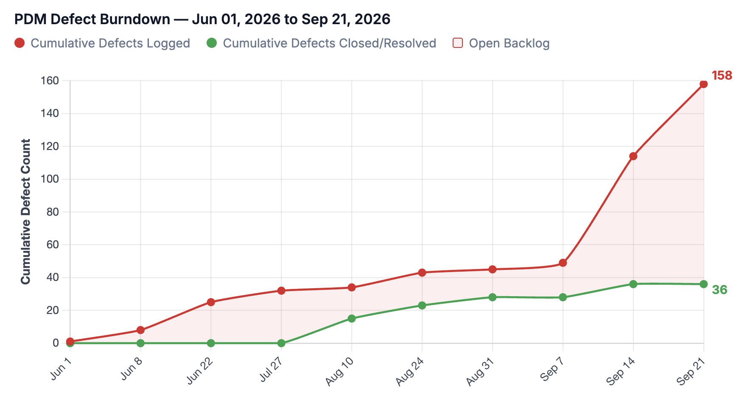
Legend:
Status:
PDM Testing Defect Report | Testing Status
Complete
On Track
At Risk
Off Track
As-of: 09/21/2026
The below table summarizes the full set of PDM defects across Cursory and SIT test phases along with PDM defect burn down with key insights. The defect identification is outpacing the defect resolution causing defect backlog to grow significantly during SIT phase.
Overall Testing Defect Summary
Iteration | Total | Open (Active/New) | Closed | Resolved
Iteration 2 | 26 | 1 | 25 | 0
Iteration 2.1 | 8 | 3 | 5 | 0
Iteration 3 | 13 | 7 | 5 | 1
SIT | 111 | 111 | 0 | 0
TOTAL | 158 | 122 | 35 | 1
Key Insights on Defects:
SIT has 111 open defects (91% of all open PDM issues), all logged this week as SIT execution kicked off for the first time.
  35 of 111 are "Missing Functionality“, things never built, not just bugs.
  44 of 111 are Certify related defects
  13 of 111 are “Requirement Update” / Enhancement
  Rest of the defects are not uncategorized and will be triaged during defect triage call.
Older iteration (2, 2.1, 3) defects are still lingering with HE working on those with priority.
Key Insights on PDM Defect Burndown:
Since testing began in June 2026, the PDM workstream has logged 158 defects against 36 closed/resolved (23%), leaving an open backlog of 122 as SIT execution continues.
The widening gap between the logged and closed lines reflects intake outpacing resolution.
Defect closure throughput will need to accelerate to keep pace with ongoing SIT defect discovery.

Slide 5
Legend:
Status:
Benefits Testing Execution Report | SIT Testing Status
Complete
On Track
At Risk
Off Track
As-of: 09/21/2026
Benefits SIT is at risk overall, with 846 of 969 planned cases executed (87%) at a 70% pass rate. 61 open defects are concentrated in claim adjudication issues, primarily around out-of-network benefit coverage and payment logic.
Overall Testing Execution Summary
Phase | Planned TCs* | Executed | Execution % | Passed | Pass % | Failed | Fail % | In Progress | Blocked | Not Started | Defects
SIT – Priority Benefit | 489 | 486 | 99% | 386 | 79% | 100 | 21% | 0 | 0 | 3 | 47
SIT – 2026 Benefits | 480 | 360 | 75% | 210 | 58% | 150 | 42% | 0 | 0 | 117 | 14
Benefits SIT Review Summary – Test Cases
Benefit Type | Planned TCs* | Target Completion Date | Executed | Passed | Failed | In Progress | Blocked | Not Started | Defects
Signature HMO | 243 | 10/15/2026 | 243 | 182 | 61 | 0 | 0 | 0 | 19
Access PPO | 164 | 10/15/2026 | 161 | 125 | 36 | 0 | 0 | 3 | 6
Premium PPO | 82 | 10/15/2026 | 82 | 79 | 2 | 0 | 0 | 0 | 2
MMEGWP PPO CWRU MAPD | 238 | 11/30/2026 | 161 | 106 | 55 | 0 | 0 | 77 | 12
Classic HMO NEOH | 242 | 11/30/2026 | 199 | 104 | 95 | 0 | 0 | 40 | 22
Grand Total | 969 | -- | 846 | 596 | 250 | 0 | 0 | 120 | 61
*Test case planning and ADO upload is in progress; cases will be added to ADO in alignment with test execution window.
Executed — The test case has been run at least once; a result has been recorded (regardless of outcome).
Passed — The test case was executed and all steps/assertions met the expected results successfully.
Failed — The test case was executed but one or more steps/assertions did not match the expected results, indicating a defect or issue.
In Progress – The test case is currently in-progress awaiting to clear pending dependencies
Link to detailed list of defects in ADO: ADO Benefit Defects

Slide 6
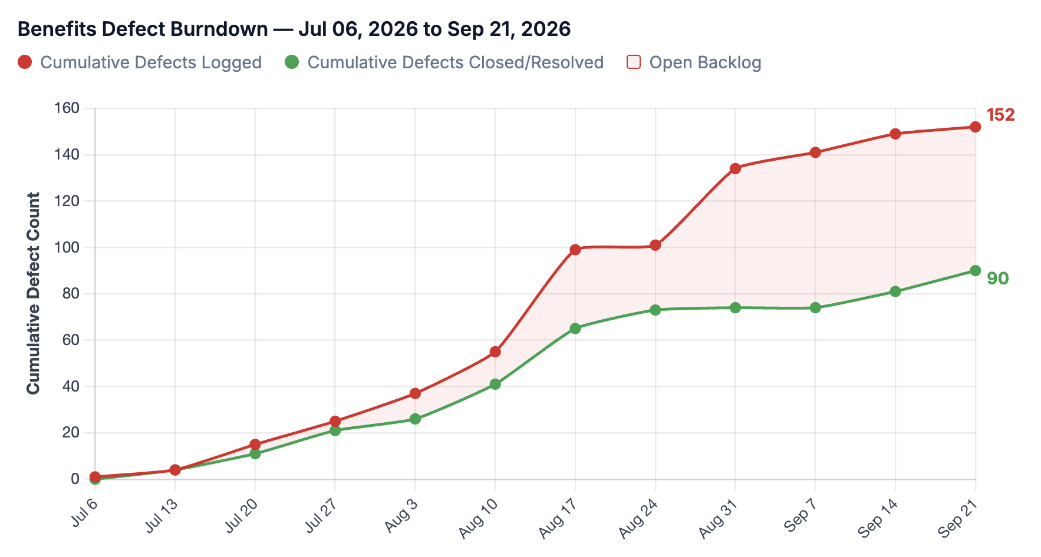
Legend:
Status:
Benefits Testing Defect Report | Testing Status
Complete
On Track
At Risk
Off Track
As-of: 09/21/2026
The below table summarizes the full set of Benefits defects across SIT along with Benefits defect burn down with key insights. The defect identification is outpacing the defect resolution causing defect backlog to grow significantly during SIT phase.
Overall Testing Defect Summary
Plan | Total | Open (Active/New) | Closed | Resolved
Signature HMO | 40 | 19 | 20 | 1
Access PPO | 35 | 6 | 29 | 0
Premium PPO | 27 | 2 | 25 | 0
Classic HMO NEOH | 31 | 23 | 5 | 3
MMEGWP PPO CWRU MAPD | 19 | 12 | 7 | 0
TOTAL | 152 | 62 | 86 | 4
Key Insights on Defects:
Benefits has 62 open defects across 5 plans, with 90 of 152 total bugs (59%) closed to date as SIT testing progresses.
23 of 62 are against Classic HMO NEOH
19 of 62 are against Signature HMO
12 of 62 are against MMEGWP PPO CWRU MAPD
6 of 62 are against Access PPO
2 of 62 are against Premium PPO
Key Insights on Benefits Defect Burndown:
Since testing began in July 2026, the Benefits workstream has logged 152 defects against 90 closed/resolved (59%), leaving an open backlog of 62 as testing continues.
The widening gap between logged and closed lines from late August reflects intake outpacing resolution, particularly the week of Aug 31 where 33 new defects were logged with only 1 closed.
Defect closure throughput will need to accelerate to keep pace with ongoing testing across all 5 benefit plans.

Slide 7
Legend:
Status:
Enrollment Testing Execution Report | SIT Testing Status
Complete
On Track
At Risk
Off Track
As-of: 09/21/2026
Enrollment SIT is on-track but trending at-risk since only 1 of 21 planned case is executed thus far and even that case is failing. 3 open defects relate to HRP enrollment validation, UI search, and missing subscription data issues.
Overall Testing Execution Summary
Phase | Planned TCs* | Executed | Execution % | Passed | Pass % | Failed | Fail % | In Progress | Blocked | Not Started | Defects
SIT | 21 | 1 | 5% | 0 | 0% | 1 | 100% | 0 | 0 | 20 | 3
SIT Review Summary – Test Cases
Workstream | Planned TCs* | Target Completion Date | Executed | Passed | Failed | In Progress | Blocked | Not Started | Defects
Enrollment | 21 | 10/15/2026 | 1 | 0 | 1 | 0 | 0 | 20 | 3
Grand Total | 21 | -- | 1 | 0 | 1 | 0 | 0 | 20 | 3
* Test case planning is still in progress; expect planned test case count to increase in coming weeks
Executed — The test case has been run at least once; a result has been recorded (regardless of outcome).
Passed — The test case was executed, and all steps/assertions met the expected results successfully.
Failed — The test case was executed but one or more steps/assertions did not match the expected results, indicating a defect or issue.
Link to detailed list of defects in ADO: ADO Enrollment Defects

Slide 8
Legend:
Status:
EDI Testing Execution Report | SIT Testing Status
Complete
On Track
At Risk
Off Track
As-of: 09/21/2026
Enrollment SIT is on-track but trending at-risk as 1 of 22 planned case is executed thus far and even that case is failing. 4 open defects involve claim-load exceptions, attachment coding, and workbasket edit/review issues on initial HRP test claims.
Overall Testing Execution Summary
Phase | Planned TCs* | Executed | Execution % | Passed | Pass % | Failed | Fail % | In Progress | Blocked | Not Started | Defects
SIT | 22 | 1 | 5% | 0 | 0% | 1 | 100% | 0 | 0 | 21 | 4
SIT Review Summary – Test Cases
Workstream | Planned TCs* | Target Completion Date | Executed | Passed | Failed | In Progress | Blocked | Not Started | Defects
EDI | 22 | 10/15/2026 | 1 | 0 | 1 | 0 | 0 | 21 | 4
Grand Total | 22 | -- | 1 | 0 | 1 | 0 | 0 | 21 | 4
* Test case planning is still in progress; expect planned test case count to increase in coming weeks
Executed — The test case has been run at least once; a result has been recorded (regardless of outcome).
Passed — The test case was executed, and all steps/assertions met the expected results successfully.
Failed — The test case was executed but one or more steps/assertions did not match the expected results, indicating a defect or issue.
Link to detailed list of defects in ADO: ADO EDI Defects

