Slide 1
Lasso And Ridge
Presentation Prepared by -Swapnil

Slide 2
Purpose of Ridge & Lasso Regression:
The main objective of creating a model(training data) is making sure it fits the data properly and reduce the loss.
Sometimes the model that is trained which will fit the data but it may fail and give a poor performance during analysing of data (test data).
This leads to over-fitting. Regularization came to overcome over-fitting.

Slide 3
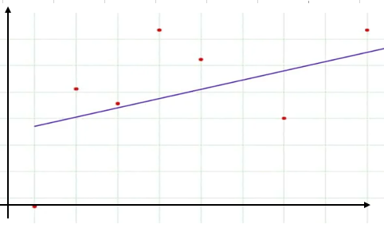
Ridge Regression (L2 Regularization)
Over-fitting happens when the model learns signal as well as noise in the training data and wouldn’t perform well on new/unseen data on which model wasn’t trained on.
To avoid over-fitting your model on training data like cross-validation sampling, reducing the number of features, pruning, regularization, etc.
So to avoid over-fitting, we perform Regularization.

Slide 4
When to use Ridge/Lasso
Best Fit Line-1
Test Data Set
Salary
Train Data Set
Ex. As shown in fig. Best Fit Line is stip line.
As there are huge difference between train and test data set Over-fitting occurs due to which there is high bias and high variance due to which our Model gives worst Result
To get good result we need low bias low variance dataset.
So for getting best result we use L1(Lasso) and L2(Ridge) Regularization.
6k
5k
4k
3k
2k
1k
1yr
Experience
2yrs
3 yrs

Slide 5



Computation/Selection of Best Fit Line
Best Fit Line-1
Test Data Set
Salary
Best Fit Line-2
Train Data Set
Equation of
Straight Line =
Best Fit Line-3
Cost Function/
Sum of Residue=
Equation of Ridge Regression
=any positive number
Experience

Slide 6

Limitations:-

