Slide 1
Next Day Temperature Predection
Team:
Sumanth Gannamani
Snehith Jaggari

Slide 2
Problem Statement
The objective of this project is to develop a predictive model capable of forecasting the next day's minimum and maximum temperatures. This involves using historical weather data to identify the most predictive features among various meteorological variables, while excluding less relevant attributes such as date and station number. The project will employ exploratory data analysis and automatic feature elimination techniques to enhance model accuracy and reliability.

Slide 3
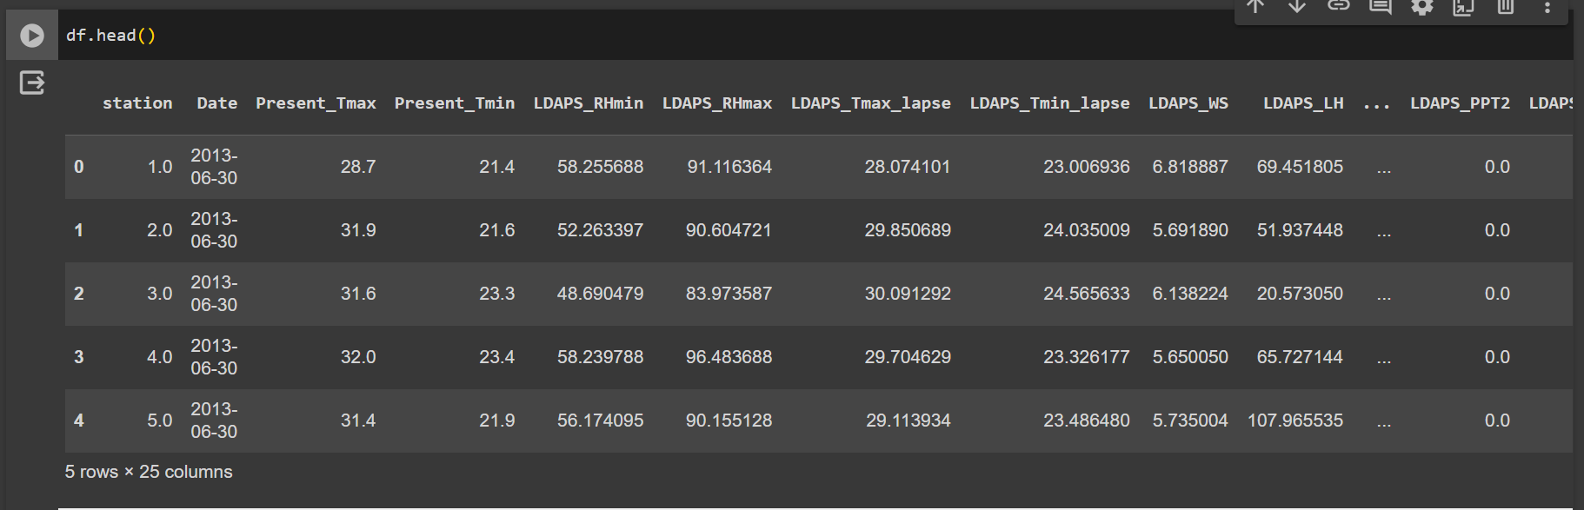
Data Set
The dataset consists of 7,750 instances and 25 attributes, including various meteorological variables along with the target variables of next day's minimum and maximum temperatures. The first 23 attributes encompass potential predictors like atmospheric pressure levels, humidity, wind speed, and others. However, not all attributes are directly relevant to the forecasting task, such as date and station number. The project will involve an initial exploratory data analysis to identify the most impactful features.

Slide 4
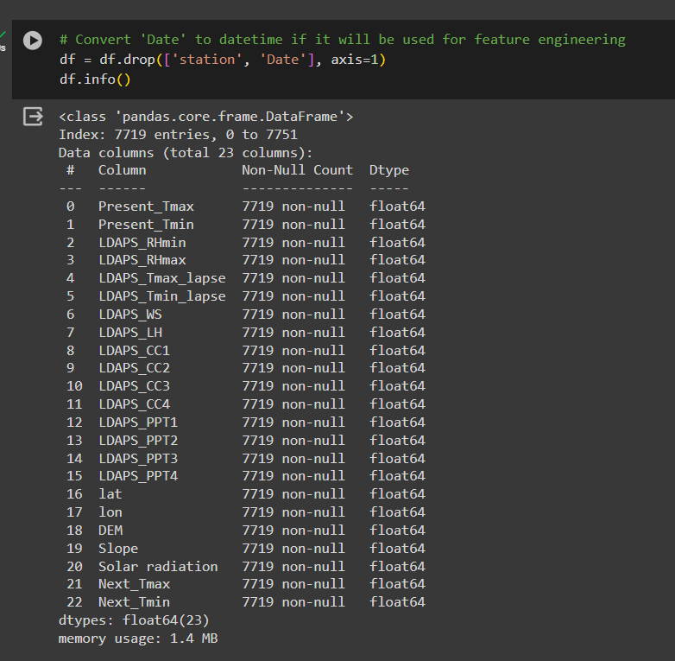
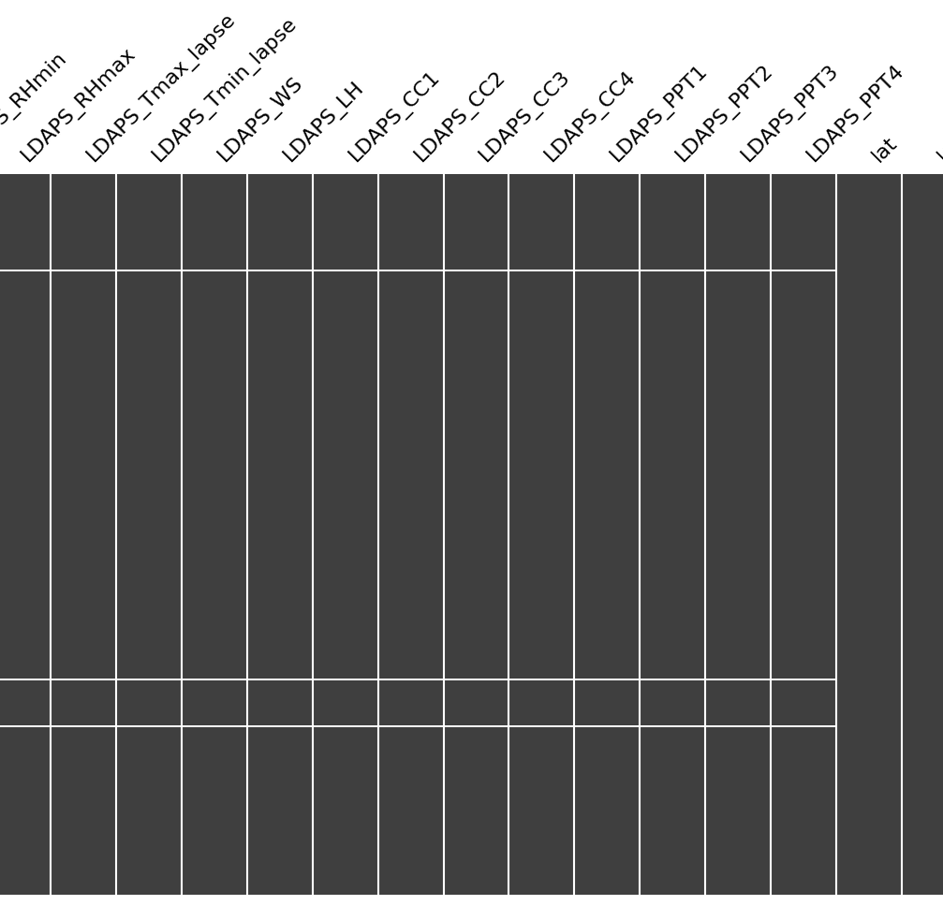
Data Cleaning & Analysis

Slide 5
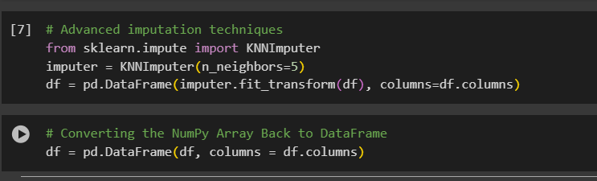


Slide 6
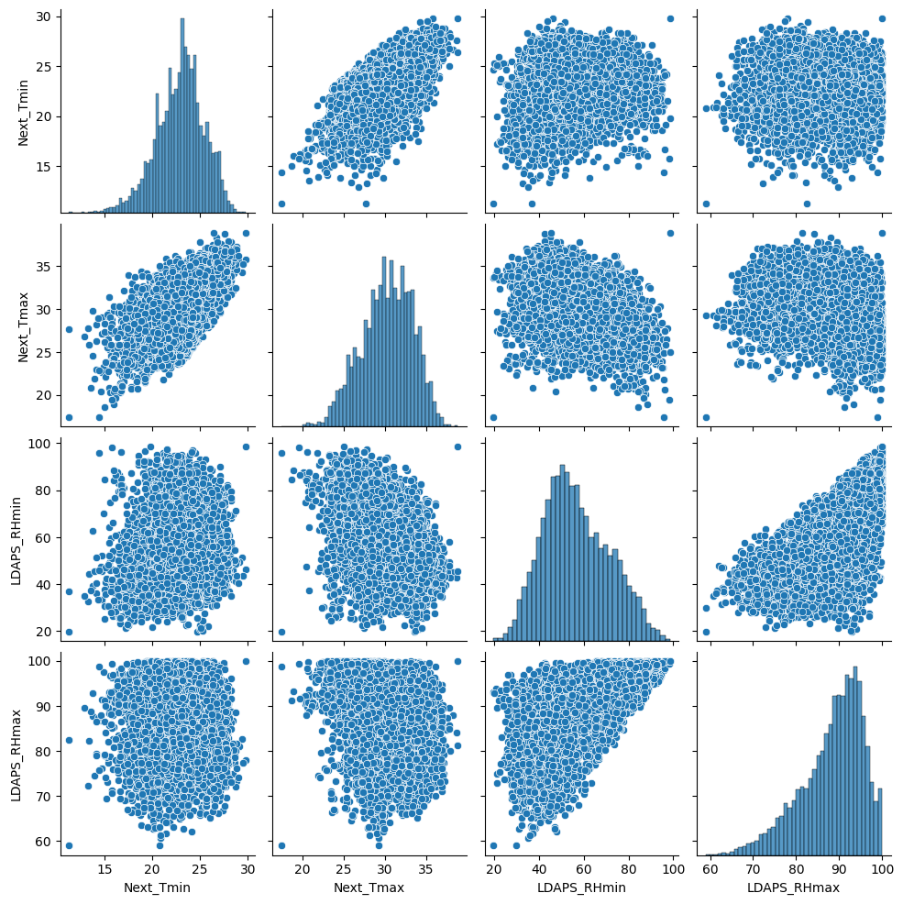
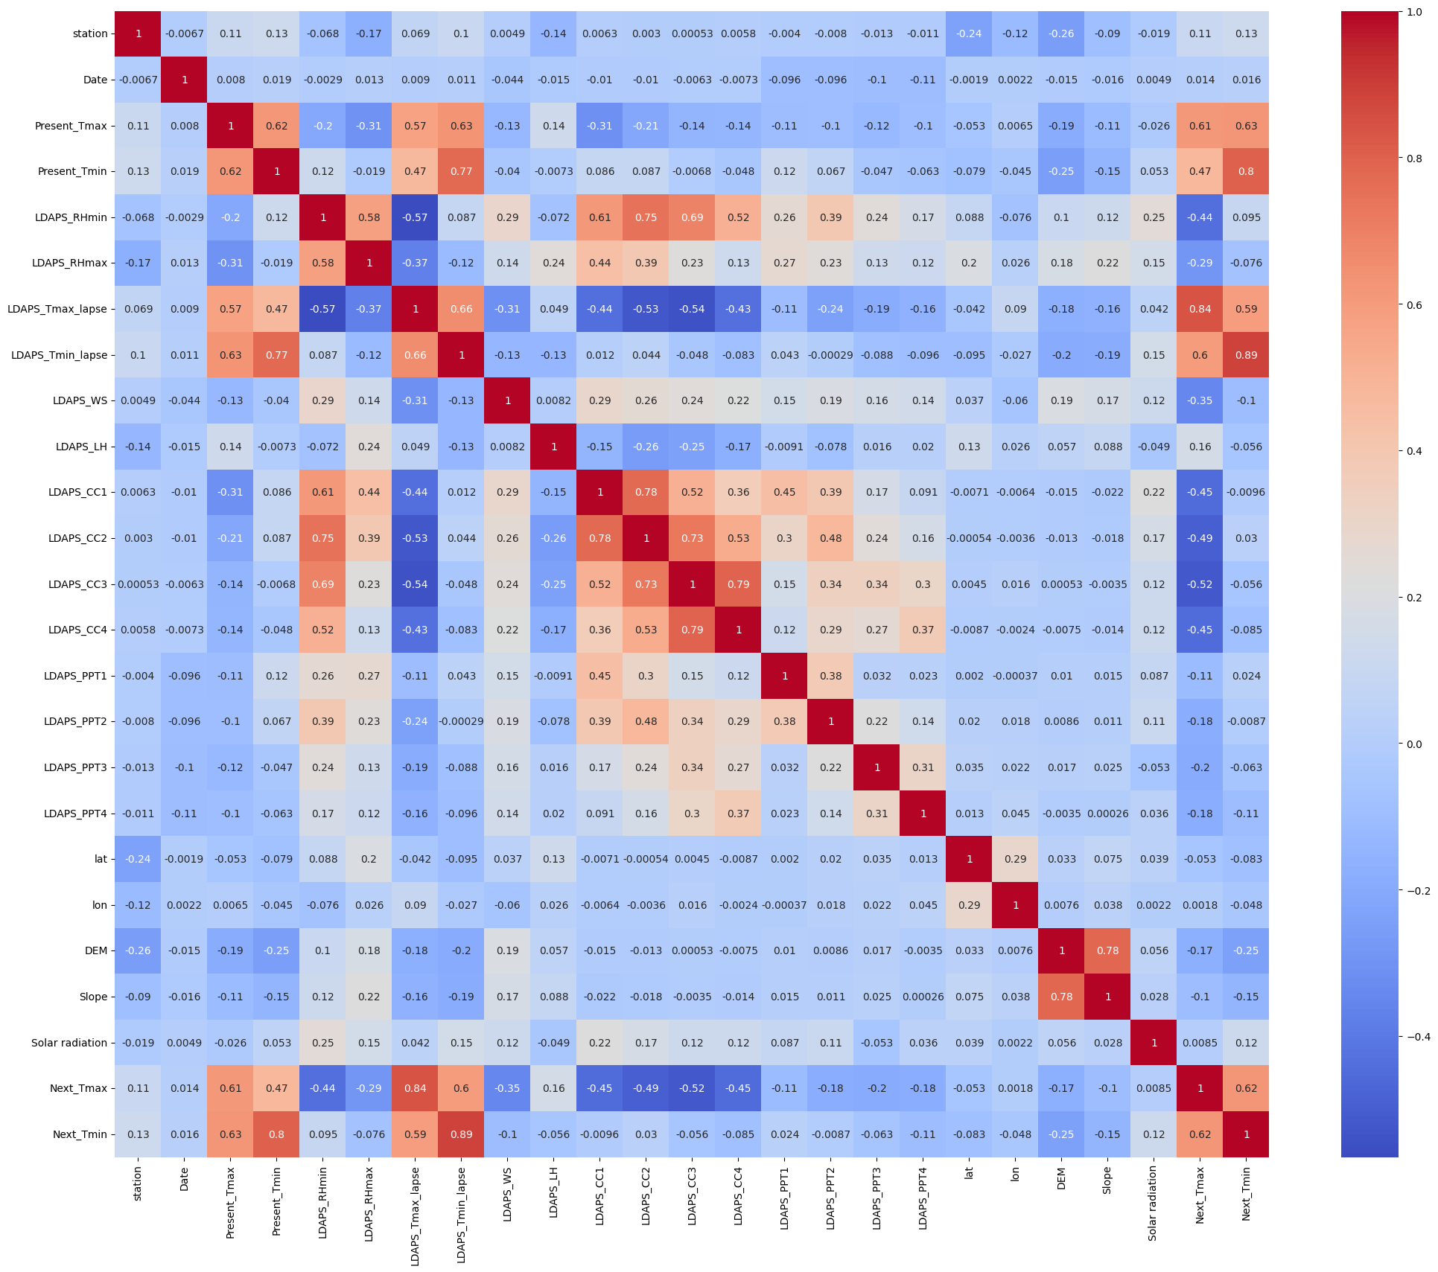
EDA

Slide 7
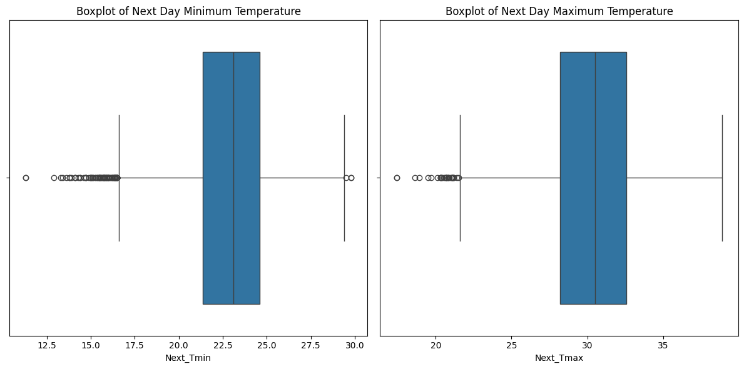
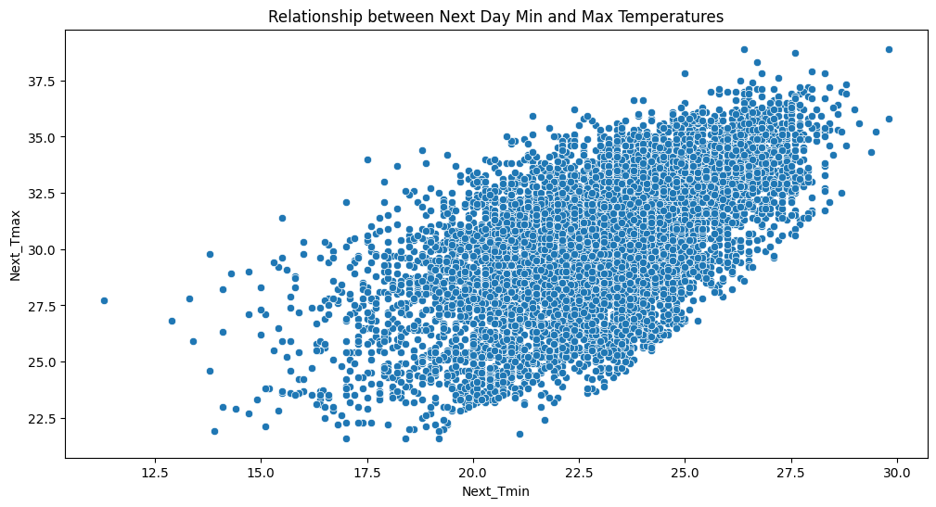

Slide 8
Algorithms Approach
Data Preparation: Separate input features and targets and split the dataset into training and testing subsets with a 20% test size.
Baseline Model Evaluation: Train and evaluate diverse regression models (Linear Regression, Random Forest, Gradient Boosting, KNN, SVR) using key performance metrics.
Feature Selection and Dimensionality Reduction: Utilize pipelines for scaling, feature selection via SelectKBest, and dimensionality reduction with PCA.
Hyperparameter Tuning: Optimize model parameters using GridSearchCV to enhance model performance and accuracy.

Slide 9
Observations
R² Score from the results for T_MIN:
Linear Regression: R² Score = 0.8205
Random Forest: R² Score = 0.8452
Gradient Boosting: R² Score = 0.8342
K-Nearest Neighbors (KNN): R² Score = 0.8338
Support Vector Regression (SVR): R² Score = 0.8537
R² Score from the results for T_MAX:
Linear Regression: R² Score = 0.7466
Random Forest: R² Score = 0.8760
Gradient Boosting: R² Score = 0.8097
K-Nearest Neighbors (KNN): R² Score = 0.9041
Support Vector Regression (SVR): R² Score = 0.8645

Slide 10
Observations After Ensemble
Results for T_MIN:
Linear Regression: R² Score = 0.8205
Random Forest: R² Score = 0.8444
Gradient Boosting: R² Score = 0.8341
K-Nearest Neighbors (KNN): R² Score = 0.8338
Support Vector Regression (SVR): R² Score = 0.8537
Results for T_MAX:
Linear Regression: R² Score = 0.7466
Random Forest: R² Score = 0.8758
Gradient Boosting: R² Score = 0.8099
K-Nearest Neighbors (KNN): R² Score = 0.9041
Support Vector Regression (SVR): R² Score = 0.8645

Slide 11
Conclusion
Diverse Models Enhance Insights: Utilizing multiple regression models revealed varied strengths in temperature prediction.
Impact of Hyperparameter Tuning: Adjusting model parameters significantly improved accuracy, particularly for Random Forest and SVR.
Crucial Role of Feature Selection: Implementing feature selection techniques like PCA proved essential for optimizing model performance.
Valuable Performance Metrics : Metrics such as MSE, MAE, R², and Explained Variance were key in evaluating and comparing model effectiveness.
Real-World Application : The project highlighted the application of machine learning in enhancing weather forecasting accuracy, beneficial for critical sectors.

Slide 12
THANK YOU

