Slide 1






DESIGN
THINKING

Innovation Hub- Collaborative Resources
Team 2

Slide 2

Problem discovery


How to find mentors?
How to find projects?
INNOVATION
HUB

Slide 3




















Full process
Data Collection
Assessment &Matching
Collaborative Resources
Contact &Meeting
Feedback &Reassessment

Slide 4
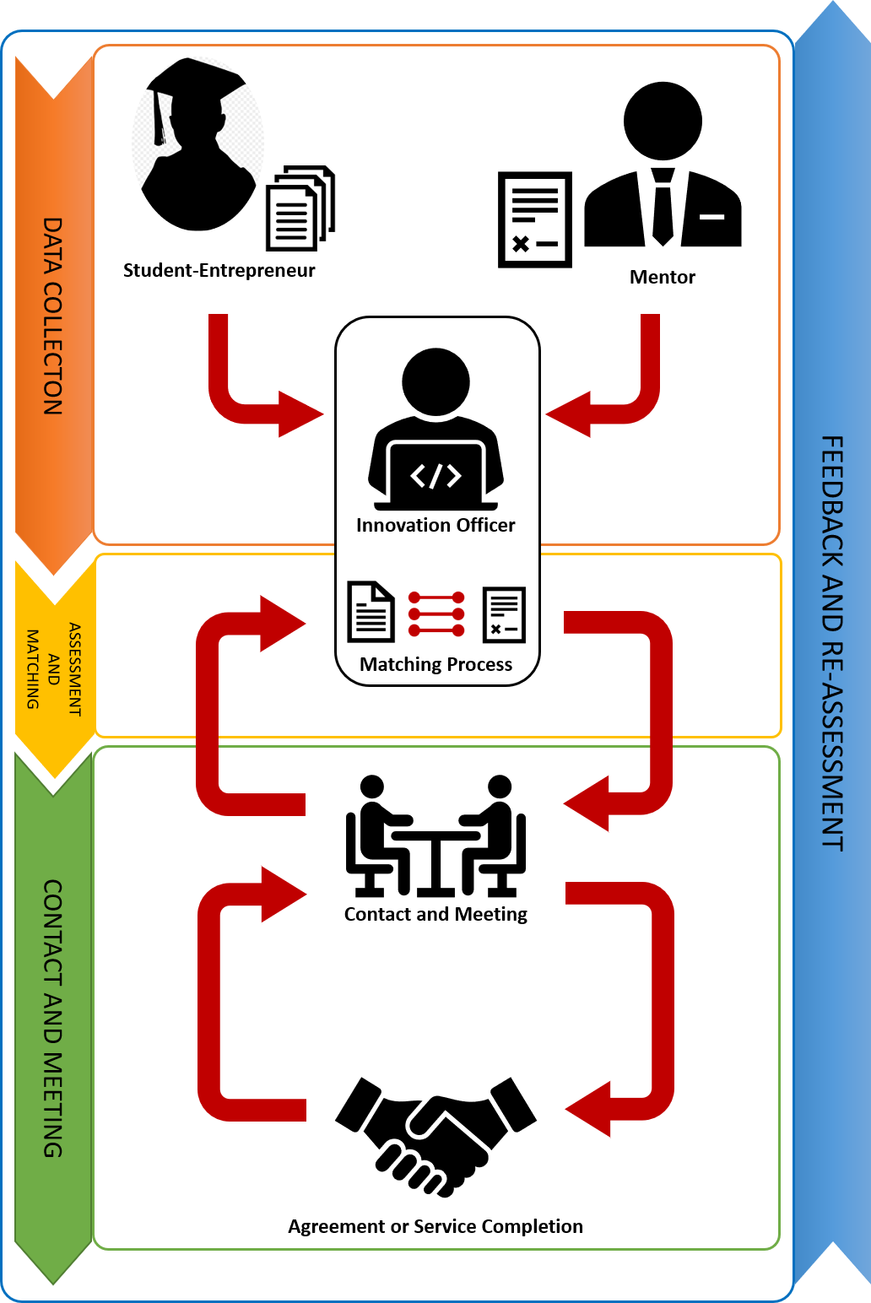

Slide 5



Critical elements
Office

Slide 6



Rule 01
Rule 02
Rule 03
Rule 04
Rule 05
Rule 06
Skill compatibility
Mutual interests
Project domain
Project
Stage
Availability
Personality


−
10%
14%
17%
17%
20%
22%

Slide 7





In house board
IT
Business
Finance
Law
Policy

Slide 8
Confidential Agreement
❍




⬇

Business Strategy

Malware
Attack
❍
Virus
Thread
⬇
Data Protection

Strong Passwrod

Business Strategy

Slide 9


Future: Open to the public
Marketing Strategy


◆


◆
We shall consider open to the general public in order to promote the CMU-A.
The innovation hub promotes CMU-A and potentially attract external funding from the government
Notes:
9

Slide 10


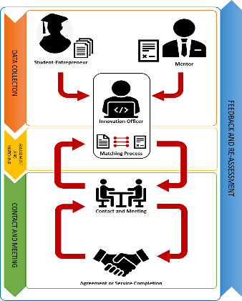
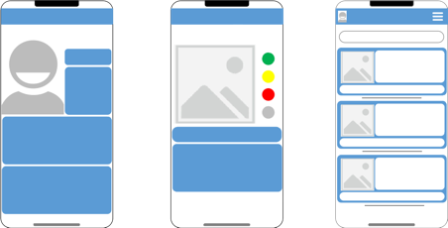
Iteration
Design Scope
◆
Design Criteria


Final Report and Presentation
Learning Launch
Start Here
Collaboration
Resources
Napkin Pitch
◆
Key Assumptions
10

Slide 11
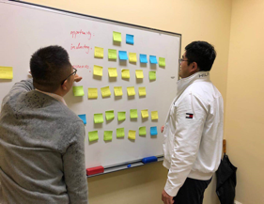
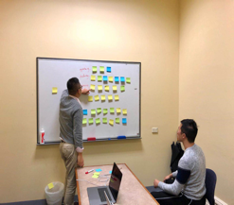
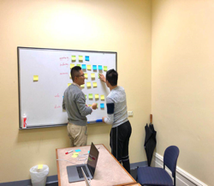
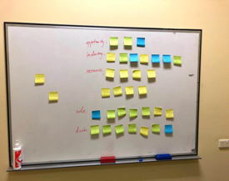
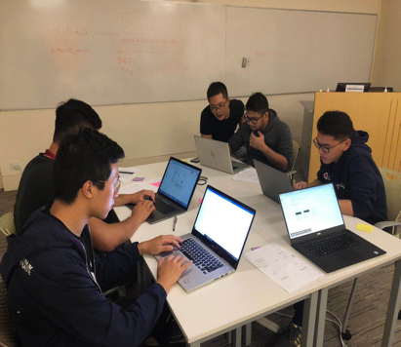
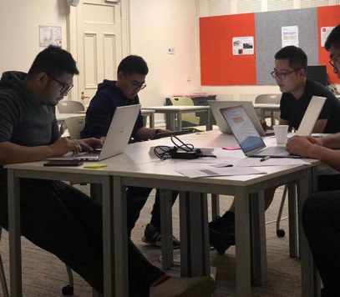
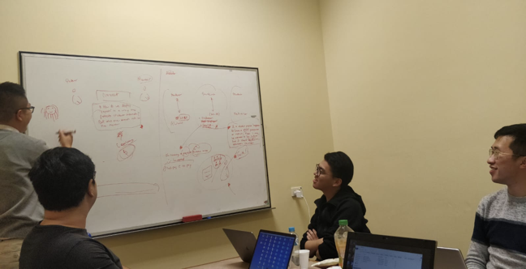
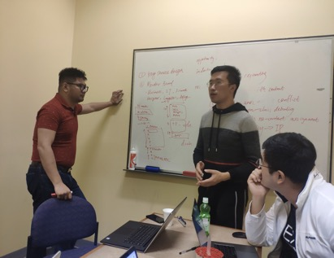
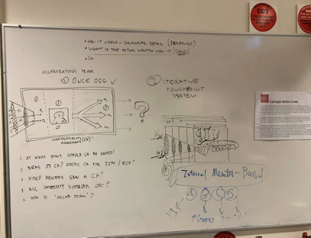
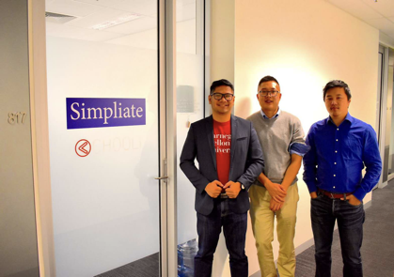
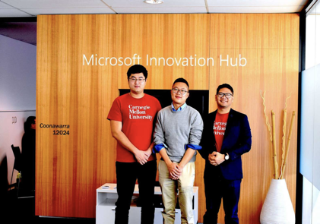

Project Journey Map

Slide 12


