Slide 1
Introduction to GSIM
Business Group
Essi Kaukonen (Statistics Finland) and Giorgia Simeoni (Istat)

Slide 2
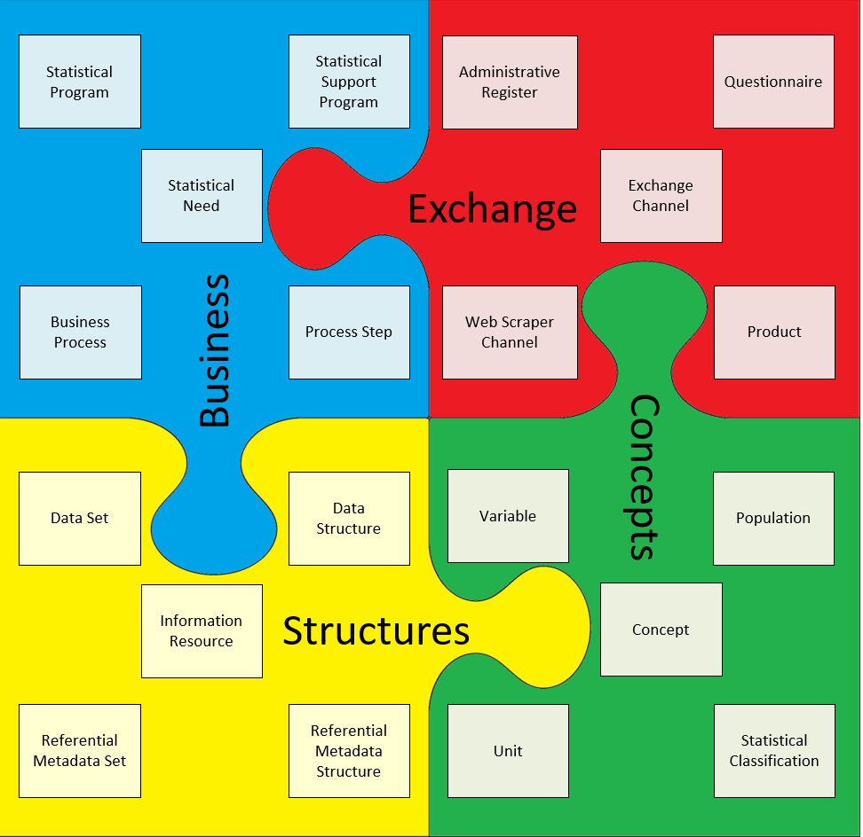
Business Group
The Business group is used to capture the designs and plans of statistical programs, and the processes undertaken to deliver those programs.
This includes the identification of a Statistical Need, the Business Processes that comprise the Statistical Program and the evaluations of them.

Slide 3
Some important information objects in the Business Group
Process Function
Process Step
Process Output
Transformed Output
Process Metric
Process Execution Log
Statistical Need
Business Case
Statistical Program
Statistical Program Design
Statistical Program Cycle
Business Process

Slide 4
From the Statistical Need to the Business Process
Statistical Program
initiates
has
Statistical Need
initiates
Business Case
uses
Statistical Program Cycle
includes
Business Process
Is based on
Statistical Program Design
performs

Slide 5
Statistical Need
A requirement, request or other notification that will be considered by an organization. A Statistical Need does not necessarily have structure or format - it is a 'raw' need as received by the organization. A Statistical Need may be of a variety of types including Environmental Change or Information Request.
Explanatory text: The Statistical Need is a proposed or imposed requirement, request or other notification as it has been received by an organization. A Statistical Need is a raw expression of a requirement, and is not necessarily well-defined. A related object - Change Definition - is created when a Statistical Need is analyzed by an organization. Change Definition expresses the raw need in well-defined, structured terms. Once a Statistical Need has been received, the first step is to do the conceptual work to establish what it is we are trying to measure. The final output of this conceptual work is the Change Definition. In some cases, the Statistical Need can result from the Assessment of the quality, efficiency, etc. of an existing process.
Example: A EU Regulation is a Statistical Need e.g. COMMISSION REGULATION (EU) No 41/2013 of 19 February 2013 implementing Regulation (EC) No 1338/2008 of the European Parliament and of the Council on Community statistics on public health and health and safety at work, as regards statistics based on the European Health Interview Survey (EHIS)

Slide 6
Business Case
A proposal for a body of work that will deliver outputs designed to achieve outcomes. A Business Case will provide the reasoning for undertaking a Statistical Support Program to initiate a new Statistical Program Design for an existing Statistical Program, or an entirely new Statistical Program, as well as the details of the change proposed.
Explanatory text: A Business Case is produced as a result of a detailed consideration of a Change Definition. It sets out a plan for how the change described by the Change Definition can be achieved. A Business Case usually comprises various evaluations. The Business Case will specify the stakeholders that are impacted by the Statistical Need or by the different solutions that are required to implement
Example: A document proposing to launch a new survey to implement the EU Regulation

Slide 7
Statistical Program
A set of activities, which may be repeated, that describes the purpose and context of a set of Business Process within the context of the relevant Statistical Program Cycles.
Explanatory text: The Statistical Program is one of a family of objects that provide the environmental context in which activities to produce statistics within a statistical organization are conducted. Statistical Program is the top level object that describes the purpose and objectives of a set of activities. Statistical Program will usually correspond to an ongoing activity such as a survey or output series. Some examples of Statistical Program are: Labour Force Survey - Multipurpose Household Survey - National Accounts - Demography - Overseas Arrivals and Departures
Related to the Statistical Program object there are Statistical Program Design and Statistical Program Cycle objects that hold the detailed information about the design and conduct of the Business Process.
Example: the European Health Interview Survey (EHIS)

Slide 8
Statistical Program Design
The specification of the resources required, processes used and description of relevant methodological information about the set of activities undertaken to investigate characteristics of a given Population.
Explanatory text: The Statistical Program Design is a series of objects that provide the operational context in which a set of Business Processes is conducted.
A simple example is where a Statistical Program relates to a single survey, for example, the Labour Force Survey. The Statistical Program will have a series of Statistical Program Design objects that describe the methodology and design used throughout the life of the survey. When a methodological change is made to the survey, a new Statistical Program Design is created to record the details of the new design.
Example: the description of the sampling design adopted by the European Health Interview Survey (EHIS), e.g. Two-stage element sampling with stratification of primary sampling units with municipalities as primary sampling units and households as elementary units…

Slide 9
Statistical Program Cycle
A set of activities to investigate characteristics of a given Population for a particular reference period.
Explanatory text: A Statistical Program Cycle documents the execution of an iteration of a Statistical Program according to the associated Statistical Program Design for a certain reference period. It identifies the activities that are undertaken as a part of the cycle and the specific resources required and processes used and description of relevant methodological information used in this cycle defined by the Statistical Program Design.
Example: the 2015 edition of European Health Interview Survey (EHIS)

Slide 10
Business Process
The set of Process Steps to perform one of more Business Functions to deliver a Statistical Program Cycle or Statistical Support Program.
Explanatory text: For example, a particular Statistical Program Cycle might include several data collection activities, the corresponding editing activities for each collection and the production and dissemination of final outputs. Each of these may be considered separate Business Processes for the Statistical Program Cycle.
Example: the set of activities needed to collect the data for the 2015 edition of European Health Interview Survey (EHIS)

Slide 11

Business Process has Process Steps
performs
Business
Function
Business
Process
has
Process Step

Slide 12
Process Step
A Process Step is a work package that performs a Business Process.
Explanatory text: A Process Step can be as big or small as the designer of a particular Business Service chooses. From a design perspective, one Process Step can contain "sub-steps", each of which is conceptualized as a (smaller) Process Step in its own right. Each of those "sub-steps" may contain "sub-steps" within them and so on indefinitely. It is a decision for the process designer to what extent to subdivide steps. At the most detailed level the Process Step is designed to process particular Process Inputs, according to a particular Process Method, to produce particular Process Outputs.
Note: Process Step can be a GSBPM phase, a GSBPM sub-process or lower level.

Slide 13
Business Function
Something an enterprise does, or needs to do, in order to achieve its objectives.
Explanatory text: A Business Function delivers added value from a business point of view. It is delivered by bringing together people, processes and technology (resources), for a specific business purpose.
A Business Function may be defined directly with descriptive text and/or through reference to an existing catalogue of Business Functions.
Examples: "Review, validate and edit", "Identify and address outliers"

Slide 14
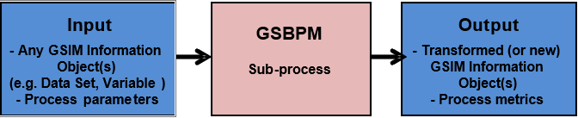
GSIM and GSBPM

Slide 15
Process Output
Any instance of an information object which is produced by a Process Step as a result of its execution.

Slide 16
Process Output in detail
Transformed Output
is a type of
Process Output
is a type of
Process Metric
is a type of
Process Execuotion Log

Slide 17
Transformed Output
A Process Output (a result) which provides the "reason for existence" for the Process Step.
Examples: new Data Set, derived Variable
Process Metric
A Process Output whose purpose is to measure and report some aspect of how the Process Step performed during execution.
Process Execution Log
The Process Execution Log captures the output of a Process Step which is not directly related to the Transformed Output it produced. It may include data that was recorded during the real time execution of the Process Step.

Slide 18
More information about the business group?
Business group
31 information objects in GSIM v1.2

