Slide 1
A K-means run on my MapReduce implementation.
A first draft.

Slide 2
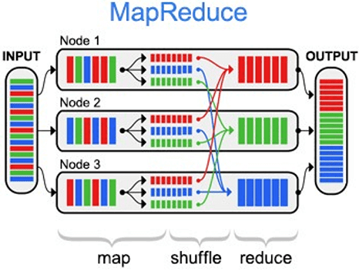
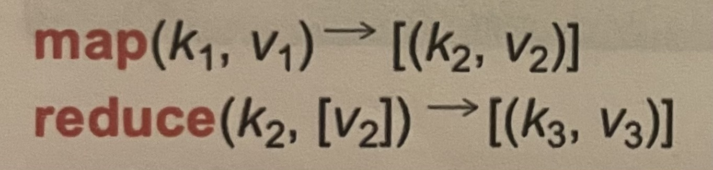

Slide 3
K-means
Get K random centroids
Get its nearest points
Something changed
Calculate new centroids
Finished

Slide 4
Data splitting
0
length
Data
Splitting equally between mappers
0
# mappers
Sending each offset to one mapper (incapsulated in a job data structure)

Slide 5
Retrieving data
Margin (eg. 10%)
0
# mappers
…2,4;6,7;3,9;2,9;6,7;4,5;2,7;2,5;8,4;6,1;5,9;3,5;3,8;2,3;...
Get_actual_begin(...)
Get_actual_end(...)
req := http.NewRequest("GET", ...)
req.Header.Add("Range", "bytes=" + strconv.FormatInt(begin, 10) + "-" + strconv.FormatInt(end, 10))
resp, err := client.Do(req)

Slide 6
Mapping
(clustering specific)
For each point :
Clusters’ centroids
Point
0,(3,6)
(3,6)
1,(0,6)
2,(8,2)
Assign to the nearest (euclidean distance) centroid

Slide 7
Encoding
For maximal flexibility
keys
map[string]interface{}
map[string]struct{}
points encoded as string
Clustering algorithm specific

Slide 8
Keys splitting
Master assigns one or more keys to each reducer (exclusively).
Main data structure, here, is:
map[string]map[string]*Server
keys
server ids
Contains ip, port, etc.

Slide 9
Sending the jobs
Encapsulated and sent to the respective server.
map[string]map[string]struct{}
server ids
keys

Slide 10
Reducing
(clustering specific)
For each point, get the mean using welford one pass
map[string]map[string]struct{}
keys
points

Slide 11
Encoding
For maximal flexibility
keys
map[string]interface{}
[]float
Clustering algorithm specific

Slide 12
Iteration
type Task struct {
Id string
Origin_id string
Send_time int64
Start_time time.Time
Resource_link string
Mappers_amount int32
Margin int8
Separate_entries byte
Separate_properties byte
Properties_amount int8
Initialization_algorithm string
Map_algorithm string
Map_algorithm_parameters interface{}
Reducers_amount int32
Reduce_algorithm string
Reduce_algorithm_parameters interface{}
Join_algorithm string
Join_algorithm_parameters interface{}
Iteration_algorithm string
Iteration_algorithm_parameters interface{}
Keys_x_servers *orderedmap.OrderedMap
Keys_x_servers_version int8
Jobs map[string]*Job
Jobs_done map[string]*Job
}
Algorithm specific function, has a []interface{} as parameter and it is preserved during the iterations.
Thus results can be saved there and compared (k-means is searching a fixpoint!)

Slide 13
Worst failure case
One mapper fails during reducer phase
Previously done jobs are re-scheduled
Reducer scheduler is put on pause
Jobs done
Update Key’s location and resume reduce scheduler

Slide 14
Thanks!

Slide 15
Resend limiter (desynch issue)
Window size 3
sender
receiver
Unacked and unackable, deadlock
0
1
7
0
7
0
2
6
1
6
1
exp 0
sender
receiver
exp 0
exp 0
5
2
5
2
4
3
4
3
After 5 unacked resend, sender will try to go forward even if this segment isn't acked and timeot will be resetted.
It's just one way to fix it. Sure not the best one.
Use the byte number like TCP does.

Slide 16
Strange List (1)
NextNode pointer
Array of node's pointer
nodes
Generic state
i
i+1
Window's size
Memory

Slide 17
Strange List (2)
NextNode pointer
Array of node's pointer
nodes
i segment's ack received
Have to remove this segment from the list!
i
i+1
Window's size
Memory

Slide 18
Strange List (2)
NextNode pointer
Array of node's pointer
nodes
Suppose i segment expired instead
So after removing it like we did in the last slide
Resend the i segment
Have to add it to the list!
i
i+1
Window's size
Memory
Hence
i+2
The list is alway ordered
Only needed to check up the first entry timeout!

Slide 19
Next season: Things I'd like to do
Make it full duplex
Variable window size
Better handling of timeout
Disconnection function
3-way handshake
Polish the code
Statistics measurements
Have fun overwhelming other TCP connections!

