Slide 1
A reliable protocol on an unreliable channel.
A very rough approach.

Slide 2
Connection or not Connection?
Is it just a heritage of good old TLC guys?
Why don't we do a PnP oriented system?
Intrinsically in circuit switching architecture
TCP/IP Levels 0-3
We may demux packets just by <IPS,IPD,PortS,PortD>

Slide 3
Like circuit switching
Server needs to allocate hardware resources for each client.
It -most of all- wants to free the resources once client leaves.
Freeing up resources and then reloading it up costs very much!
It wants to know when he leaves!(Teardown)
So if TCP weren't Connection-oriented we should add the connection in the Application layer!

Slide 4
A rough 2-way handshake connection on UDP
Connection waiting (server)
Connection request (client)
loop {
if ((recvfrom(sockfd, buff, len, 0, from, fromlen)) < 0{exit(EXIT_FAILURE);}
if (*((unsigned char *)buff) == (unsigned char)255) {
if (connect(sockfd, from, *fromlen) < 0) {exit(EXIT_FAILURE);}
int bytes;
while((bytes = writen(sockfd,buff,sizeof(unsigned char)))<=0 ){if(bytes<0){exit(EXIT_FAILURE);}}
break;
}
}
Wait for anything
Check the magic number
Connect (important, it will remember IP and port destination and will filter any packet that doesn't come from the client)
Send the handshake.
Connection done. (Did server receive my handshake?)
unsigned char sendline[1];
sendline[0]=(unsigned char)255;
if ((writen(sockd, sendline, 1)) < 0) {exit(EXIT_FAILURE);}
int letti=0;
sendline[0]=0;
fd_set set;
struct timeval timeout,time;
int rv;
FD_ZERO(&set); /* clear the set */
FD_SET(sockd, &set); /* add our file descriptor to the set */
timeout.tv_sec = TIME_OUT;
timeout.tv_usec = 0;
if(gettimeofday(&time,NULL)!=0){exit(EXIT_FAILURE);}
while(sendline[0]!=(unsigned char)255){
printf("attendo risposta del server\n");
rv = select(sockd + 1, &set, NULL, NULL, &timeout);
if(rv == -1){exit(EXIT_FAILURE);}
else if(rv == 0){return EXIT_FAILURE;}
struct timeval timenow;
if(gettimeofday(&timenow,NULL)!=0){exit(EXIT_FAILURE);}
if ((timenow.tv_sec - time.tv_sec) >TIME_OUT) {return EXIT_FAILURE;}
letti=readn(sockd, sendline, 1);
if (letti< 0) {exit(EXIT_FAILURE);}
}
return EXIT_SUCCESS;
Send the magic number
Select with such parameters will wait until socket's buffer isn't empty or time has expired. So to speak we are waiting for the handshake.
I forgot to put connect into the function!
Connection done.

Slide 5
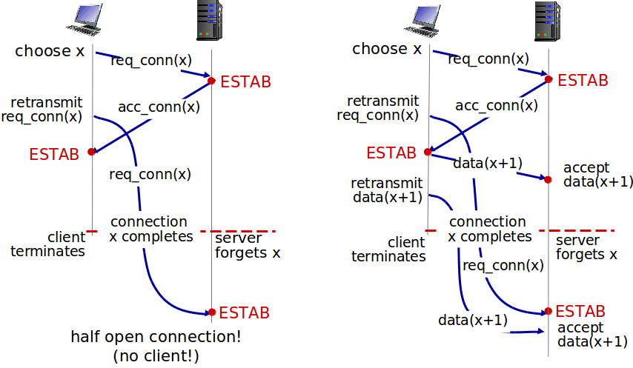
2 or 3 way handshake?
Less is more Failure scenarios
For simplicity I considered the 2-way, it's enough for the testing use. The failure scenarios aren't so frequent.
I'll code the 3-way when I'll reuse this protocol in other consumer programs.
In order to overwhelm other TCP connections!

Slide 6
Receive function
loop{
for (;;) {if ((letti=noisy_readn(fd, (void*)swapper, PACKETSIZE)) < 0) {perror("errore in readn");exit(1);}else if (letti>0){break;}}
numberreceivedpacket=swapper[0];
if(numberreceivedpacket>(unsigned char)WINDOW ){exit(EXIT_FAILURE);}
bytes[numberreceivedpacket]=letti;
if(((startwindow>endwindow)&&((numberreceivedpacket<startwindow)&&(numberreceivedpacket>endwindow)))||( (startwindow<endwindow)&&((numberreceivedpacket<startwindow)||(numberreceivedpacket>endwindow)))){continue;}
alreadyreceived[numberreceivedpacket]=(unsigned char)1;
unsigned char* swap=NULL;
swap=swapper;
swapper=pacchettiptr[numberreceivedpacket];
pacchettiptr[numberreceivedpacket]=swap;
for (;;) {
if ((letti=noisy_writen(fd, (void*)&numberreceivedpacket, sizeof(unsigned char))) < 0) {perror("errore in writen");exit(1);}else if(letti>0)}break;}}
while(alreadyreceived[startwindow]==(unsigned char)1){
memcpy((void*)(buf+*bytescrittisubuffer),(void*)&pacchettiptr[startwindow][1],bytes[startwindow]-1);
*bytescrittisubuffer = *bytescrittisubuffer+bytes[startwindow]-1;
if(*bytescrittisubuffer==n){
--------------------------------------------------------
}
alreadyreceived[startwindow]=0;
startwindow=(startwindow+1)%WINDOW;
endwindow=(endwindow+1)%WINDOW;
}
}
Receave it and put it in the swapper
Consistency check on the segment number (rejection)
Note that I received that segment
Send the ack
If the first segment is received save it and push the window
Finish, inform the sender that buffer is full

Slide 7
The swapper
Data copy avoidance
Pointers (pacchettiptr)
swappertofree=swapper;
loop{
for (;;) {if ((letti=noisy_readn(fd, (void*)swapper, PACKETSIZE)) < 0) {perror("errore in readn");exit(1);}else if (letti>0){break;}}
numberreceivedpacket=swapper[0];
[..]
unsigned char* swap=NULL;
swap=swapper;
swapper=pacchettiptr[numberreceivedpacket];
pacchettiptr[numberreceivedpacket]=swap;
[..]
}
[..]
//swappertofree Is needed to remember the address of the “Little Memory” to free it up after all.
[..]
free(swappertofree);
[..]
Memory
i
Swapper
Window
Segment(i)
It will go in the memory area pointed by Swapper
Little Memory

Slide 8
The swapper
Data copy avoidance
Pointers (pacchettiptr)
swappertofree=swapper;
loop{
for (;;) {if ((letti=noisy_readn(fd, (void*)swapper, PACKETSIZE)) < 0) {perror("errore in readn");exit(1);}else if (letti>0){break;}}
numberreceivedpacket=swapper[0];
[..]
unsigned char* swap=NULL;
swap=swapper;
swapper=pacchettiptr[numberreceivedpacket];
pacchettiptr[numberreceivedpacket]=swap;
[..]
}
[..]
//swappertofree Is needed to remember the address of the “Little Memory” to free it up after all.
[..]
free(swappertofree);
[..]
j
Memory
i
Swapper
Window
Segment(j)
It will go in the memory area pointed by Swapper
Little Memory

Slide 9
The swapper
Data copy avoidance
Pointers (pacchettiptr)
swappertofree=swapper;
loop{
for (;;) {if ((letti=noisy_readn(fd, (void*)swapper, PACKETSIZE)) < 0) {perror("errore in readn");exit(1);}else if (letti>0){break;}}
numberreceivedpacket=swapper[0];
[..]
unsigned char* swap=NULL;
swap=swapper;
swapper=pacchettiptr[numberreceivedpacket];
pacchettiptr[numberreceivedpacket]=swap;
[..]
}
[..]
//swappertofree Is needed to remember the address of the “Little Memory” to free it up after all.
[..]
free(swappertofree);
[..]
j
Memory
i
Swapper
Window
And so on
Little Memory

Slide 10
Send function (1)
loop{
if ((finestrafinita == 0)&&(n-*scritto>0)) {
buffer[0] = (unsigned char)ptr;
if (n - *scritto >= PACKETSIZE) {
byte_inf[ptr] = *scritto;
byte_scritti[ptr] = PACKETSIZE - 1;
dim = PACKETSIZE-1;
} else if (n - *scritto < PACKETSIZE) {
byte_inf[ptr] = *scritto;
dim = n - *scritto;
byte_scritti[ptr] = n - *scritto;
}
memcpy(buffer + 1, buf + *scritto, dim);
for (;;) {
if ((bytes = noisy_writen(fd, buffer, dim+1)) < 0) {exit(1);}else if (bytes == dim+1)break;}
*scritto = *scritto + dim;
if(gettimeofday(&times[ptr],NULL)!=0){exit(EXIT_FAILURE);}
ptrarr[ptr]=(unsigned char)ptr;
list_put(&lista,(void*) &times[ptr], &ptrarr[ptr], ptr);
if (ptr == ptrsup)
finestrafinita = 1;
else {
ptrinc(&ptr);
}
}
[...]
If there are some segments in the window, which have been never sent, send it
Calculation of segment size
Send the segment
Refresh the written bytes
Add the segment information -clock included- to check and resend it when it'll expire
Check if it was the last segment of the window or go forward

Slide 11
Send function (2)
int rv;
FD_ZERO(&set); /* clear the set */
FD_SET(fd, &set); /* add our file descriptor to the set */
timeout.tv_sec = 0;
timeout.tv_usec = 500;
for(;;){
rv = select(fd + 1, &set, NULL, NULL, &timeout);
if(rv == -1){exit(EXIT_FAILURE);}
else if(rv == 0){break;}
letti=noisy_readn(fd, buffer, PACKETSIZE);
if (letti< 0) {exit(EXIT_FAILURE);}
ptrletto = (unsigned char)buffer[0];
if(ptrletto==(unsigned char)254){
[chiudo e handshake]
}
if(checklist(&lista,ptrletto)==0){
continue;
}
RECV:
if (ptrletto == ptrinf) {
unsigned char i=ptrletto;
do {
ptrinc(&ptrinf);
ptrinc(&ptrsup);
ack[i]=0;
i+=(unsigned char)1;
i%=WINDOW;
if(finestrafinita==1){
ptrinc(&ptr);
finestrafinita =0;
}
}while( (i!=ptrsup) && (ack[i]==1));
}
else
ack[ptrletto]=(unsigned char)1;
if(gettimeofday(&nowtime,NULL)!=0){exit(EXIT_FAILURE);}
if(resendlimiter[ptrletto]!=0){
if(list_empty(&lista)==0){
if(nowtime.tv_sec>times[ptrletto].tv_sec){time_out=(time_out/4)*3 +(((nowtime.tv_sec- times[ptrletto].tv_sec)/4)*1000000) + (nowtime.tv_usec - times[ptrletto].tv_usec)/4;}
}
list_remove(&lista, ptrletto);
}
else{
time_out=TIME_OUT*1000000;
}
resendlimiter[ptrletto]=5;
}
if((n-*scritto<=0)&&(list_empty(&lista)==1)){
[two way handshake e fine trasmissione]
}
Preparation for the select timeout
Read acks, timeout is needed to avoid loop when we are only waiting for acks.
Received ack of the oldest segment, go forward
Other segment's ack received: remove it from the list and refresh timeout with the estimated RTT
If we sent all of the bytes and the list of not-acked segments is empty, close and do 2-way handshake

Slide 12
Too much simple timeout
Very high!
When ack has been received: timeout=oldtimeout*3/4 + timetoack/4
When a timeout has occurred: timeout=oldtimeout/2 + defaulttimeout/2
When a desynch occurs: timeout=defaulttimeout
Next slide
It doesn't work very well.
A too small timeout is often fails!
Better consider the standard deviation like TCP already does.

Slide 13
Resend limiter (desynch issue)
Window size 3
sender
receiver
Unacked and unackable, deadlock
0
1
7
0
7
0
2
6
1
6
1
exp 0
sender
receiver
exp 0
exp 0
5
2
5
2
4
3
4
3
After 5 unacked resend, sender will try to go forward even if this segment isn't acked and timeot will be resetted.
It's just one way to fix it. Sure not the best one.
Use the byte number like TCP does.

Slide 14
Strange List (1)
NextNode pointer
Array of node's pointer
nodes
Generic state
i
i+1
Window's size
Memory

Slide 15
Strange List (2)
NextNode pointer
Array of node's pointer
nodes
i segment's ack received
Have to remove this segment from the list!
i
i+1
Window's size
Memory

Slide 16
Strange List (2)
NextNode pointer
Array of node's pointer
nodes
Suppose i segment expired instead
So after removing it like we did in the last slide
Resend the i segment
Have to add it to the list!
i
i+1
Window's size
Memory
Hence
i+2
The list is alway ordered
Only needed to check up the first entry timeout!

Slide 17
Next season: Things I'd like to do
Make it full duplex
Variable window size
Better handling of timeout
Disconnection function
3-way handshake
Polish the code
Statistics measurements
Have fun overwhelming other TCP connections!

