Slide 1


FX PB Collateral
Automating FX Prime Brokerage Monitoring
Replacing tedious manual portal extractions with an automated end-to-end data pipeline & Power BI analytics dashboard

Slide 2


The Business Problem & Enterprise Impact
Understanding the manual bottlenecks in daily FX Prime Brokerage collateral and limits reporting.

Slide 3

Manual Process Challenge
1
2
2
Portal Authentication
Manual Screenshotting
Manual Screenshotting
Operations team had to manually log into the Prime Brokerage (PB) portal every morning, navigate through reporting sub-menus, and await slow report loads.
Gather relevant quantitative and qualitative data from internal and external sources
Gather relevant quantitative and qualitative data from internal and external sources
3
Teams Pasting & Delays
Clean incomplete records, remove duplicates, and ensure accuracy to maintain data integrity

Slide 4




Implemented Solution
Automated Ingestion Pipeline
Power BI Dataflows
Connects to SharePoint, cleans, aggregates, and structures the raw CSV data for downstream reporting
Automated Email Delivery
PB portal configured to auto-distribute daily CSV files
Power Automate Workflow
Power BI Reports
Cloud workflow automatically saves CSV files to a secured SharePoint folder
Automatically refreshed interactive reports distributed to the primary stakeholders

Slide 5
Operational Speed & Impact
<10s
Instant Collateral Requirements Visibility
By removing manual portal logins, screenshotting, and Teams messaging, the solution compresses the daily reporting cycle from over 15 minutes down to sub-second automated dashboard access.
Time to Decision Insight
Stakeholders receive updated, reliable, and queryable collateral data before the market opens every morning.

Slide 6

Public Portfolio & GitHub Replication
Enterprise project securely recreated into an open-source demonstration

Slide 7
Enterprise vs Open Source
Workplace Production |  | GitHub Replication
Prime Brokerage portal CSV feeds | Data | Custom Python script generating synthetic FX data
Microsoft SharePoint Online | Storage | PostgreSQL on Neon Database
Power BI Dataflows to BI reports | Connection | Direct Power BI connection to Neon DB.
Power BI Report | Reporting | Power BI Report (other tools will be used)

Slide 8

Data Architecture
Python & Neon PostgreSQL Pipeline
Data Generation
Database Integration
Developed a Python script to synthesize mock data mimicking original reports
Structured a relational schema and automated data loads directly into a Neon PostgreSQL serverless cloud database
Power BI Reports
Connected Power BI REports directly to Neon Database to model data, write DAX measures, and publish the dashboard

Slide 9
AI-Assisted Development
1
2
3
Rapid Scripting & Synthetic Logic
Database Schema Optimization
Documentation
Leveraged Generative AI assistance to program complex Python generator scripts
Leveraged AI prompts to help design PostgreSQL tables— schema layout, primary keys, and data types for Neon DB
Generated docstrings and a comprehensive GitHub README explaining setup instructions for reviewers

Slide 10
Reporting Examples
Interactive Power BI Reports

Slide 11
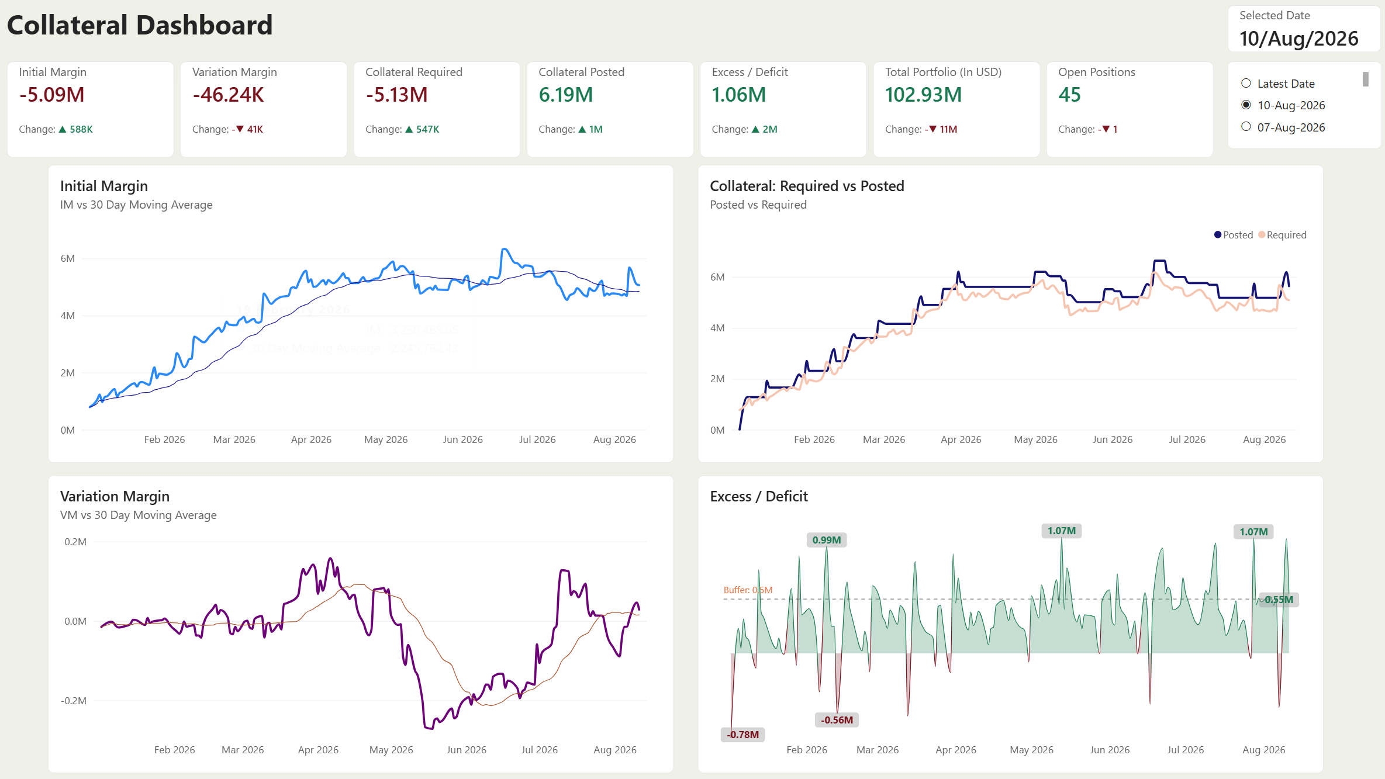
Collateral Dashboard
1
2
2
Portal Authentication
Manual Screenshotting
Manual Screenshotting
Gather relevant quantitative and qualitative data from internal and external sources
3
Teams Pasting & Delays
Clean incomplete records, remove duplicates, and ensure accuracy to maintain data integrity

Slide 12
WORK IN PROGRESS

