Slide 1



FX PB Collateral
Automating FX Prime Brokerage Monitoring
Replacing tedious manual portal extraction with an automated end-to-end data pipeline and Power BI analytics dashboard

Slide 2


The Business Problem & Enterprise Impact
Understanding the manual bottlenecks in daily FX Prime Brokerage collateral and limits reporting.

Slide 3


Manual Process Challenge
1
2
Portal Authentication
Manual Screenshotting
Operations team had to manually log into the Prime Brokerage (PB) portal every morning, navigate through reporting sub-menus, and await slow report loads.
Capture the relevant collateral, limits and portfolio information from the portal reports.
3
Teams Pasting & Delays
Consolidate the extracted information and manually share updates with stakeholders.

Slide 4




Implemented Solution
Automated Ingestion Pipeline
Power BI Dataflows
Connects to SharePoint, cleans, aggregates, and structures the raw CSV data for downstream reporting
Automated Email Delivery
PB portal configured to auto-distribute daily CSV files
Power Automate Workflow
Power BI Reports
Cloud workflow automatically saves CSV files to a secured SharePoint folder
Automatically refreshed interactive reports distributed to the primary stakeholders

Slide 5

Operational Speed & Impact
<10s
Instant Collateral Requirements Visibility
By removing manual portal logins, screenshotting, and Teams messaging, the solution compresses the daily reporting cycle from over 15 minutes down to under 10 seconds.
Time to Decision Insight
Stakeholders receive an updated, reliable collateral report every morning

Slide 6


Value Added Through Analytics
Power BI Reporting gives additional value
Trend Analysis – Daily collateral movements visualized over time
Limit Utilization Monitoring – Daily view of PB limits
Counterparty Exposure Insights – Aggregated exposure by counterparty
Operational Transparency – Stakeholders can self‑serve instead of requesting ad‑hoc updates.

Slide 7

Public Portfolio & GitHub Replication
Enterprise project securely recreated into a public portfolio demonstration

Slide 8
Enterprise vs Public Portfolio
Enterprise Production |  | GitHub Replication
Prime Brokerage portal CSV feeds | Data | Custom Python script generating synthetic FX data
Microsoft SharePoint Online | Storage | PostgreSQL on Neon Database
Power BI Dataflows to BI reports | Connection | Direct Power BI connection to Neon DB.
Power BI Report | Reporting | BI Tools – Power BI or Google Data Studio

Slide 9

Data Architecture
Python & Neon PostgreSQL Pipeline
Data Generation
Database Integration
Developed a Python script to synthesize mock data mimicking original reports
Structured a relational schema and automated data loads directly into a Neon PostgreSQL serverless cloud database
Power BI Reports
Connected Power BI directly to Neon PostgreSQL database to model data, write DAX measures, and publish the dashboard

Slide 10

AI-Assisted Development
1
2
3
Rapid Scripting & Synthetic Logic
Database Schema Optimization
Documentation
Used Generative AI to accelerate the development of complex Python data-generation scripts.
Leveraged AI prompts to help design PostgreSQL tables—schema layout, primary keys, and data types for Neon PostgreSQL database.
Generated docstrings and a comprehensive GitHub README explaining setup instructions for reviewers.
4
Implementation
AI-accelerated implementation while designing, testing, and validating the logic.

Slide 11
Reporting Examples
Interactive Power BI Reports

Slide 12

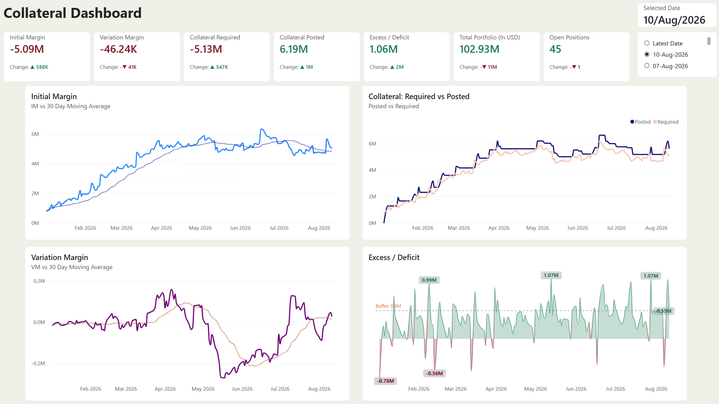
Collateral Dashboard

Slide 13
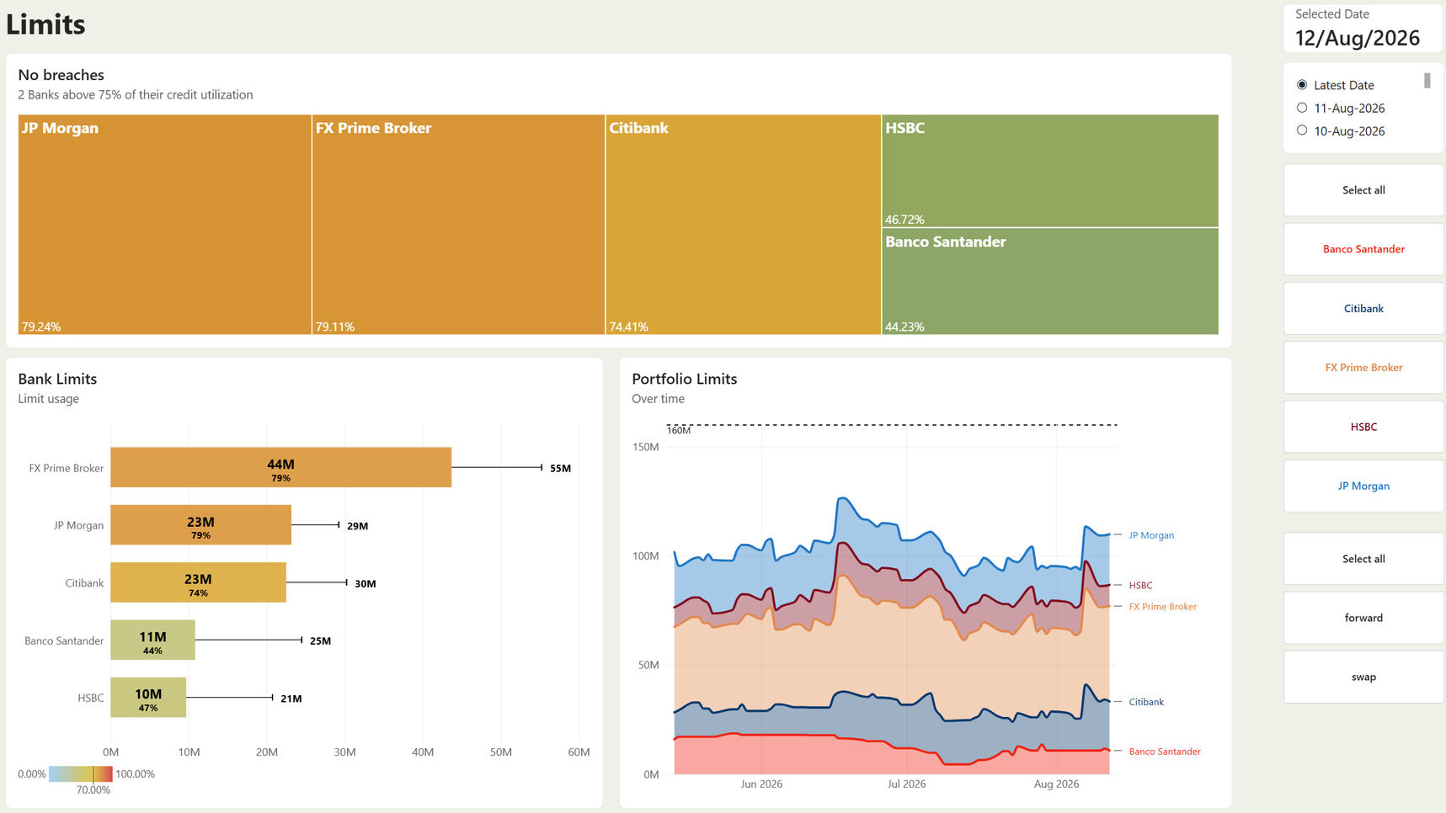
Limits

Slide 14
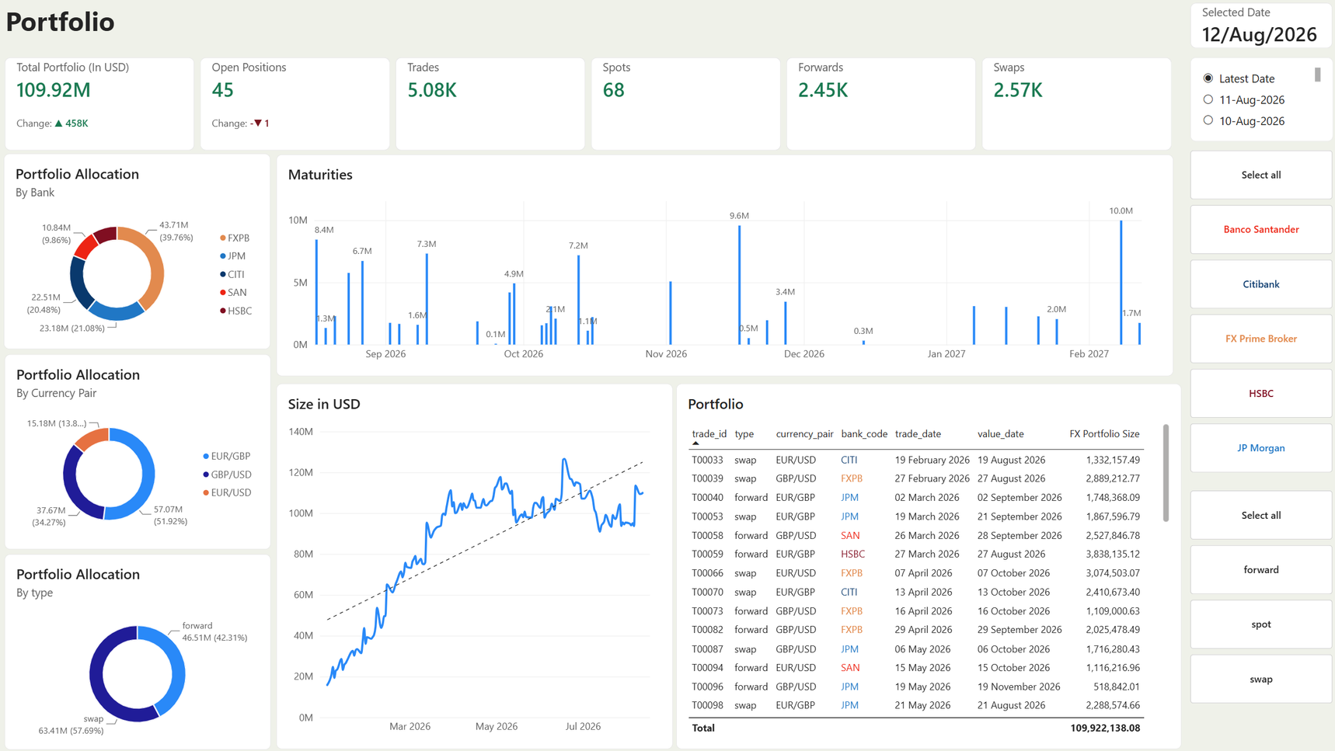
Portfolio

