Slide 1



PERSONAL PROJECT | DATA AUTOMATION
Daily FX Rates
From a public FX rates source to a live report, with no manual steps
Sergio | October 2026

Slide 2
Why I Built It
1
Where can I get FX rate data for free?
It started as a proof of concept: using Visual Studio Code with AI to build something real.
It was also a project that could grow: getting the FX rates I need in my other reports, to convert data into a base currency such as USD.
2
How do I use an API to bring the data in?
3
My Python and SQL are intermediate. How far can AI help me go?
4
How do I make the whole flow run by itself?

Slide 3
What Was Done
A daily feed of EUR and GBP rates against USD, stored and reported automatically
1
2
3
4
A Python script gets the daily EUR and GBP rates against USD from a public rates source (the Frankfurter API).
The rates are saved in two places: a CSV file as a backup, and a PostgreSQL table in a Neon cloud database.
The job runs by itself every day at 18:00 UTC with GitHub Actions. A Slack message is sent if it fails.
A Google Data Studio report reads the database and refreshes itself once a day. It shows GBP/USD, EUR/USD and GBP/EUR.
THE RESULT
One clean source of FX rates that my other reports and projects can use.
The goal: prove I could build this in Visual Studio Code with AI, and get the FX rates my other reports need.

Slide 4
How the Workflow Runs
GitHub Actions
1
Source
Runs every day at 18:00 UTC, or started by hand
4
Database
5
Report
Frankfurter API
2
Python script
Neon PostgreSQL
SQL views
Google Data Studio
Daily EUR and GBP rates against USD
Reads what is stored, gets the missing dates, cleans the data and fills the gaps
Table fx_rates
Live report for the user
every run
on failure
3
CSV backup
Slack alert
One source, many users
File saved back to GitHub
Sent only if the run fails
This report is only the first user. My other reports and Python projects can read the same table.
Database login kept as a GitHub secret
1 Get rates → 2 Clean and fill gaps → 3 Save CSV backup → 4 Update database → 5 Report shows new rates

Slide 5
How I Worked with AI
I started with GitHub Copilot in Visual Studio Code. Now I use Claude.
My part
AI's part
  The idea, and clear instructions for every step
  Testing and debugging
  Some pieces myself with AI assistance, like the table settings and the unique key
  The Data Studio report
  Filling my gaps on the most technical side: the code and the connections
  Writing the code from my instructions
  Helping me solve each issue I found when testing
  Helping me polish the report
WHY DATA STUDIO AND NOT POWER BI
I can share a link and anyone can open the report. Power BI needs a licence and admin rights to share. I would have been quicker in Power BI, and the report would look nicer, but nobody outside could see it.

Slide 6
Decisions I Made
Four choices that shaped the project
What I decided
Why
USD as the base currency
My other reports need to convert data into one base currency. With every rate stored against USD, the conversion is always the same.
A rate for every day, also weekends and holidays
I learned this in Power BI: a day with no rate cannot be converted. Empty days use the last known rate and are flagged "filled"; market rates are flagged "raw".
A database, with a CSV file as backup
I started with only a CSV file. Then I moved to a database and found Neon, a free PostgreSQL option. The CSV stayed as the backup.
A full check once a week, not on every run
Checking the whole history every day was not needed. Daily runs look at the last 14 days. Every Monday the script checks everything.

Slide 7
Testing and Debugging
DAYS WITH NO DATA
DUPLICATE DATA
WRONG VALUES
Some days were missing from the data completely.
The same date and currency appeared more than once.
Some days were filled before the real rate arrived, so the value was wrong.
The fix
The fix
The fix
Every Monday the script checks the whole history for missing days and loads them again. Daily runs check the last 14 days.
A unique key on date and currency. Existing rows are updated, not added again.
Filled rates from the last 7 days are checked again on every run, and replaced when the real rate arrives.
I log every issue in GitHub and then solve it. Getting the data was the easy part. Making it reliable was the real work.

Slide 8
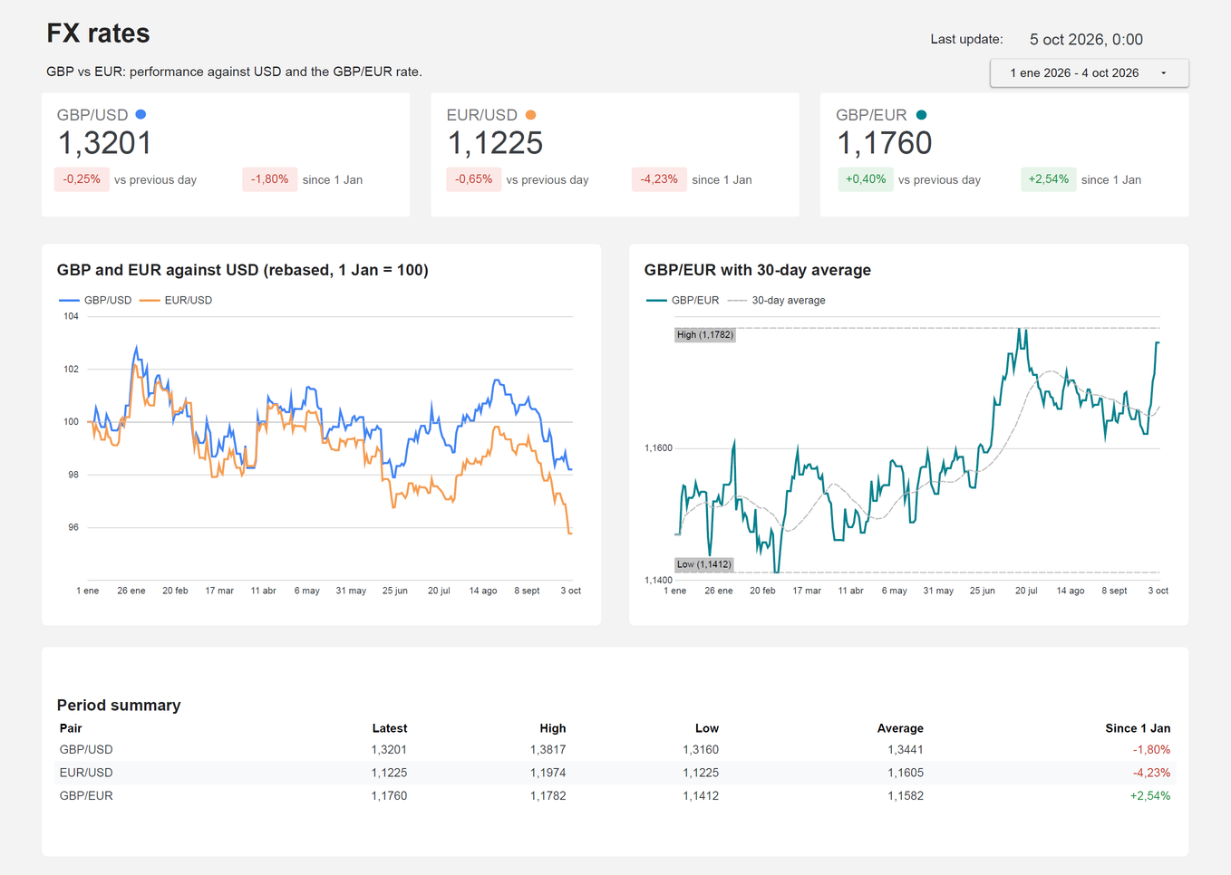
The Final Result
3
FX rates in one live report
GBP/USD and EUR/USD come from the market. GBP/EUR is calculated from both.
0
manual steps from source to report
The job runs every day at 18:00 UTC and alerts me only if it fails. Data Studio refreshes the report once a day.
2
quality flags on every rate
Raw for a market rate, filled for a rate carried forward on a weekend or holiday.
See the live report: https://datastudio.google.com/s/sC5tlwXPGVI

Slide 9
Four Questions, Answered
1
Free FX data: the Frankfurter API, a public source of daily rates at no cost.
AI helped me with my gaps on the most technical side: the code and the connections.
Testing, debugging and the decisions stayed with me.
2
Using an API: one request from a Python script brings the rates in, ready to clean and store.
3
AI: it wrote the code from my instructions and helped me solve each issue. I tested, debugged and decided.
4
Running by itself: GitHub Actions runs the script every day and alerts me if it fails. Data Studio refreshes the report once a day.

