Slide 1
Capstone Project: Biodiversity
National Parks Service Project
November 2019

Slide 2
Problem statement
Analyze data on endangered species from several different parks.
We are analyzing the conservation statuses of the species to see is there are any patterns to the species that become endangered..

Slide 3
Data Description
We are analysing the conservation status of 5541 different species.
This species belong to 7 categories:
Mammal
Bird
Reptile
Amphibian
Fish
Vascular Plant
Nonvascular Plant

Slide 4
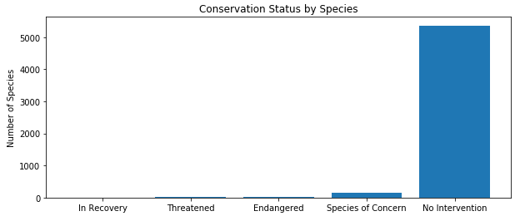
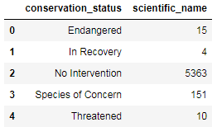
Conservation Status by Species
We are studying 5 different statuses: In Recovery, Threatened, Endangered, Species of Concern and No intervention. We clearly see that most of the species do not need any intervention.

Slide 5
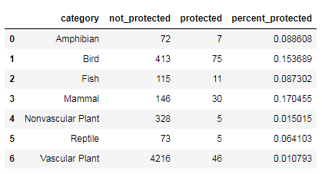
2. Are certain types of Species more likely to be endangered?
After studying more in detail our dataset, we see that most of the species not in danger belong to Vascular Plant and only 1% are in danger.
On the other hand, we see that Mammal and Bird have the highest percent of species in danger: 17% and 15%. Are Mammal more likely to be endangered than Bird?

Slide 6


2. Are certain types of Species more likely to be endangered? (continued)
Are Mammal more likely to be endangered than Bird? Is the difference between Mammal and Reptile significant? We have we have performed a Chi Square Test.

Slide 7
3. Should be conservationist concerned?
We started with a data divided in 5 categories and then we have divided this categories in 2. Our approach discarding those species not in danger it is correct. However, we are aggregating all the rest of species in 1 group so our analysis is not considering any trend: for example those species in recovery or those species that move down from one category to another.
Omitting all the above and based on our results, we can see that Mammal and Bird are the species that conservationist should be more focused.

Slide 8
Observation Analysis
Sheeps observations: foot and mouth disease study.
Yellowstone National Park have been running a program to reduce this disease. We want to know how many sheeps we need to observe in order to know if this program is working with a 90% of confidence.

Slide 9
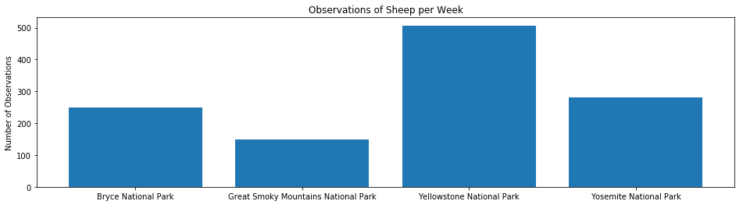
1. Sheep observations
Below are the Sheep sightings at different national parks:

Slide 10
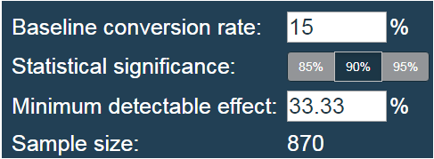
2. What is the sample size we need?
We know that 15% of sheeps at Bryce Park have foot and mouth disease. We want to detect reductions of at least 5 percent. Using a sample size calculator we know that we need a sample 870 observations.
This will take:
3.5 weeks at Bryce Park
1.7 weeks at Yellowstone Park
5.8 weeks at Great Smoky Mountains Park
3 weeks at Yosemite Park

