Slide 1
RoboGarden Bootcamp Capstone Project ClearForK Porosity & Rock Type study Regression and Classification Supervised Study
By: Sahar Gargary
July 2019

Slide 2
Source Of Idea
Permian Basin Located West of Texas
heterogeneous, low permeability carbonate reservoirs
Core analysis is expensive
Adapting ML methods will enables us to …

Slide 3


Data acquisition
CSV Data: extracted Data and created CSV Tables from PDF files for 5 Wells
Wireline Log Data (6863 entries)
Routine Core Analysis Data (3343 entries)
Rock Type Data (558 entries)

Slide 4
Data analysis & Preparation
Exploratory Data Analysis (EDA)
Merged core data and log data for regression study (3076 entries, Table1)
Merged rock type and log data for classification study (558 entries, Table2)
Created pair plot to observe the correlation between parameters
Spearman Correlation
FacetGrid was used to visualize porosity
Created Well Composite visualization to observe logs behaviour
Created Boxplot to observe the Porosity range in each well

Slide 5
Table 1. Core and Log Data
wellName | Depth | GR | fN | rb | PE | Dt | RD | RS | Porosity_air | Density_air | kair_air
NRU_1509 | 729 | 729 | 729 | 729 | 729 | 729 | 729 | 729 | 729 | 729 | 729
NRU_1510 | 633 | 633 | 633 | 633 | 633 | 633 | 633 | 633 | 633 | 633 | 633
NRU_207 | 743 | 743 | 743 | 743 | 743 | 743 | 743 | 743 | 743 | 743 | 743
NRU_3319 | 152 | 152 | 152 | 152 | 152 | 152 | 152 | 152 | 152 | 152 | 152
NRU_3533 | 819 | 819 | 819 | 819 | 819 | 819 | 819 | 819 | 819 | 819 | 819

Slide 6
Table 2 . Rock Type and Log Data
wellName | Depth | GR | fN | rb | PE | Dt | RD | RS | Rock Type
NRU_1509 | 38 | 38 | 38 | 38 | 38 | 38 | 38 | 38 | 38
NRU_1510 | 40 | 40 | 40 | 40 | 40 | 40 | 40 | 40 | 40
NRU_207 | 323 | 323 | 323 | 323 | 323 | 323 | 323 | 323 | 323
NRU_3319 | 40 | 40 | 40 | 40 | 40 | 40 | 40 | 40 | 40
NRU_3533 | 117 | 117 | 117 | 117 | 117 | 117 | 117 | 117 | 117

Slide 7
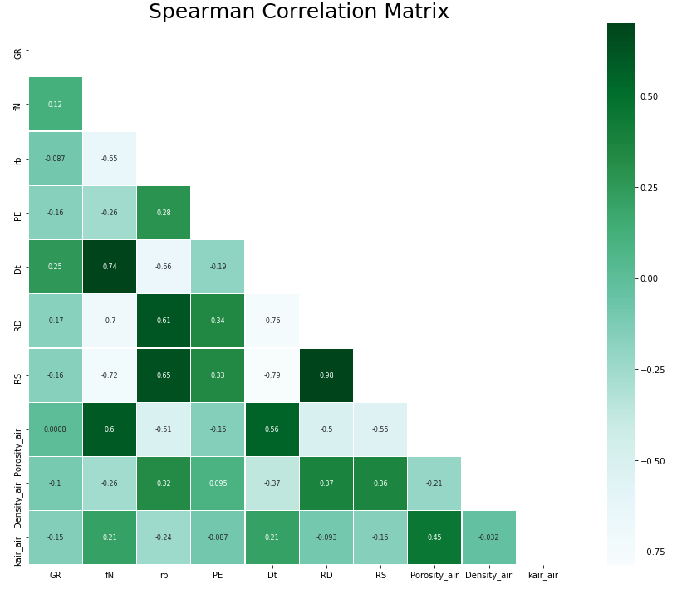

Slide 8
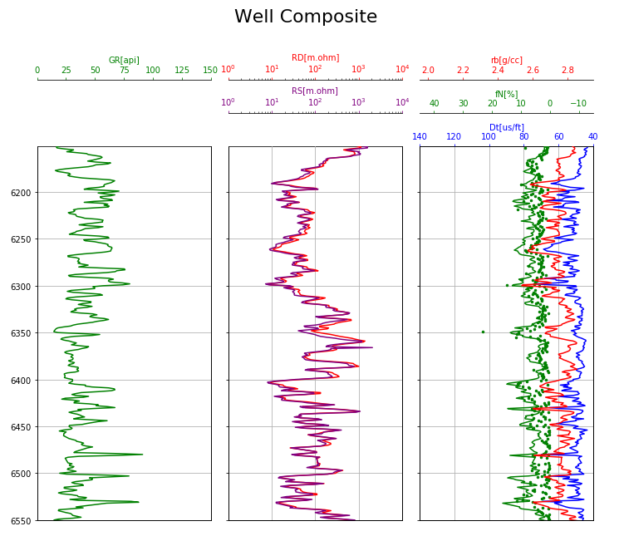

Slide 9
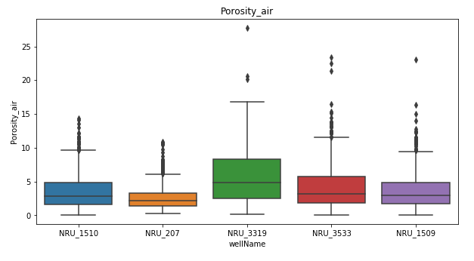

Slide 10
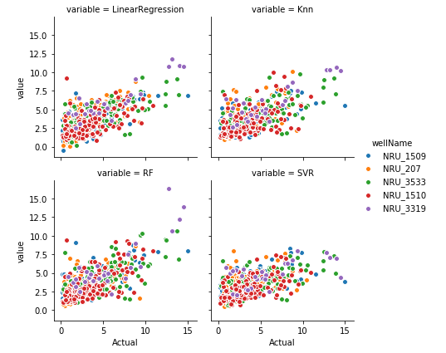
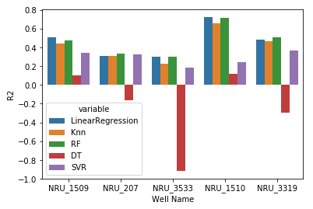
Regression Study
Regression Models (Porosity): Regression Models and Deep Learning (ANN)
R2 score for ANN 0.4690

Slide 11
Regression Study
Regression Models (Porosity): Regression Models and Deep Learning (ANN)
R2 score for ANN 0.4690

Slide 12
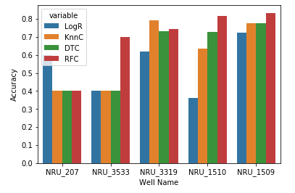
Classification Study
Classification Models (Rock Type): Classification Models and Deep Learning (ANN)
ANN Accuracy is 0.705

Slide 13
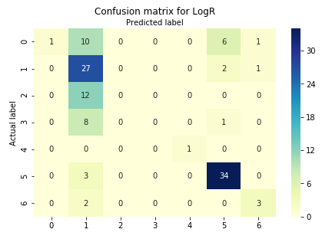
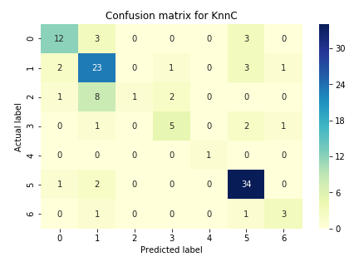
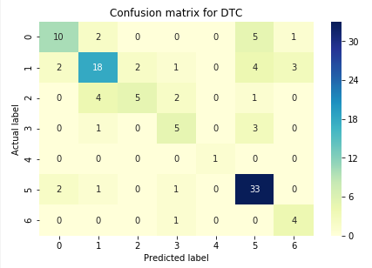
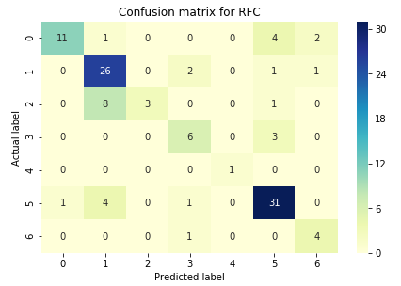

Slide 14
Final Performance Results
Regression (Porosity)
LinearRegression : 0.49
Knn : 0.45
RF : 0.49
DT : -0.16
SVR : 0.36
ANN: 0.47
Classification (Rock Type)
LogR : 0.58
KnnC : 0.71
DTC : 0.68
RFC : 0.73
ANN: 0.71

Slide 15
Further studies
More comprehensive review of the core and log data to identify potential bad data
Residual analysis on errors
Perform a similar study on permeability
Combining the results with core data

Slide 16
References
Thesis:
Doublet, L.E.B., An Integrated Geological and Engineering Reservoir Characterization of the North Robertson, PhD Dissertation (2001)
Github:
https://github.com/sgargary/ML-Capstone_SG

Slide 17


Questions?

Slide 18

Thank You!

