Slide 1
Python Sudoku Program - Overview
Three components:
Create the “first order” candidate list
Prune the candidate list based on:
Non-hidden and hidden “tuples” (pair, triplet, …) for a given house
X-Wing
Pointing Pairs
Y-Wing
Fill in solution cells based on:
Only a single value exists in the “candidates”
Analysis of the histogram of the candidates for a given “house” (row, col or square)

Slide 2
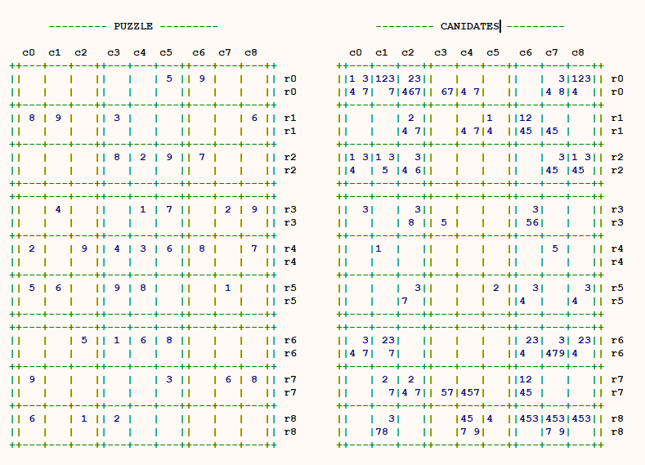

Create First Order Candidate List
Finding the “first order” candidates for cell (7,2):
In the PUZZLE:
Row 7 already has: 3,6,8,9
Col 2 already has: 1,5,9
Sqr 6 already has: 1,5,6,9
Union of row 7, col 2, sqr 6:
1, ,3, ,5,6, ,8,9
So, what’s left for CANIDATES is:
2,4,7

Slide 3
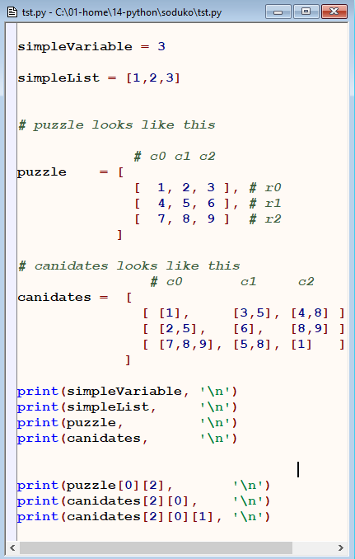
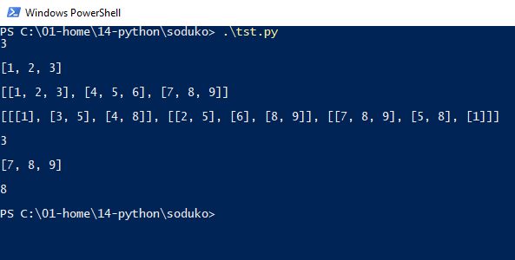
A Word About Lists in Python

Slide 4
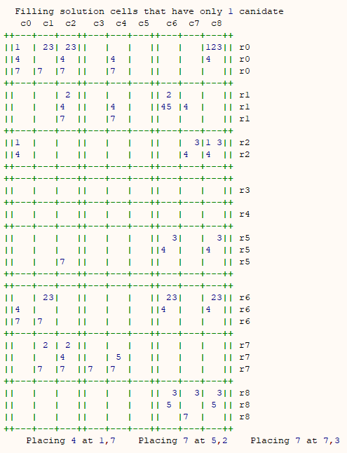
Fill Cells With Only One Candidate

Slide 5
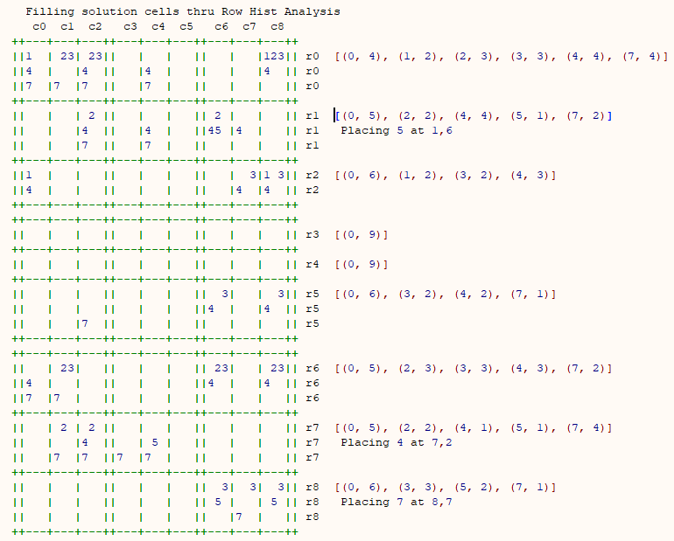
Fill Cells Via (Row) Histogram Analysis
The histogram shows that only one cell on row 1 can contain a 5 – so that cell must be a 5.
The histogram shows that only one cell on row 7 can contain a 4 – so that cell must be a 4.
The histogram shows that only one cell on row 8 can contain a 7 – so that cell must be a 7.

Slide 6
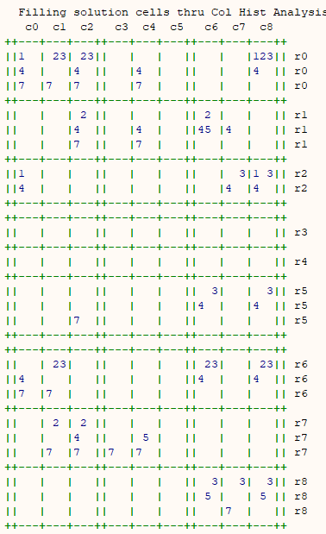
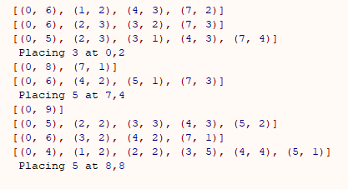
Fill Cells Via (Col) Histogram Analysis
Same explanation as with row histogram analysis except this time look at the col histograms instead.

Slide 7
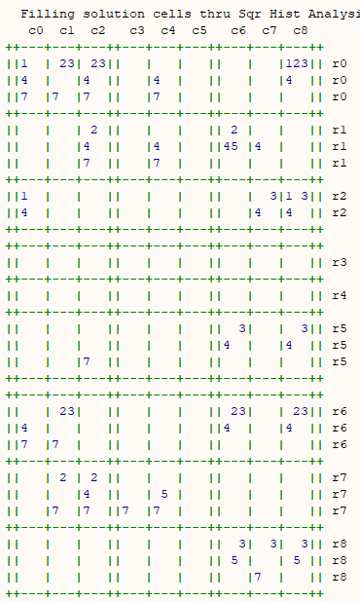
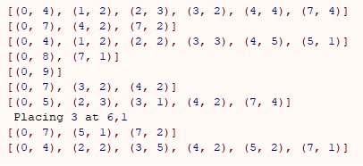
Fill Cells Via (Sqr) Histogram Analysis
Same explanation as with row histogram analysis except this time look at the square histograms instead.

Slide 8
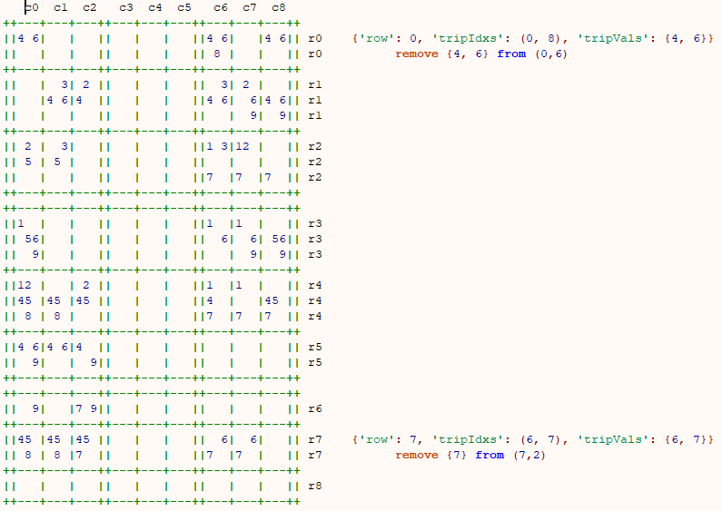
Pruning Naked Pairs
Two cells on row 0 contain (4,6) and only (4,6). We don’t know which one is going to be a 4 or which one is going to be a 6, but it doesn’t matter. One of them is going to be a 4 and the other is going to be a 6 – that’s for sure.
What it means is that 4 or 6 cannot be a candidate for any other cell on this row.
You can apply a similar technique to cols and squares to eliminate candidates within the col or square, respectively.

Slide 9
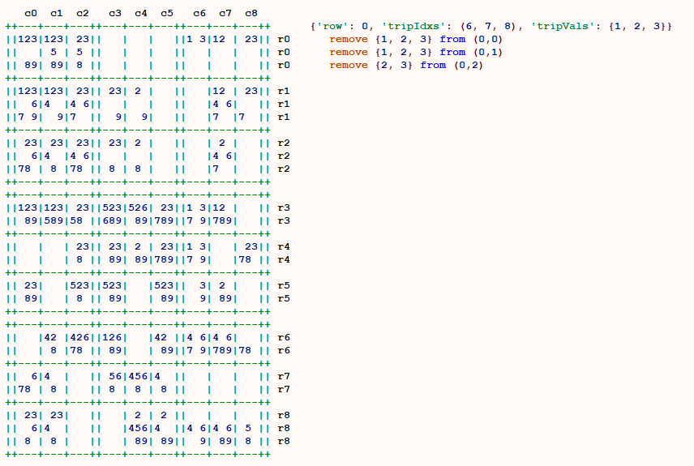
Pruning Naked Triples
Three cells on row 0 contain (combined) only three numbers (1,2,3). Three cells, only three numbers – that’s the key. We don’t know which one is which, but, again, it doesn’t matter – one is going to be 1 one a 2 and one a 3, that’s for sure.
What it means is that 1 or 2 or 3 cannot be a candidate for any other cell on this row.
Generally, this is easier to spot when all three square contain all 3 numbers (1,2,3) but they don’t have to.
You can apply a similar technique to cols and squares to eliminate candidates within the col or square, respectively.

Slide 10
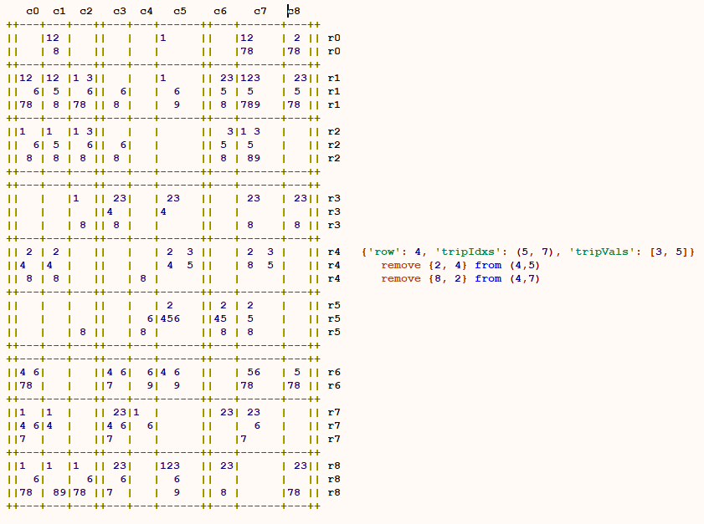
Pruning Hidden Pairs
Ok, hang on things are about to get weird.
On row 4 there are only two places where 3 and 5 can exist. You'd see them as a naked pair, if they weren't hidden by extra numbers.
Because 3 and 5 can only exist in two of those cells (no other cells will accept either of them), that means they must be in those two cells, leaving no room for any other. Even though you don't know which is which, you can remove all other candidates from the within those two cells.
Note that with naked pairs candidates outside the pair’s cells are removed whereas with hidden pairs candidates inside the pair’s cells are removed.

Slide 11
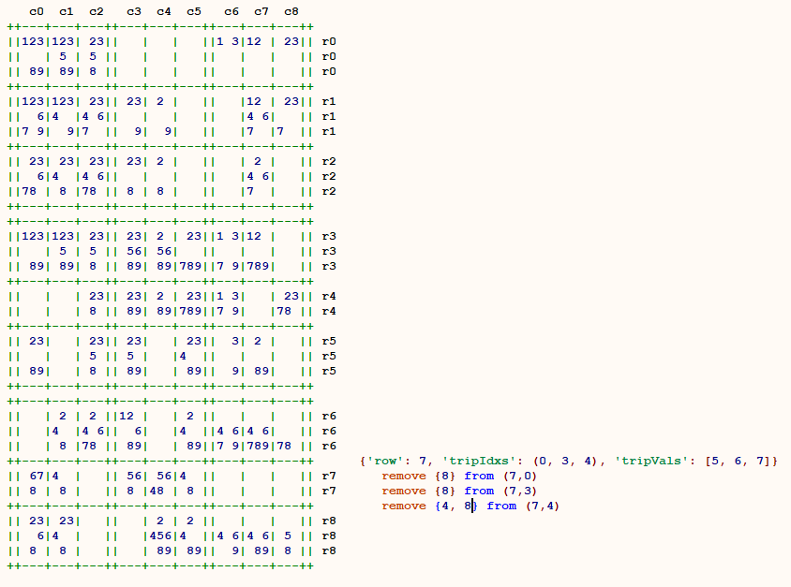
Pruning Hidden Triples
The algorithm for hidden triplets leverages off the algorithm for naked triplets in the same way that hidden pairs leverages off the naked pairs.
Again, the naked/hidden pair/triple algorithms can be applied to a row, col or square.
BTW the same techniques work for quads (4 cells 4 values), etc.
Have fun. Hard by hand easier by computer especially if you have a single routine that just accepts “N” as a parameter!! Which I do.

Slide 12
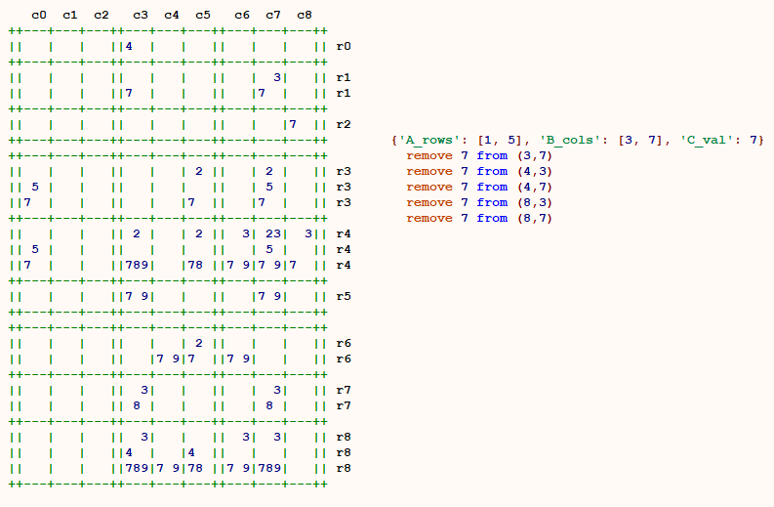
Pruning X-Wing
Only two cells in row 1 can be a 7.
Only two cells in row 5 can be a 7.
The cols that the 7’s appear in in rows 1 and 5 are the same – they form an “X”.
As such, the 7’s in cols 3 and 7 must appear on rows 1 and 5 – either at 1,3 and 5,7 or at 1,7 and 5,3.
Therefore any 7’s that appear in cols 3 and 7 (and not on rows 1 and 5) can be eliminated.
Note: this is not a great example (but still valid) because cell 1,3 is a “single candidate”.

Slide 13
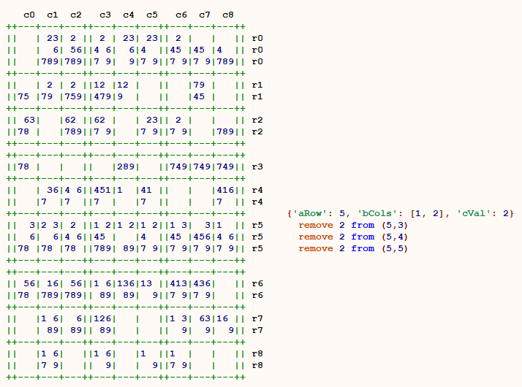
Pruning Pointing Pairs
In square 3, only 2 cells can be a 2. Because they are on the same row (and because one of them is going to definitely be a 2) we can eliminate 2 as a candidate from other cells on that row.

Slide 14
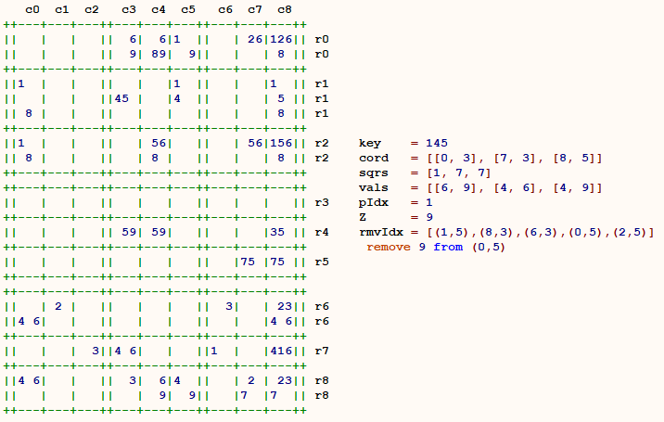
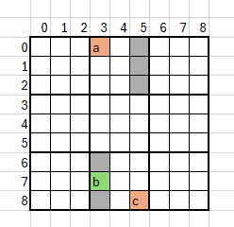

Pruning Y Wings
Find 3 cells each of which has exactly 2 values and for which those values are of the form [ (X,Y), (X,Z), (Y,Z) ].
The cells must be arranged such that one of the cells can “see” both or the other 2 but those other 2 cannot “see” each other. The first cell is called the “pivot” and the other two are called “wings”. Drawing lines from the pivot to each wing forms a “Y”.
The intersection of the cells seen by each of the two wings is called “the intersection”.
The value (there will only be one) that’s shared between the wings can be eliminated from “the intersection”.

Slide 15
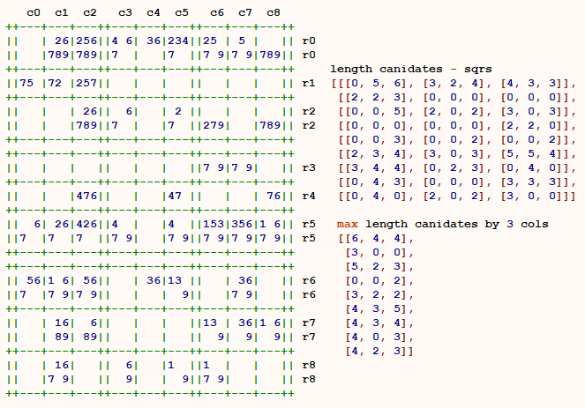
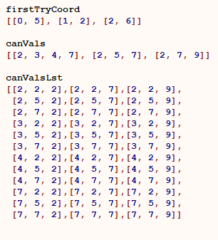
Guessing
Find three cells all in different rows, cols and squares but all in the same “row of squares”.

