Slide 1

Project:2
Crown and Anchor
By
Girish Gedala
Bharadwaj Avasarala

Slide 2
Introduction
Crown and Anchor is a game played using 3 dice and a mat consisting of 6 symbols.
The player has to choose a symbol on the mat.
He then places some amount at stake.
Three dice are thrown, if the symbol that is selected by the player shows up at least on one single dice, then the player wins, if it doesn’t he loses the amount.
If the symbol shows up on more than one dice, the player’s winning amount multiplies.

Slide 3
Project Description
In this project we try to implement the given game, “Crown and Anchor”.
The entire game is designed and implemented using HTML5,CSS and PHP.
The design is implemented using the CSS and HTML
All the functionalities are implemented using PHP.
The Project consists of three screens.
  Home Screen
  Game Play Screen
  How to Play Screen

Slide 4
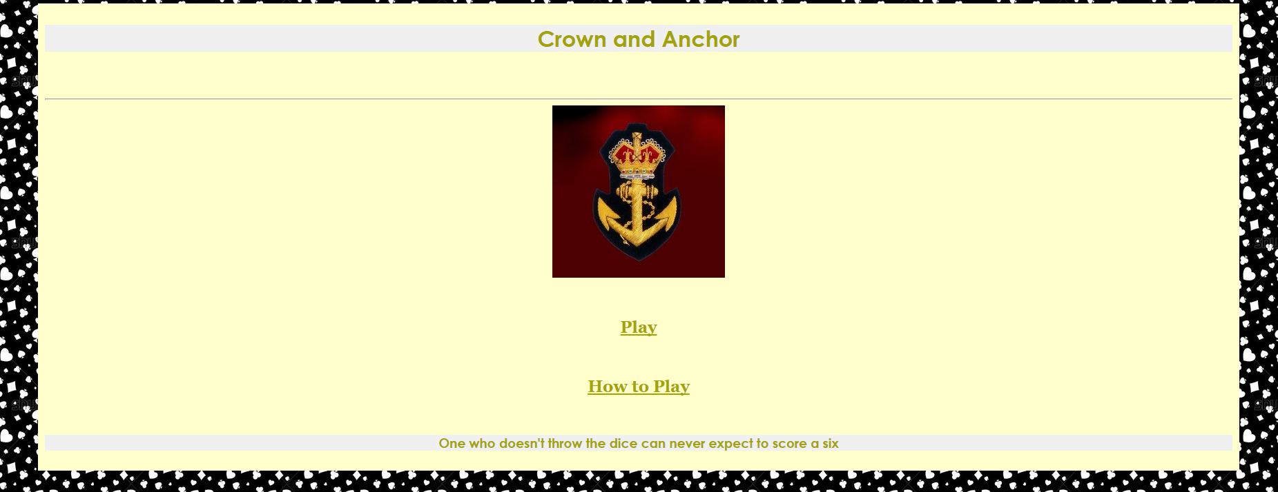
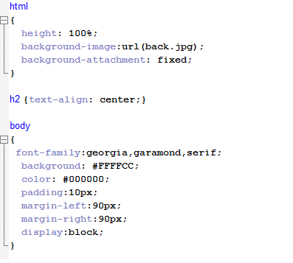
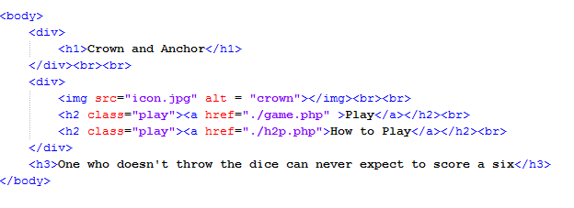
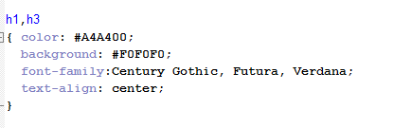
Home Screen

Slide 5
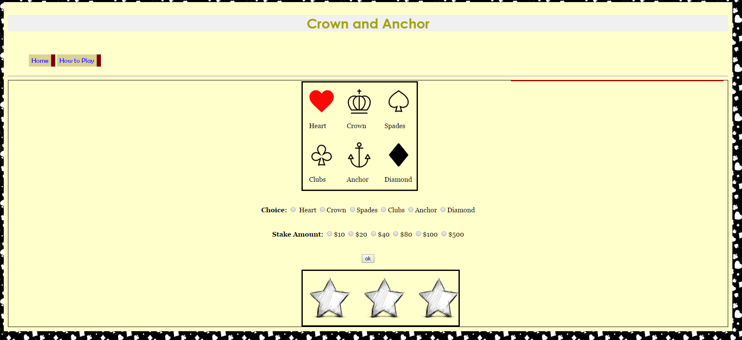
Game Screen

Slide 6
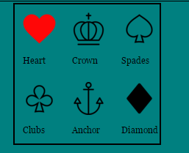
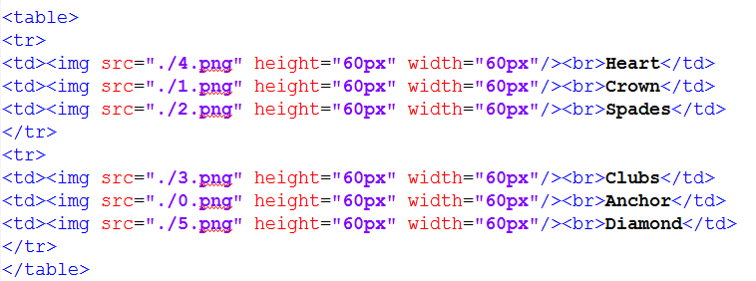
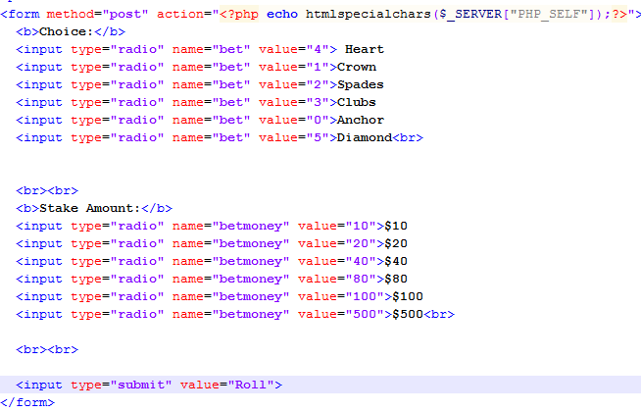
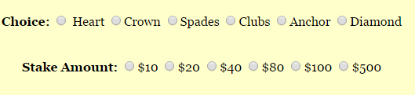
Code Snippets

Slide 7
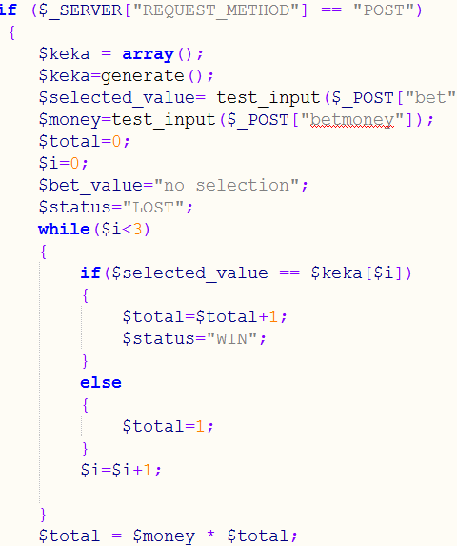
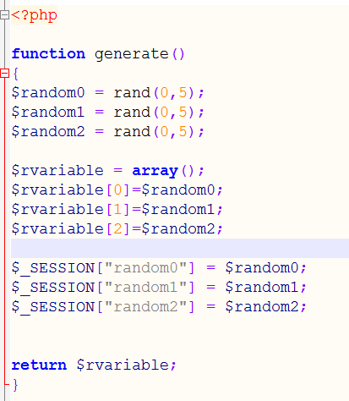
Code Snippets

Slide 8

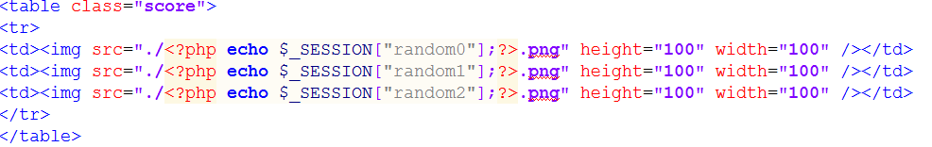
Code Snippets

Slide 9

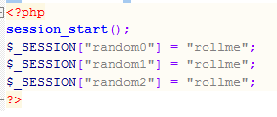
Code Snippets

Slide 10

Code Snippets

Slide 11
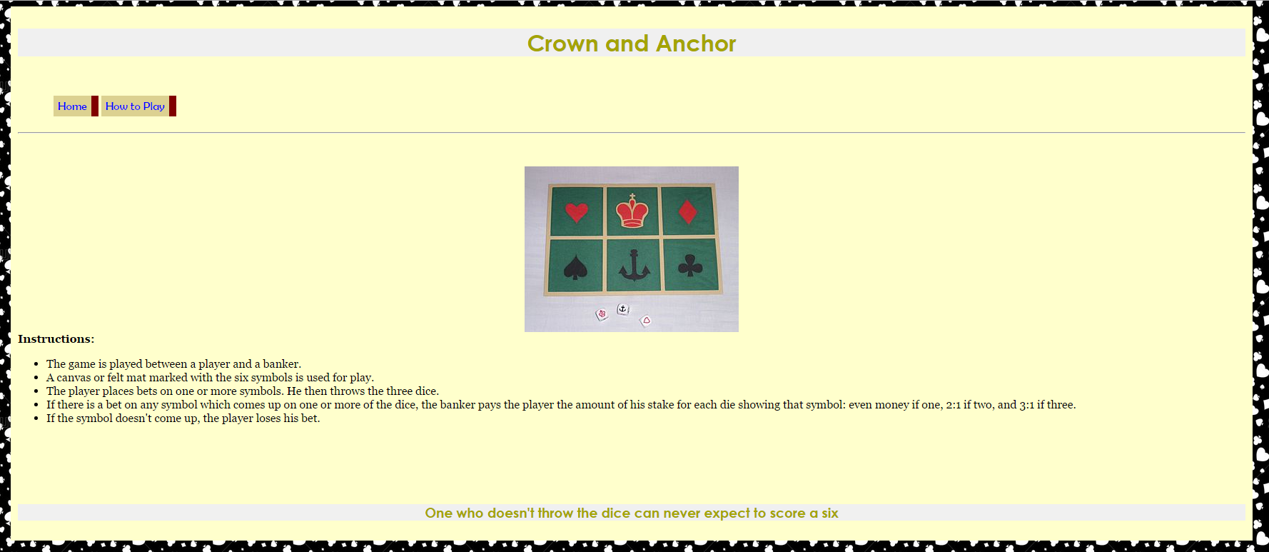
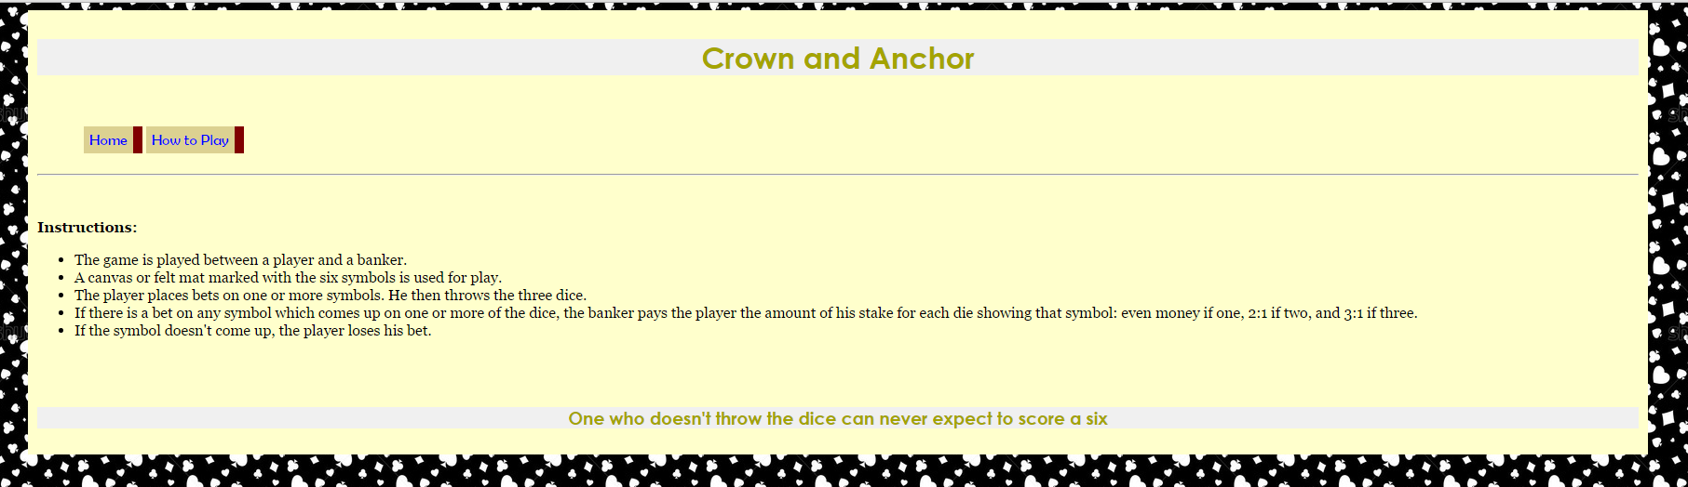
How to Play Screen

Slide 12

Any Questions?

Slide 13


