Slide 1
PACMAN ARCADE (CS101)
Soham Gaunekar (Team Leader) 140110001
Nisarg Bhushan Gagrani 140110021
Soumya Nimodiya 140110051
Aditya Kumawat 140110070

Slide 2
PROBLEM STATEMENT
Goal 1: To have a hands-on understanding of the basic functionalities of Allegro 5.

Slide 3
Goal 2: To generate an animated hero (Pacman) responding to user input (arrow keys or WASD).

Slide 4
Goal 3: To create a map and have the animated sprites responding to the boundaries.

Slide 5
Goal 4: Addition of automated Ghost movements running in 2 different modes: Chase and Frighten.

Slide 6
CHALLENGES
Animation of each individual sprite (Pacman & Ghosts).
Overcome: defining an enumerator for direction and creating sprite sheets dependent on this direction.

Slide 7
Confining the animated sprites within the maze boundaries.
Overcome: representing the entire maze in a 2D matrix with each element being a 20x20 pixel tile having binary values signifying allowed path or boundary walls.

Slide 8
Automating ghost movement.
Special functions have been defined in the sprite class. An enumerator for sprite identity has also been described to differentiate between a ghost and hero. Move(), junction() and turn() functions have been defined to control ghost movement. These have been comprehensively documented in the documentation pdf.

Slide 9
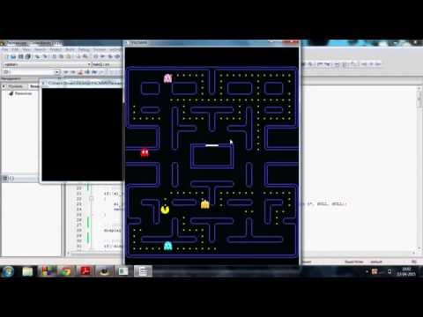
PROJECT VIDEO

Slide 10


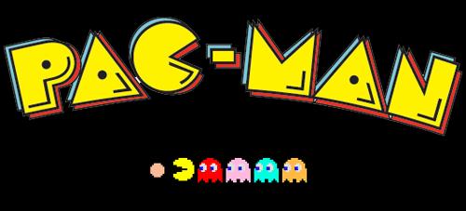

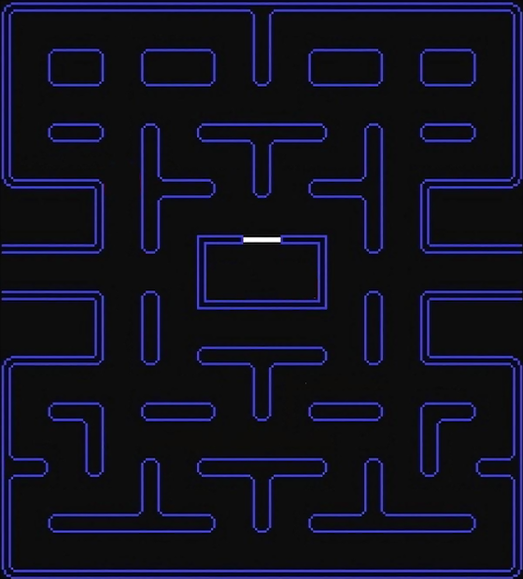



PROJECT SPRITE SHEETS
Frightened Sprites
Pacman Maze
Opening Logo
Pacman Spritesheet
Ghost Spritesheets

Slide 11
FUTURE WORK
Random maze generator can be added to increase the number of levels. Such random generators can be incorporated into real world applications such as Google Maps

Slide 12
Algorithms such as A* or DFS can be incorporated to expand Ghost movement modes from 2 to 3 (namely Chase, Scatter and Frighten). A* is commonly used for the common pathfinding problem in applications such as games, but was originally designed as a general graph traversal algorithm.

