Slide 1
Test-Driven & Behavior-Driven Development
July 27 2018
DotNet User Group

Slide 2
What are Tests in general
Express the expected behaviour before writing code.
  Code proven to meet requirements
  Lesser debug time
  Tests become Safety Net
  Eliminate Bugs
  Rhythm of Success

Slide 3
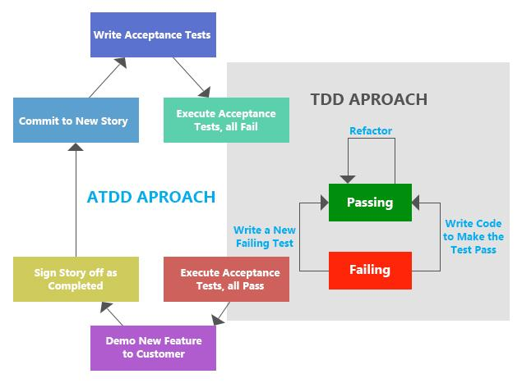
Test-Driven Development Flow
First the developer writes some tests.
The developer then runs those tests and (obviously) they fail because none of those features are actually implemented.
Next the developer actually implements those tests in code.
If the developer writes their code well, then the in next stage they will see that their tests pass.
The developer can then refactor their code, add comments and clean it up, as they wish because the developer knows that if the new code breaks something, then the tests will be an alert by failing.

Slide 4
Why Behavior-Driven Development?
Behavior-Driven Development (BDD) is a technique that operates at a slightly higher level than TDD while still following the basic principle of writing the test, then coding to pass the test.
In contrast to TDD, BDD is when we write behavior & specification that then drives our software development.
BDD also meant to eliminate issues that TDD might cause.
(https://sqa.stackexchange.com/questions/15263/exactly-how-are-bdd-tdd-atdd-kanban-and-scrum-different-from-a-waterfall-appr)

Slide 5
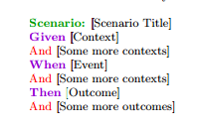
Scenarios
GIVEN, an initial context
WHEN, occurrence of an event
THEN, expected outcome
Parameters in Quotes, " "
Connectives - And and Not (only in then condition)

Slide 6
Simple Unit Test (Calculator.feature)
Feature: Calculator
In order to avoid silly mistakes
As a math idiot
I want to be told the sum of two numbers
@CalcTag
Scenario: Add two numbers
Given I have entered 50 into the calculator
And I have also entered 70 into the calculator
When I press add
Then the result should be 120 on the screen

Slide 7
Sample BDD (BrowserTest.feature)
Feature: Login Action
Scenario: Successful Login with Valid Credentials and Logout
Given User is on "http://www.store.demoqa.com"
When User Navigate to LogIn Page "http://store.demoqa.com/products-page/your-account/"
And User enters UserName and Password
Then Message displayed Login Successfully
When User LogOut from the Application
Then Message displayed LogOut Successfully

Slide 8
Sample Unit Test - Javascript (Javascript-UNIT/SimpleCalculator_Tests.js)
/// <reference path="../jasmine/jasmine.js" />
/// <reference path="SimpleCalculator.js" />
describe("SimpleMath_Test", function () {
var sc = new SimpleCalculator();
  it("sum_test", function () {
    var num1 = 5;
    var num2 = 6;
    var expected = 14;
    var actual = sc.sum(num1, num2);
    expect(actual).toBe(expected);
  });
  it("square_test", function () {
    var num1 = 5;
    var expected = 25;
    var actual = sc.square(num1);
    expect(actual).toBe(expected);
  });
});

Slide 9
Tools will be used for Demo today
Visual Studio 2015
  Extension and Updates
    Specflow for Visual Studio 2015
    Chutzpah Test Adapter for the Test Explorer
  NuGet Package Manager
    Nunit
    NUnit3TestAdapter
    Selenium.WebDriver
    Selenium.Support
    Selenium.Chrome.WebDriver
    Selenium.WebDriver.IEDriver
    SpecFlow
    SpecRun.SpecFlow
    SpecRun.Runner (free trial version to get nice html report)
    Jasmine

Slide 10
Reference
http://www.dotnetcurry.com/patterns-practices/1375/behavior-driven-development-bdd
https://saucelabs.com/resources/articles/getting-started-with-webdriver-in-c-using-visual-studio
http://toolsqa.com/selenium-webdriver/c-sharp/set-up-project-for-selenium-automation-framework-in-csharp/
https://www.webagesolutions.com/blog/archives/1540

Slide 11
Questions?

