Slide 1
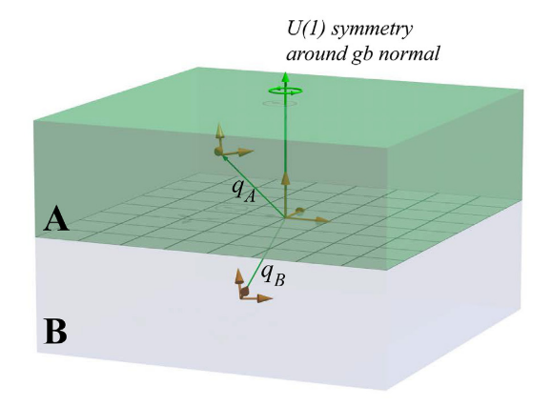
z
q_{L}

Slide 2


