Slide 1

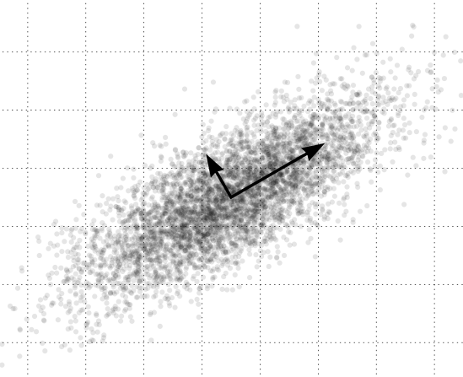
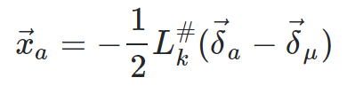

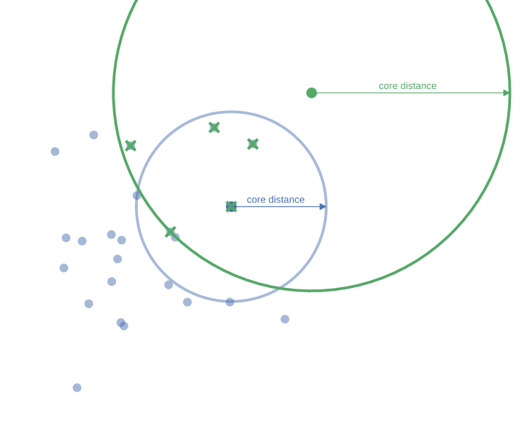
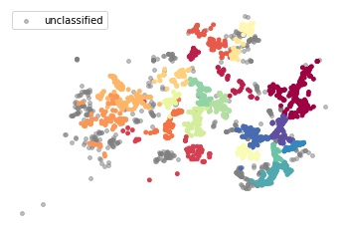

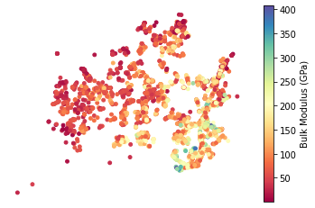
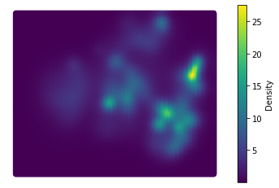
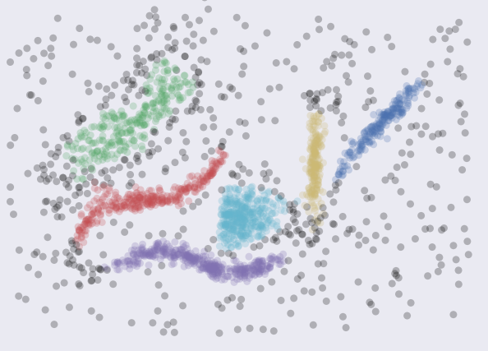
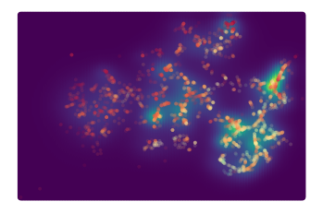
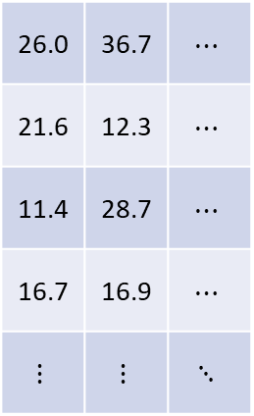
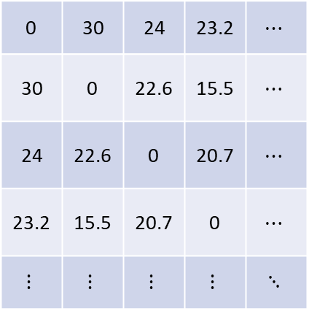
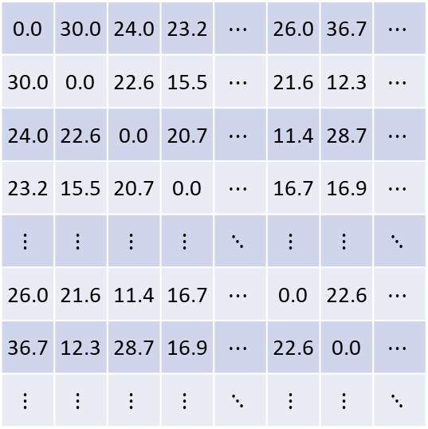
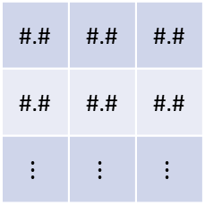
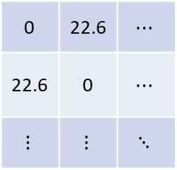
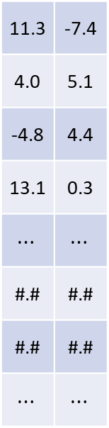
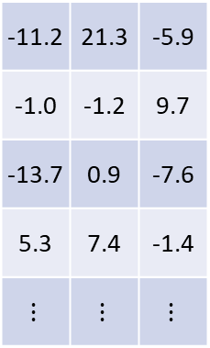
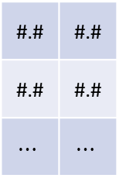
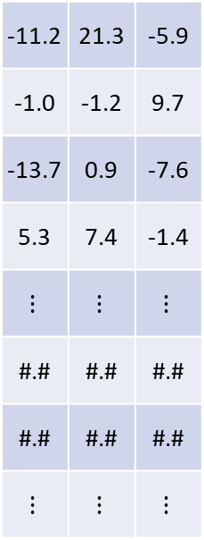
Train
Validation
Data
Formula | Target
Zr1 | 95.2185
K2Mg5Sn3 | 21.9926
C1In1La3 | 56.1611
Al3B2Ru4 | 253.761
… | …
Formula | Target
As1Pu1 | 87.2611
B6Ba1 | 143.861
… | …
Train
Formula | Target
Zr1 | 95.2185
K2Mg5Sn3 | 21.9926
C1In1La3 | 56.1611
Al3B2Ru4 | 253.761
… | …
As1Pu1 | 87.2611
B6Ba1 | 143.861
… | …
Earth Mover’s Pairwise Distances
Validation
Earth Mover’s Pairwise Distances
Train
Validation
0 | 30 | 24 | 23.2 | $$⋯$$
30 | 0 | 22.6 | 15.5 | $$⋯$$
24 | 22.6 | 0 | 20.7 | $$⋯$$
23.2 | 15.5 | 20.7 | 0 | $$⋯$$
$$⋮$$ | $$⋮$$ | $$⋮$$ | $$⋮$$ | $$⋱$$
26.0 | 36.7 | $$⋯$$
21.6 | 12.3 | $$⋯$$
11.4 | 28.7 | $$⋯$$
16.7 | 16.9 | $$⋯$$
$$⋮$$ | $$⋮$$ | $$⋱$$
Train
Validation
PCA
Embedding
Train
Train
0.0 | 30.0 | 24.0 | 23.2 | $$⋯$$ | 26.0 | 36.7 | $$⋯$$
30.0 | 0.0 | 22.6 | 15.5 | $$⋯$$ | 21.6 | 12.3 | $$⋯$$
24.0 | 22.6 | 0.0 | 20.7 | $$⋯$$ | 11.4 | 28.7 | $$⋯$$
23.2 | 15.5 | 20.7 | 0.0 | $$⋯$$ | 16.7 | 16.9 | $$⋯$$
$$⋮$$ | $$⋮$$ | $$⋮$$ | $$⋮$$ | $$⋱$$ | $$⋮$$ | $$⋮$$ | $$⋱$$
26.0 | 21.6 | 11.4 | 16.7 | $$⋯$$ | 0.0 | 22.6 | $$⋯$$
36.7 | 12.3 | 28.7 | 16.9 | $$⋯$$ | 22.6 | 0.0 | $$⋯$$
$$⋮$$ | $$⋮$$ | $$⋮$$ | $$⋮$$ | $$⋱$$ | $$⋮$$ | $$⋮$$ | $$⋱$$
-11.2 | 21.3 | -5.9
-1.0 | -1.2 | 9.7
-13.7 | 0.9 | -7.6
5.3 | 7.4 | -1.4
$$⋮$$ | $$⋮$$ | $$⋮$$
#.# | #.# | #.#
#.# | #.# | #.#
$$⋮$$ | $$⋮$$ | $$⋮$$
Train
Train
cMDS
Validation
Project new point into cMDS space
stats.stackexchange.com/q/368331
Validation
,
Train cMDS Embedding
Validation cMDS Embedding
densMAP Embedding
-11.2 | 21.3 | -5.9
-1.0 | -1.2 | 9.7
-13.7 | 0.9 | -7.6
5.3 | 7.4 | -1.4
$$⋮$$ | $$⋮$$ | $$⋮$$
#.# | #.# | #.#
#.# | #.# | #.#
$$⋮$$ | $$⋮$$ | $$⋮$$
11.3 | -7.4
4.0 | 5.1
-4.8 | 4.4
13.1 | 0.3
$$⋯$$ | $$⋯$$
#.# | #.#
#.# | #.#
$$⋯$$ | $$⋯$$
Train
Validation
HDBSCAN*
Train densMAP Embedding
Validation densMAP Embedding
11.3 | -7.4
4.0 | 5.1
-4.8 | 4.4
13.1 | 0.3
#.# | #.#
#.# | #.#
$$⋯$$ | $$⋯$$
Validation
HDBSCAN*
Cluster via HDBSCAN*
0 | 22.6 | $$⋯$$
22.6 | 0 | $$⋯$$
$$⋮$$ | $$⋮$$ | $$⋱$$
**Still implementing, hence transparency**
Validation
Cluster via HDBSCAN*
Add Validation Points to Existing Clusters
Target Values
Density
+
Target Values
Density
High-target/Low-density Multi-objective Optimization
+
High-target/Low-density Multi-objective Optimization
https://en.wikipedia.org/wiki/Principal_component_analysis#/media/File:GaussianScatterPCA.svg
https://umap-learn.readthedocs.io/en/latest/#
Hargreaves, C. J.; Dyer, M. S.; Gaultois, M. W.; Kurlin, V. A.; Rosseinsky, M. J. The Earth Mover’s Distance as a Metric for the Space of Inorganic Compositions. Chem. Mater. 2020, 32 (24), 10610–10620. https://doi.org/10.1021/acs.chemmater.0c03381.

Slide 2
