Slide 1


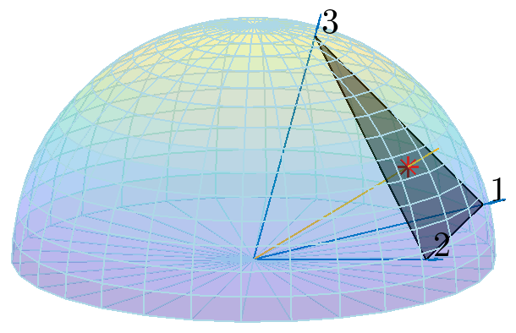
Degenerate Dimensions
Linear Projections
Intersection and Interpolation

Slide 2
