Slide 1
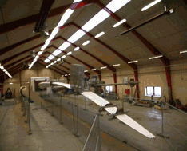
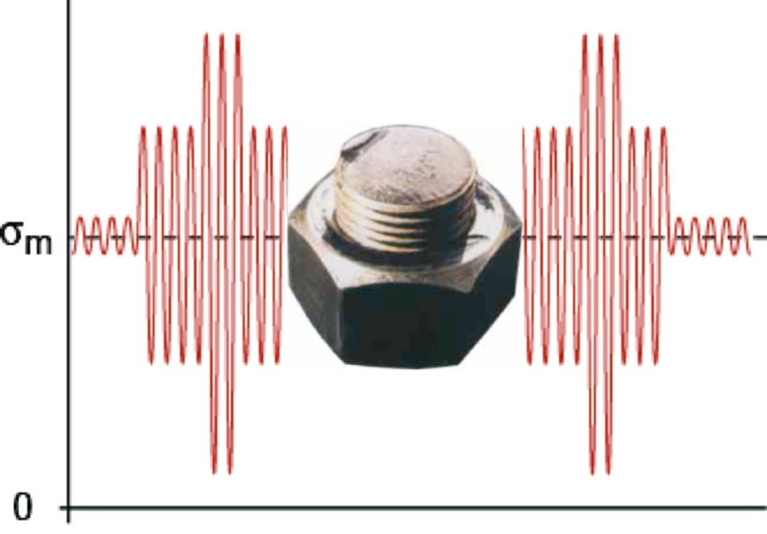
Fatigue of materials
Fatigue is failure due to cyclic loading. A microscopic crack can
initiate from a flaw in the material or surface scratch, grow to
a macroscopic size, and finally lead to complete failure of an
engineering component. If a relatively large flaw is present, the
fatigue life may be greatly reduced.
Notes:
Fatigue started from base of thread – stress concentrator

Slide 2
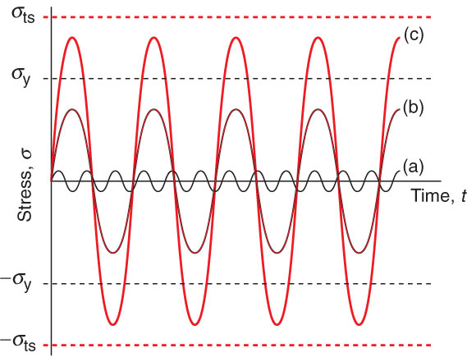
Types of Cyclic Loading
Low amplitude acoustic vibration
High-cycle fatigue: cycling below
the yield strength
(c) Low-cycle fatigue: cycling above
the yield strength but below the
the tensile strength
High-cycle fatigue loading is most significant in
engineering terms

Slide 3
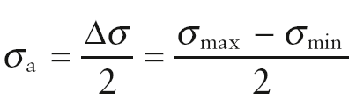
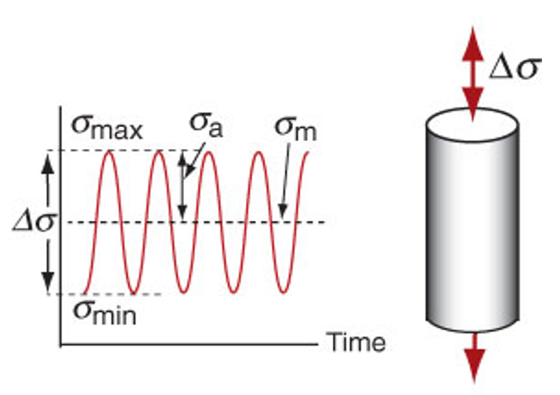
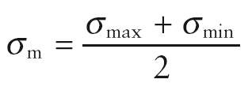
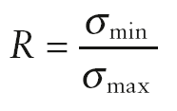
Cyclic loading

Slide 4
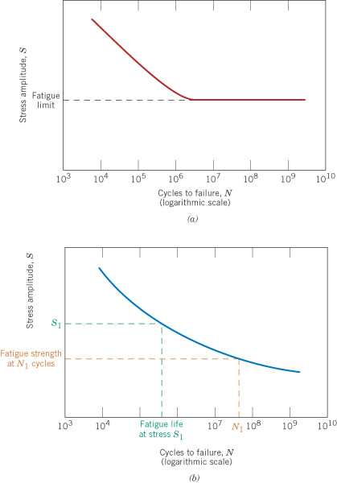
c09f25
Stress-life curves
from fatigue tests
Fatigue limit behavior,
as in some steels
No fatigue limit, as in
aluminum alloys

Slide 5
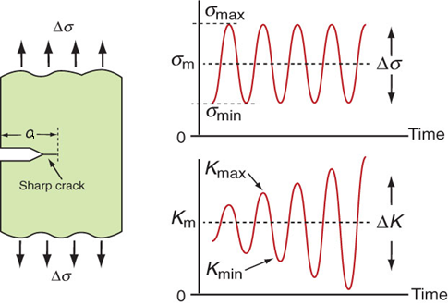

Fatigue Loading of Cracked Components
Fatigue crack growth is studied by cyclically
loading specimens containing a sharp crack
Cyclic stress intensity range
The range ΔK increases
with time under constant
cyclic stress because the
crack grows in length

Slide 6
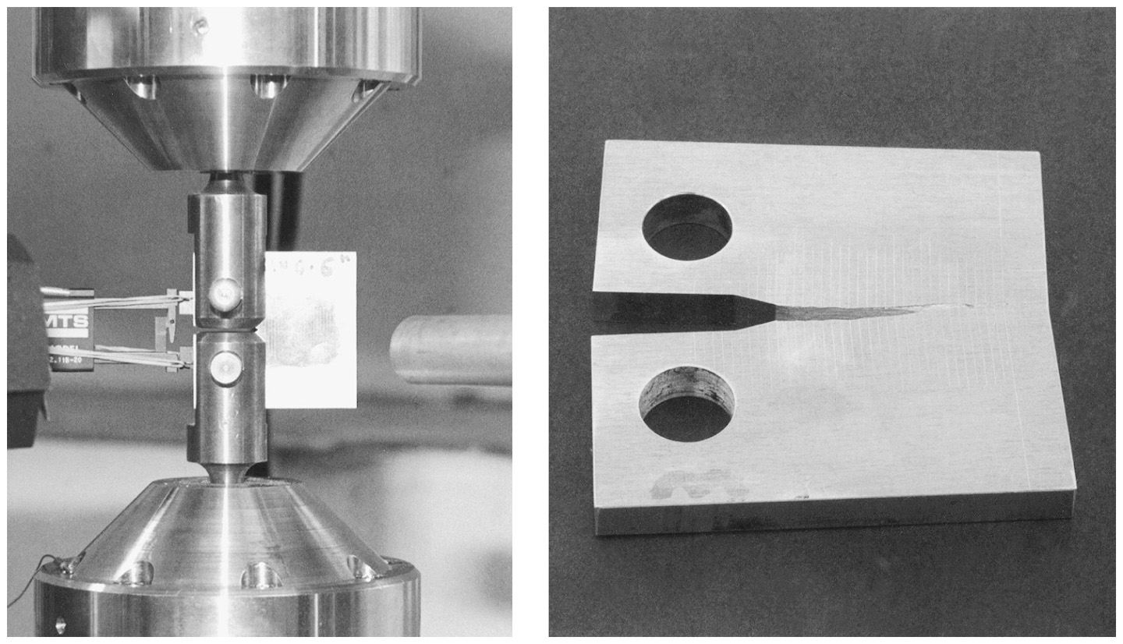
Fatigue crack growth rate test
Cyclic loading is applied to a material sample so as to grow a crack, with
the increasing length of the crack being measured.
From: Mechanical Behavior of Materials: Engineering Methods for Deformation, Fracture, and Fatigue, 3rd edition, by Norman E. Dowling. ISBN 0-13-186312-6. © 2007 by Pearson Education, Inc., Upper Saddle River, NJ. All rights reserved.
Notes:
Figure: 11-071-2

Slide 7
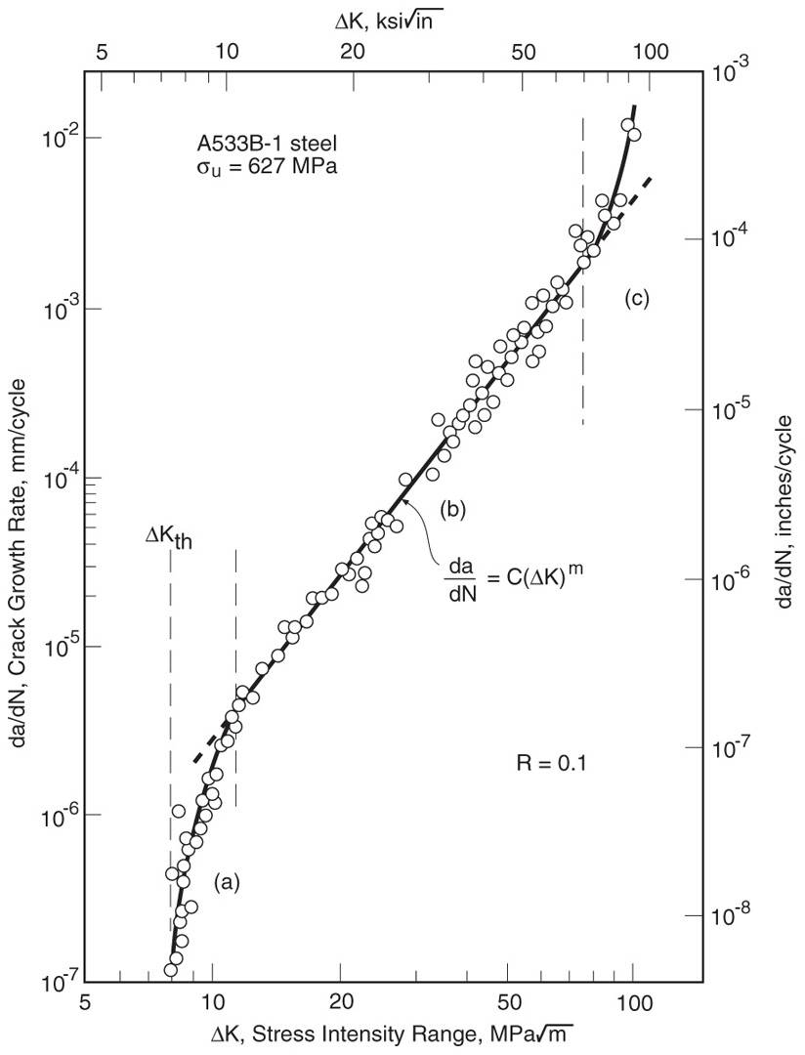
Crack growth behavior
When measured over a wide
range, crack growth rates da/dN
become very slow at low ΔK,
and at high ΔK transition to
unstable behavior due to the
beginning of brittle fracture or
gross yielding. A power
relationship applies except near
either extreme.
m ≈ 3 for metals
From: Mechanical Behavior of Materials: Engineering Methods for Deformation, Fracture, and Fatigue, 3rd edition, by Norman E. Dowling. ISBN 0-13-186312-6. © 2007 by Pearson Education, Inc., Upper Saddle River, NJ. All rights reserved.
Notes:
Figure: 11-03

Slide 8
Example Problem: A polystyrene ruler is loaded as a cantilever with a cyclic force that varies from 0 to 10 N.
What depth of transverse crack is needed at the base of the cantilever for fast fracture to occur when the end force is 10 N?
If the ruler has an initial transverse scratch of depth 0.1 mm, how many cycles of the force will it take before the ruler breaks?
For this problem assume n = 4 and C = 5 x 10⁻⁶ when Δσ is in MPa.

Slide 9
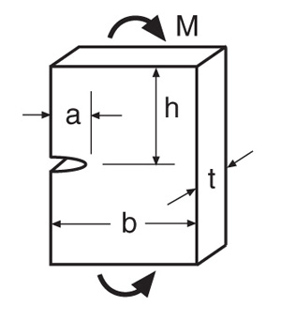
Single-edge-cracked plate in bending
From: Tada, H., P. C. Paris, and G. R. Irwin. 2000.
The Stress Analysis of Cracks Handbook, 3rd ed.,
ASME Press, American Society of Mechanical
Engineers, New York, NY.

Slide 10
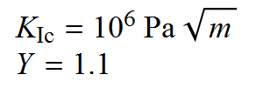



Example Problem: A polystyrene ruler is loaded as a cantilever with a cyclic force that varies from 0 to 10 N.
What depth of transverse crack is needed at the base of the cantilever for fast fracture to occur when the end force is 10 N?

Slide 11
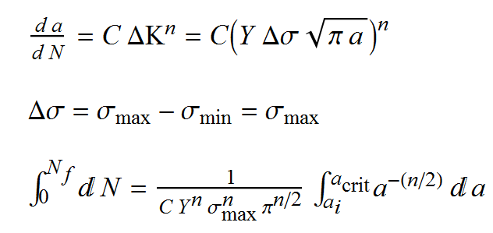
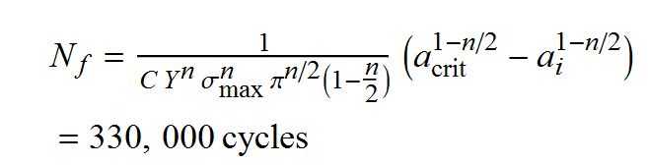
(b) If the ruler has an initial transverse scratch of depth 0.1 mm, how many cycles of the force will it take before the ruler breaks?
For this problem assume n = 4 and C = 5 x 10⁻⁶ when Δσ is in MPa.

Slide 12
Creep
Creep is deformation that proceeds gradually with time. Such behavior is more prevalent at higher temperatures. In crystalline
materials (metals and ceramics) it becomes significant above 0.3 to 0.6T_{m}, depending on the material, and it occurs in polymers at room temperature.
Creep rupture occurs when a material gradual tears apart as a result of excessive creep deformation.

Slide 13
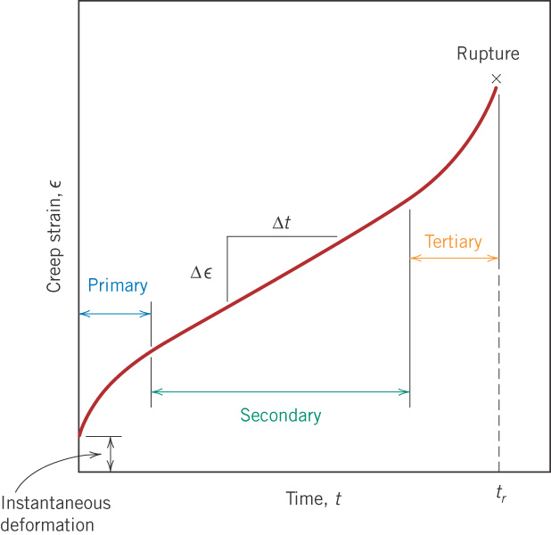
c09f35
Stages of creep
In a creep test at a given temperature, stress is held constant and the increase in strain is measured.

Slide 14
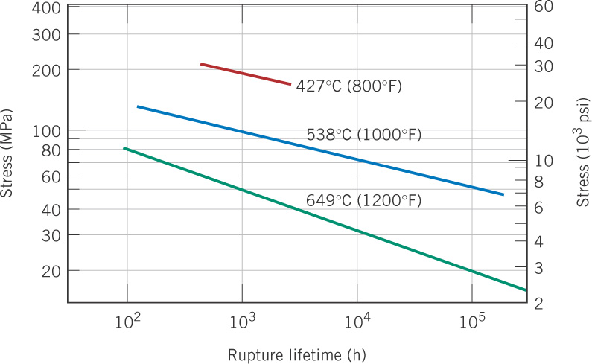
c09f37
Stress vs. rupture life curves
nickel alloy

Slide 15
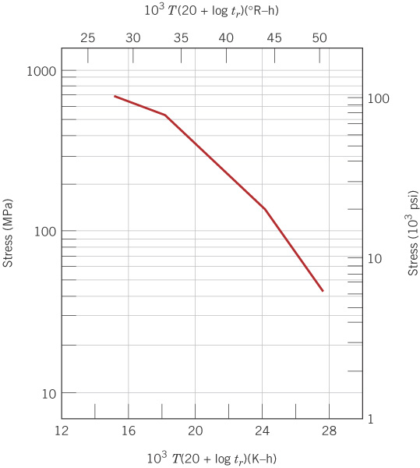
c09f39
Larsen-Miller plot
From tests done at various stresses σ and temperatures T, each giving a rupture time t_{r} , plot σ versus P_{LM}, where:
t_{r} in hours, σ in MPa,
T in kelvin, K = °C + 273
Horizontal scale:
P_{LM} = 12,000, 16,000, etc.

Slide 16
A Larsen-Miller parameter plot gives stress as a function of the quantity P_{LM} that combines temperature and rupture time into one variable. Given such a plot, if any two of t_{r} , σ, and T are known, the third one can be calculated.
t_{r} in hours, σ in MPa, T in Kelvin, K = °C + 273
Rather than reading a graph, it is convenient to fit the data to a
polynomial as follows

Slide 17
Example fitted data
C, log (h) | b₀ | b₁ | b₂ | b₃
17 | 38,405 | −8206 | 0 | 0

Slide 18
Another example
C, log (h) | b₀ | b₁ | b₂ | b₃
20 | 116,400 | −120,500 | 53,460 | −8,188

Slide 19
Design Example 9.2
Alloy S-590 is subjected to a stress of 140 MPa at 800°C. Estimate the time to creep rupture.
Solution: Use the data fit just given to calculate the P_{LM} value for the given stress, and from this and the given temperature, calculate the rupture time.
C, log (h) | b₀ | b₁ | b₂ | b₃
17 | 38,405 | −8206 | 0 | 0

