Slide 1
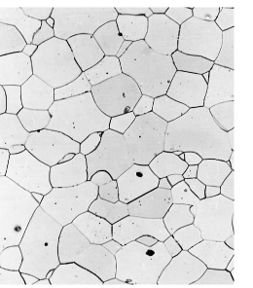
Previously we only discussed homogeneous materials (solid solutions / single phase materials)
Example:
Fe-C alloy
A small amount of C was soluble in the Fe lattice.
Only 1 phase.
Now we discuss, heterogeneous solids / mixtures of solid solutions. We have exceeded the solubility limit and now have more than one phase

Slide 2
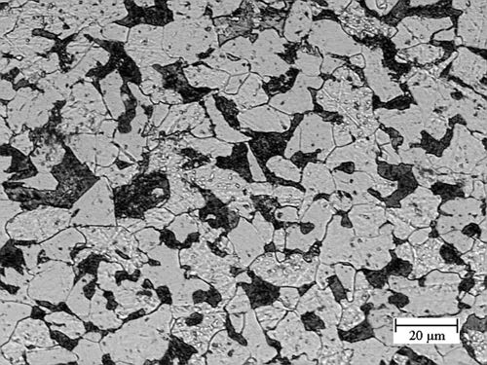
Now we discuss, heterogeneous solids (more than one solid solution i.e. phases). We have exceeded the solubility limit and now have more than one phase. Consider Fe-C alloy.
Carbon < 0.022 wt%
Carbon > 0.022 wt%
Carbon ~ 0.022 wt%
Carbon ~ 6.7 wt%

Slide 3
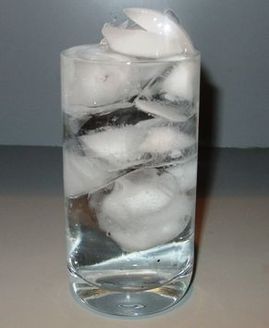
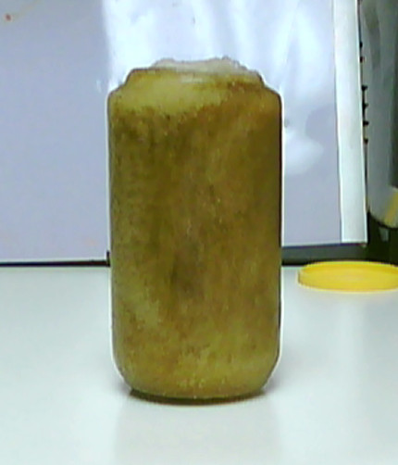
Phases
Phase: Homogenous portion of material with uniform physical and chemical characteristics - not generally a pure substance, often a liquid solution or solid solution. Example: syrup
Component: Pure element or compound: H₂O and C₁₂H₂₂O₁₁

Slide 4
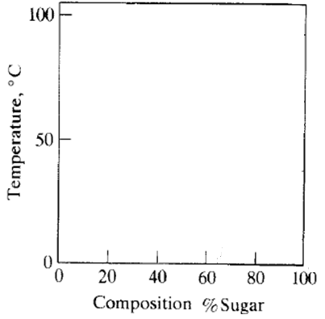
Let’s add sugar to water at 50 C

Slide 5
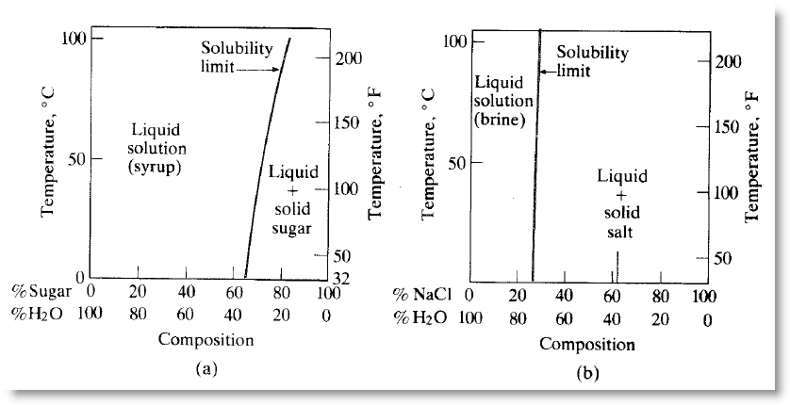
Solubility Limits
Solubility limit: Line on a phase diagram separating complete solubility (single phase) and incomplete solubility (two-phase) regions.

Slide 6
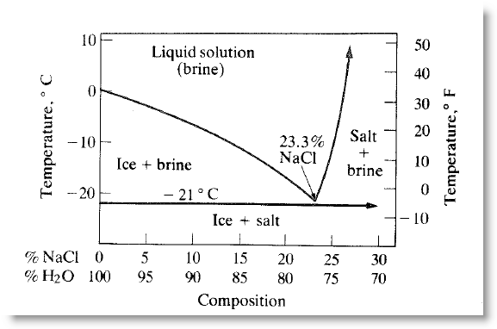
Diagram of Phases
Homogeneous material (solution or single phase)
Heterogeneous material (mixture of two phases)

Slide 7
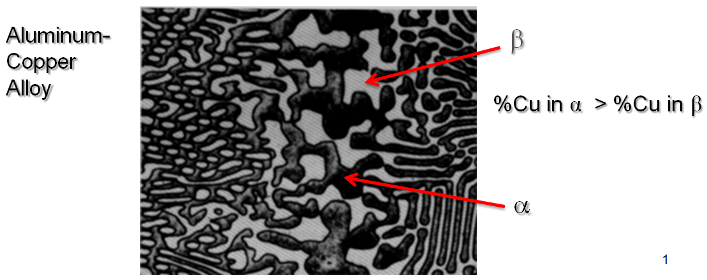
Solubility of Cu in Al exceeded
Heterogeneous material (mixture of two phases):
Phases here are “solid solutions”
Terms to know:
Identify the Components vs Phases above

Slide 8
Phase Diagram Examples

Slide 9
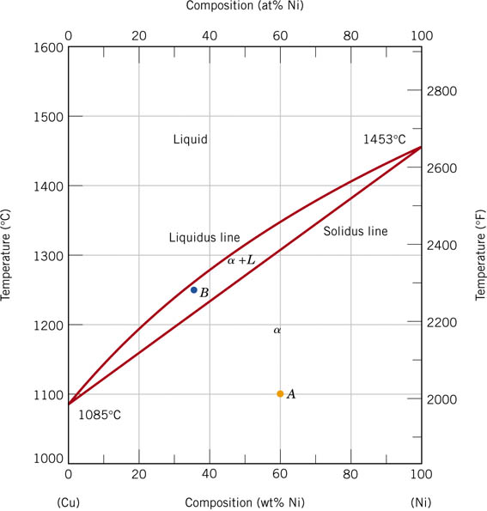

Slide 10
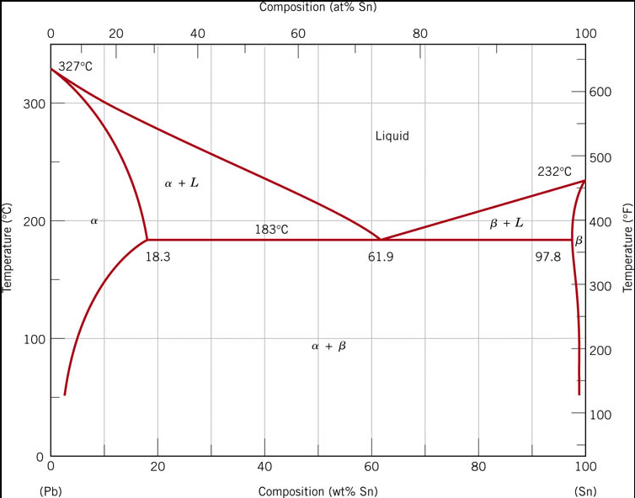

Slide 11
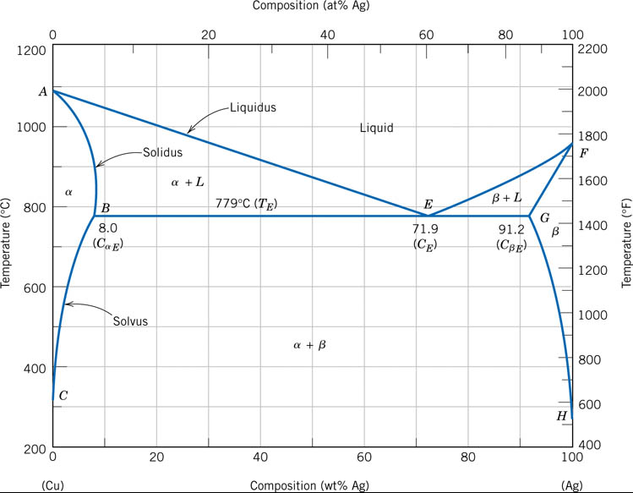

Slide 12
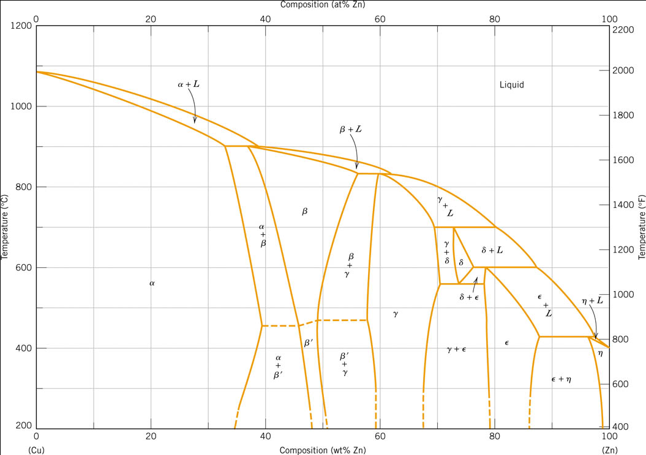

Slide 13
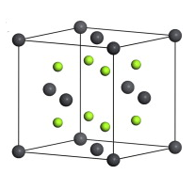
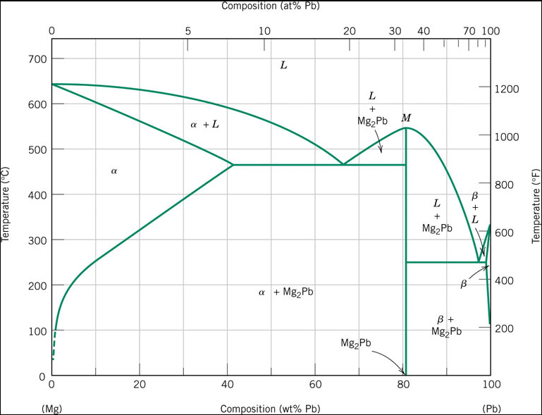

Slide 14
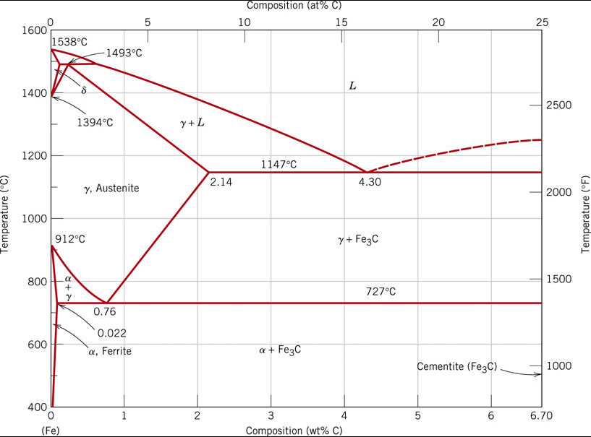

Slide 15
Phase Diagrams: Review of Terminology
Terminology:
Solid Solution
Mixture
Solubility Limit
Component
Phase
Solidus
Liquidus
Solvus
Eutectic
Isomorphous

Slide 17
Let’s consider a 35wt% Ni – 65wt% Cu alloy at three temperatures: (a) 1300 C, (b) 1250 C, and (c) 1190 C
Identify for each temperature:
Phases Present
Composition of each phase present
Fraction of each phase present

Slide 18
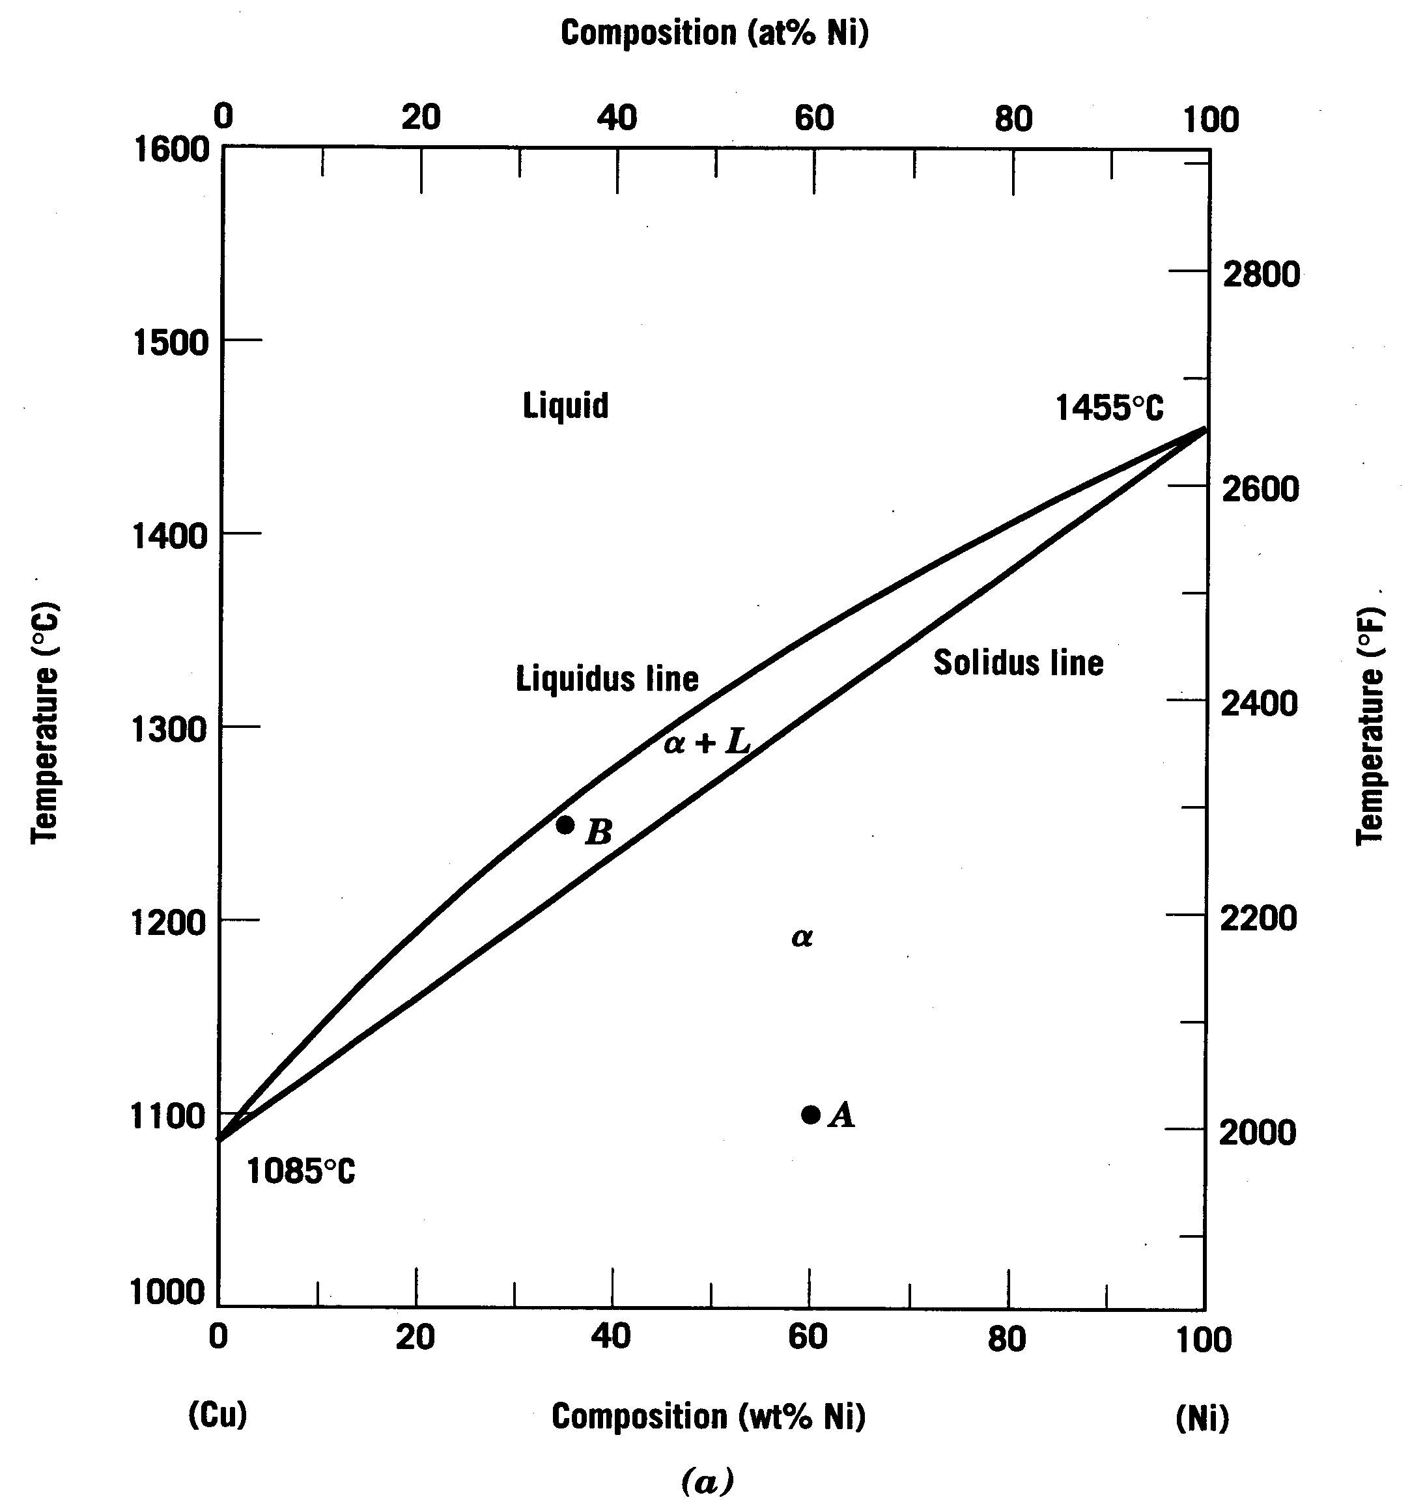
Consider: Cu-Ni phase diagram
Example of a Binary Isomorphous Phase Diagram
Let’s look at this region

Slide 19
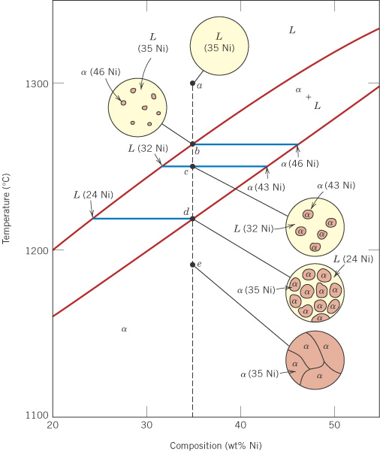
c10f04
Consider a 35wt% Ni alloy
1300°C
Components: Cu and Ni.
1. Phases present for 35% Ni at various temperatures:
At 1300°C (a) there is one phase: liquid solution, L.
At 1250°C (c) there are two phases: (1) solid solution α, (2) liquid solution L.
At 1190°C (e) there is one phase: solid solution, α.
1250°C
1190°C
 Cu
Ni 

Slide 20
c10f04
2. Phase compositions
At (a) 100% liquid solution, L
At (c), for the two phases, from the tie line:
(1) L is 32% Ni
(2) α is 43% Ni
At (e) 100% solid solution, α
1260°C
1220°C
Also:
At 1260°C (b) the first solid phase α forms.
At 1220°C (d) the last remaining liquid solidifies.
 Cu
Ni 

Slide 21
c10f04
3. Mass (weight) fractions
At (a) and (b): W_{L} = 1.00
At (d) and (e): W_{α} = 1.00
At (c), for the two phases,
L (32% Ni) and α (43% Ni):
32
43
 Cu
Ni 

Slide 22
c10f04
3. Mass (weight) fractions
At (a) and (b): W_{L} = 1.00
At (d) and (e): W_{α} = 1.00
At (c), for the two phases,
L (32% Ni) and α (43% Ni):
0.27
0.73
L
32
35
α
43
 Cu
Ni 
Notes:
WL = 0.73
Walpha = 0.27

Slide 23
c10f04
3. Mass (weight) fractions
At (a) and (b): W_{L} = 1.00
At (d) and (e): W_{α} = 1.00
At (c), for the two phases,
L (32% Ni) and α (43% Ni):
R
S
L
32
(c)
35
α
43
%Ni
 Cu
Ni 
Notes:
For handout

Slide 24
Summary questions on phase diagrams (so far):
At a given temperature and composition, what are the:
• Phases present?
• Phase compositions?
• Weight fractions (phase amounts / phase fractions)?
• Sketch the microstructure?
For a given composition, for cooling from liquid:
• At what temperature does the first solid phase form, and what is its composition?
• At what temperature does the last liquid phase solidify, and what is its composition?

