Slide 1
Let’s consider a 35wt% Ni – 65wt% Cu alloy at three temperatures: (a) 1300 C, (b) 1250 C, and (c) 1190 C
Identify for each temperature:
Phases Present
Composition of each phase present
Fraction of each phase present

Slide 2
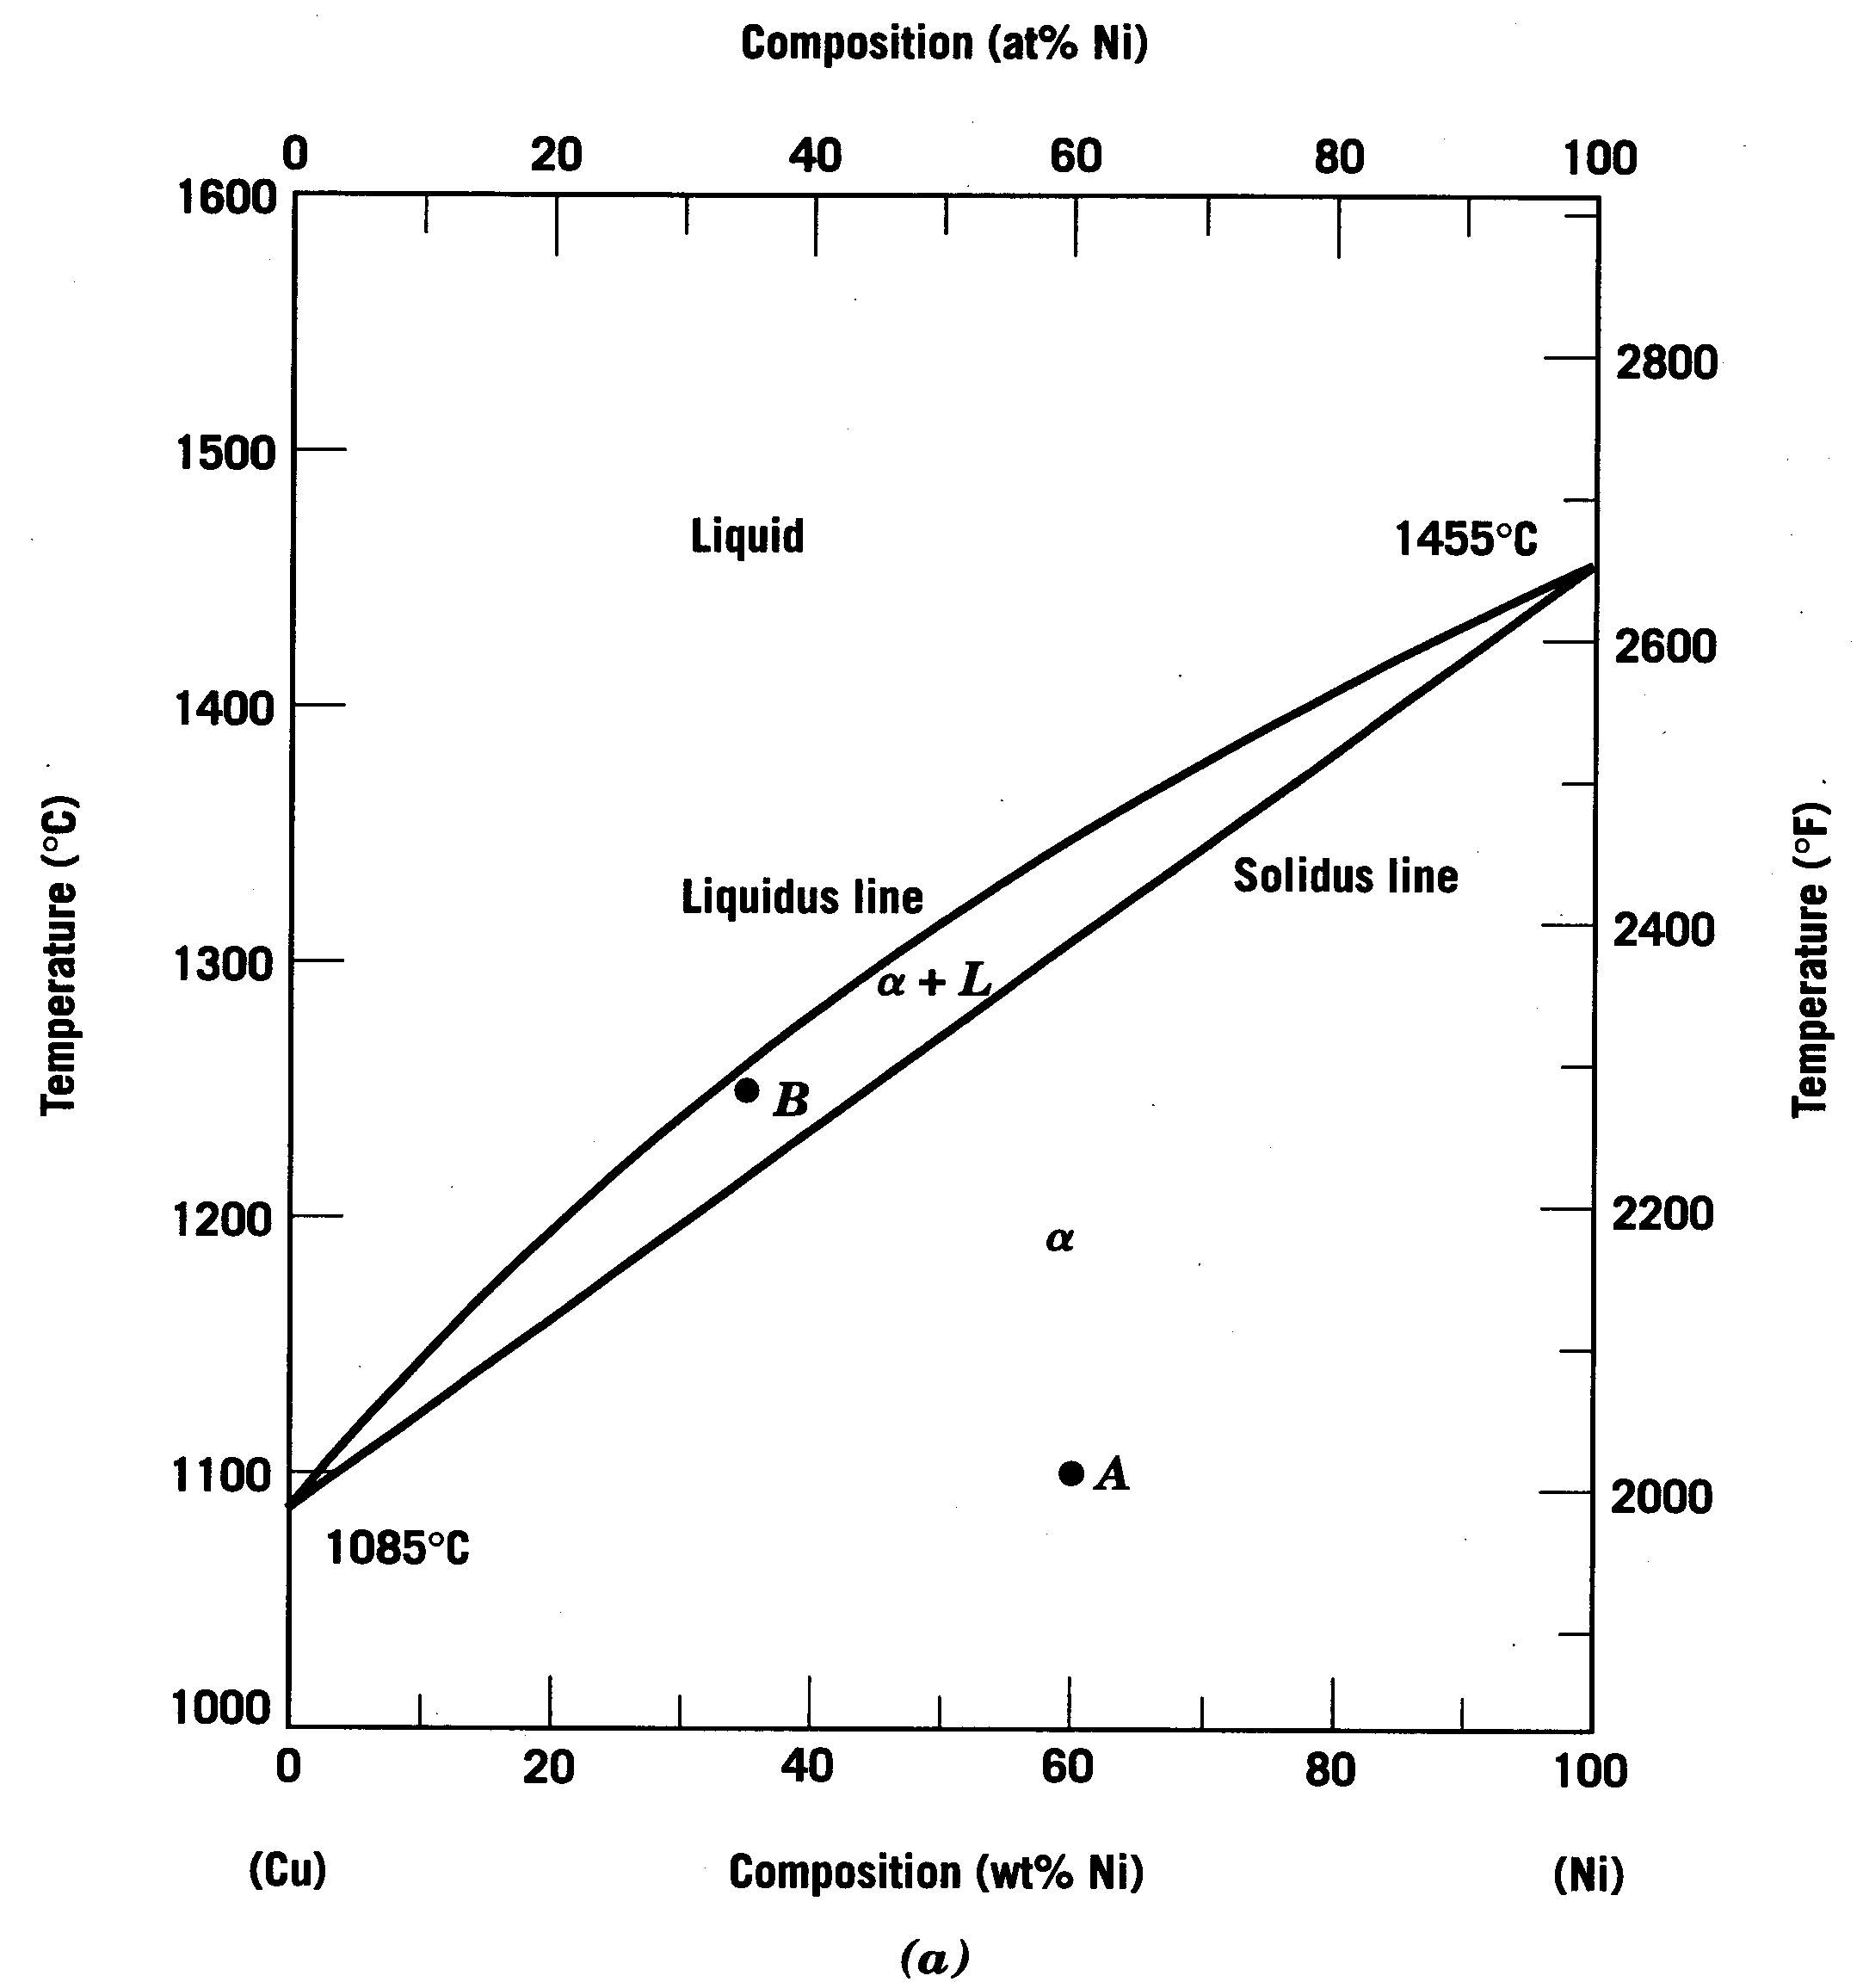
Consider: Cu-Ni phase diagram
Example of a Binary Isomorphous Phase Diagram
Let’s look at this region

Slide 3
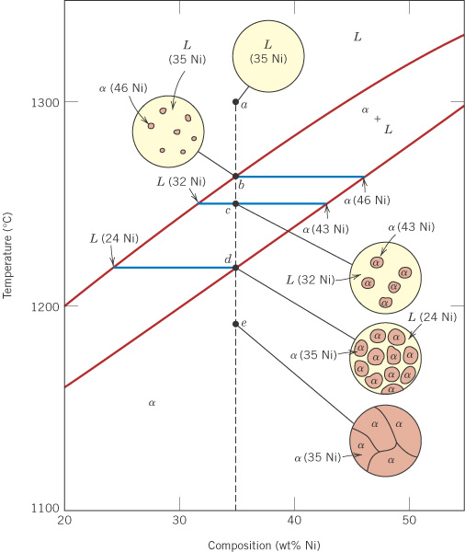
c10f04
Consider a 35wt% Ni alloy
1300°C
Components: Cu and Ni.
1. Phases present for 35% Ni at various temperatures:
At 1300°C (a) there is one phase: liquid solution, L.
At 1250°C (c) there are two phases: (1) solid solution α, (2) liquid solution L.
At 1190°C (e) there is one phase: solid solution, α.
1250°C
1190°C
 Cu
Ni 

Slide 4
c10f04
2. Phase compositions
At (a) 100% liquid solution, L
At (c), for the two phases, from the tie line:
(1) L is 32% Ni
(2) α is 43% Ni
At (e) 100% solid solution, α
1260°C
1220°C
Also:
At 1260°C (b) the first solid phase α forms.
At 1220°C (d) the last remaining liquid solidifies.
 Cu
Ni 

Slide 5
c10f04
3. Mass (weight) fractions
At (a) and (b): W_{L} = 1.00
At (d) and (e): W_{α} = 1.00
At (c), for the two phases,
L (32% Ni) and α (43% Ni):
32
43
 Cu
Ni 

Slide 6
c10f04
3. Mass (weight) fractions
At (a) and (b): W_{L} = 1.00
At (d) and (e): W_{α} = 1.00
At (c), for the two phases,
L (32% Ni) and α (43% Ni):
0.27
0.73
L
32
35
α
43
 Cu
Ni 
Notes:
WL = 0.73
Walpha = 0.27

Slide 7
c10f04
3. Mass (weight) fractions
At (a) and (b): W_{L} = 1.00
At (d) and (e): W_{α} = 1.00
At (c), for the two phases,
L (32% Ni) and α (43% Ni):
R
S
L
32
(c)
35
α
43
%Ni
 Cu
Ni 

Slide 8
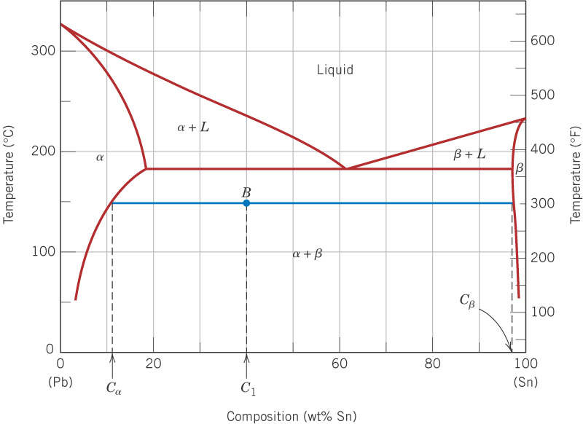
c10f09
Examples 9.2 and 9.3(a)
For 40 wt% Sn - 60 wt% Pb
at 150°C, find:
Phases present:
(1) α is Pb-rich SS
(2) β is Sn-rich SS
11
98
Phase compositions, wt%:
α has 11% Sn, 89% Pb
β has 98% Sn, 2% Pb
40
Weight (mass) fractions:

Slide 9
c10f09
Examples 9.2 and 9.3(a)
For 40 wt% Sn - 60 wt% Pb
at 150°C, find:
Phases present:
(1) α is Pb-rich SS
(2) β is Sn-rich SS
11
98
Phase compositions, wt%:
α has 11% Sn, 89% Pb
β has 98% Sn, 2% Pb
40
Weight (mass) fractions:
0.33
0.67
α
β
11
40
98

Slide 10
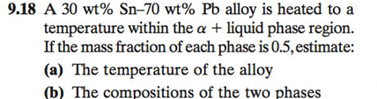
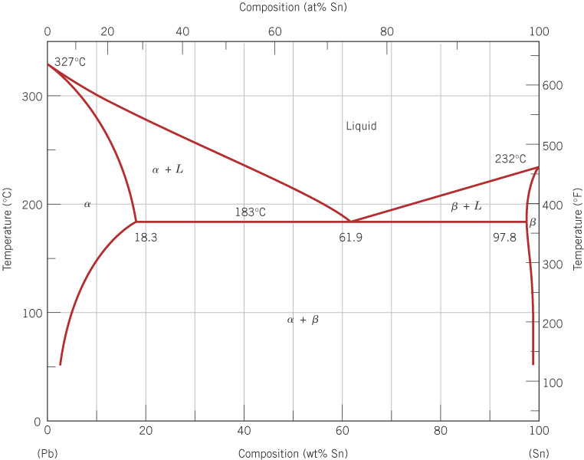

Slide 13
Microstructure

Slide 14
c10f08
Pb-Sn phase diagram – Let’s take a look at microstructure

Slide 15
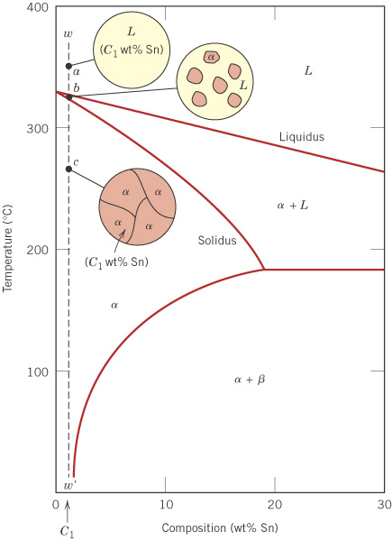
c10f11
Pb-Sn - single phase case
For a sufficiently small wt% Sn,
the solubility limit will never be
exceeded, so that a single phase alloy results.
Pb

Slide 16
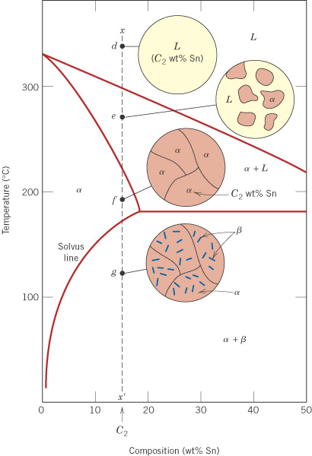
c10f12
Pb-Sn - simple
two-phase case
(no eutectic)
For larger wt% Sn, the solubility limit is exceeded on cooling, so that a two-phase material results.
Pb

Slide 17
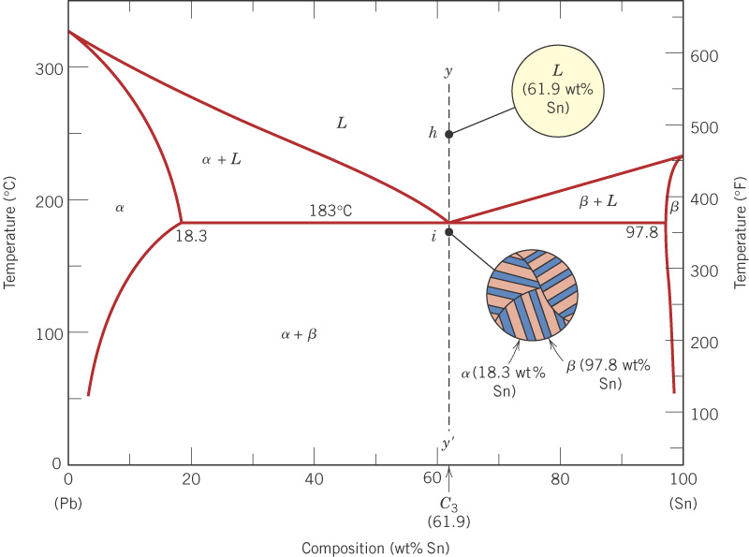
c10f13
Pb-Sn eutectic
For 61.9 wt% Sn, a layered eutectic structure is formed.
eutectic point
A
B
A-B is the eutectic line

Slide 18

c10f14
Pb-Sn eutectic
The dark areas are Pb-rich α solid solution, and the light areas are Sn-rich β solid solution.
375X

Slide 19
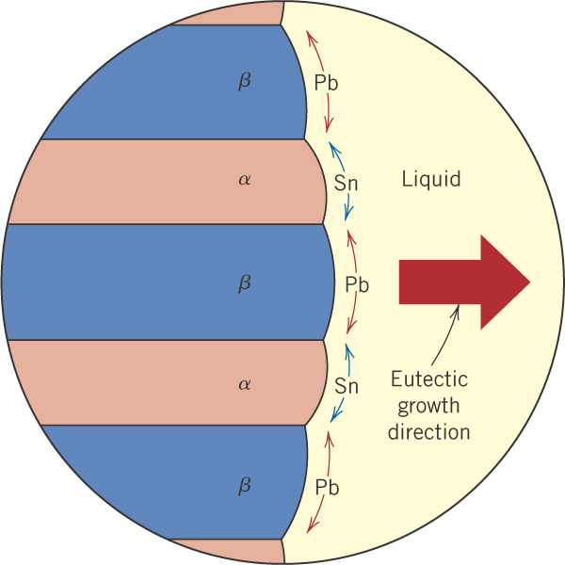
c10f15
Eutectic structure forms only from the liquid phase
82 wt% Pb
98 wt% Sn

Slide 20
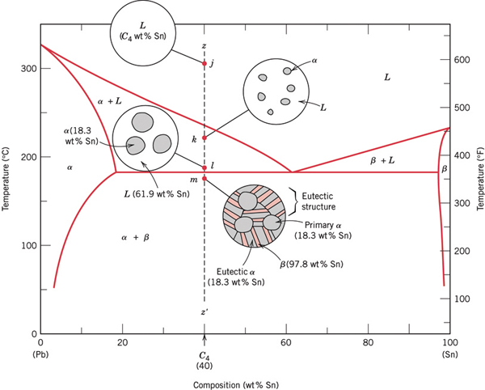
If we drop below 183 C, the L will transform into the eutectic structure, but we already have some α formed in the α + L region above 183 C.
Pb-Sn eutectic
plus primary α

Slide 21
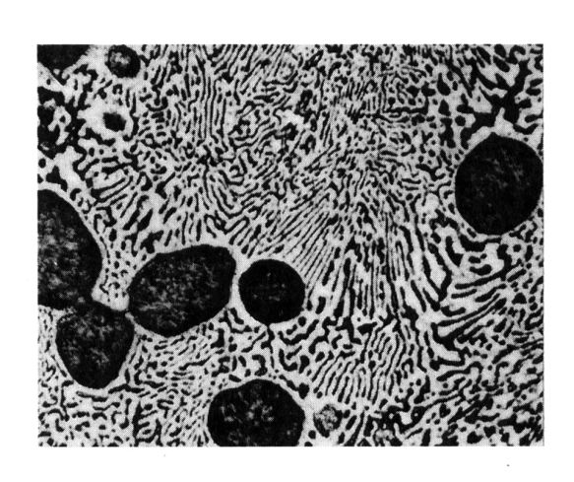
Pb-Sn eutectic
plus primary α
dark areas = Pb-rich α solid solution
light areas = Sn-rich β solid solution.
Eutectic α
dark
Eutectic β
α’
light
400X
Eutectic structure

Slide 22
Mass fractions of microconstituents – Eutectic System

Slide 23
Pb-Sn eutectic
plus primary α
dark areas = Pb-rich α solid solution
light areas = Sn-rich β solid solution.
Eutectic α
dark
Eutectic β
α’
light
400X
Eutectic structure

Slide 24
If we drop below 183 C, the L will transform into the eutectic structure, but we already have some α formed in the α + L region above 183 C.
Pb-Sn eutectic
plus primary α

Slide 25
Calculation of fractions of alpha & beta in final microstructure

Slide 26
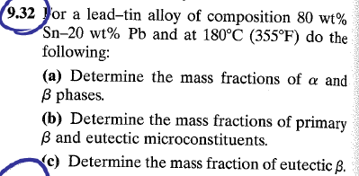
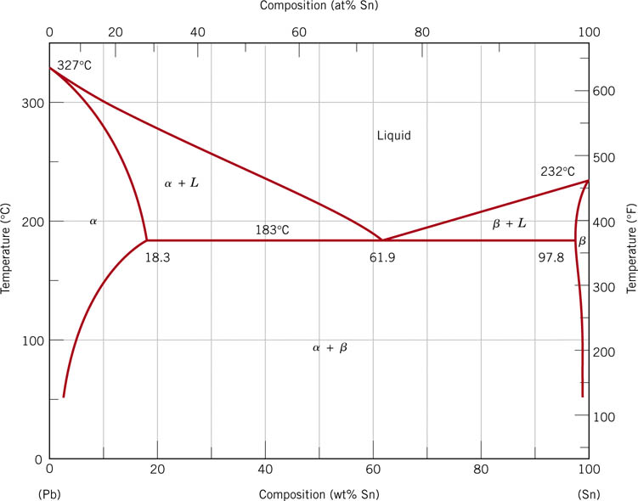
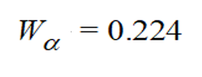
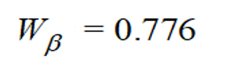




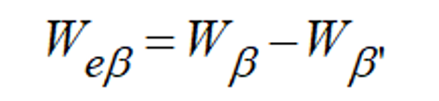

See if you can repeat the calculations for a composition greater than 61.9 wt%
Answers:

Slide 27
The End

