Slide 1
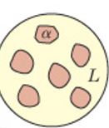
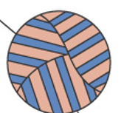
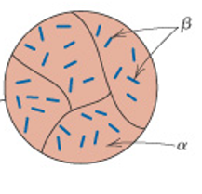
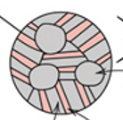
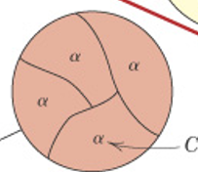



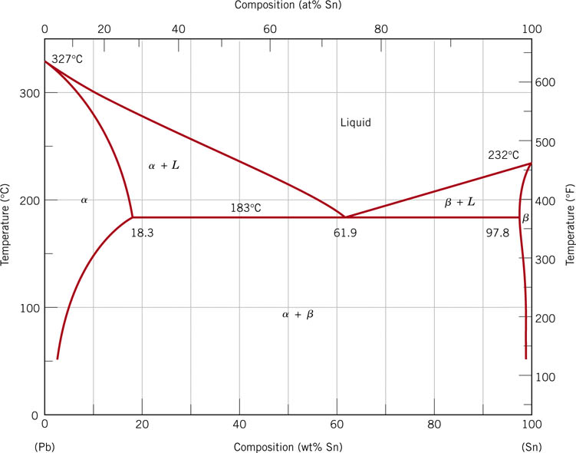
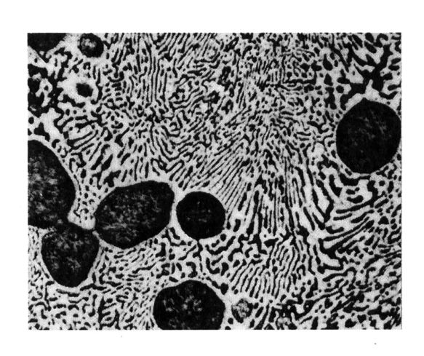

Slide 4
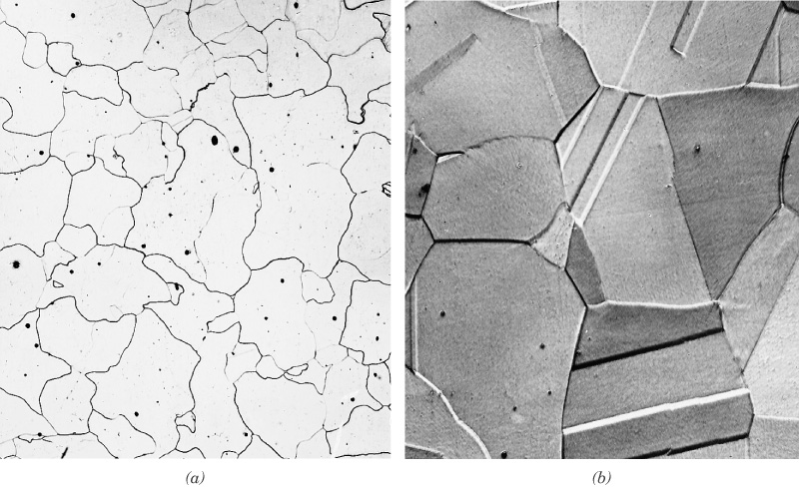
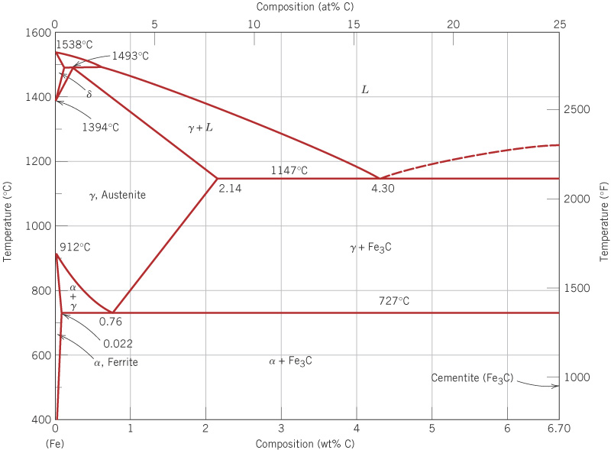
c10f28
Iron - iron carbide (Fe - Fe₃C) phase diagram
BCC
eutectic pt.
FCC
eutectoid pt.
BCC

Slide 5
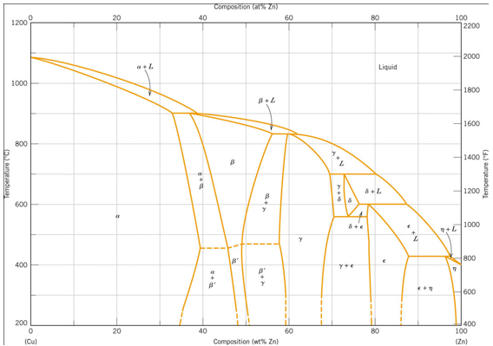

Slide 6
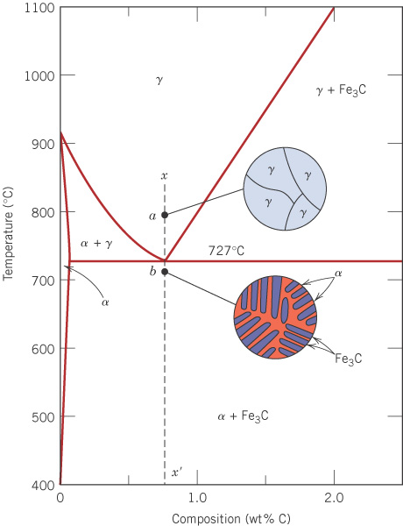
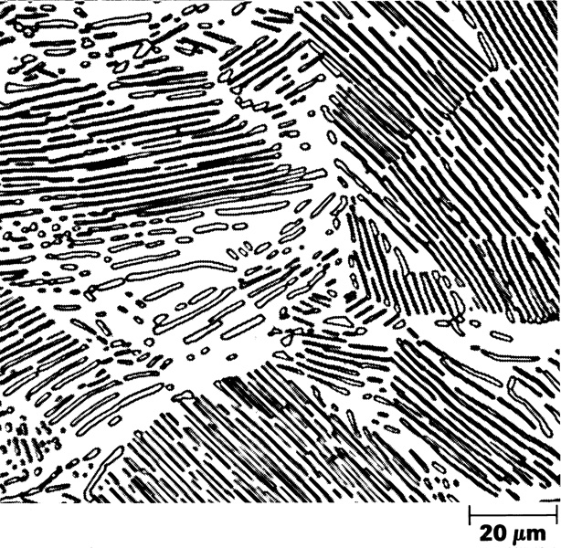
c10f30
Eutectoid structure
Slowly cool 0.76 wt% C steel from the γ region.
0.76 wt% C
α + Fe₃C eutectoid
- called pearlite
Fe

Slide 7
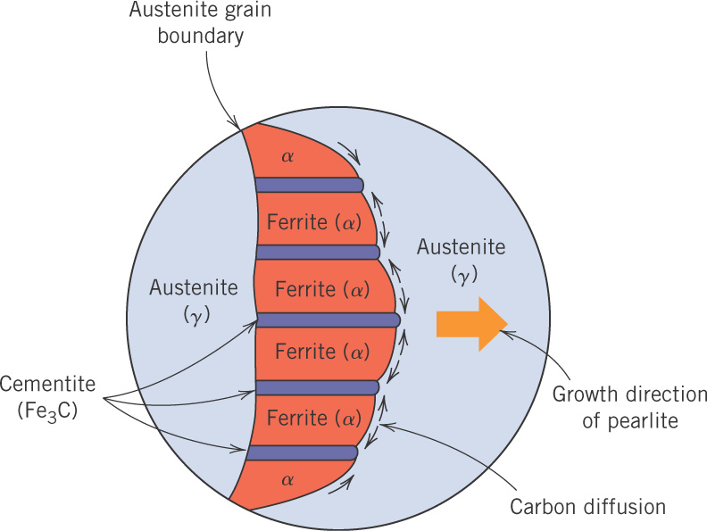
c10f32
Eutectoid formation

Slide 8
c10f31
Nomenclature
Ferrite: α-iron, BCC structure (magnetic)
Austenite: γ-iron, FCC structure (nonmagnetic)
δ ferrite: also BCC
Cementite: iron carbide, Fe₃C (6.7 wt% C)
Pearlite: α + Fe₃C eutectoid (0.76 wt% C)
Iron: < 0.008 wt% C
Steel: 0.008 to 2.1 wt% C, usually < 1%
Cast Iron: ~ 4.5 wt% C

Slide 9
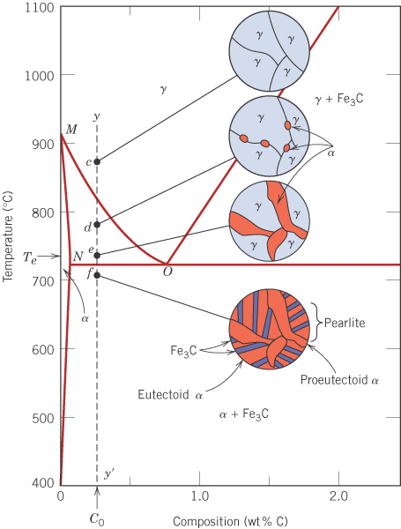
c10f33
Hypoeutectoid steels
(ferrite-pearlite steels)
0.022 to 0.76 wt% C
Slow cooling from the γ region gives a structure of pearlite (eutectoid) plus ferrite (proeutectoid α).
0.76

Slide 10
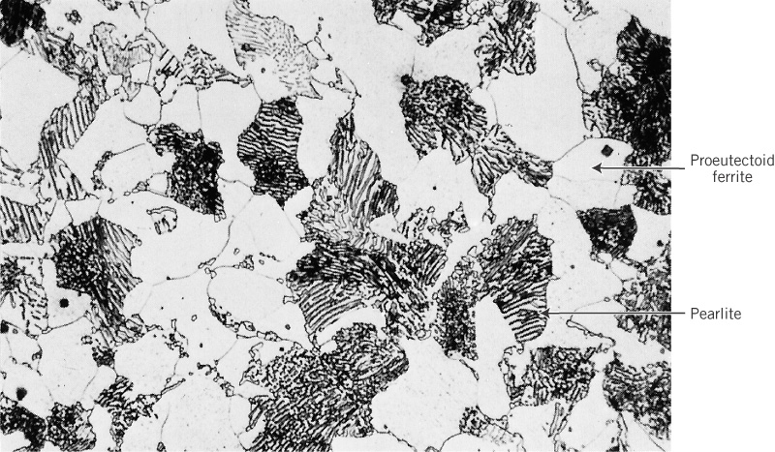
c10f34
Ferrite-pearlite steel structure (0.38 wt% C)
635X

Slide 11
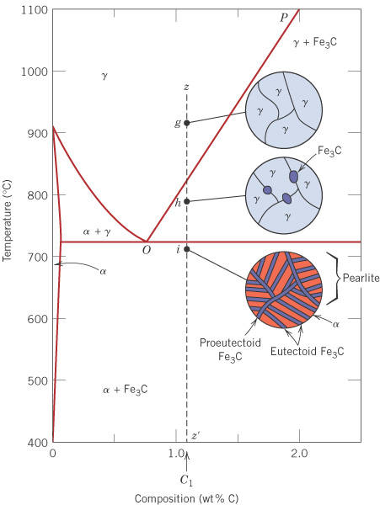
c10f36
Hypereutectoid steels
(pearlite-cementite steels)
0.76 to 2.14 wt% C
Slow cooling from the γ region gives a structure of pearlite (eutectoid) plus cementite (proeutectoid Fe₃C).
0.76

Slide 12
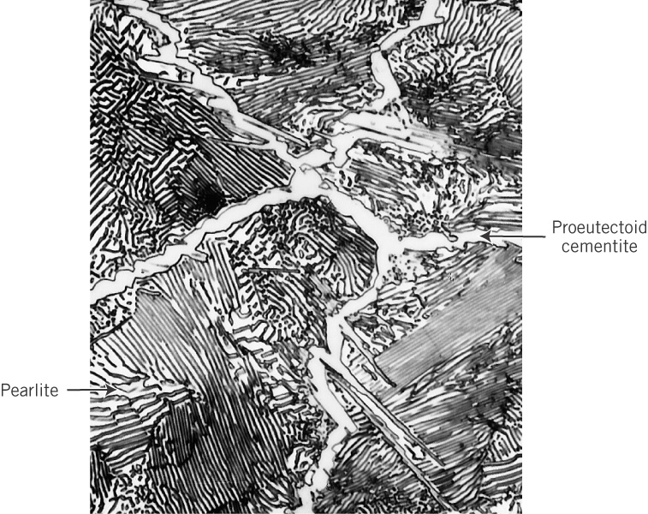
c10f37
Pearlite-cementite steel structure (1.4 wt% C)

Slide 13
c10f34
Calculation of fractions of Proeutectoid Ferrite, Ferrite in Pearlite & Cementite in Pearlite)

Slide 14
Calculation of fractions of Proeutectoid Ferrite, Ferrite in Pearlite & Cementite in Pearlite)

Slide 15
Major Concepts
Phase diagram: Graphical representation, for particular components, showing the effect of temperature and composition on the phases present.
Phase transformation: The time dependent process of phase changes when a temperature change crosses a boundary on the phase diagram.
Comment: Phase diagrams as studied in Ch. 9 are equilibrium phase diagrams, as they show the phases after sufficient (sometimes lengthy) time has elapsed for the phase transformations to occur.

