Slide 1
Chapter 10
Diffusion dependent transformations with no change in composition or number of phases e.g. solidification of pure metal, allotropic transformations, recrystallization & grain growth.
Diffusion dependent transformations with changes in composition and / or number of phases e.g. eutectoid reaction
Diffusionless transformation producing a metastable phase e.g. martensitic transformation
Incongruent vs congruent phase transformations

Slide 2

Two stages
Nucleation – formation of small particles (could be as few as 100 atoms)
Growth – growth of nuclei until equilibrium fraction is reached

Slide 3

Condition: e.g. T < T_{m}
Energy of a solid particle in a liquid
Critical size for stability
Rate of forming critical size particles
X
Rate of attaching atoms to particle
=
Nucleation rate (rate of forming stable particles)
Nucleation rate
X
Growth rate
= Overall transformation rate (e.g. liquid to solid)
Fraction of transformation vs time:
Time-Temperature-Transformation Diagram (TTT)

Slide 4
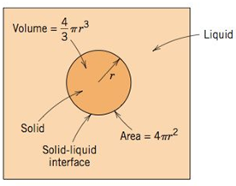

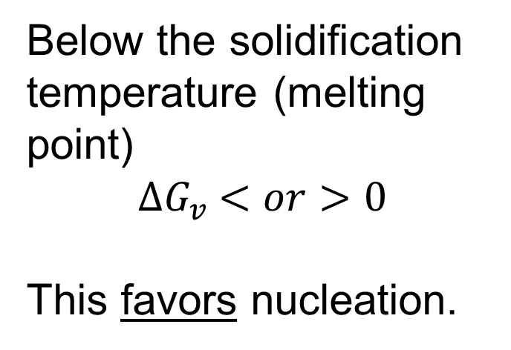
Nucleation (Homogeneous or Heterogeneous)
Below the solidification temperature (melting point)
${∆G}_{v} <or>0$
This favors nucleation.
Homogeneous nucleation
What hinders nucleation? (What energy change is > 0?)
Notes:
Ask students whether less than or greater than. Blank = “favors”

Slide 5
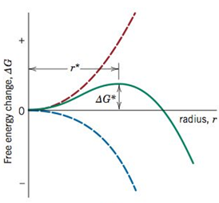



Free Energy of a Solid Particle in a Liquid below T_{m}
Notes:
How to find critical cluster size? Note: free energy change per volume term is a function of temperature. What is this value at the melting point? Above the melting point? How does total free energy curve change as temperature decreases?

Slide 6

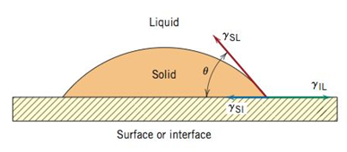


Slide 7
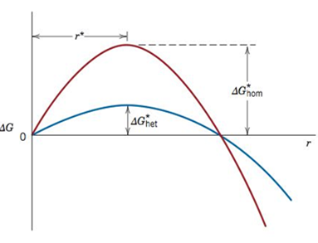

Homogeneous vs Heterogeneous Nucleation

Slide 8

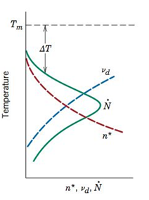

Rate of Nucleation
Notes:
# nuclei per volume per time = nucleation rate

Slide 9
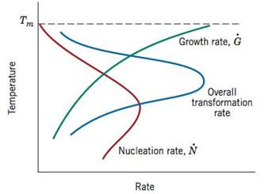
Transformation Rate
Note that the overall transformation rate decreases if you are too high or too low in temperature. Growth vs Nucleation

Slide 10
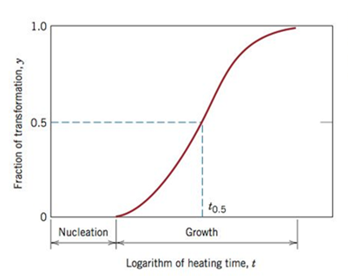

Avrami Equation

Slide 11
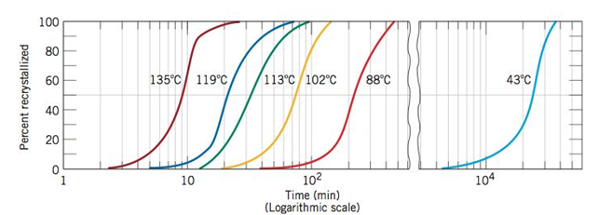
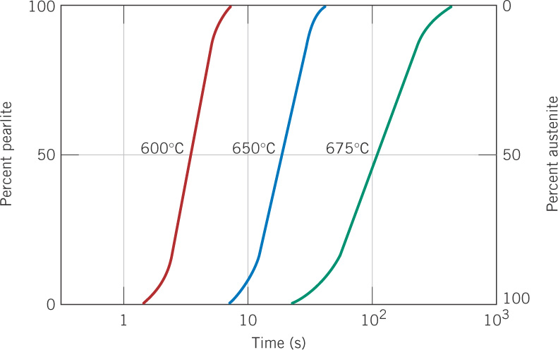
% Recrystallization for pure copper
Austenite to Pearlite transformation

Slide 12
Condition: e.g. T < T_{m}
Energy of a solid particle in a liquid
Critical size for stability
Rate of forming critical size particles
X
Rate of attaching atoms to particle
=
Nucleation rate (rate of forming stable particles)
Nucleation rate
X
Growth rate
= Overall transformation rate (e.g. liquid to solid)
Fraction of transformation vs time:
Time-Temperature-Transformation Diagram (TTT)

Slide 14
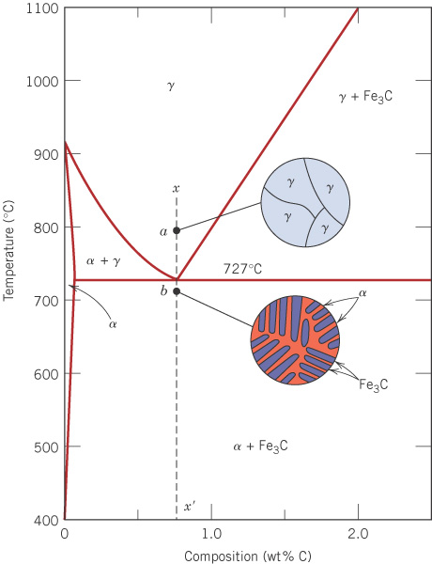
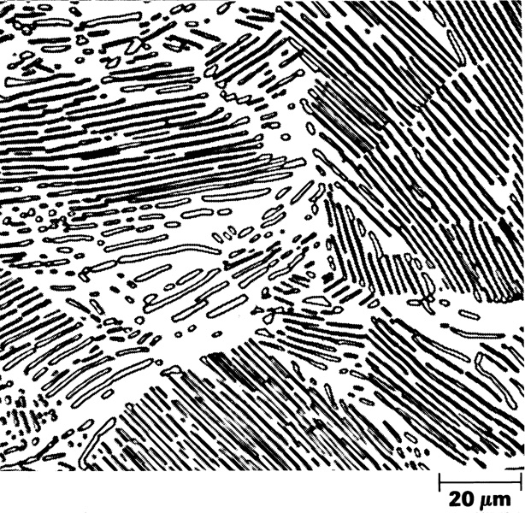
c10f30
Recall: eutectoid steel
Slowly cool 0.76 wt% C steel from the γ region.
0.76 wt% C
α + Fe₃C eutectoid
- called pearlite
Fe

Slide 15
c11f12
Austenite (γ-Fe) to pearlite transformation times
This shows the behavior for eutectoid (0.76 wt% C) steel, when the temperature is suddenly decreased from the γ region to 600, 650, or 675°C in the α+Fe₃C region.
Why is the process
faster for lower
temperature during transformation?

Slide 16
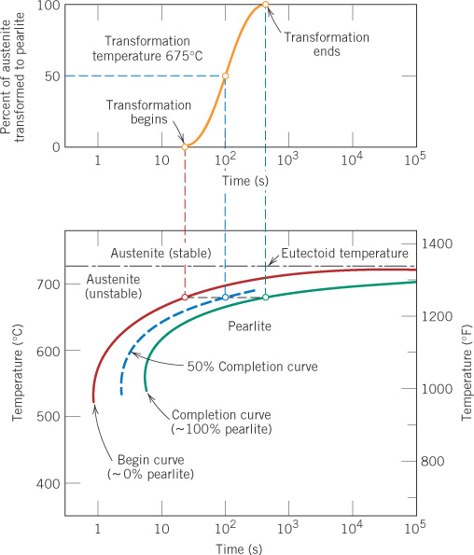
c11f13
Isothermal T-T-T diagram for eutectoid steel
A time-temperature-transformation (T-T-T) diagram supplies the time dimension that is missing in the equilibrium phase diagram.
Consider the following processing steps:
1. Austenitize
2. Quench to 620 C and hold for 100 sec
3. Cool to room temperature

Slide 17
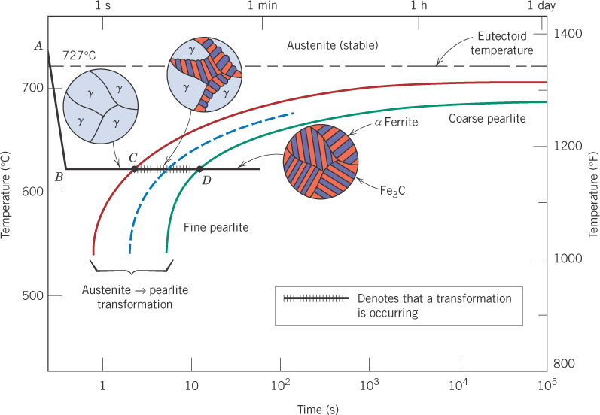
c11f14
Isothermal microstructural changes for eutectoid steel
0%
50%
100%

Slide 18
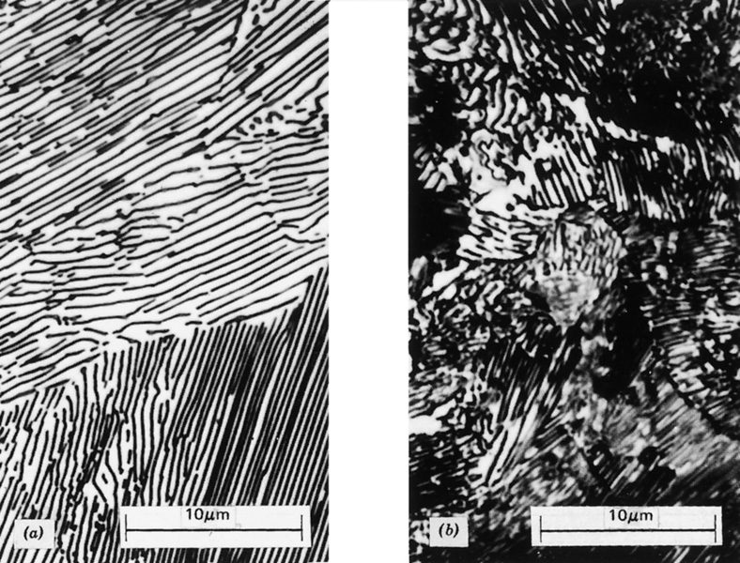
c11f15
Coarse pearlite Fine pearlite
Faster diffusion of C at higher temperatures causes coarser pearlite.

Slide 19
c11f14
Isothermal microstructural changes for eutectoid steel
0%
50%
100%

Slide 20
c11f13
Isothermal T-T-T diagram for eutectoid steel
A time-temperature-transformation (T-T-T) diagram supplies the time dimension that is missing in the equilibrium phase diagram.
Consider the following processing steps:
1. Austenitize
2. Quench to 620 C and hold for 100 sec
3. Cool to room temperature

Slide 21
c11f14
Isothermal microstructural changes for eutectoid steel
0%
50%
100%

Slide 22
c11f15
Coarse pearlite Fine pearlite
Faster diffusion of C at higher temperatures causes coarser pearlite.

Slide 23
c11f14
Isothermal microstructural changes for eutectoid steel
0%
50%
100%

Slide 24
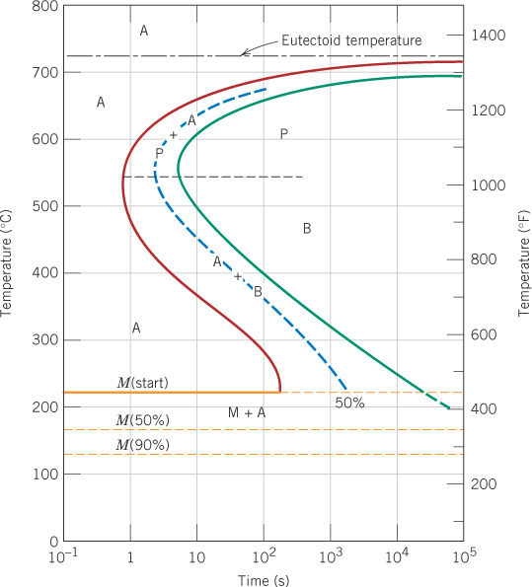
c11f23
Even more of the
isothermal T-T-T
diagram for
eutectoid steel
A = austenite
P = pearlite
B = bainite
M = martensite
Martensite is formed by very rapid cooling (quenching) past the nose to a low temperature.
The amount of martensite formed depends only on the temperature reached, not on the time held after quenching.

Slide 25
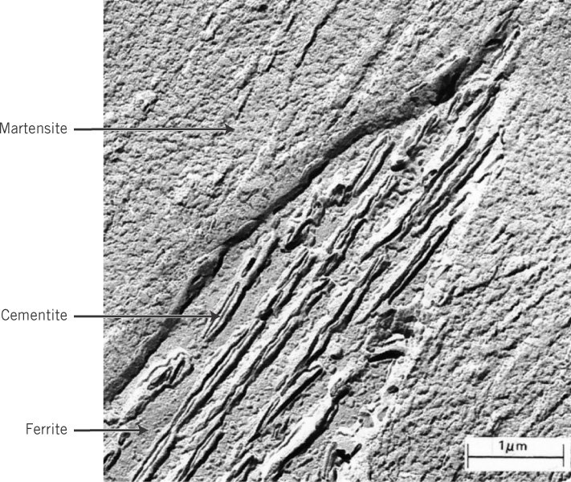
c11f17
Bainite - needles or plates with ferrite and cementite phases
The fine structure of bainite can be seen only at very high magnification.
Fe₃C
α-Fe

Slide 26
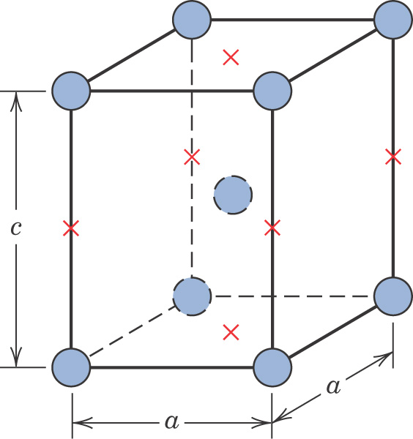
c11f21
Body-centered tetragonal (BCT) crystal structure
The quenching to form martensite is so rapid that the carbon atom atoms do not have time to diffuse (move) to form pearlite or bainite, and become trapped in the BCC lattice of
α-Fe, distorting it to a BCT.
Hence, this is called a diffusionless transformation.
Possible sites for
C atoms

Slide 27
c11f23
Notes:
Go over examples in class – Have class try to figure out microstructure.

Slide 28
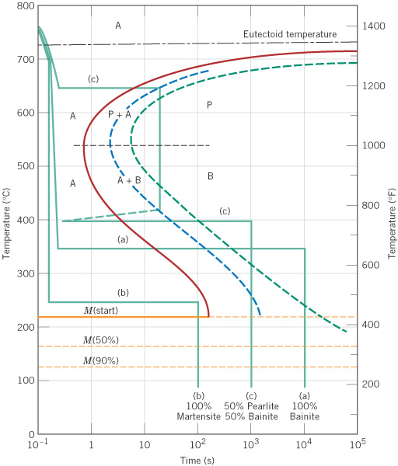
c11f25
Review: Example 10.2
Different sequences of cooling and holding at temperature can be used to achieve different microstructures.

