Slide 1
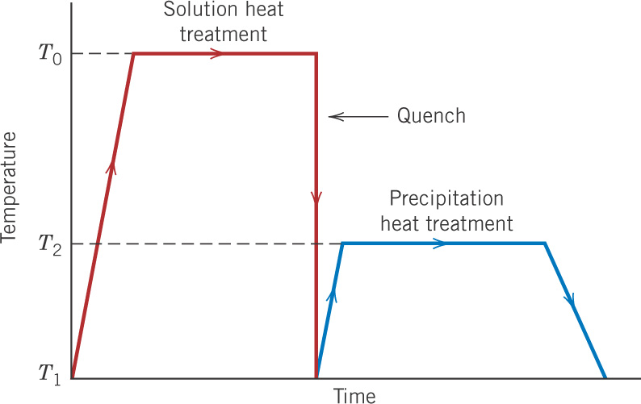
c11f41
Quenching and
tempering of steels
Austenitize
γ (FCC) structure
Temper to form
α (BCC) + Fe₃C
(one to a few hours)
Martensite, BCT
very hard, brittle

Slide 2
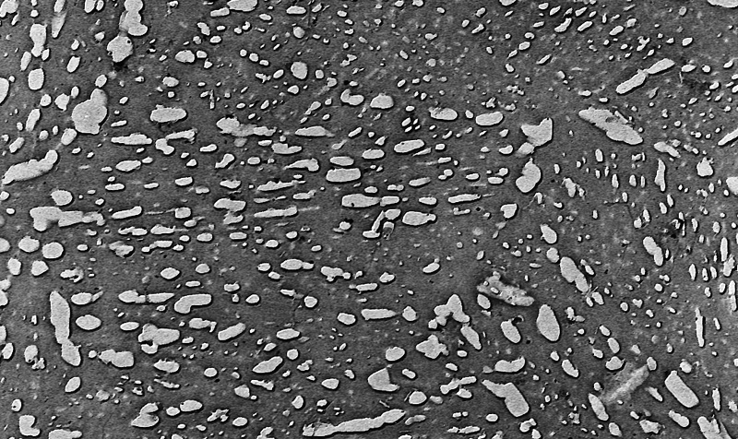
c11f34
Tempered
martensite
9300X
Very small
Fe₃C particles in
α-Fe matrix
Martensite tempered at ~600°C, which looks like spheroidite except that the Fe₃C particles are much smaller.

Slide 3
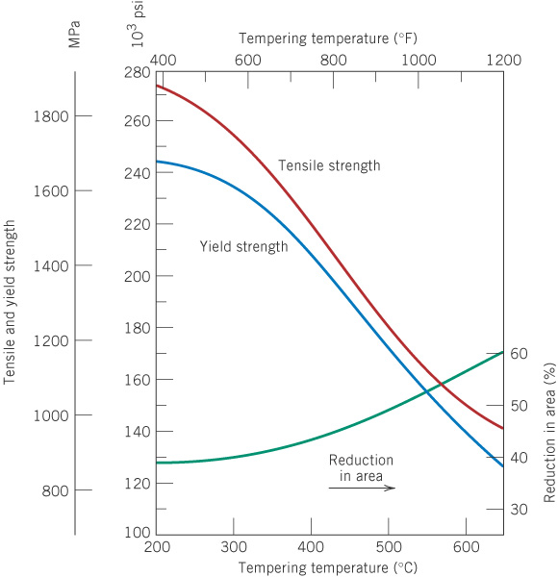
c11f35
Mechanical properties of AISI 4340 steel versus tempering
temperature (one-hour temper)

Slide 4
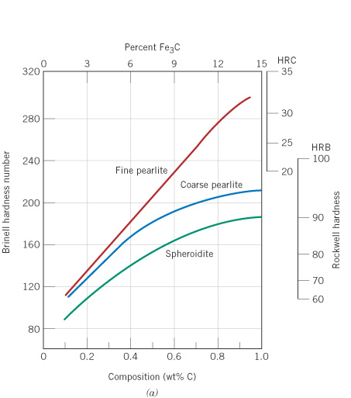
c11f31
Hardness versus wt% C for plain carbon steels
with various microstructures
Where would martensite and tempered martensite fall on this plot?

Slide 5
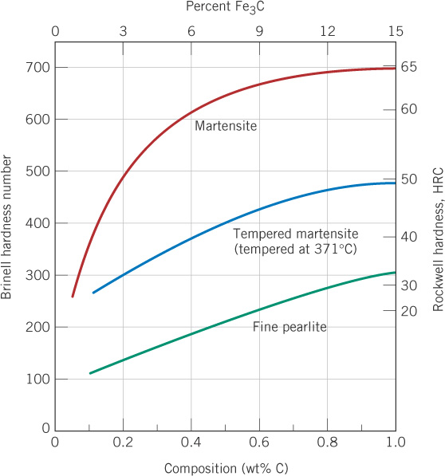
c11f33
Brinell hardness
versus wt% C for
fine pearlite, martensite,
and tempered martensite

Slide 6
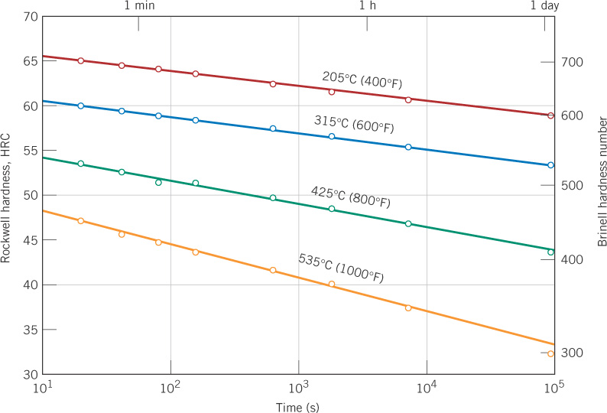
c11f36
Hardness versus tempering time
Times of one or a few hours are usually used.

Slide 7
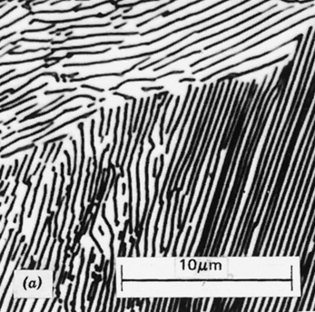
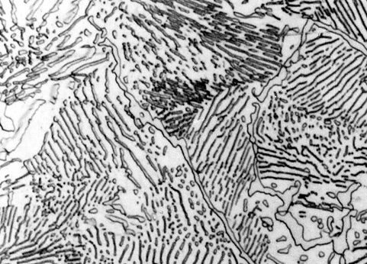
c11f20
What happens if we hold just below the eutectoid temperature for a long time?
Example: How would the pearlite structure change? Why?
Does weight fraction of phases change?
Notes:
Partially transformed pearlite to spheroidite. Reduce phase boundary area.

Slide 8
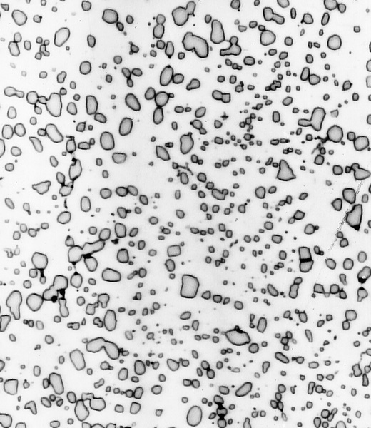
c11f19
Spheroidite
Fe₃C phase - in roughly spherical particles, not layers as in pearlite
α-Fe surrounding
the Fe₃C particles
What happens if we keep holding this at elevated temperature?
Do weight fractions of phases change?

Slide 9
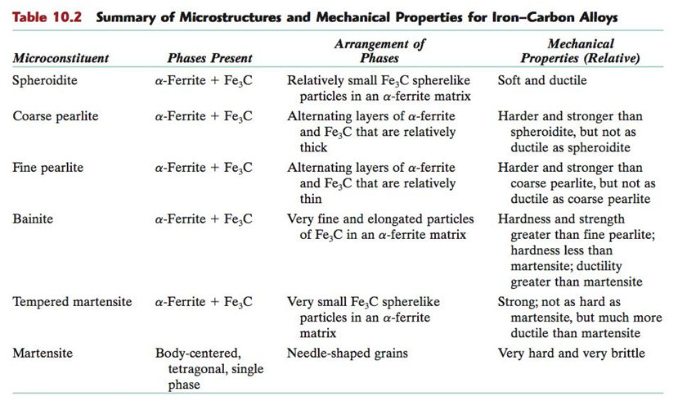
c11tf02

Slide 10
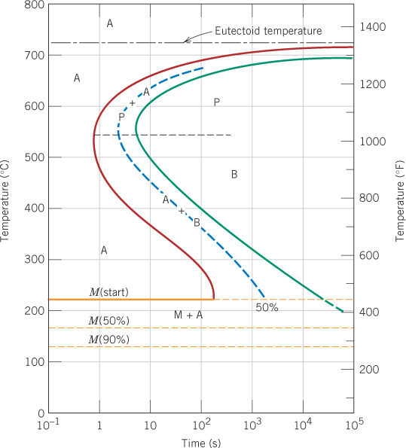
c11f23

Slide 11
Read about CCT curves
These are straight forward to use.

Slide 12
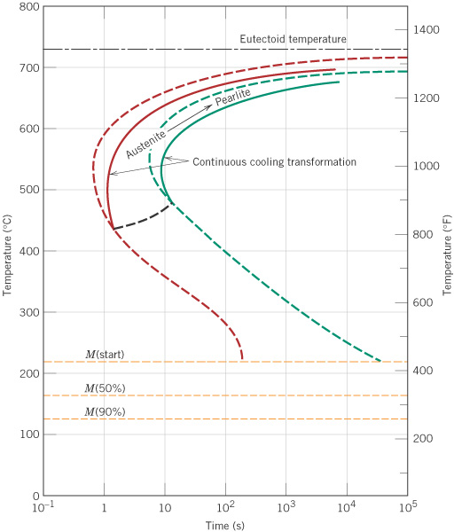
c11f26
C-C-T diagram for
eutectoid steel
For constant cooling rates, as in °C/s, a continuous cooling transformation
(C-C-T ) diagram is used.
This is similar to an isothermal T-T-T diagram, but the curves shift some.

Slide 13
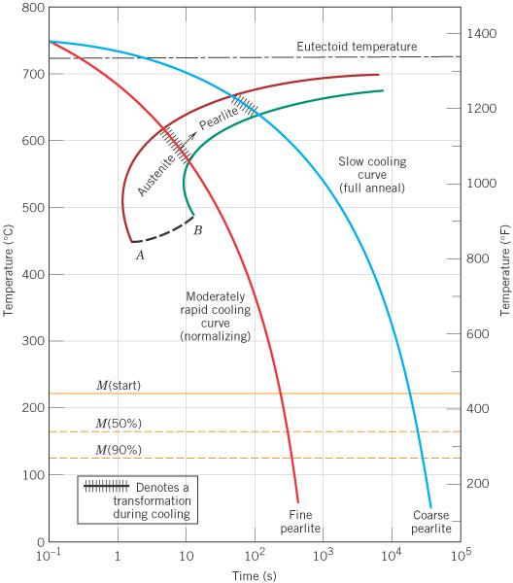
c11f27
C-C-T diagram for
eutectoid steel - cooling rate effect
Two different continuous cooling rates give different results.
“Full Anneal” versus “Normalizing”
Where is Bainite?
Notes:
No Bainite. Curve A-B is where Pearlite transformation ceases and we have retained austenite which becomes Martensite.

Slide 14
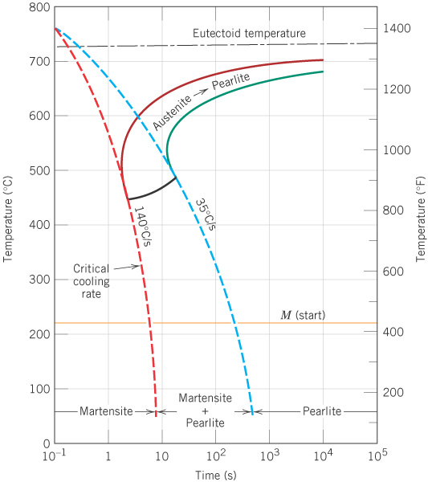
c11f28
C-C-T diagram for
eutectoid steel - critical rates
> 140°C/s gives martensite, < 35°C/s gives pearlite, and
intermediate rates give a combination.

Slide 15
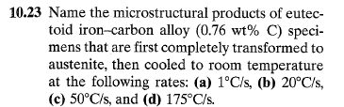
c11f28

