Slide 1
Chapter 8: Failure
Describe the mechanism of crack propagation for both ductile and brittle modes of fracture.
Explain why the strengths of brittle materials are much lower than predicted by theoretical calculations.
Define fracture toughness in terms of (a) a brief statement and (b) an equation; define all parameters in this equation.
Make a distinction between fracture toughness and plane strain fracture toughness.
Name and describe the two impact fracture testing techniques.
Define fatigue and specify the conditions under which it occurs.
From a fatigue plot for some material, determine (a) the fatigue lifetime (at a specified stress level) and (b) the fatigue strength (at a specified number of cycles).
Define creep and specify the conditions under which it occurs.
Given a creep plot for some material, determine (a) the steady-state creep rate and (b) the rupture lifetime.
Notes:
5. We will focus on Charpy. You can read about setup difference in your textbook for Izod.

Slide 2
Chapter 8 Failure Mechanisms
Strength vs Toughness
How does Toughness typically change with temperature?
Why do we need fracture mechanics (isn’t Charpy impact testing enough)?
Fracture toughness vs Brittle Fracture
Stress Intensity vs Fracture Toughness

Slide 3
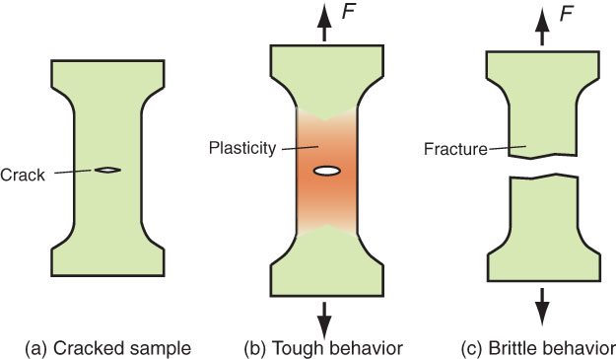
Strength vs.Toughness
Toughness
Resistance of a material
to the propagation
of a crack
Strength
Resistance of a material
to plastic flow

Slide 4
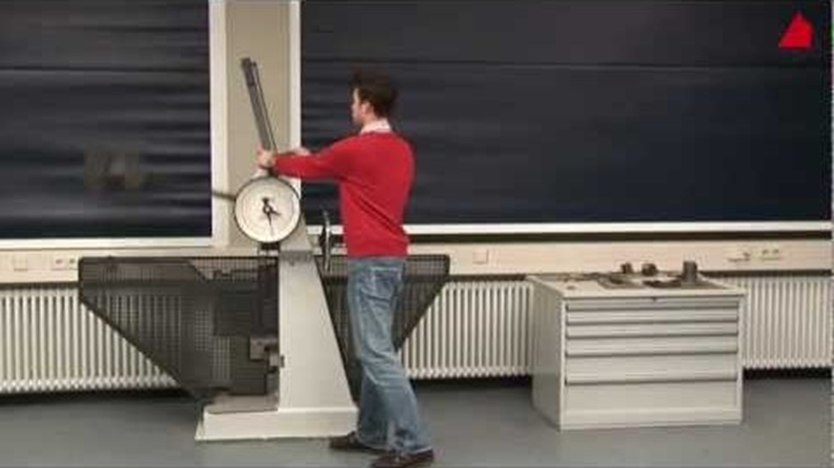
Testing for Toughness
Watch the Charpy Impact Testing video in the Canvas media gallery for Chapter 8.

Slide 5
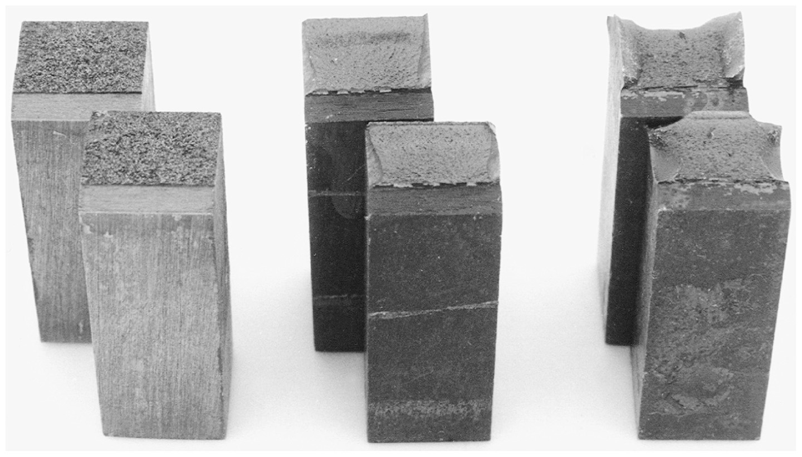
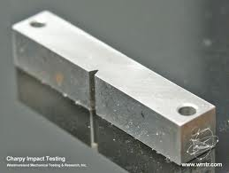
Gray cast iron
AISI 4140 steel
σ_{u} ≈ 1550 MPa
AISI 4140 steel
σ_{u} ≈ 950 MPa
Typical Charpy fractures
Notes:
Figure: 04-37

Slide 6
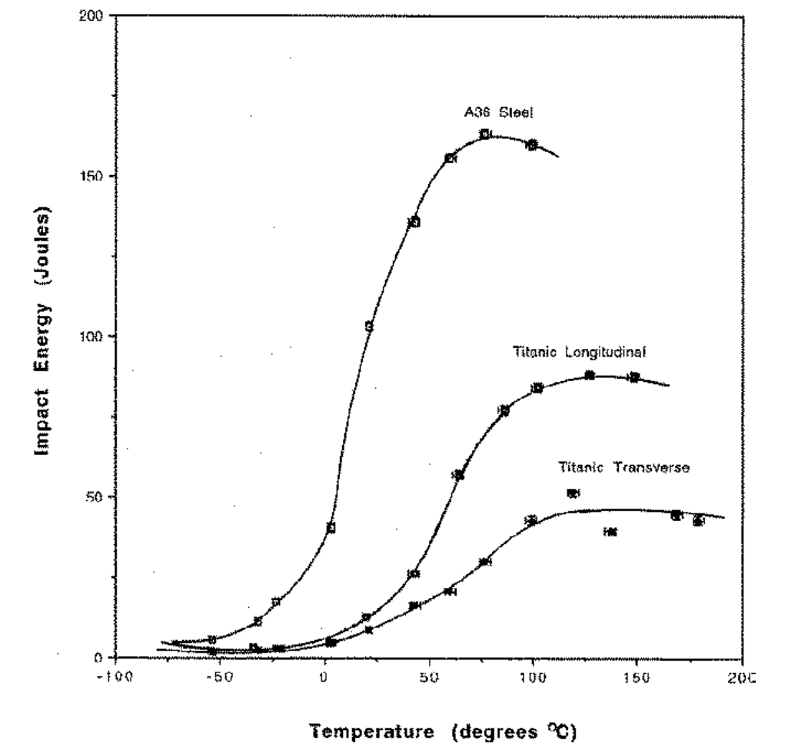
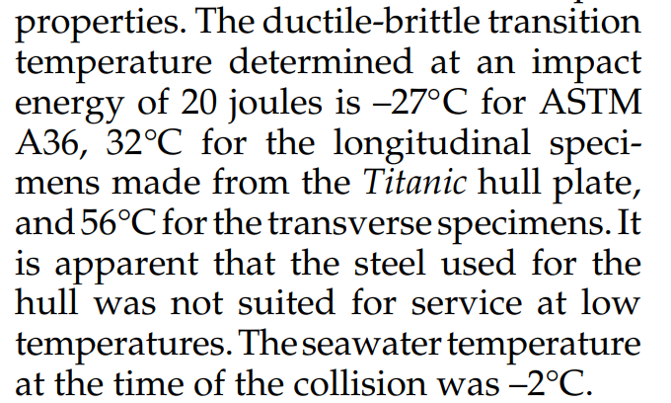
Charpy Impact Testing - Titanic

Slide 7
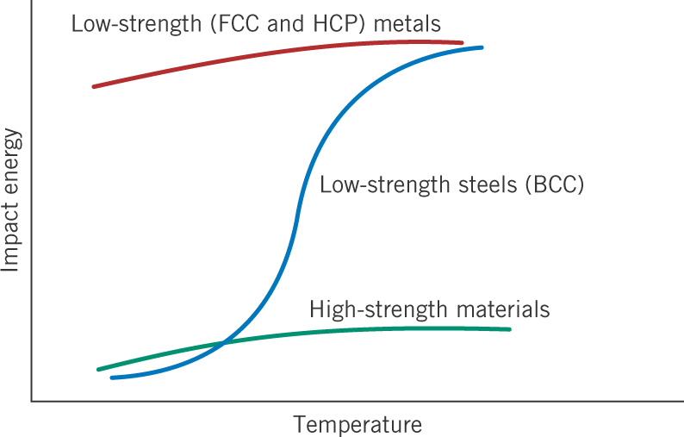
c09f21
Trends in impact energy with temperature

Slide 8
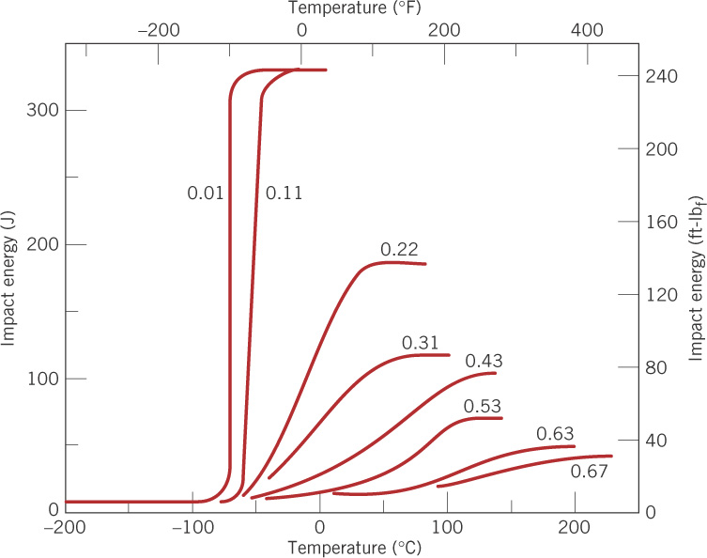
c09f22
Effect of carbon content in plain-carbon steels
wt% C

Slide 9
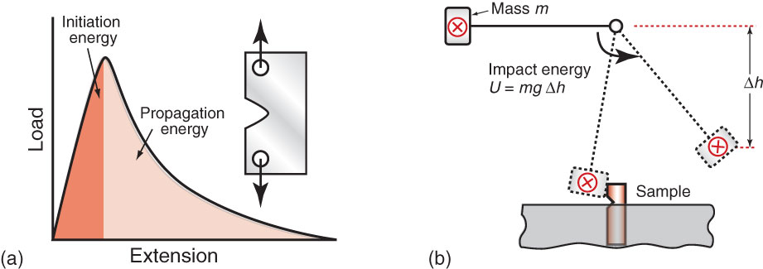
Testing for Toughness
This type of test provides a comparison of the toughness of
materials – however, it does not provide a way to express
toughness as a material property
We Need Fracture Mechanics

Slide 10
Fracture mechanics

Slide 11
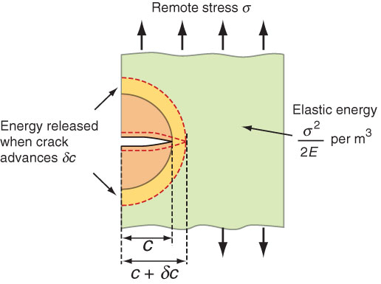
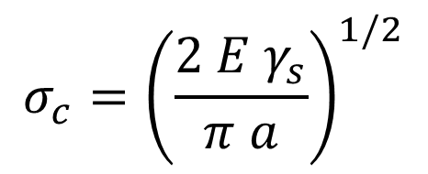
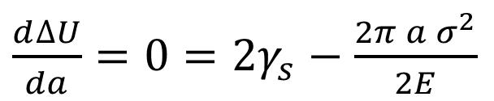


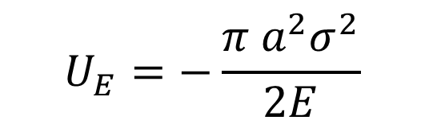
Critical stress for crack propagation in a brittle material (Griffith Criterion)
$$U_{E}=−\frac{π a^{2}σ^{2}}{2E}$$
$$U_{s}=2aγ_{s}$$
$$∆U=U_{s}+U_{E}$$
$\frac{d∆U}{da}=0=$ $2γ_{s}−\frac{2π a σ^{2}}{2E}$
$$σ_{c}={\left(\frac{2 E γ_{s}}{π a}\right)}^{1/2}$$
Notes:
U is the elastic strain energy per unit plate thickness released from a crack of length, a (From Inglis 1913)
UE is approximately sigma^2/2E times the circular area ½ Pi c^2 = Pi c^2 sigma^2 / (4 E). The Inglis analysis is more rigorous and a factor of 2 is dropped out of this approximation.
Us is the surface energy

Slide 12
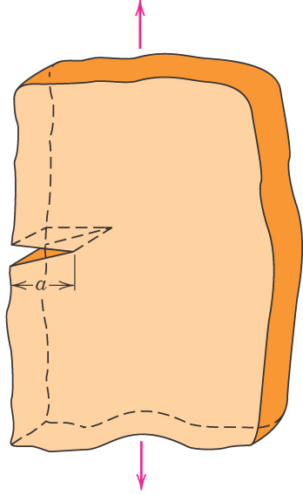

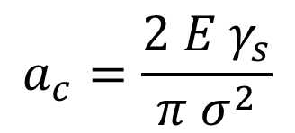
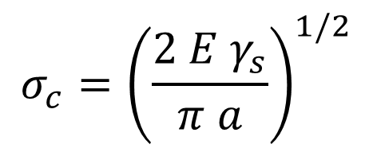
Example: maximum flaw size in glass
A relatively large plate of a glass is subjected to a tensile stress of 40 MPa. If the specific surface energy and modulus of elasticity for this glass are 0.3 J/m² and 69 GPa, respectively, determine the maximum length of a surface flaw that is possible without fracture.
$$σ_{c}={\left(\frac{2 E γ_{s}}{π a}\right)}^{1/2}$$
$$a_{c}=\frac{2 E γ_{s}}{π σ^{2}}$$

Slide 13
Stress Concentration & Fracture toughness
Non-brittle materials i.e. ductile materials

Slide 14
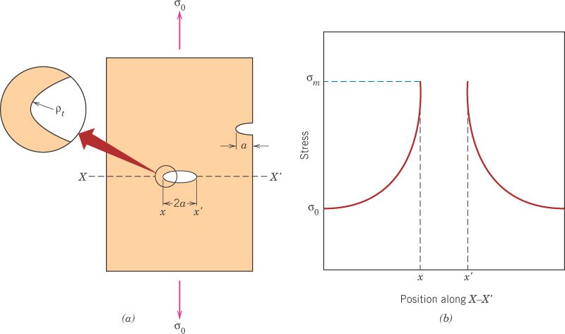
c09f08
Stress raiser effect
of an elliptical hole
- wide plate, w >> a, elastic behavior
w
k_{t} is the stress concentration factor.
- do not confuse with K.

Slide 15
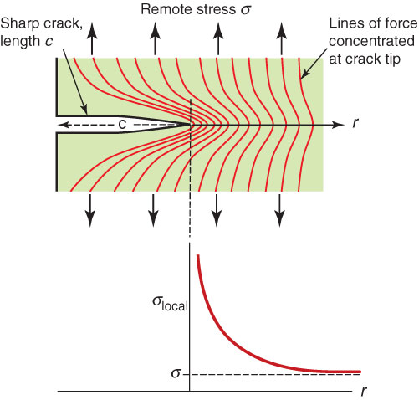

What about a “sharp” crack?
The local stress σ_{local} at the crack tip rises steeply
a – crack length
r – distance from crack tip
σ – remote stress
Y – geometric constant
* valid when r << c

Slide 16
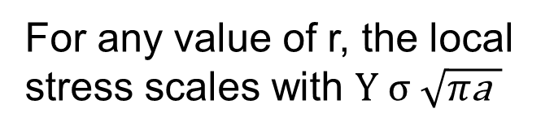
Fracture Toughness, K_{c}
For any value of r, the local
stress scales with $Y σ \sqrt{π\text{a} }$
When K (stress intensity) reaches a critical value K_{c} we get fracture.

Slide 17
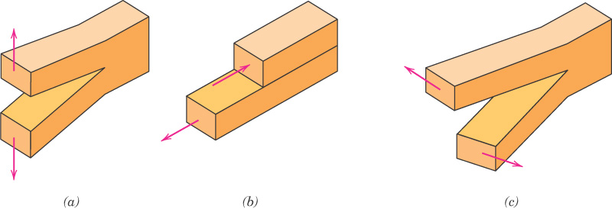
c09f10
The three fracture modes
Mode I
tension
Mode II
sliding shear
Mode III
tearing shear

Slide 19
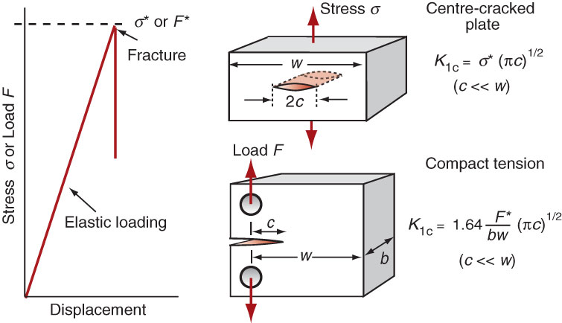
Plane Strain Fracture Toughness
Cracks propagate when the stress intensity factor exceeds a critical value

Slide 20
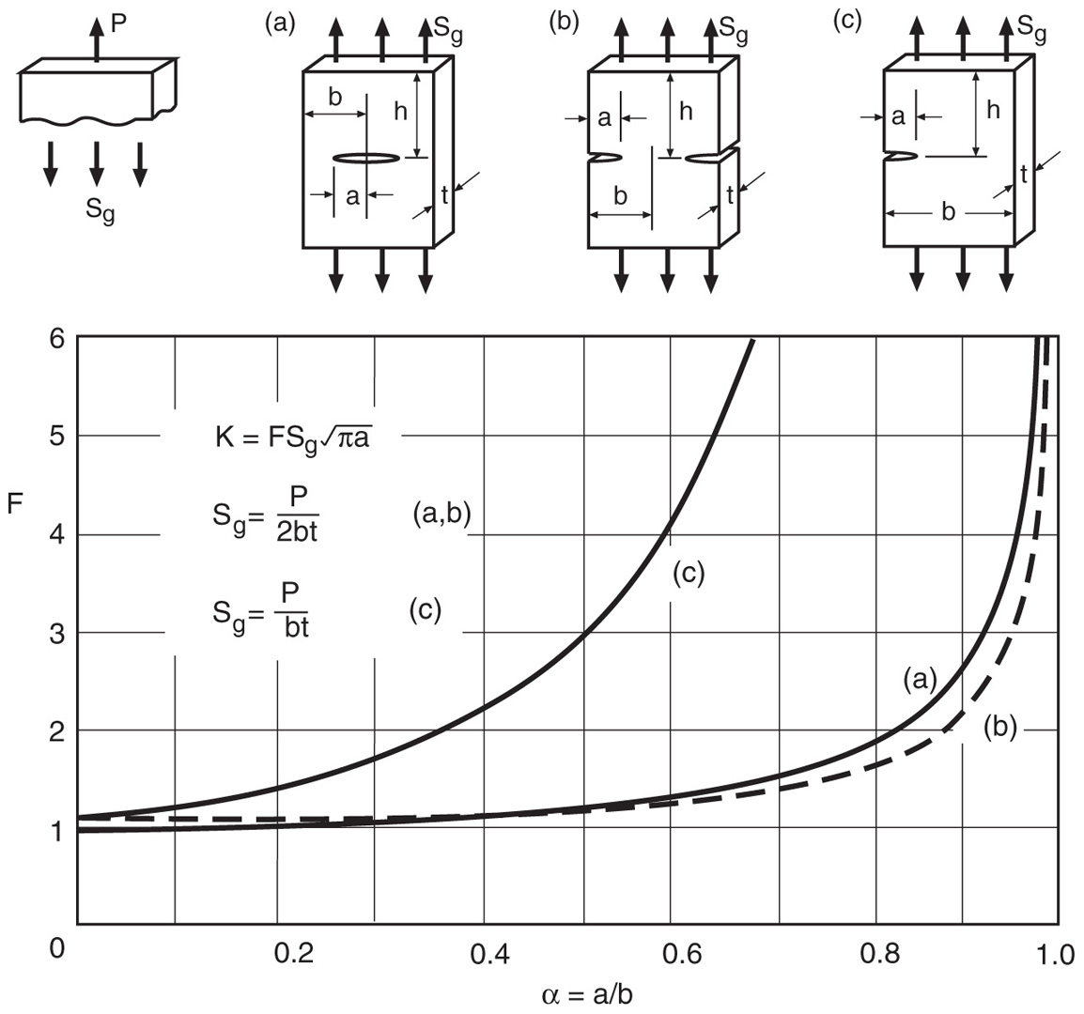
σ
Center-cracked
plate in tension
σ
From: Tada, H., P. C. Paris, and G. R. Irwin. 2000.
The Stress Analysis of Cracks Handbook, 3rd ed.,
ASME Press, American Society of Mechanical
Engineers, New York, NY.

Slide 21
σ
Single-edge-cracked
plate in tension
σ
From: Tada, H., P. C. Paris, and G. R. Irwin. 2000.
The Stress Analysis of Cracks Handbook, 3rd ed.,
ASME Press, American Society of Mechanical
Engineers, New York, NY.

Slide 22
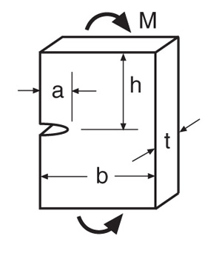
Single-edge-cracked plate in bending
From: Tada, H., P. C. Paris, and G. R. Irwin. 2000.
The Stress Analysis of Cracks Handbook, 3rd ed.,
ASME Press, American Society of Mechanical
Engineers, New York, NY.

Slide 23
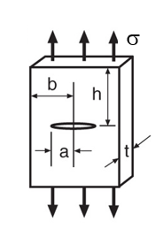
Example: A center-cracked plate of 2024-T3 aluminum alloy has
dimensions b = 50 and t = 5 mm, and it is subject to a tensile force
of P = 50 kN. What is the safety factor against brittle fracture if the
crack length a is: (a) 10 mm, and (b) 30 mm.
Solution: Since K is a measure of the severity of a crack situation, and
K_{Ic} is a measure of a materials resistance to fracture, a suitable safety
factor is:
To evaluate K, we need

Slide 24
(a) For a = 10 mm,
Since α < 0.4, we have Y ≈ 1.0, and
This value is reasonable, but not as large as might be desired, given that there is considerable statistical scatter in K_{Ic} values.

Slide 25
(b) For a = 30 mm,
Since α > 0.4, we need to compute Y.
This value is unsafe, despite the fact that σ is well below the material’s
yield strength of 345 MPa.

Slide 27
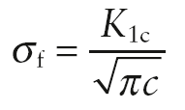
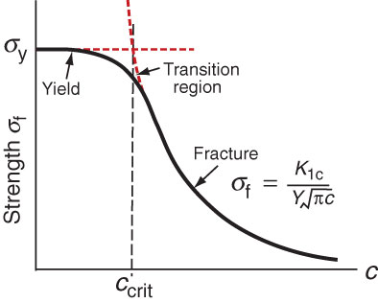
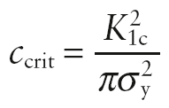
A material transitions
from yield to fracture
at a critical crack length
Stress required for fracture for a given crack length
Crack length necessary
for fracture at a materials
yield strength

Slide 28
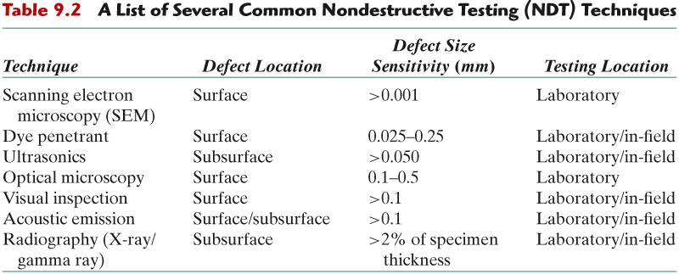
c09tf02
What maximum load can we expect?
8.2
But the above chart is overly optimistic.
Typical minimum crack sizes that can be
found by inspection are on the order of
1.2 mm = 0.05 inch. Cracks as large as
25 mm = 1 inch have been missed in
aircraft inspection.

Slide 29
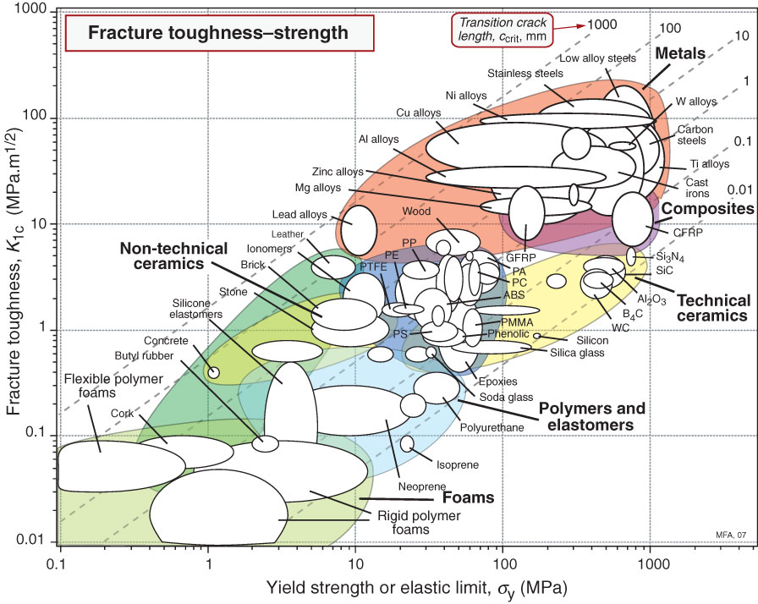
Transition crack length plotted on chart – values can range from near- atomic dimensions for ceramics to almost a meter for ductile metals

Slide 30
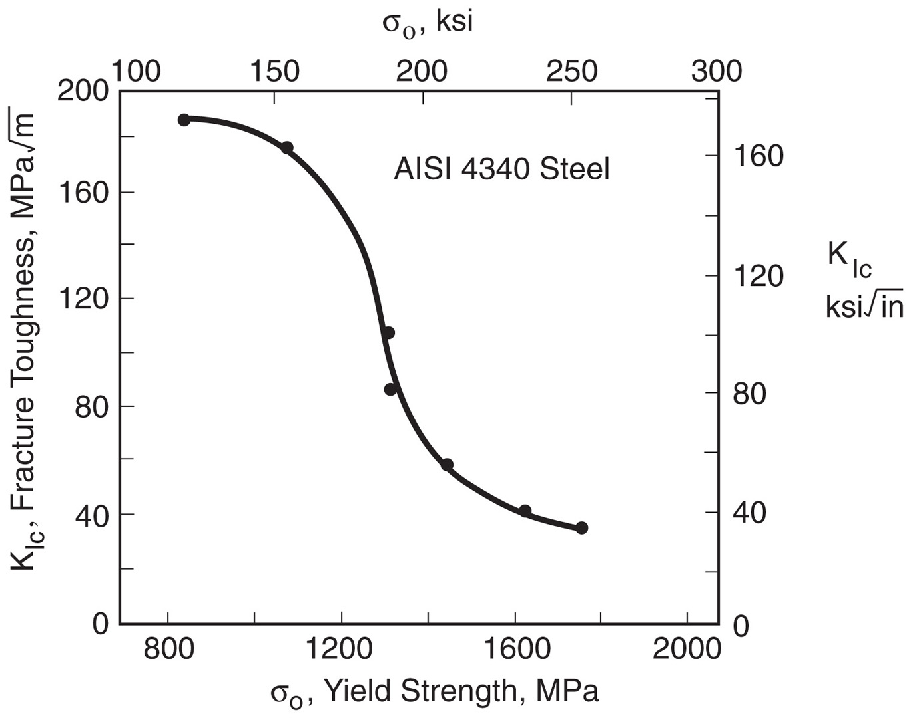
K_{Ic} versus
strength
For a given steel, strength and hardness can be increased by heat
treatment, but this results in decreased ductility and fracture toughness.
Notes:
Figure: 08-32

