Slide 1
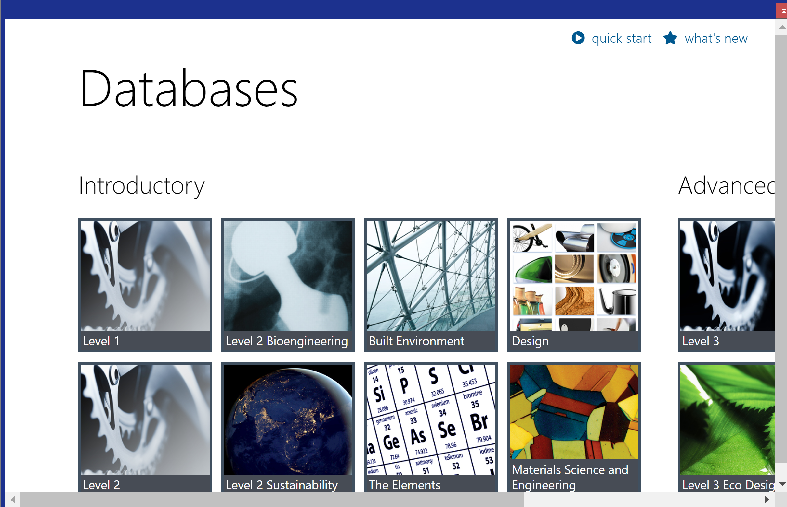
CES EDUPACK 2024
Let’s take a look at the relationship between Bond Energy (Cohesive Energy) and Elastic Stiffness (Young’s Modulus)

Slide 2
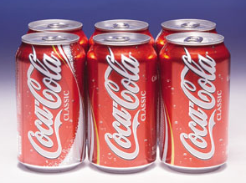
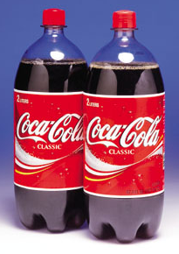
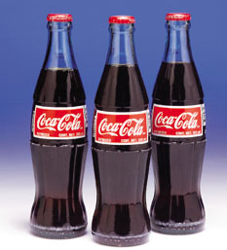
Selection
A successful product – one that performs well, is good value for money and gives pleasure to the user – uses the best materials for the job, and fully exploits its potential and characteristics
Materials selection is not about choosing a material, but a profile of properties that best meets the needs of the design
Material and process are interdependent
Materials and processes are grouped into families; each family has a characteristic profile, the “family likeness,” which is useful to know when selecting which family to use for a design

Slide 3
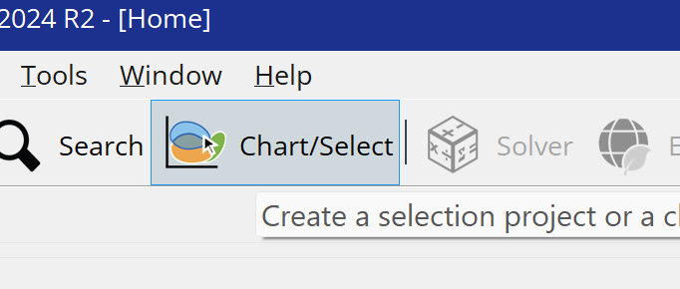
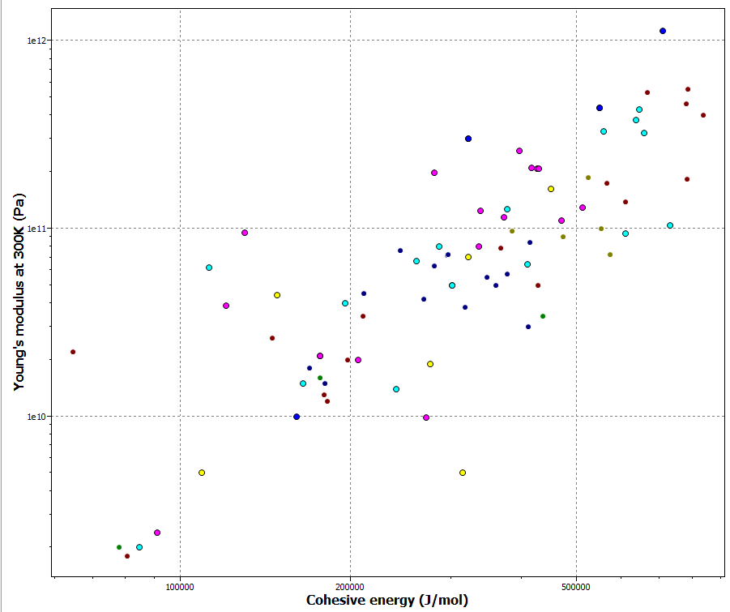
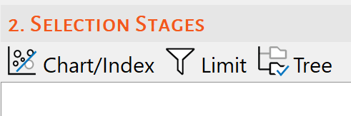
Change database to The Elements
Change units in Tools/Settings/Units to SI and Absolute Temperature
Use “Chart/Select” button to make your Graph
Set “Select from”: All Elements

Slide 4
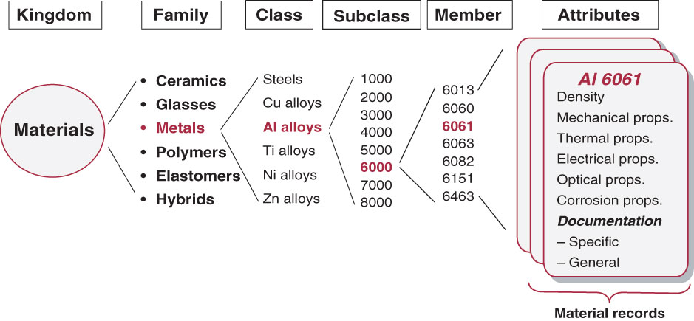
Organization in CES EduPack
In practice it is sufficient to group materials into 6 families giving the above tree diagram.

