Slide 1
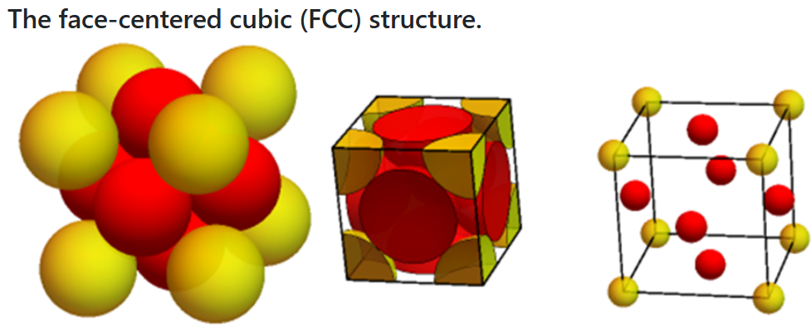
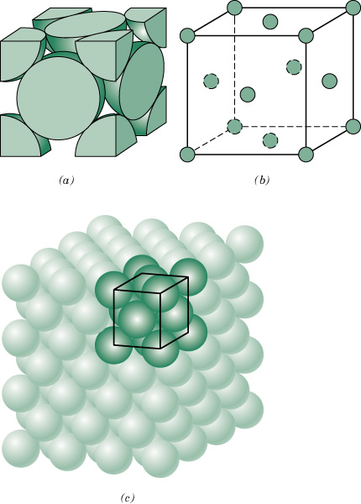

c03f01
Face-centered cubic (FCC) crystal structure
(a) space-filled model, (b) cut-sphere model, and (c) exploded-view model
Close-Packed Structure
APF = 0.74
4 atoms/(unit cell)
Notes:
Derive APF and lattace parameter relationship given on slide.

Slide 2
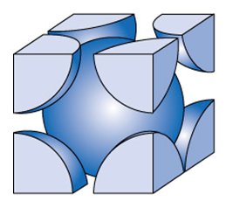
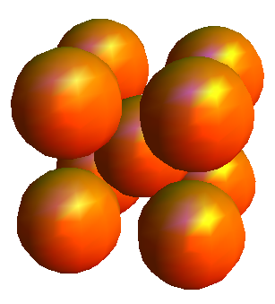
Body Centered Cubic (BCC)
Non close-packed structure
Notes:
Counts the number of atoms.

Slide 3
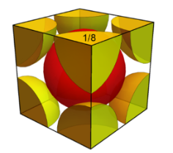
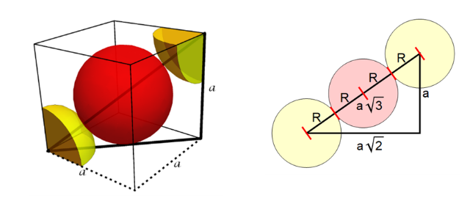

c03f02
Body-centered cubic (BCC) crystal structure
APF = 0.68
2 atoms/(unit cell)
Notes:
Don’t derive these. This is homework.

Slide 4
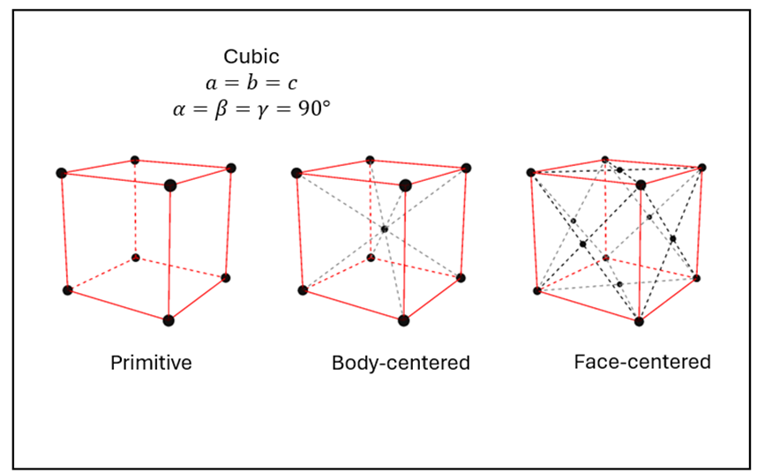
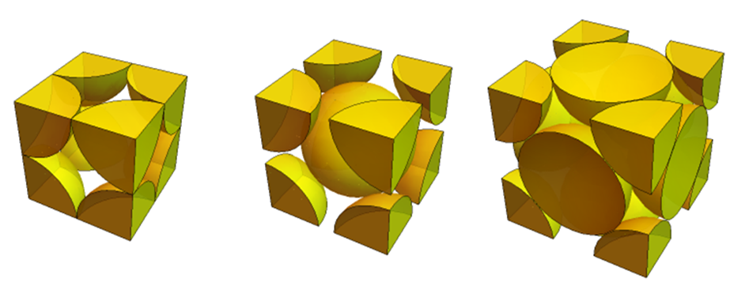

Slide 5
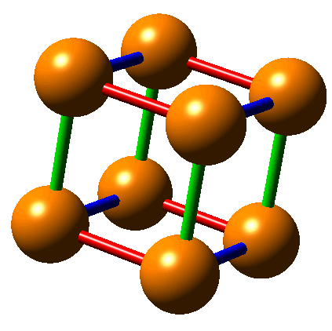
Example: Point Coordinates
Write the fractional coordinates.

Slide 6
c03f01
In class: FCC crystal structure
Write the fractional coordinates of the atoms

Slide 7
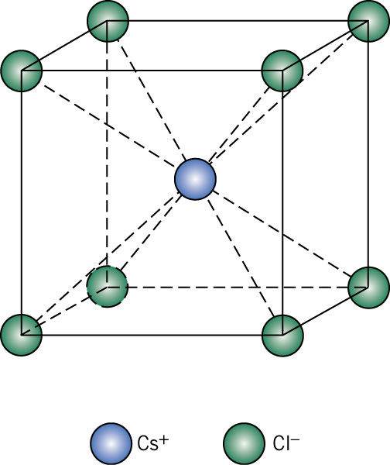
c03f06
In Class: CsCl structure
Write the fractional coordinates of the atoms

Slide 8
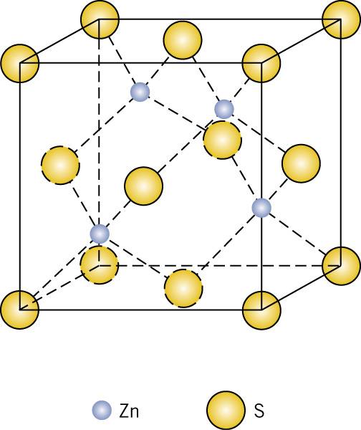
c03f07
In Class: Zn blende structure
Write the fractional coordinates of the atoms

Slide 9
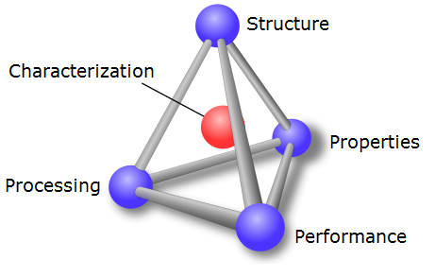
Recall MSE tetrahedron

Slide 10
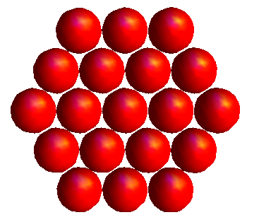
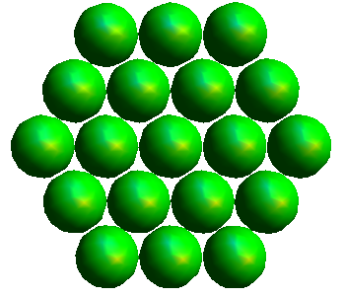
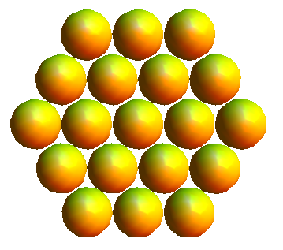
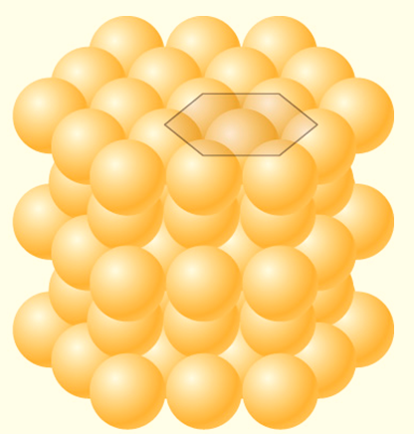
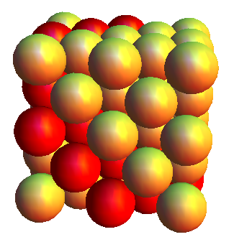
ABCABC vs ABAB packing

