Slide 1
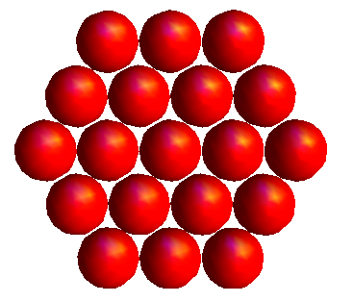
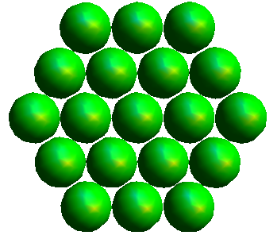
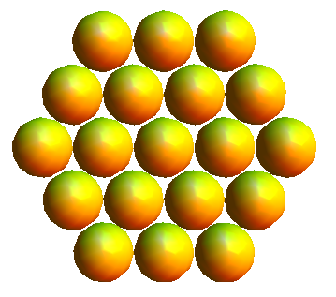
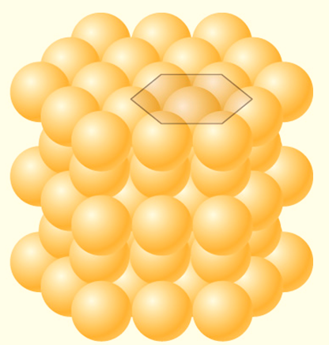
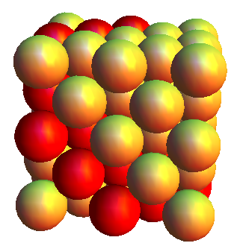
ABCABC vs ABAB packing
(111) plane
(sgcorcoran.github.io/brightspace)

Slide 2
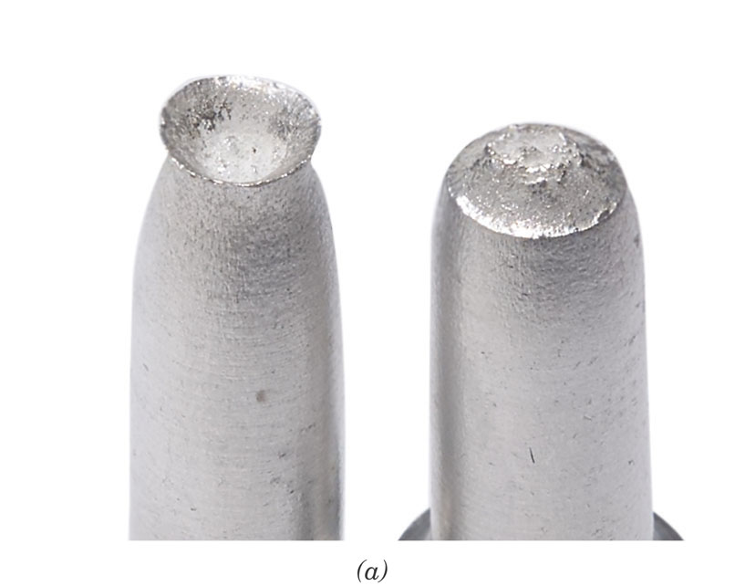
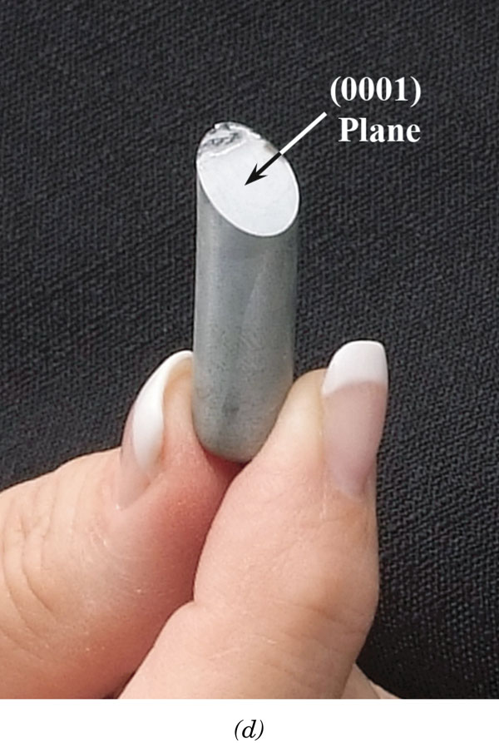
FCC vs HCP
ABAB packing
ABCABC packing
Notes:
Al vs Zn. How do we know this is related to structure and not the fact they are different materials. Consider tin

Slide 3
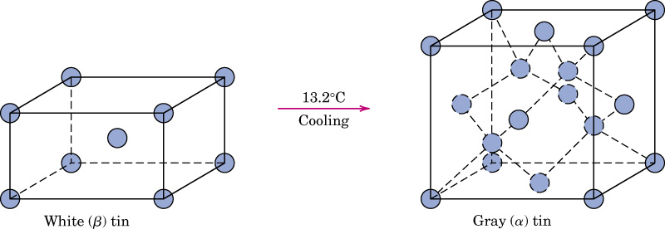
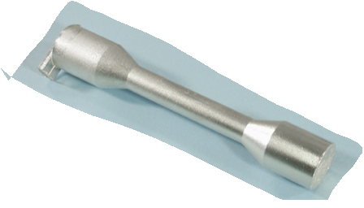
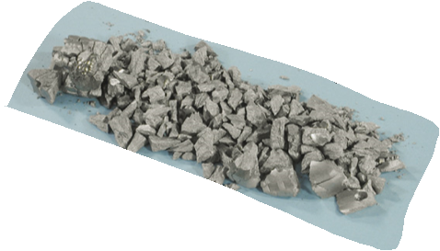
c03impf02a
Two forms (allotropes) of tin, Sn
body-centered tetragonal
structure, ρ = 7.3 g/cm³
diamond cubic structure
ρ = 5.8 g/cm³

Slide 4
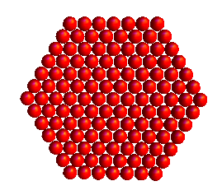
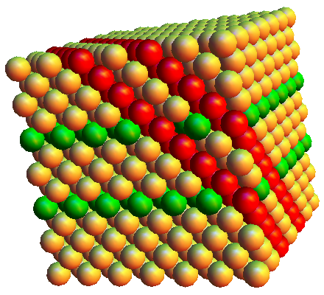
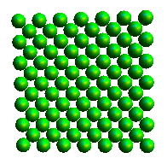
Distance between planes depends upon orientation of planes and arrangement of atoms. Each plane has a different arrangement of atoms.
Notes:
Use mathematica program to show
Sketch / show packing of (111) (110) and (100). If planes have different packing and spacings, would a property like elastic modulus depend upon the direction that the crystal is pulled?

Slide 5
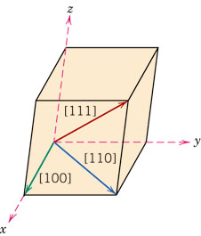
Crystallographic Directions
It is often useful to refer to certain directions in a crystal or to certain planes of atoms in a crystal. We need a simplified system to do this.
Find coordinates (relative to edge length, a) of two points along the direction of interest.
Subtract “tail” point from “head” point.
Clear fractions and reduce to smallest integers.
Enclose the numbers in square brackets and use an “overbar” for negative numbers.

Slide 6
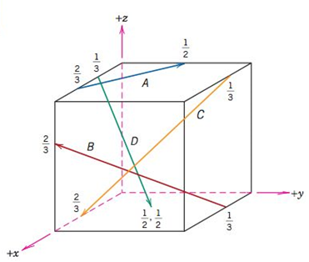
Crystallographic Directions
Fine the indices for the direction labeled B below

Slide 7
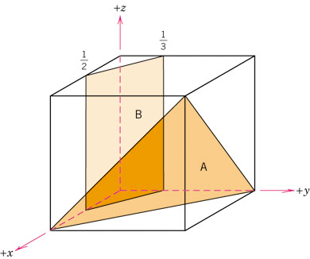
Determine the indices for plane B
Find fractional a, b, and c intercepts.
Take the reciprocal of each intercept.
Clear fractions but do not reduce the result.
Enclose the result in parentheses.
* If a plane does not cross an axis, the intercept is taken to be infinity.

Slide 8
Determine the indices for plane A
Find fractional a, b, and c intercepts.
Take the reciprocal of each intercept.
Clear fractions but do not reduce the result.
Enclose the result in parentheses.

Slide 9
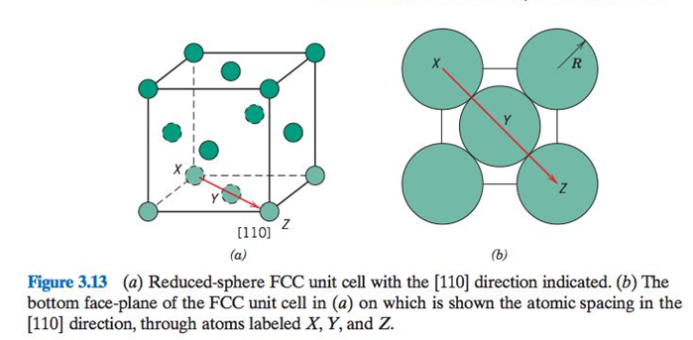
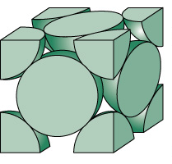
Sketch the atom placement on the (100) plane for FCC

Slide 10
Sketch the atom placement on the (100) plane for FCC

Slide 11
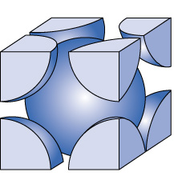
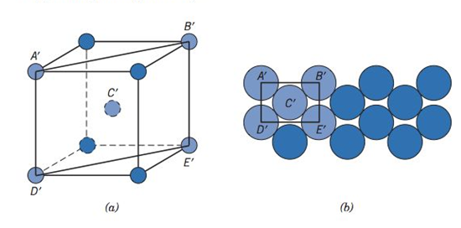
Sketch the (110) plane for the BCC structure

Slide 12
Sketch the (110) plane for the BCC structure

