Slide 1
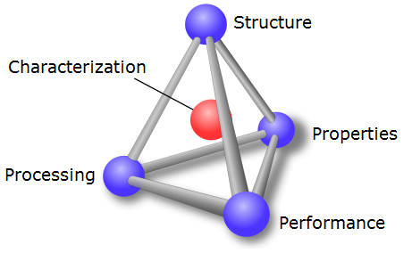
Chapter 4: Imperfections in Solids
In Chap 3, we discussed “perfect” crystalline solids.
In this chapter, we are going to learn about defects that exist in crystalline solids.
Processing can change the number and types of defects in a solid.
Defects often control / alter material properties.

Slide 2
Chapter 4: Imperfections in Solids
Types of imperfections in crystals
- Point (1D): vacancy, interstitial, substitutional
- Line (2D): dislocations
- Interfacial (3D): surface, grain boundary, twin boundary

Slide 3
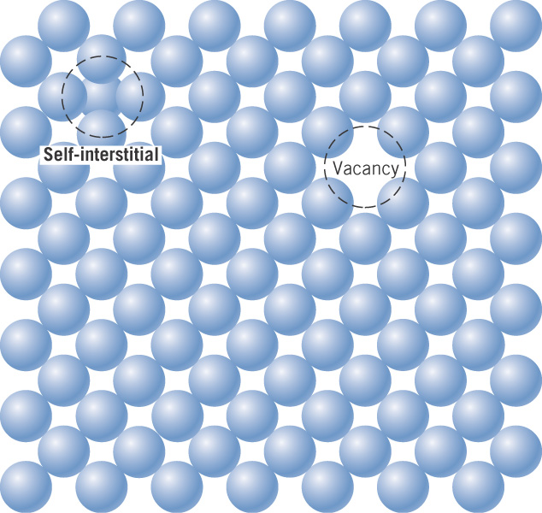
c05f11
Types of imperfections in crystals
point: vacancy, interstitial
line: dislocations
interfacial: grain boundary, twin boundary
Point defects in a metal crystal

Slide 4
Equilibrium number of vacancies
Vacancies spontaneously form in a solid, with the number
increasing with temperature.
This is an example of the Arrhenius equation, with this general
form applying to a variety of thermally activated processes in
materials science and chemistry.

Slide 5
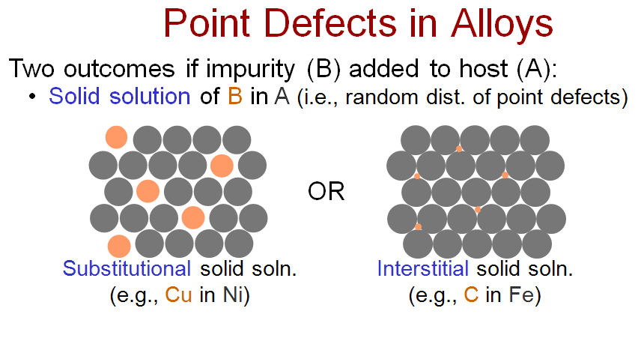
Point defects in a metal or alloy
- the impurity atoms are in solid solution
Substitutional
impurity
Interstitial
impurity
How big are the interstitial sites in a crystal?

Slide 6
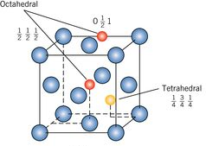
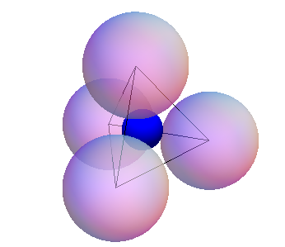
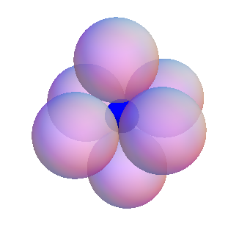







Tetrahedral and Octahedral Interstitial Sites in FCC
Use the Crystalline Solids Program to view interstitial sites in the FCC lattice.

Slide 7
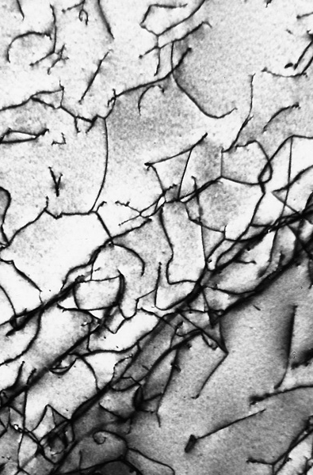
c05f11
Types of imperfections in crystals
- point: vacancy, interstitial
- line: dislocations
- interfacial: grain boundary, twin boundary
Dislocations in a
titanium alloy
at 51,500X

Slide 8
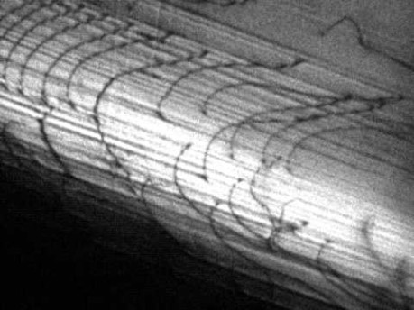

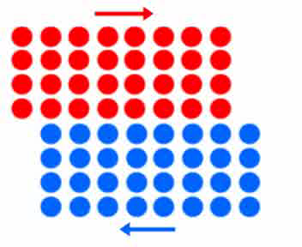
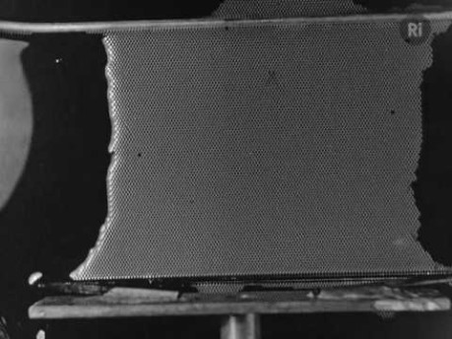
Notes:
John Kacher Dislocation Glide https://youtu.be/EXbiEopDJ_g
Excerpt from a longer film on bubble rafts, possibly made in the 1940s by William Lawrence Bragg. https://youtu.be/P345p7A4IW8

Slide 9
Notes:
John Kacher Dislocation Glide https://youtu.be/EXbiEopDJ_g
Excerpt from a longer film on bubble rafts, possibly made in the 1940s by William Lawrence Bragg. https://youtu.be/P345p7A4IW8

Slide 10
Notes:
John Kacher Dislocation Glide https://youtu.be/EXbiEopDJ_g
Excerpt from a longer film on bubble rafts, possibly made in the 1940s by William Lawrence Bragg. https://youtu.be/P345p7A4IW8

Slide 11
Notes:
John Kacher Dislocation Glide https://youtu.be/EXbiEopDJ_g
Excerpt from a longer film on bubble rafts, possibly made in the 1940s by William Lawrence Bragg. https://youtu.be/P345p7A4IW8

Slide 12
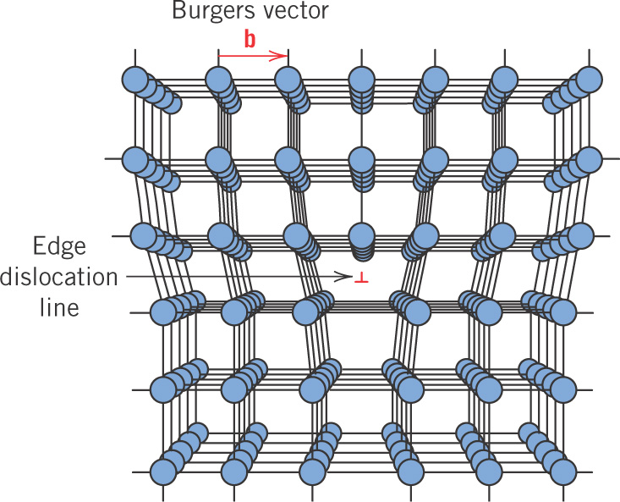
c05f08
Edge dislocation

Slide 13
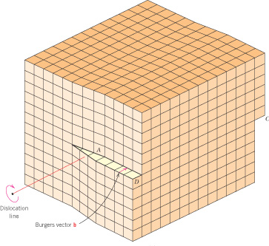
c05f09
Screw dislocation

