Slide 1
Types of imperfections in crystals
- point: vacancy, interstitial
- line: dislocations
- interfacial: grain boundary, twin boundary
Correction on homework problem (110) bcc.

Slide 2
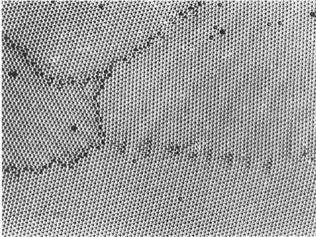
c05f12
Grain
boundaries
High angle grain boundaries
Low angle grain boundary
Notes:
After P.G. Shewmon, Tranformations in Metals, McGraw-Hill, New York, 1969, from C.S. Smith

Slide 3
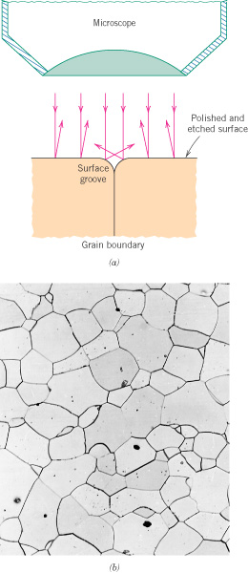
c05f19ab
Grain boundaries in an Fe-Cr alloy at 100X

Slide 4
ASTM grain size number, G
G varies 1 to 10, with 10 being very small grains
n = average number of grains/inch² at 100X

Slide 5
Example
If 62.6 grains/in² are counted on a photograph at 85X, what is
the ASTM grain size number?
We first need N, the number of grains/in² at 100X. Compared
to 85X, at 100X there are fewer grains by the ratio (85/100)².

Slide 6
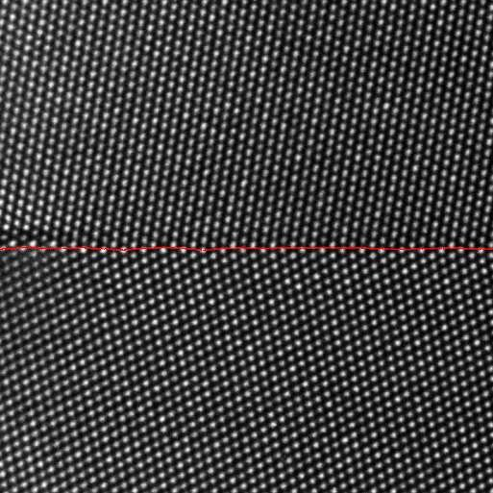
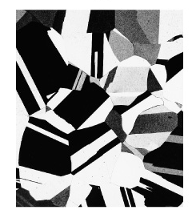
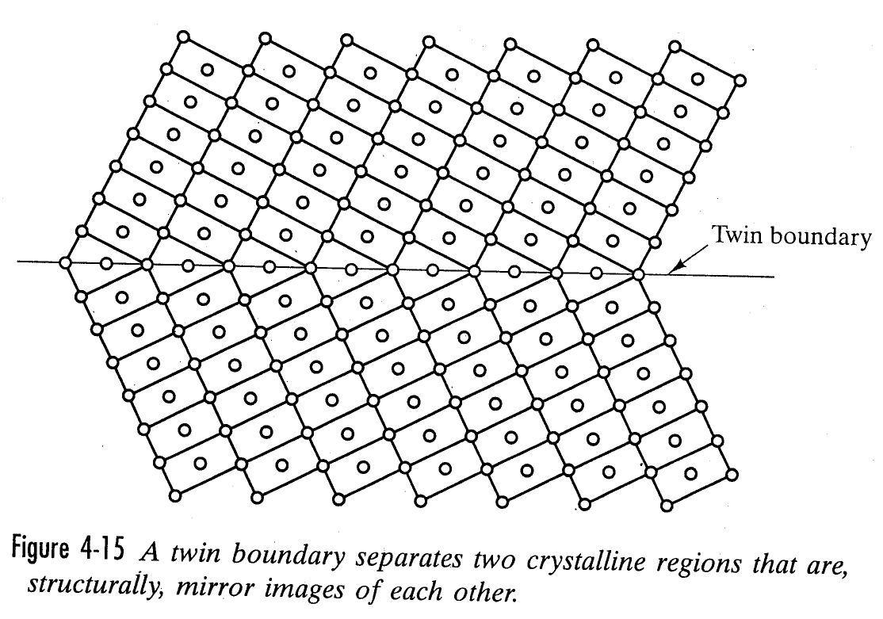
Twin boundaries
Brass at 60x
Notes:
Berkels, Benjamin & Rätz, Andreas & Rumpf, Martin & Voigt, Axel. (2007). Identification of Grain Boundary Contours at Atomic Scale. 4485. 765-776. 10.1007/978-3-540-72823-8_66.
Fig 4-15 from Shackelford, James G. Intro to materials science for engineers, 5th ed.

Slide 7
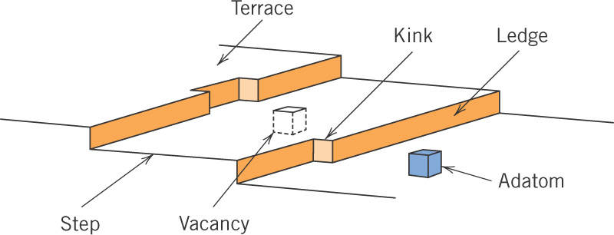
c05f15
Free surface
- Is also considered to be an interfacial defect
The energy of a free surface is directly related to the planar density of atoms.

Slide 8
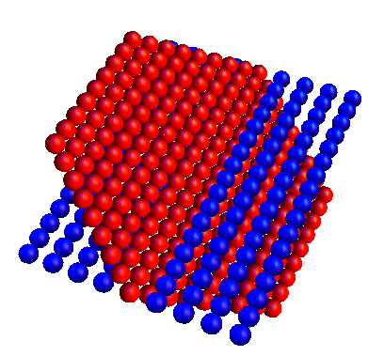
Surfaces
When considering the energy of a surface, higher planar density equals lower surface energy.

