Slide 1
Chap 2 Interatomic Bonding

Slide 2
Let’s take a look at the energy of two atoms / ions as they approach each other to form a bond
With what energy do the atoms “bond” to each other?
What is the equilibrium distance between the atoms?
What properties are related to the bonding energy between atoms?

Slide 3

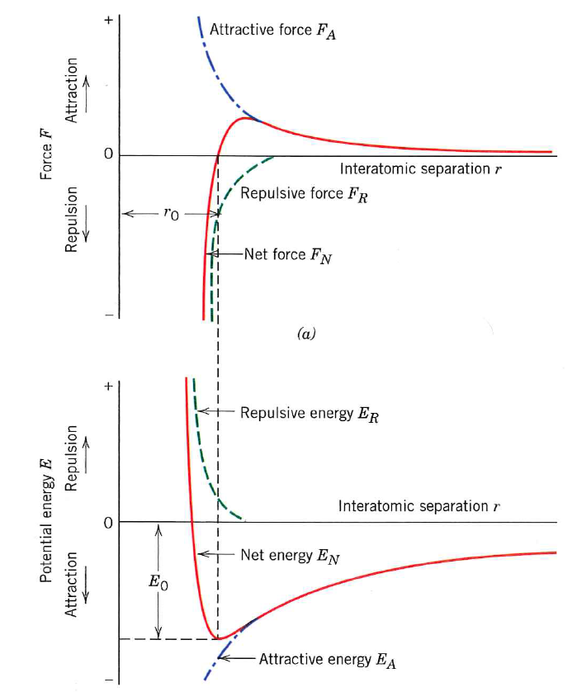
Bonding Energy
E₀ and r₀

Slide 4
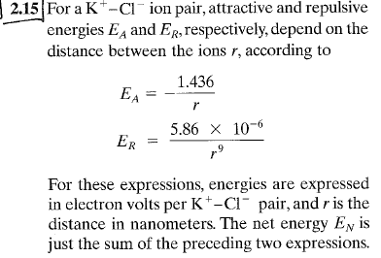
This is similar to your homework problem:
Estimate the bond energy and equilibrium atom spacing

Slide 5
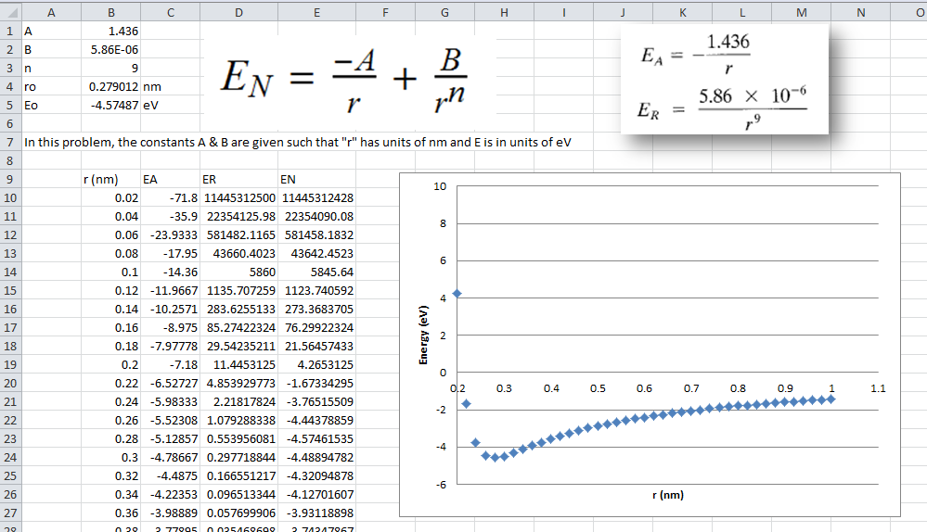
Name cells to use constants
Rescale Y-axis to see plot

Slide 6
How is melting point related to bonding energy?

