Slide 1
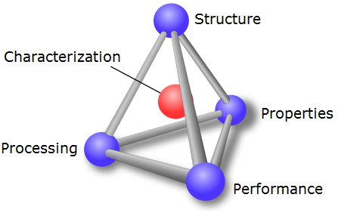
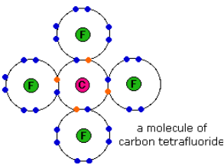
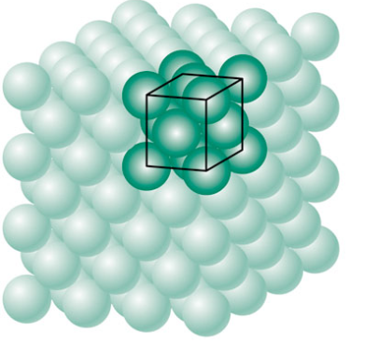
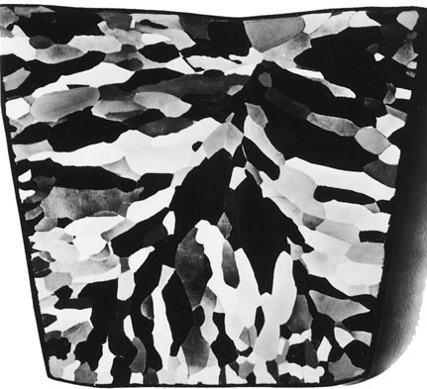
Chapter 3: The Structure of Crystalline Solids
Properties of materials are determined by their structure; processing can alter structure in specific and predictable ways
Four levels of structure:
Atomic Structure
Atomic Arrangement
Microstructure
Macrostructure

Slide 2
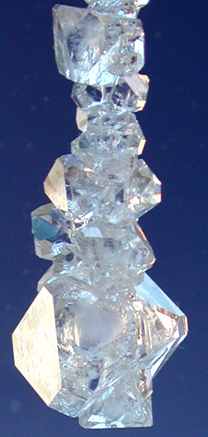
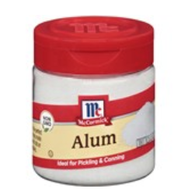
Crystal Structures
The atoms in crystalline solids arrange themselves in a highly ordered periodic structure.
7 Crystal Systems
Grow Your Own Alum Crystal
To grow these crystals you will need:
1/2 cup hot tap water
2-1/2 tablespoons Alum
Notes:
Notice well defined angles between edges of crystals. These are specific to the type of crystal and imply an underlying ordered structure of atoms.

Slide 3
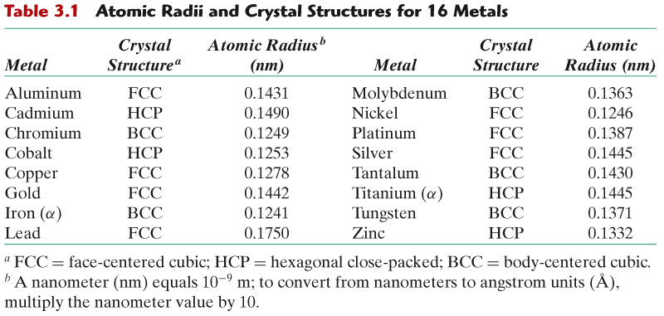
c03tf01
Crystal Structures of Common Metals
Crystal Structure = Lattice + atoms

Slide 4
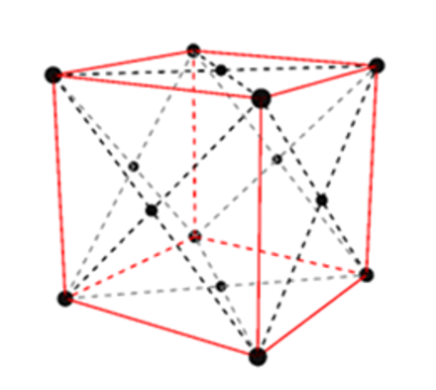
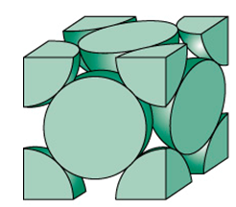
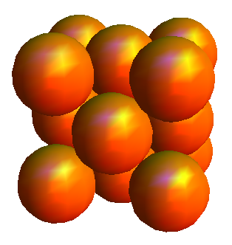
Face-centered cubic (FCC) crystal structure
Space Filling Model
Cut Sphere Model
Notes:
Pick bottom front corner atom of first unit cell and show how this is only 1/8 of an atom as the rest of the unit cells are added one by one.

Slide 5
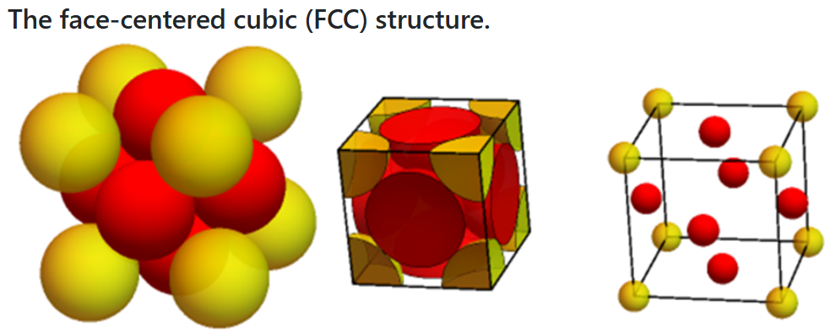
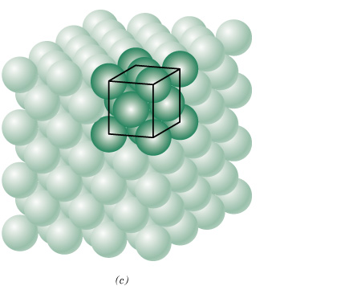

c03f01
Face-centered cubic (FCC) crystal structure
(a) space-filled model, (b) cut-sphere model, and (c) exploded-view model
Close-Packed Structure
APF = 0.74
4 atoms/(unit cell)
Notes:
Derive APF and lattace parameter relationship given on slide.

Slide 6
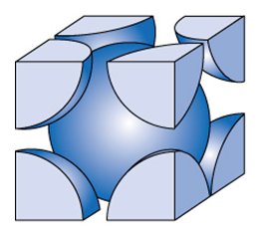
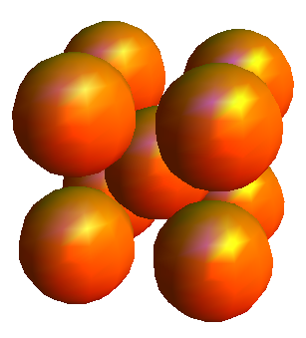
Body Centered Cubic (BCC)
Non close-packed structure
Notes:
Counts the number of atoms.

Slide 7
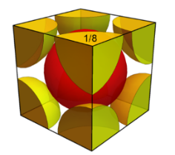
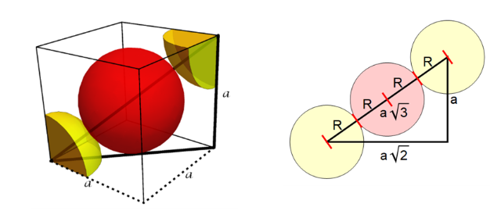

c03f02
Body-centered cubic (BCC) crystal structure
APF = 0.68
2 atoms/(unit cell)
Notes:
Don’t derive these. This is homework.

Slide 8
Extra Slides

Slide 9
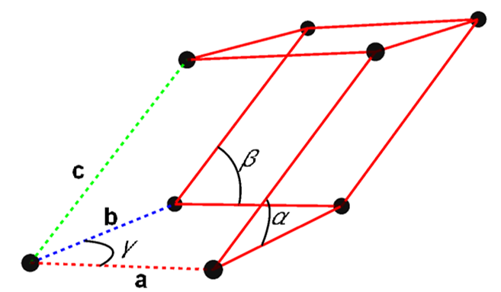
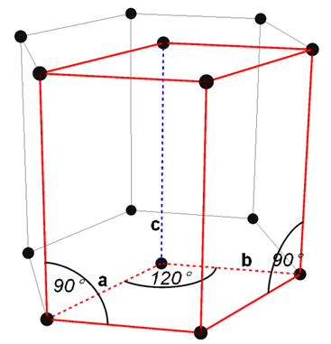
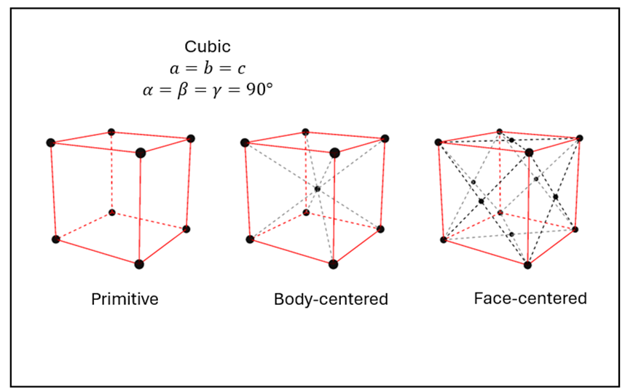
c03f20
Unit cell (general case)
Cubic Crystal System
Cubic Crystal Lattices

