Slide 1
Review of terminology
Definitions
Crystalline materials have the atoms, ions, or molecules arranged
in a periodic, three dimensional array over large numbers of atoms.
Crystal structure: the particular arrangement of atoms.
Lattice: the 3D array of points corresponding to the atomic positions.
Unit cell: the smallest repeating unit of the crystal structure.

Slide 2
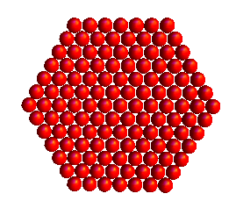
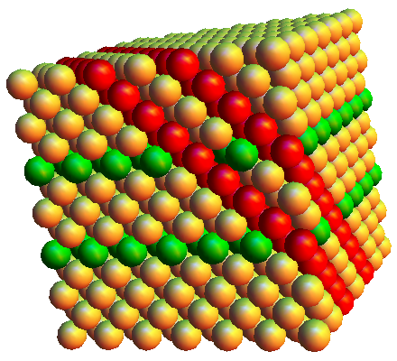
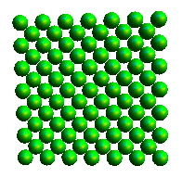
Review
Distance between planes depends upon orientation of planes and arrangement of atoms. Each plane has a different arrangement of atoms.
Notes:
Sketch / show packing of (111) (110) and (100). If planes have different packing and spacings, would a property like elastic modulus depend upon the direction that the crystal is pulled?

Slide 3
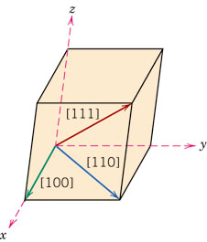
Crystallographic Directions
It is often useful to refer to certain directions in a crystal or to certain planes of atoms in a crystal. We need a simplified system to do this.
Find coordinates (relative to edge length, a) of two points along the direction of interest.
Subtract “tail” point from “head” point.
Clear fractions and reduce to smallest integers.
Enclose the numbers in square brackets and use an “overbar” for negative numbers.

Slide 4
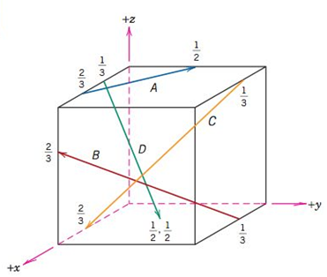
Crystallographic Directions
Fine the indices for the direction labeled B below

Slide 5
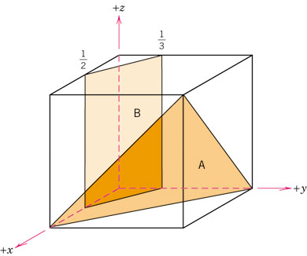
Determine the indices for plane B
Find fractional a, b, and c intercepts.
Take the reciprocal of each intercept.
Clear fractions but do not reduce the result.
Enclose the result in parentheses.
* If a plane does not cross an axis, the intercept is taken to be infinity.

Slide 6
Determine the indices for plane A
Find fractional a, b, and c intercepts.
Take the reciprocal of each intercept.
Clear fractions but do not reduce the result.
Enclose the result in parentheses.

