Slide 1

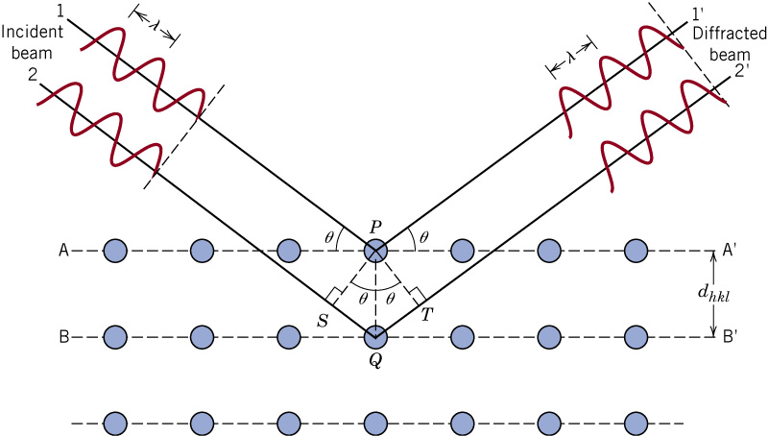
c03f37
How are crystals measured?
Fig. 3.37 X-ray diffraction

Slide 2
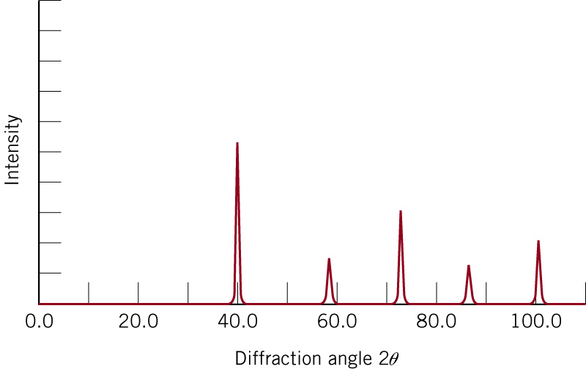
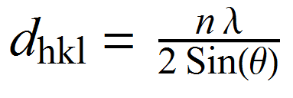
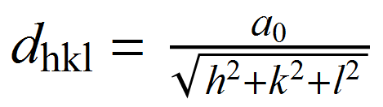
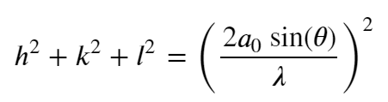
c03f43
Fig. 3.43 Diffraction peaks at various angles 2θ
This data corresponds to tungsten (BCC) and x-ray wavelength of 0.1542 nm.
Radius=0.137nm
In the cubic system, we could show that the plane spacing is given by:
Notes:
2 theta = 40.318 degrees gives h^2+k^2+l^2 = 2.0000

