Slide 1
Because macroscopic plastic deformation corresponds to the motion of large numbers of dislocations, the ability of a metal to plastically deform (yield strength) depends on the relative ease by which dislocations move.
• Grain size reduction
• Solid solution strengthening
• Strain hardening
• Multiple phase effects (Ch. 11)
- quenching and tempering of steels
- precipitation hardening of Al alloys

Slide 2
Principle: Restricting or hindering dislocation motion renders a material harder and stronger.
All strengthening mechanisms rest on this principle.
The question for you to answer is,
“How are dislocations hindered or restricted in any given strengthening mechanism?”

Slide 3
Chapter 7: Deformation and Strengthening Mechanisms
• Grain size reduction
• Solid solution strengthening
• Strain hardening
• Multiple phase effects (Ch. 11)
- quenching and tempering of steels
- precipitation hardening of Al alloys

Slide 4
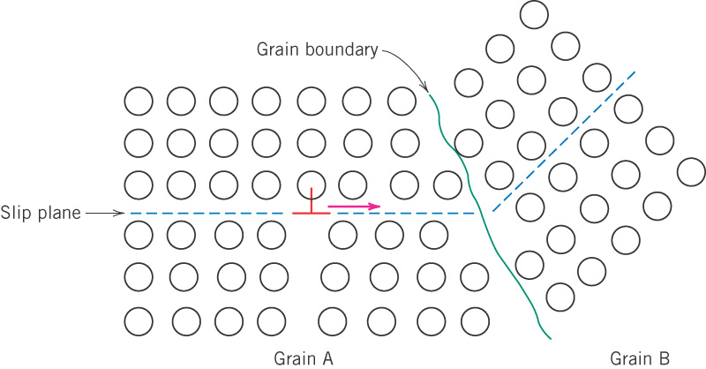
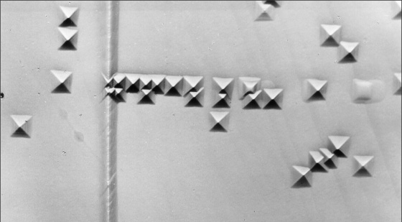
c08f14
Dislocation motion hindered by a grain boundary
At high angle grain boundaries, dislocations tend to “pile up” at grain boundaries. These pile-ups introduce stress concentrations ahead of their slip planes, which generate new dislocations in adjacent grains.
Notes:
Because the two grains are of different orientations, a dislocation passing into grain B will have to change its direction of motion; this becomes more diffi- cult as the crystallographic misorientation increases.
The atomic disorder within a grain boundary region will result in a discontinuity of slip planes from one grain into the other.

Slide 5
Why would a fine grained material have higher strength than a coarse grained material?

Slide 6
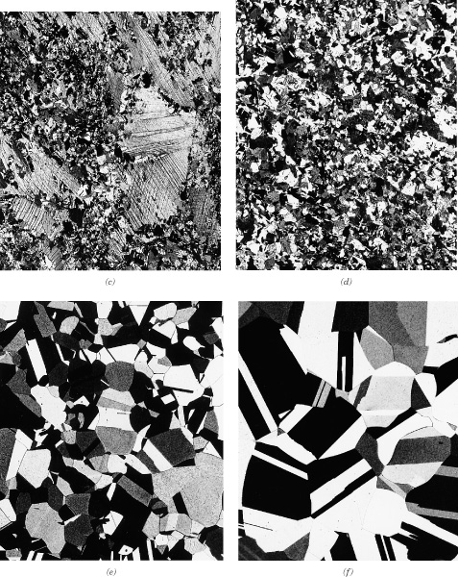
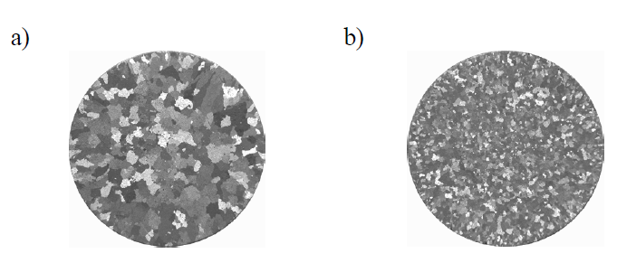
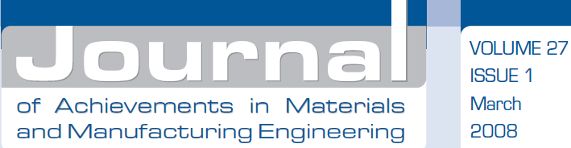
Strengthening by
grain size reduction
Brass
Cast Aluminum after inoculation with 25ppm Ti + 5ppm B,
Notes:
Recrystallization results in a finer grain sized material.
Casting with inoculants results in a finer grained material.

Slide 7
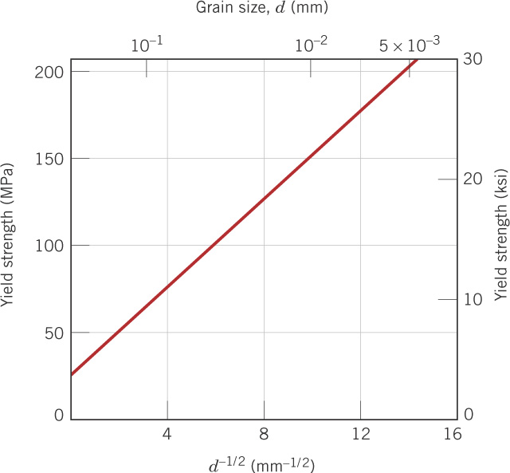
c08f15
Effect of grain size on yield strength (Hall-Petch)
70Cu-30Zn brass

Slide 8
Chapter 7: Deformation and Strengthening Mechanisms
• Grain size reduction
• Solid solution strengthening
• Strain hardening
• Multiple phase effects (Ch. 11)
- quenching and tempering of steels
- precipitation hardening of Al alloys

Slide 9
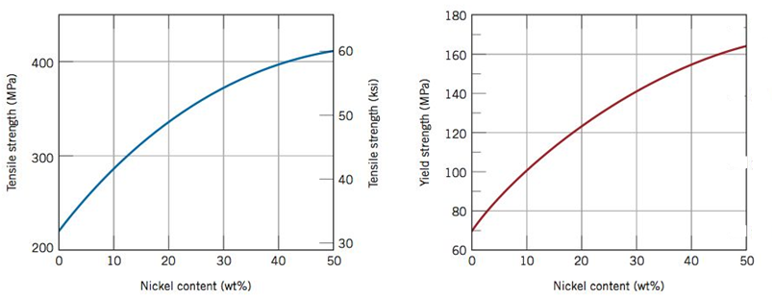
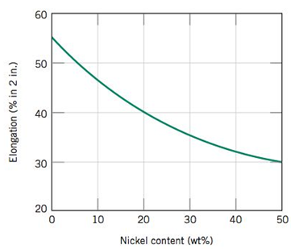
c08f16
Solid solution strengthening
The different size atoms distort
the crystal structure, making the movement of dislocations along their slip planes more difficult.

Slide 10
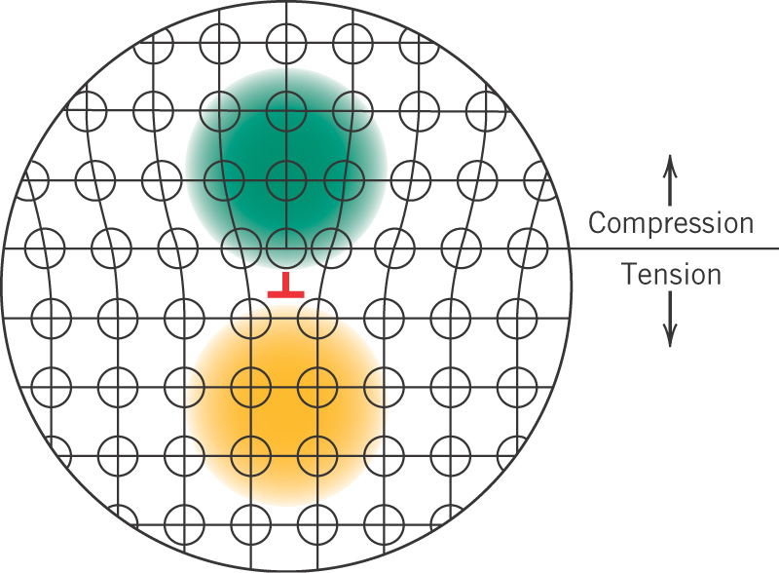
c08f04
Distortion and stress local at a dislocation
(Important for understanding strengthening mechanisms.)

Slide 11
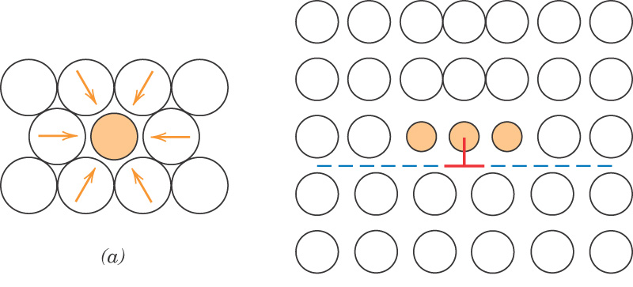
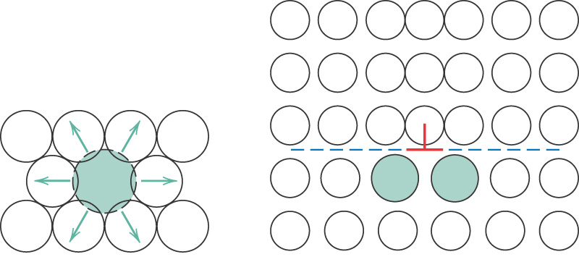
c08f17
Effects of solute atoms
Solute atoms smaller
than host atoms
Compression or
Tension?
Solute atoms larger
than host atoms
Notes:
Interactions through the strain fields around dislocation.

Slide 12
• Grain size reduction
• Solid solution strengthening
• Strain hardening
• Multiple phase effects (Ch. 11)
- quenching and tempering of steels
- precipitation hardening of Al alloys

Slide 13
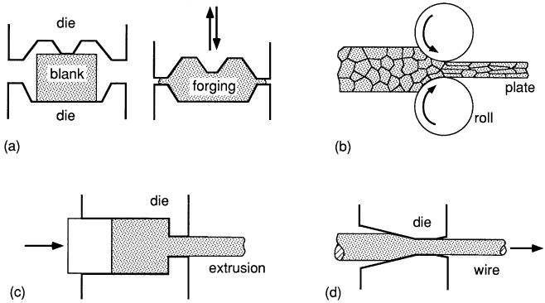
Methods of deforming metals
forging
rolling
extruding
drawing
From: Mechanical Behavior of Materials: Engineering Methods for Deformation, Fracture, and Fatigue, 3rd edition, by Norman E. Dowling. ISBN 0-13-186312-6. © 2007 by Pearson Education, Inc., Upper Saddle River, NJ. All rights reserved.

Slide 14
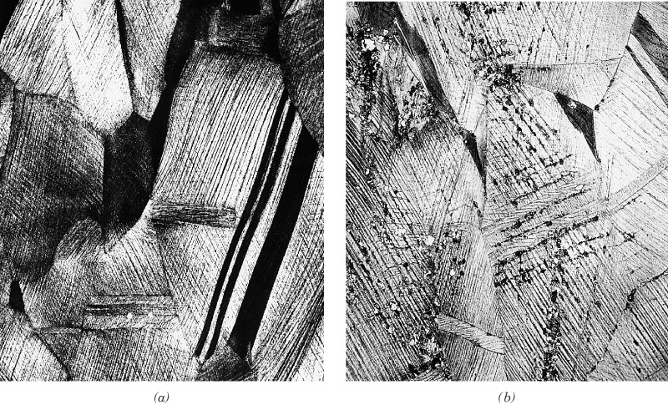
If applied at room temperature, these procedures are called
cold working and are said to produce strain hardening.
Many new dislocations are
introduced and these interfere
with each other’s motion.

Slide 15
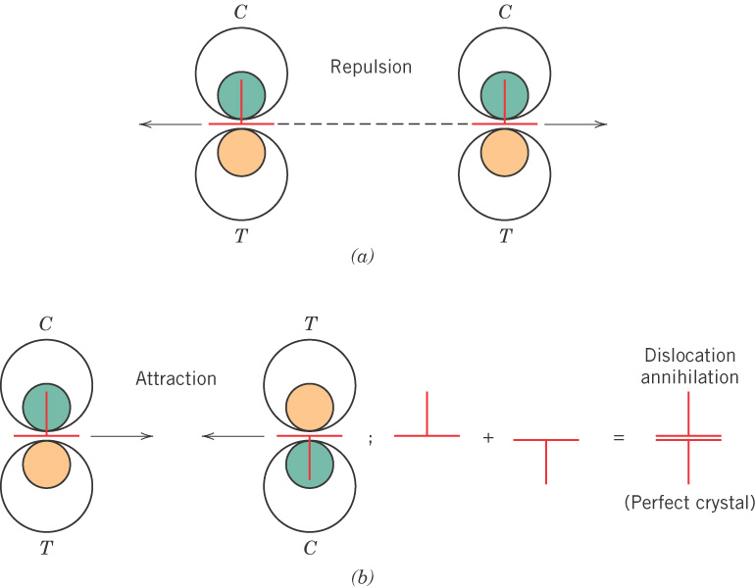
c08f05
Interactions of
dislocations

Slide 16
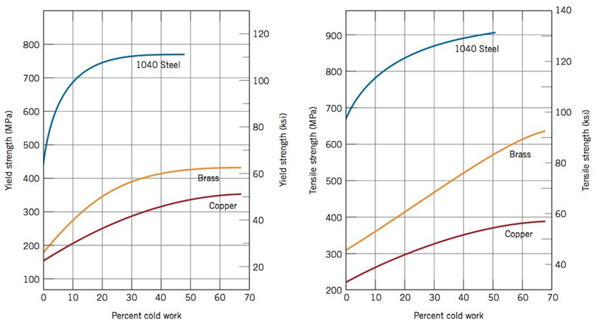
c08f19
Effects of cold work
- strength is increased
What is the tradeoff?

Slide 17
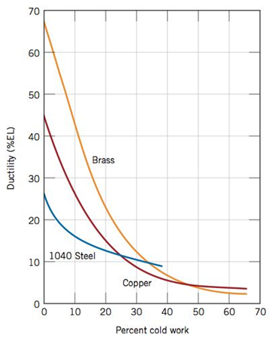
c08f19
- but ductility is decreased
As for the other methods,
strengthening (good) is
accompanied by reduced
ductility (bad).

Slide 18
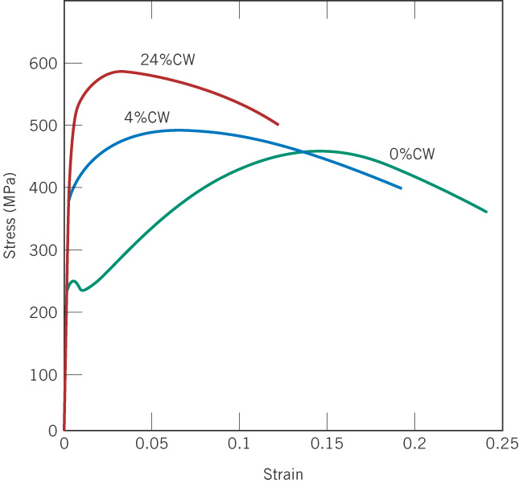
c08f20
Effects of CW on a
low-carbon steel

Slide 19
A few problems to help with your next homework

Slide 20
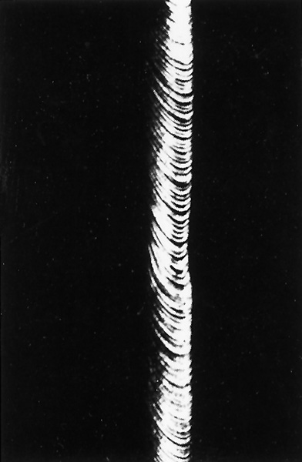
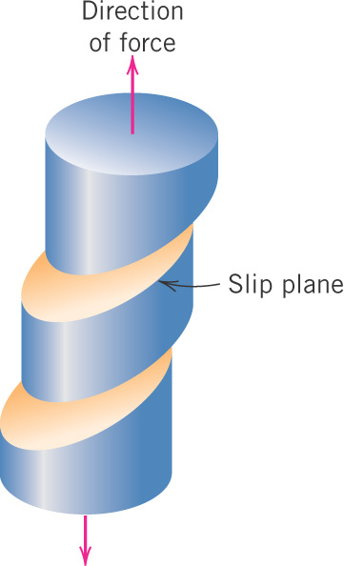
c08f08
Recall: Macroscopic slip
in a single crystal
- of zinc

Slide 21
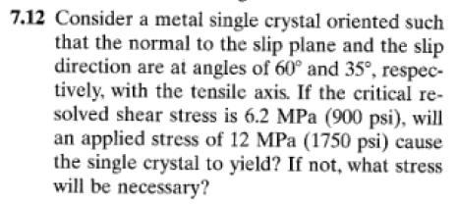

Slide 23
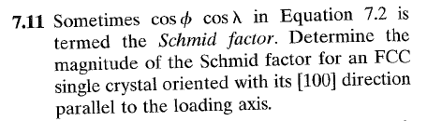
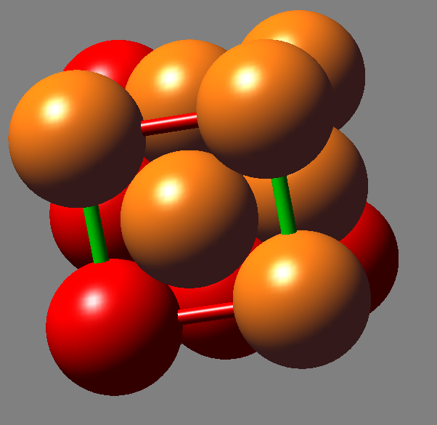
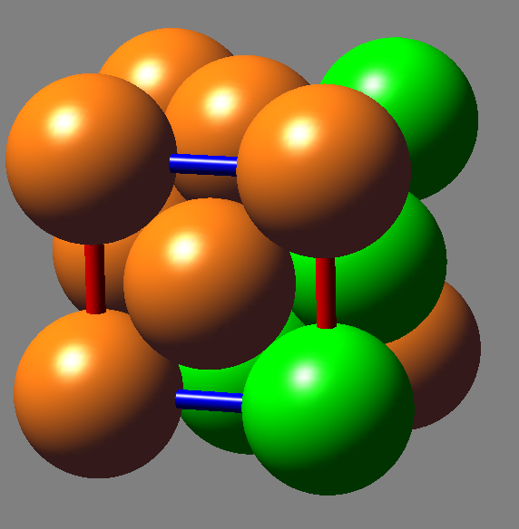
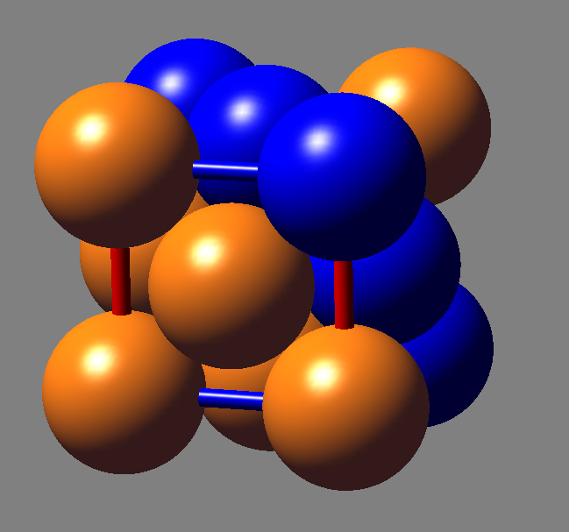
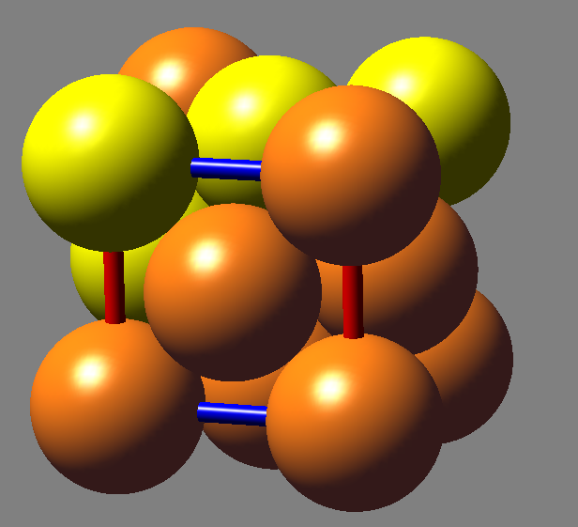
FCC Slip System

Slide 24
7.12 to 7.14 - Recovery, recrystallization, and
grain growth

Slide 25
Still working on partial credit. May return exams back Friday but more likely on Monday.

Slide 26
c08f21ab
Cold-worked brass
- after CW
- beginning to recrystallize at 580°C
Why do newly formed crystals appear?
Aren’t we increasing energy by creating more grain boundary area?

Slide 27

c08f21c-f
- recrystallization proceeds till all of the CW structure is gone at t = 8 s
%CW = 0

Slide 28
c08f21c-f
Then grain growth begins
- after 15 min at 580°C
- after 10 min at 700°C

Slide 29
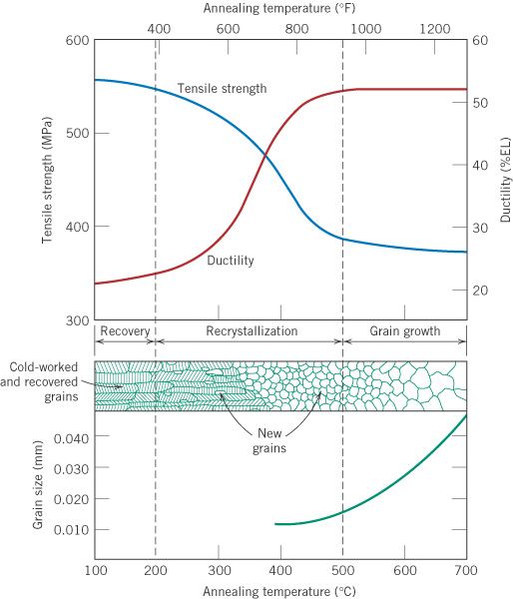
c08f22
Effect of temperature
on structure for 1h
anneal
Time → (at constant temperature)
The same changes occur with
time at a given temperature.
Annealing - holding a metal
at elevated temperature and
then cooling it slowly, causing
softening or other structural
changes.

Slide 30
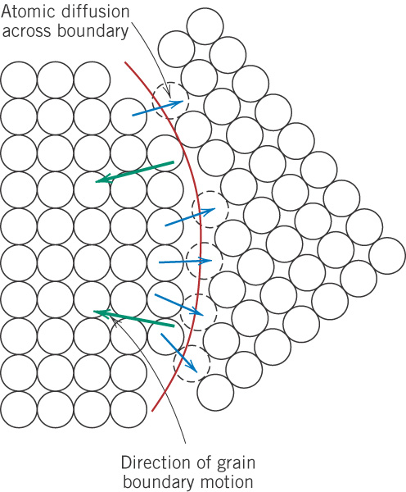
c08f24
Grain growth by diffusion

Slide 31
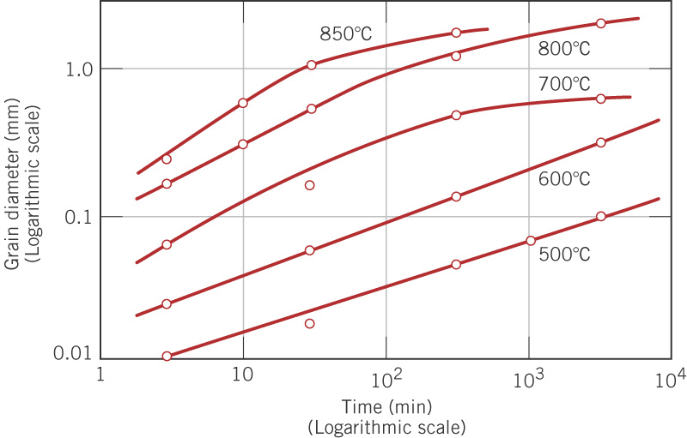
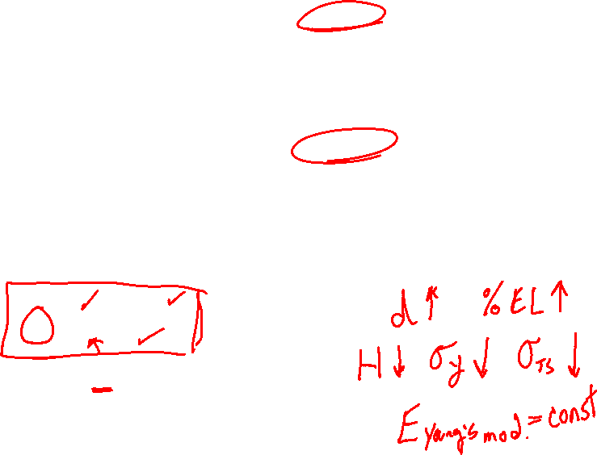
c08f25
Effect of time and temperature on grain growth

Slide 32
A Design Example
made it here lecture 2

Slide 33
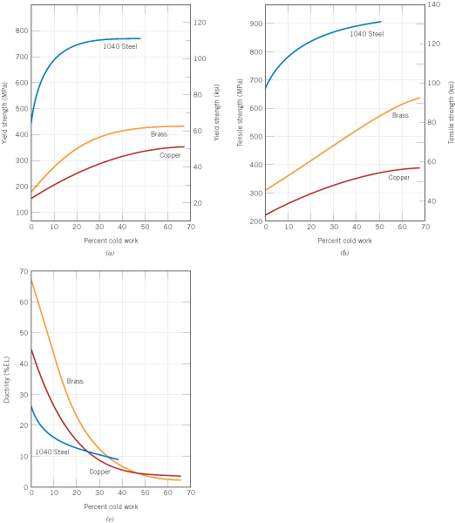
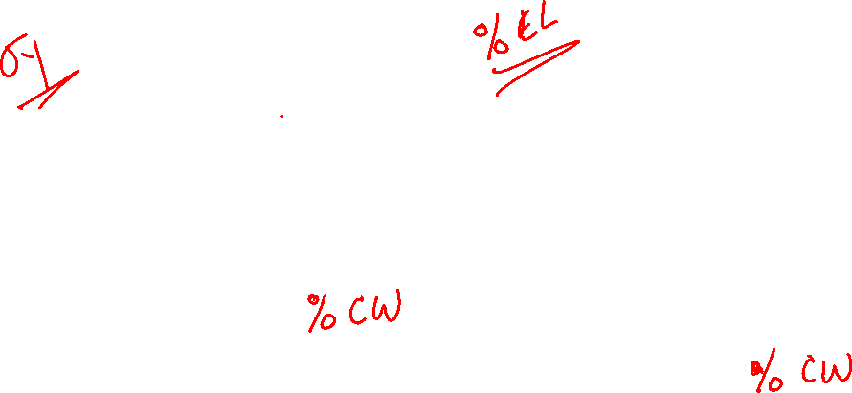
c08f19
Recall: Effects of cold work
- strength is increased
e.g. drawing

Slide 34
Design Example 7.1, pp. 239
A brass rod with initial diameter d₀ = 6.4 mm is to be cold worked by
drawing to achieve σ_{yield} > 345 MPa and %EL > 20% with final
d_{f} = 5.1 mm.
Solution: First consider drawing to d₀ → d_{f} in one step.

Slide 35

c08f19
Goal: achieve σ_{yield} > 345 MPa and %EL > 20%
σ_{yield}, MPa
σ_{yield}, ksi
%EL
410
36.5
8
36.5
%CW
%CW
This gives σ_{yield} = 410 MPa and %EL = 8%, which is OK for σ_{yield}
but fails the %EL > 20% requirement.

Slide 36
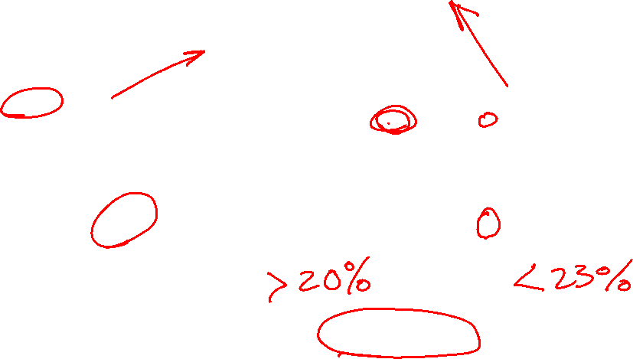
c08f19
Goal: achieve σ_{yield} > 345 MPa and %EL > 20%
σ_{yield}, MPa
σ_{yield}, ksi
%EL
345
20
20
23
%CW
%CW
Enter graphs with the required values.
20 to 23% CW is OK; use 21.5% CW as final step.

Slide 37
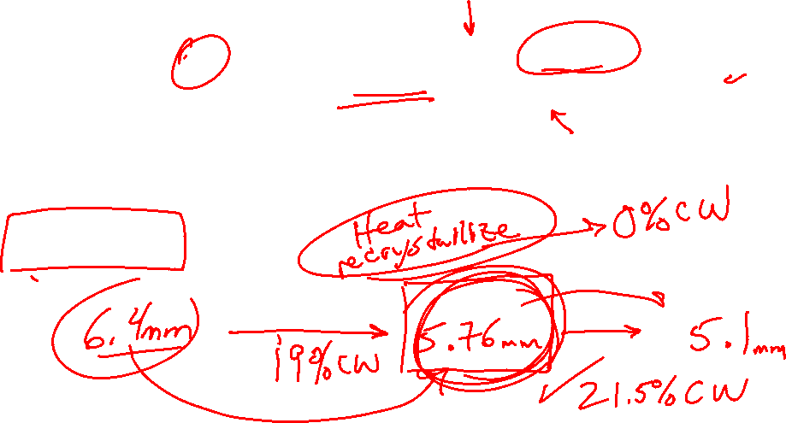
What diameter rod, d_{i} , would give our required 21.5% CW?

Slide 38
Summary:
Draw from 6.4 mm diameter to 5.76 mm (19% CW)
Anneal (recrystallize) to remove CW.
Draw from 5.76 mm diameter to desired 5.1 mm (21.5% CW).
This final step gives about 350 MPa yield strength and 21% EL, exceeding the requirements.

