Slide 1
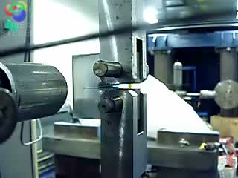
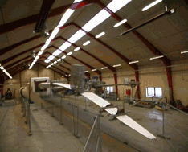

Slide 2
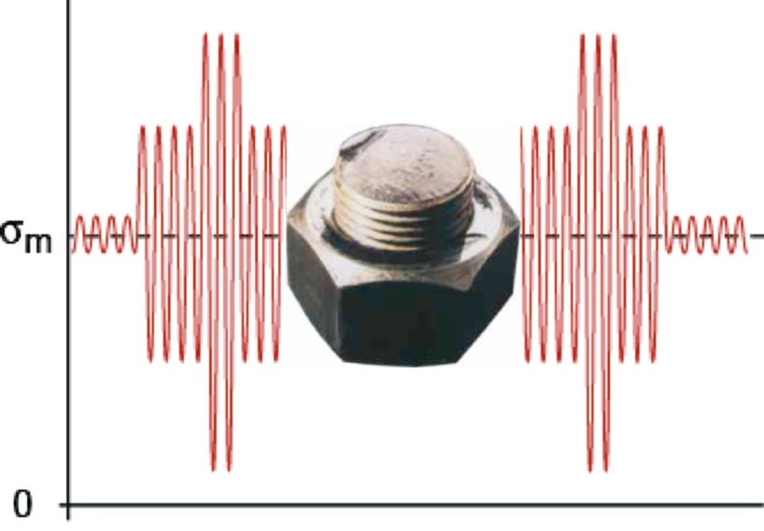
Fatigue of materials
Fatigue is failure due to cyclic loading. A microscopic crack can
initiate from a flaw in the material or surface scratch, grow to
a macroscopic size, and finally lead to complete failure of an
engineering component. If a relatively large flaw is present, the
fatigue life may be greatly reduced.
Notes:
Fatigue started from base of thread – stress concentrator

Slide 3
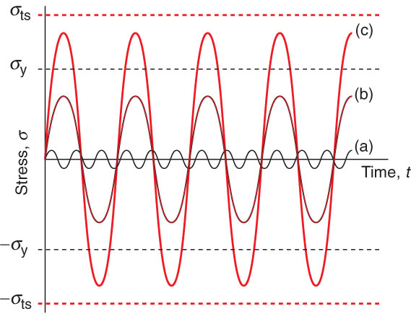
Types of Cyclic Loading
Low amplitude acoustic vibration
High-cycle fatigue: cycling below
the yield strength
(c) Low-cycle fatigue: cycling above
the yield strength but below the
the tensile strength
High-cycle fatigue loading is most significant in
engineering terms

Slide 4
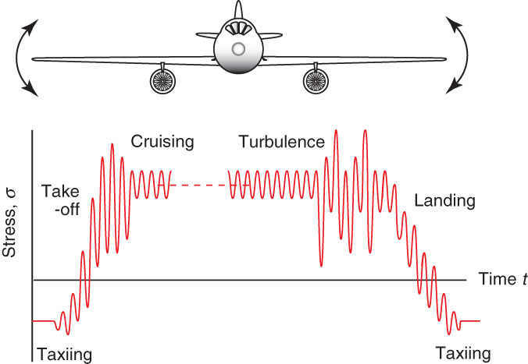
Fatigue
Fatigue failures occur due to cyclic loading at
stresses below a material’s yield strength
Depends on the amplitude of the stress and the number of cycles
Loading cycles can be in
the millions for an aircraft; fatigue testing must employ millions of fatigue cycles to provide meaningful design data

Slide 5
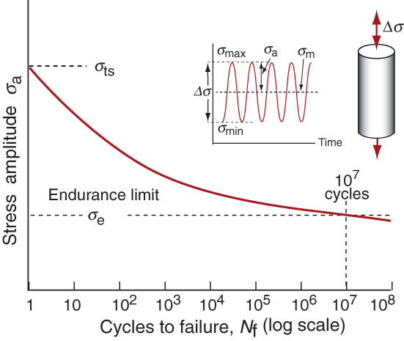
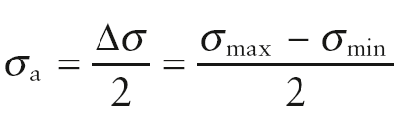
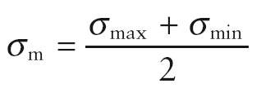
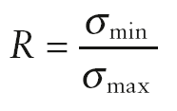
S-N Curves
Fatigue characteristics are measured and plotted on S-N curve
R value of -1 indicates
the mean stress is zero
Endurance limit σ_{e}: stress amplitude below which fracture does
not occur at all or only after a very large number of cycles (>10⁷)

Slide 6
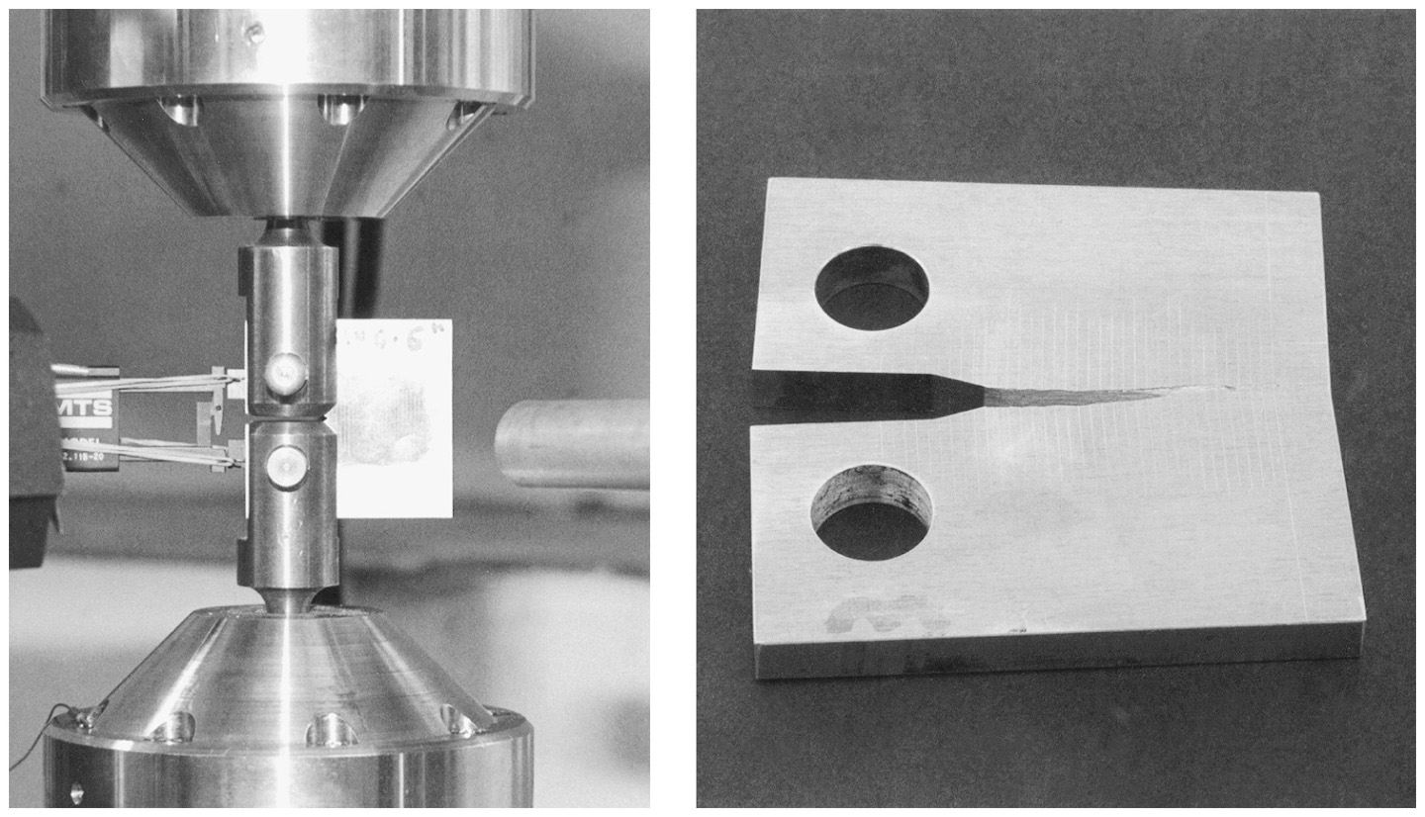
Fatigue crack growth rate test
Cyclic loading is applied to a material sample so as to grow a crack, with
the increasing length of the crack being measured.
From: Mechanical Behavior of Materials: Engineering Methods for Deformation, Fracture, and Fatigue, 3rd edition, by Norman E. Dowling. ISBN 0-13-186312-6. © 2007 by Pearson Education, Inc., Upper Saddle River, NJ. All rights reserved.
Notes:
Figure: 11-071-2

Slide 7
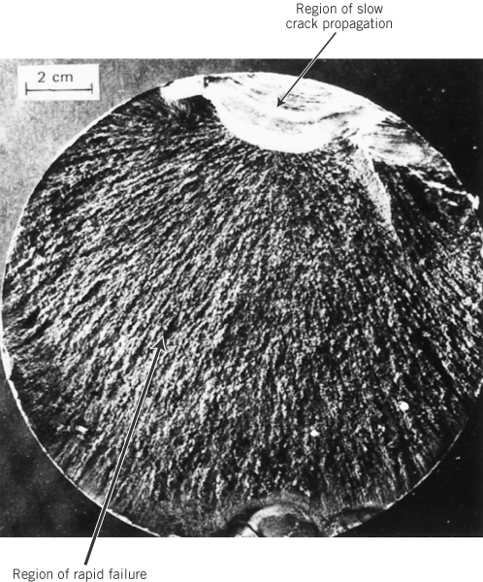
c09f30
Fatigue fracture
surface

Slide 8
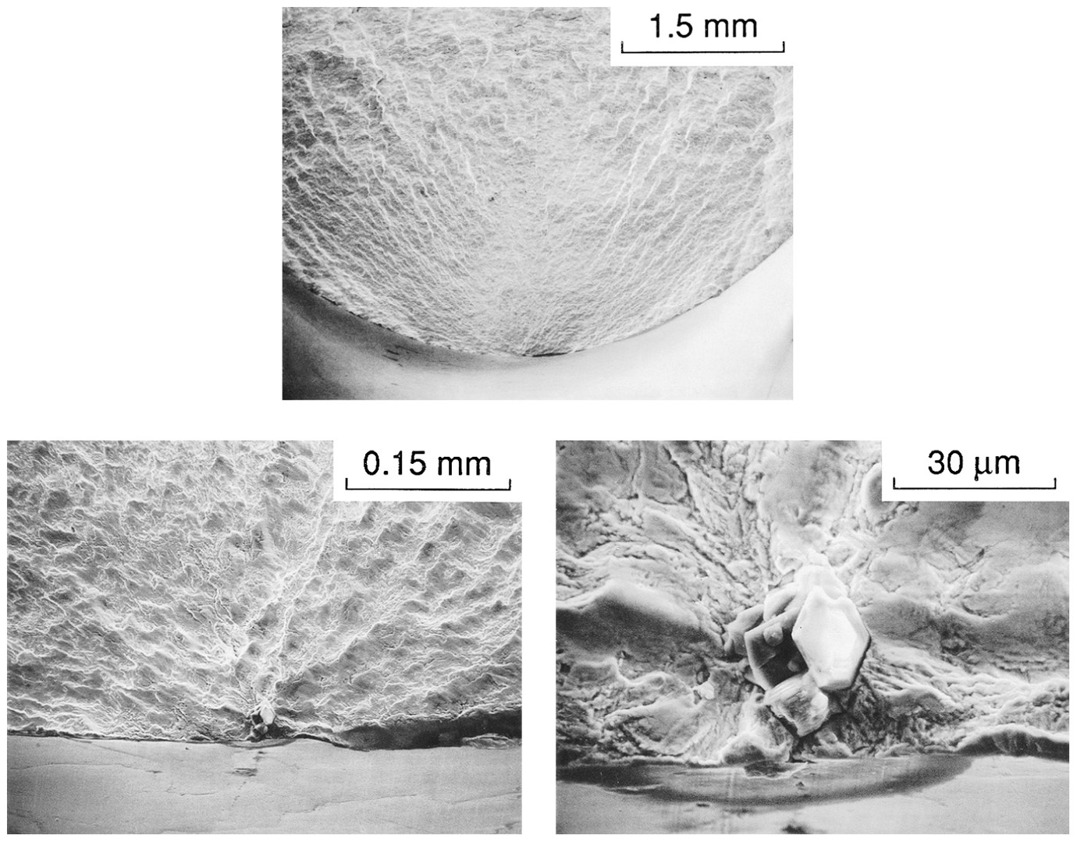
Fatigue crack origin
In an test specimen of
AISI 4340 steel, the fatigue
crack started at a brittle
inclusion particle.
From: Mechanical Behavior of Materials: Engineering Methods for Deformation, Fracture, and Fatigue, 3rd edition, by Norman E. Dowling. ISBN 0-13-186312-6. © 2007 by Pearson Education, Inc., Upper Saddle River, NJ. All rights reserved.
Notes:
Figure: 09-191-3

Slide 9
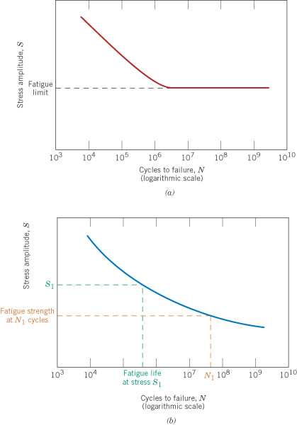
c09f25
Stress-life curves
from fatigue tests
Fatigue limit behavior,
as in some steels
No fatigue limit, as in
aluminum alloys

Slide 10
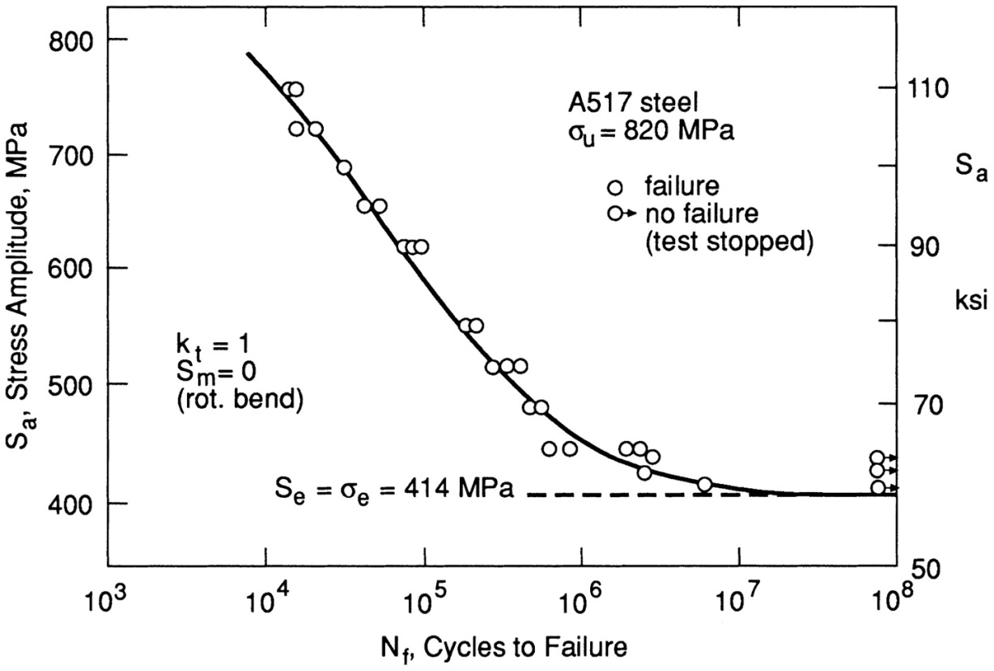
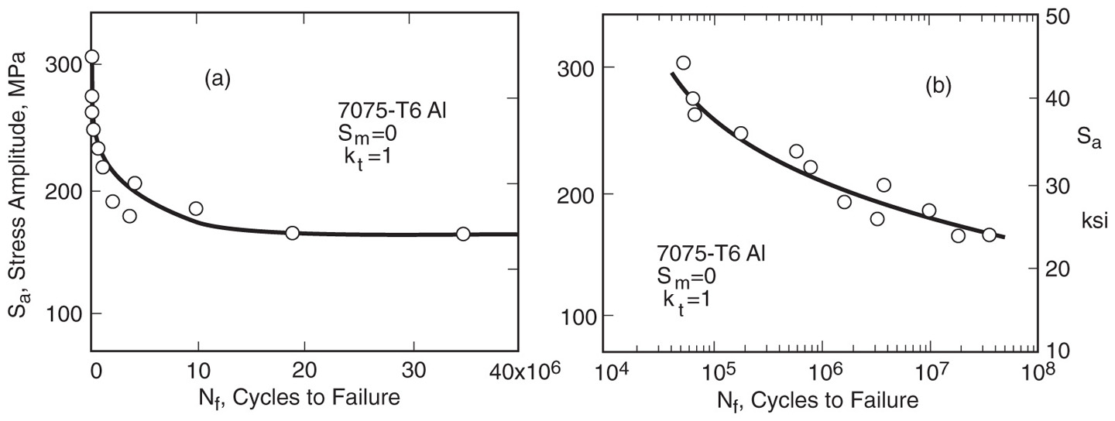
Some real
fatigue data
From: Mechanical Behavior of Materials: Engineering Methods for Deformation, Fracture, and Fatigue, 3rd edition, by Norman E. Dowling. ISBN 0-13-186312-6. © 2007 by Pearson Education, Inc., Upper Saddle River, NJ. All rights reserved.
Notes:
Figure: 09-04a-b

Slide 11
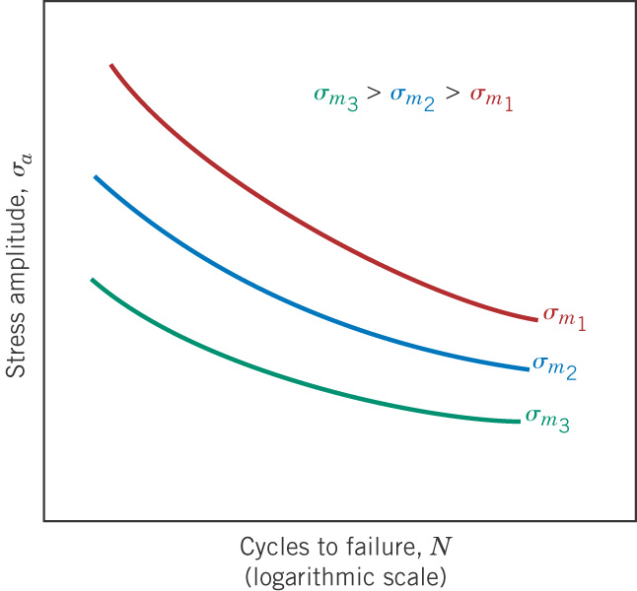
c09f31
Mean stress effect
Higher σ_{m} gives
more tension
and shorter life.

Slide 13
Recall from fracture mechanics
Stress intensity factor, K
The stresses near the crack are proportional to K. So the magnitude
of K is a measure of the severity of a crack situation.
K depends on the geometry, the stress, and the crack length:
crack length
stress
geometry

Slide 14
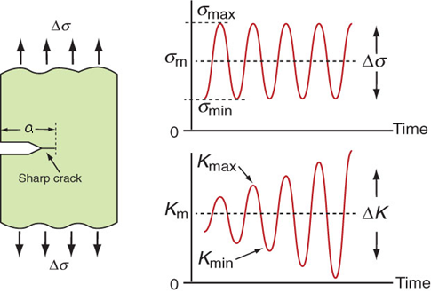

Fatigue Loading of Cracked Components
Fatigue crack growth is studied by cyclically
loading specimens containing a sharp crack
Cyclic stress intensity range
The range ΔK increases
with time under constant
cyclic stress because the
crack grows in length

Slide 15
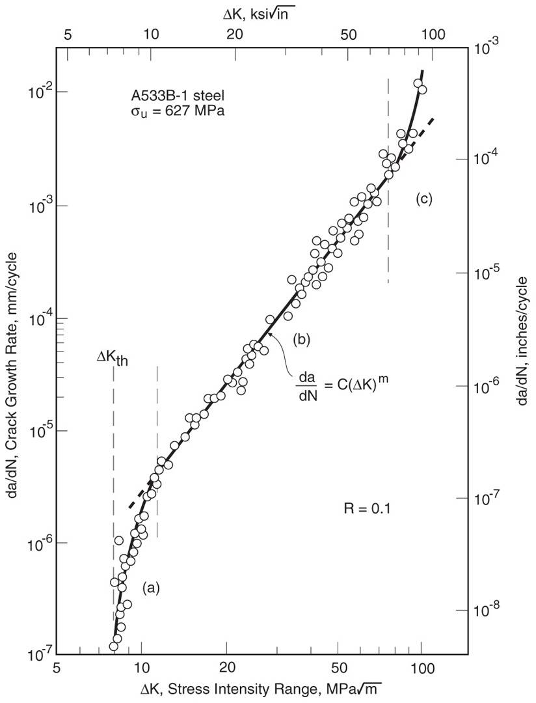
Crack growth behavior
When measured over a wide
range, crack growth rates da/dN
become very slow at low ΔK,
and at high ΔK transition to
unstable behavior due to the
beginning of brittle fracture or
gross yielding. A power
relationship applies except near
either extreme.
m ≈ 3 for metals
From: Mechanical Behavior of Materials: Engineering Methods for Deformation, Fracture, and Fatigue, 3rd edition, by Norman E. Dowling. ISBN 0-13-186312-6. © 2007 by Pearson Education, Inc., Upper Saddle River, NJ. All rights reserved.
Notes:
Figure: 11-03

Slide 16
Fatigue crack growth rate test
Cyclic loading is applied to a material sample so as to grow a crack, with
the increasing length of the crack being measured.
From: Mechanical Behavior of Materials: Engineering Methods for Deformation, Fracture, and Fatigue, 3rd edition, by Norman E. Dowling. ISBN 0-13-186312-6. © 2007 by Pearson Education, Inc., Upper Saddle River, NJ. All rights reserved.
Notes:
Figure: 11-071-2

Slide 17
Example Problem: A polystyrene ruler is loaded as a cantilever with a cyclic force that varies from 0 to 10 N.
What depth of transverse crack is needed at the base of the cantilever for fast fracture to occur when the end force is 10 N?
If the ruler has an initial transverse scratch of depth 0.1 mm, how many cycles of the force will it take before the ruler breaks?
For this problem assume n = 4 and C = 5 x 10⁻⁶ when Δσ is in MPa.

Slide 18
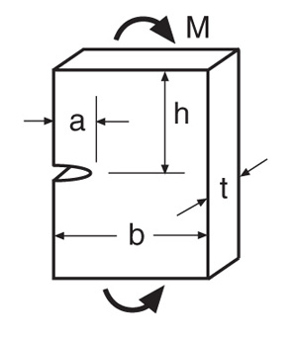
Single-edge-cracked plate in bending
From: Tada, H., P. C. Paris, and G. R. Irwin. 2000.
The Stress Analysis of Cracks Handbook, 3rd ed.,
ASME Press, American Society of Mechanical
Engineers, New York, NY.

Slide 19
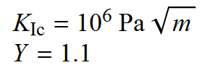



Example Problem: A polystyrene ruler is loaded as a cantilever with a cyclic force that varies from 0 to 10 N.
What depth of transverse crack is needed at the base of the cantilever for fast fracture to occur when the end force is 10 N?

Slide 20
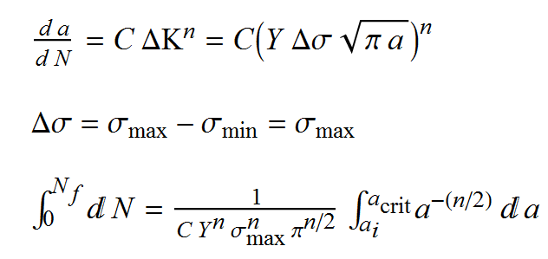
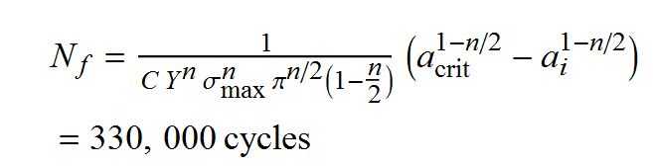
(b) If the ruler has an initial transverse scratch of depth 0.1 mm, how many cycles of the force will it take before the ruler breaks?
For this problem assume n = 4 and C = 5 x 10⁻⁶ when Δσ is in MPa.

Slide 21
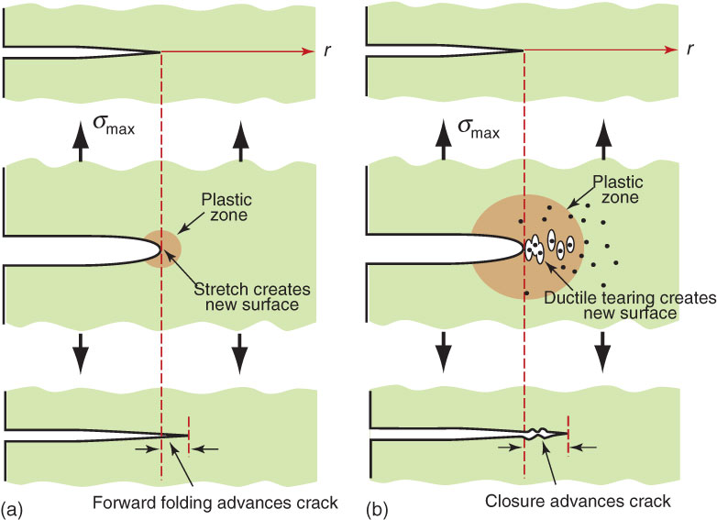
Fatigue Damage and Cracking
During high-cycle fatigue the
tension cycle produces a tiny
plastic zone which is folded
forward during compression
During low-cycle fatigue the
plastic zone is large enough
for voids to nucleate and
coalesce which advances the
crack

Slide 22
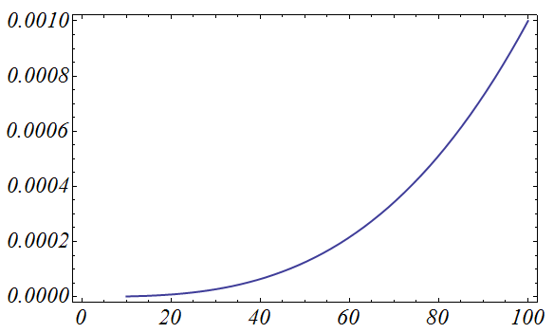
Review: Crack growth behavior
From: Mechanical Behavior of Materials: Engineering Methods for Deformation, Fracture, and Fatigue, 3rd edition, by Norman E. Dowling. ISBN 0-13-186312-6. © 2007 by Pearson Education, Inc., Upper Saddle River, NJ. All rights reserved.
Notes:
Figure: 11-03

Slide 23
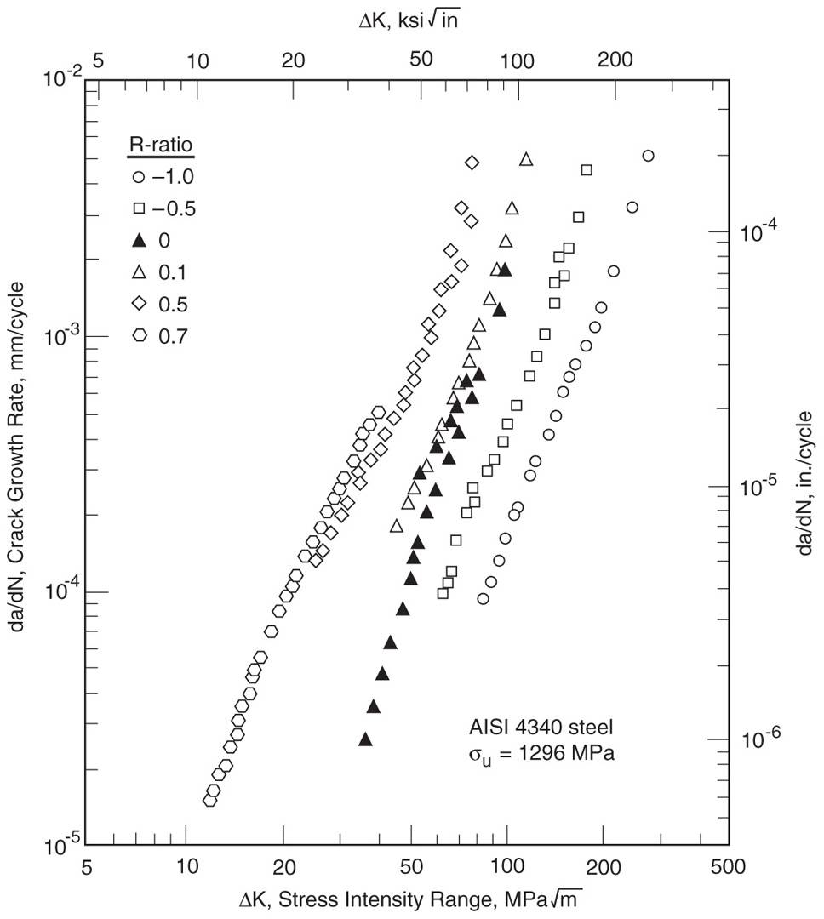
R-ratio (mean stress) effects
The most common tests
employ R ≈ 0. Behavior at
various R can be included
by considering C to depend
on R.
C₀ is C at R = 0, with
m the same for all R,
and γ gives the degree
of sensitivity to R.
γ → 1, no effect
γ → 0, strong effect
From: Mechanical Behavior of Materials: Engineering Methods for Deformation, Fracture, and Fatigue, 3rd edition, by Norman E. Dowling. ISBN 0-13-186312-6. © 2007 by Pearson Education, Inc., Upper Saddle River, NJ. All rights reserved.
Notes:
Figure: 11-04

Slide 24
Example: A center-cracked plate of AISI 4340 steel (σ_{u} = 1296 MPa) has dimensions b = 38 and t = 6 mm, and it contains an initial crack of length a_{i} = 1.0 mm. The plate is subjected to cyclic loading between constant maximum and minimum tensile forces P_{min} = 70 and P_{max} = 280 kN. Estimate the life to grow the crack to failure. Some materials properties are:
Solution: First calculate the needed stresses and the final crack length.

Slide 25
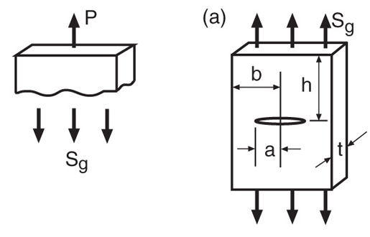
σ
Center-cracked
plate in tension
σ
From: Tada, H., P. C. Paris, and G. R. Irwin. 2000.
The Stress Analysis of Cracks Handbook, 3rd ed.,
ASME Press, American Society of Mechanical
Engineers, New York, NY.

Slide 26
To determine the final crack length, assume that Y ≈ 1.0, and then check to see if the calculation is valid, that is, if a_{f} /b ≤ 0.4.

Slide 27
We also need C for our value of R.

Slide 28
Finally, the calculated life is

