Slide 1
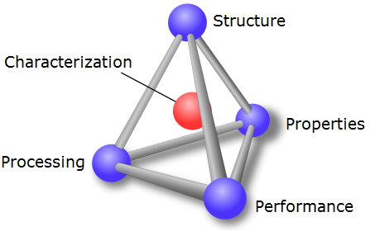
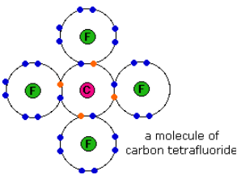
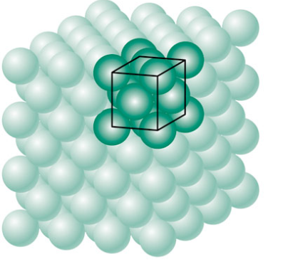
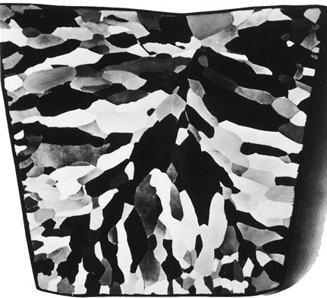
Chapter 3: The Structure of Crystalline Solids
Properties of materials are determined by their structure; processing can alter structure in specific and predictable ways
Four levels of structure:
Atomic Structure
Atomic Arrangement
Microstructure
Macrostructure

Slide 2
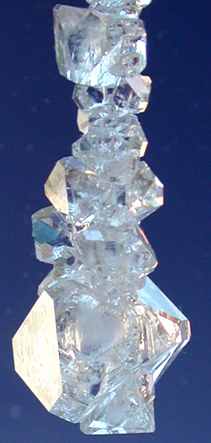
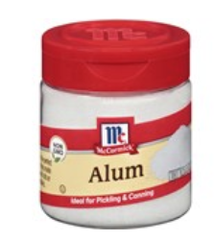
Crystal Structures
The atoms in crystalline solids arrange themselves in a highly ordered periodic structure.
7 Crystal Systems
Grow Your Own Alum Crystal
To grow these crystals you will need:
1/2 cup hot tap water
2-1/2 tablespoons Alum
Notes:
Notice well defined angles between edges of crystals. These are specific to the type of crystal and imply an underlying ordered structure of atoms.

