Slide 1
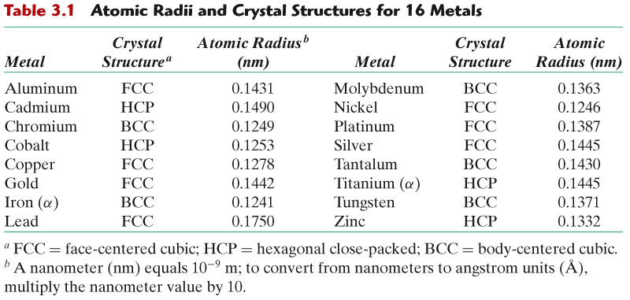
c03tf01
Crystal Structures of Common Metals
Crystal Structure = Lattice + atoms

Slide 2
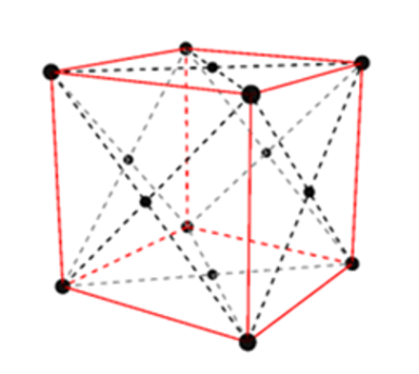
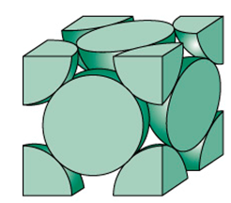
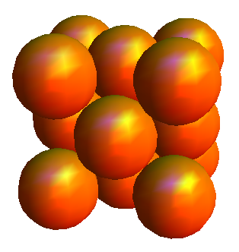
Face-centered cubic (FCC) crystal structure
Space Filling Model
Cut Sphere Model
Notes:
Pick bottom front corner atom of first unit cell and show how this is only 1/8 of an atom as the rest of the unit cells are added one by one.

Slide 3
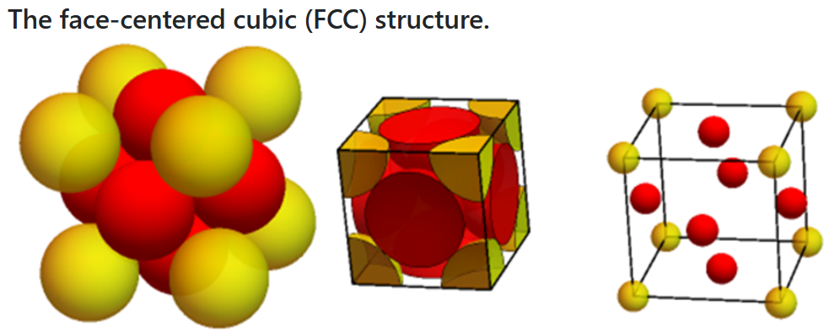
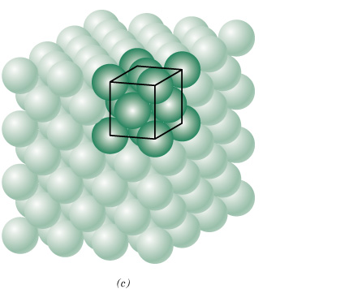

c03f01
Face-centered cubic (FCC) crystal structure
(a) space-filled model, (b) cut-sphere model, and (c) exploded-view model
Close-Packed Structure
APF = 0.74
4 atoms/(unit cell)
Notes:
Derive APF and lattace parameter relationship given on slide.

Slide 4
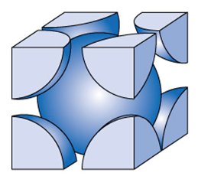
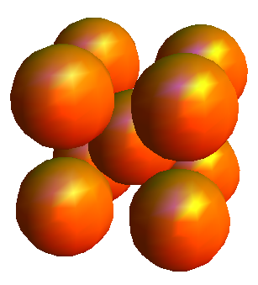
Body Centered Cubic (BCC)
Non close-packed structure
Notes:
Counts the number of atoms.

Slide 5
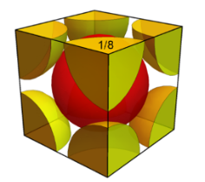
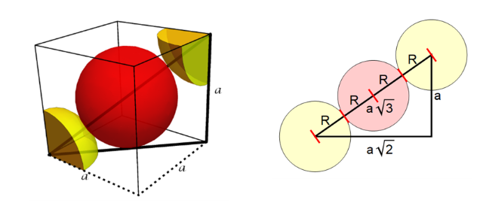

c03f02
Body-centered cubic (BCC) crystal structure
APF = 0.68
2 atoms/(unit cell)
Notes:
Don’t derive these. This is homework.

