Slide 1
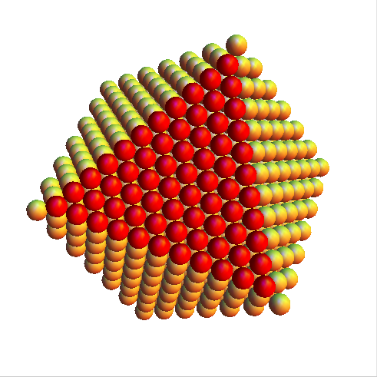
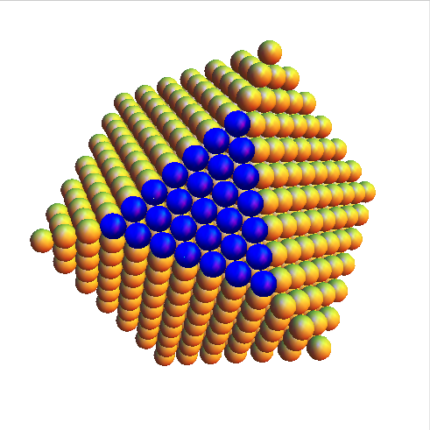
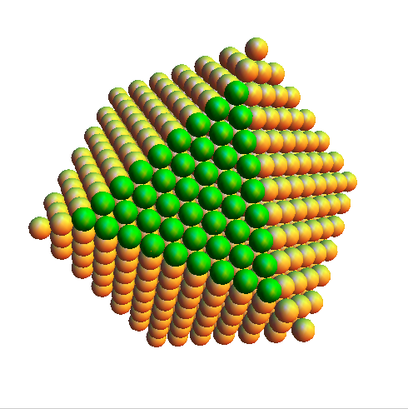
FCC can be created by stacking “billiard ball” type planes
What happens if we instead use ABAB packing?

Slide 2
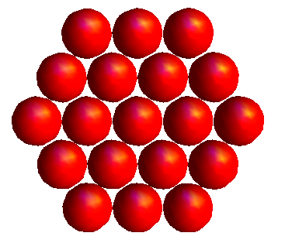
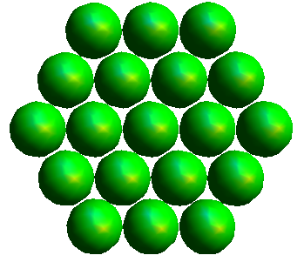
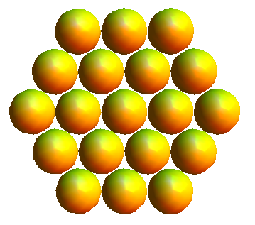
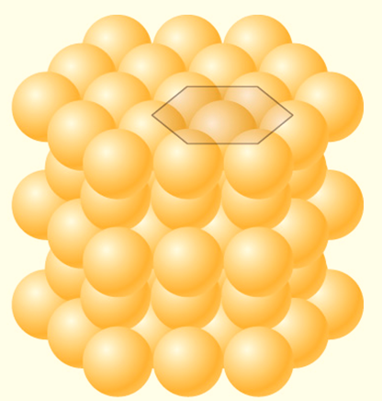
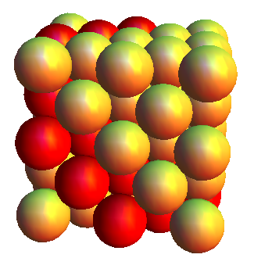
ABCABC vs ABAB packing

Slide 3
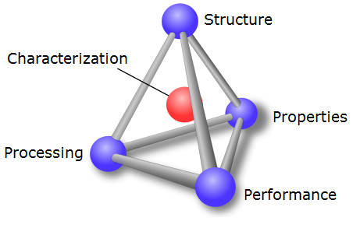
Recall MSE tetrahedron

Slide 4
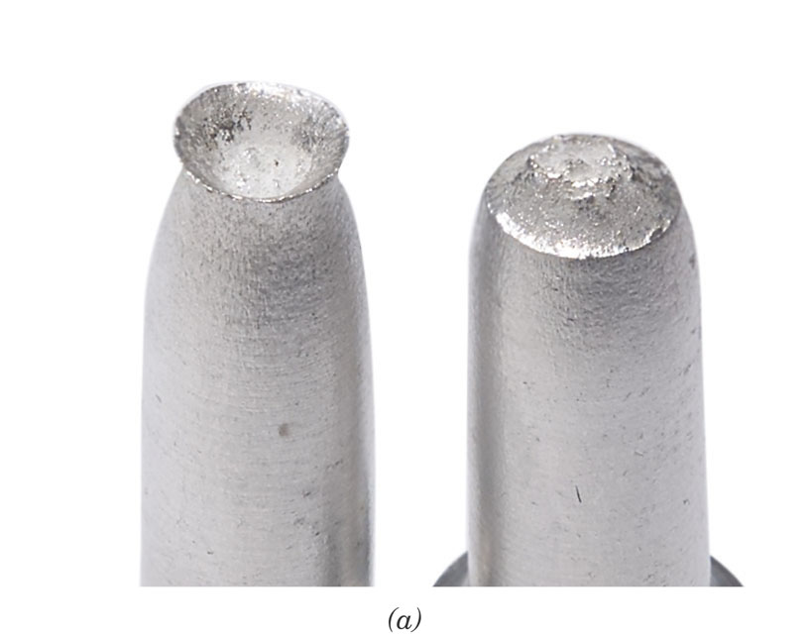
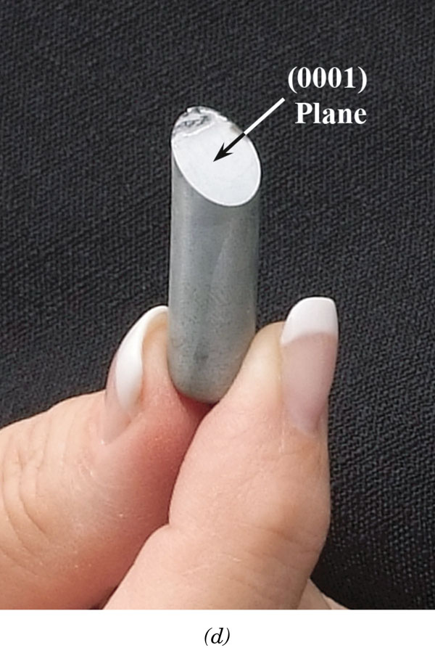
FCC vs HCP
ABAB packing
ABCABC packing

Slide 5
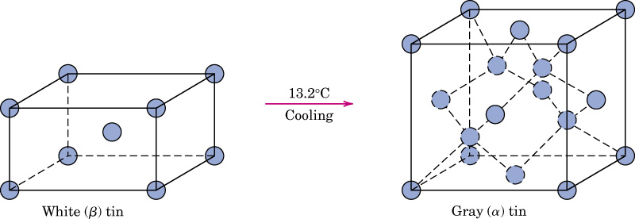
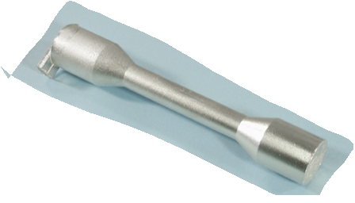
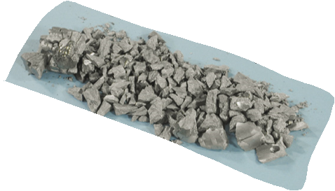
c03impf02a
Two forms (allotropes) of tin, Sn
body-centered tetragonal
structure, ρ = 7.3 g/cm³
diamond cubic structure
ρ = 5.8 g/cm³

Slide 6
Extra Slides

Slide 7
