Slide 1
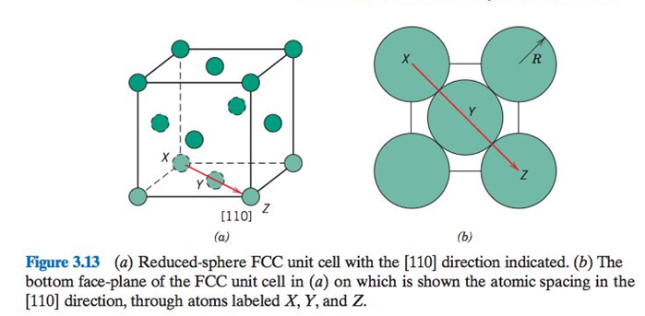
Sketch the atom placement on the (100) plane for FCC

Slide 2
Sketch the atom placement on the (100) plane for FCC

Slide 3
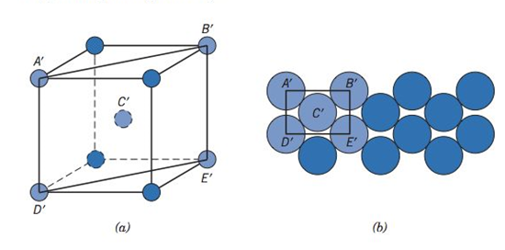
Sketch the (110) plane for the BCC structure

Slide 4
Sketch the (110) plane for the BCC structure

Slide 5
Extra Slides

Slide 6
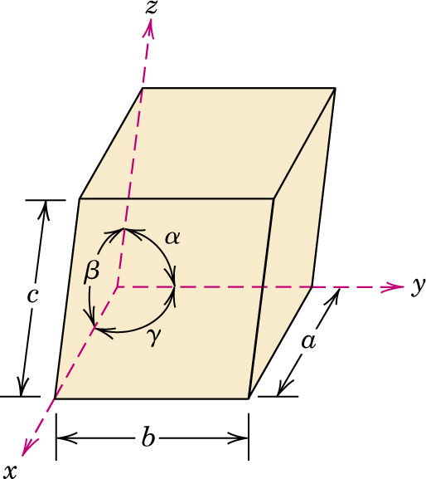
c03f20
Fig. 3.20 Unit cell
(general case)

Slide 7
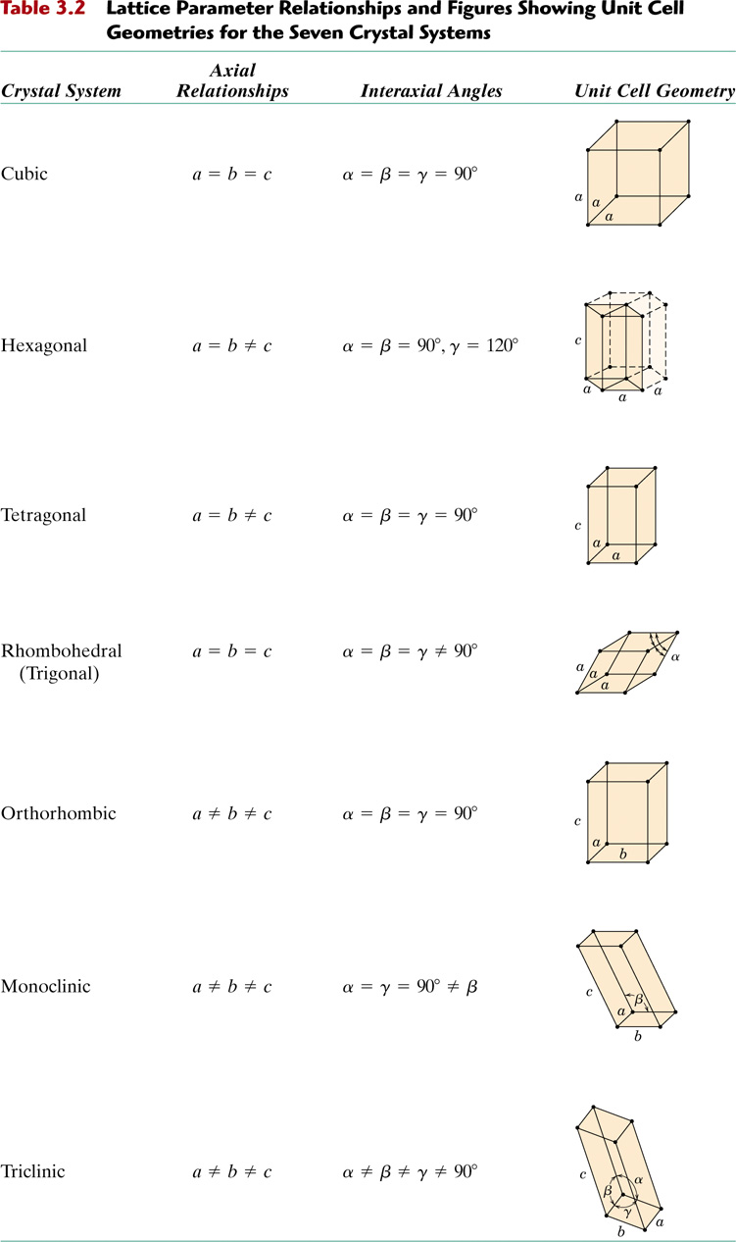
c03tf06

Slide 8
c03tf06
continued ....

Slide 9
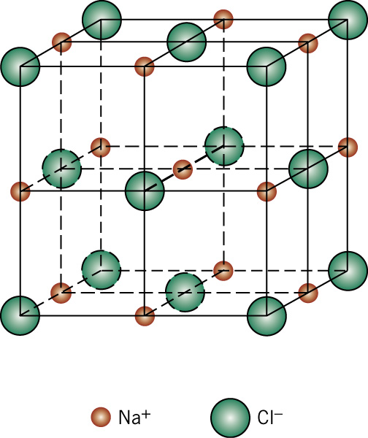
c03f05
Fig. 3.5
NaCl structure
CN = 6
MgO
FeO
TiC
ZrC

Slide 10
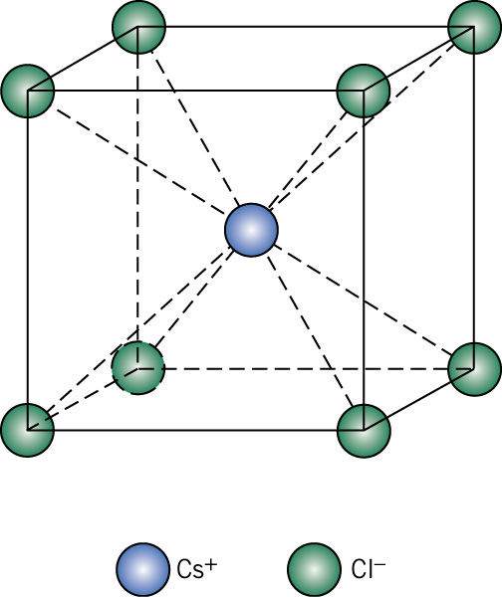
c03f06
Fig. 3.6
CsCl structure
CN = 8
CsBr
AgZn
BeCu

Slide 11
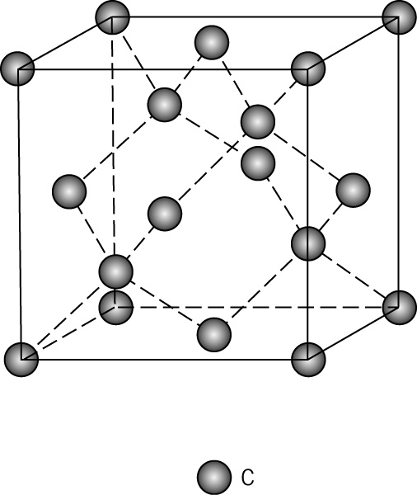
c03f16
Fig. 3.16
Diamond cubic
crystal structure
C (diamond)
Ge
Si
Sn (<13.2°)

Slide 12
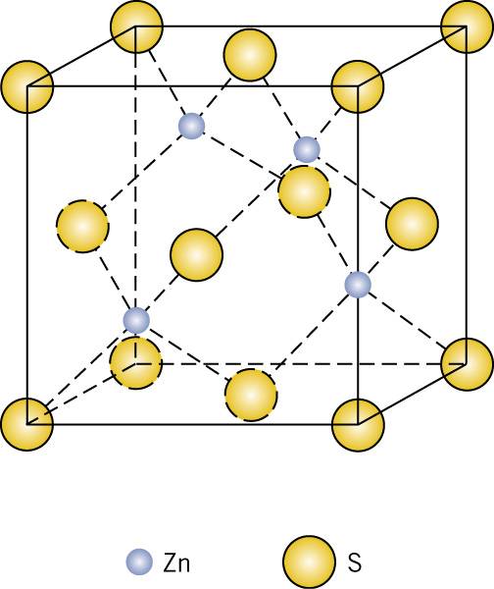
c03f07
Fig. 3.7
Zinc blende
ZnS structure
CN = 4
CdS
ZnTe
SiC

Slide 13
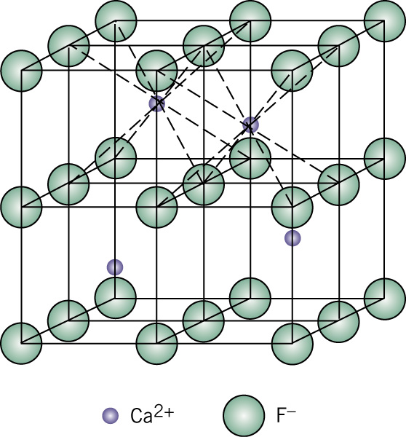
c03f08
Fig. 3.8
Fluorite
CaF₂ structure
CN = 8 (for cation)
ZrO₂
UO₂
PuO₂
ThO₂

Slide 14
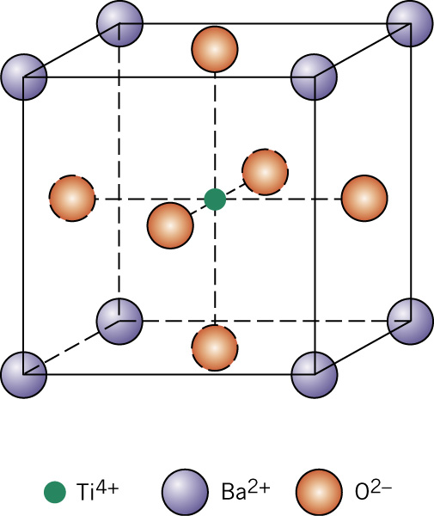
c03f09
Fig. 3.9
Perovskite
BaTiO₃ structure
SrZrO₃
SrSnO₃

Slide 15
c03f16
Fig. 3.16
Diamond cubic
crystal structure
Forms of carbon:
diamond
graphite
buckyballs, C₆₀
nanotubes

