Slide 1
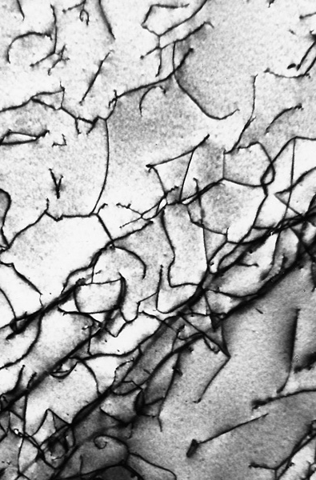
c05f11
Types of imperfections in crystals
- point: vacancy, interstitial
- line: dislocations
- interfacial: grain boundary, twin boundary
Dislocations in a
titanium alloy
at 51,500X

Slide 2
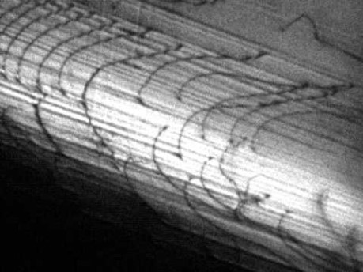

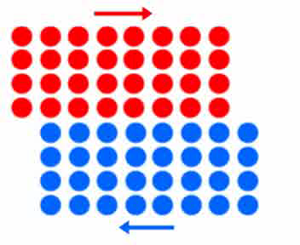
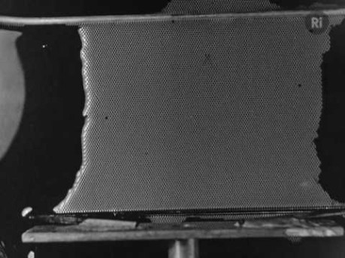
Notes:
John Kacher Dislocation Glide https://youtu.be/EXbiEopDJ_g
Excerpt from a longer film on bubble rafts, possibly made in the 1940s by William Lawrence Bragg. https://youtu.be/P345p7A4IW8

Slide 3
Notes:
John Kacher Dislocation Glide https://youtu.be/EXbiEopDJ_g
Excerpt from a longer film on bubble rafts, possibly made in the 1940s by William Lawrence Bragg. https://youtu.be/P345p7A4IW8

Slide 4
Notes:
John Kacher Dislocation Glide https://youtu.be/EXbiEopDJ_g
Excerpt from a longer film on bubble rafts, possibly made in the 1940s by William Lawrence Bragg. https://youtu.be/P345p7A4IW8

Slide 5
Notes:
John Kacher Dislocation Glide https://youtu.be/EXbiEopDJ_g
Excerpt from a longer film on bubble rafts, possibly made in the 1940s by William Lawrence Bragg. https://youtu.be/P345p7A4IW8

Slide 6
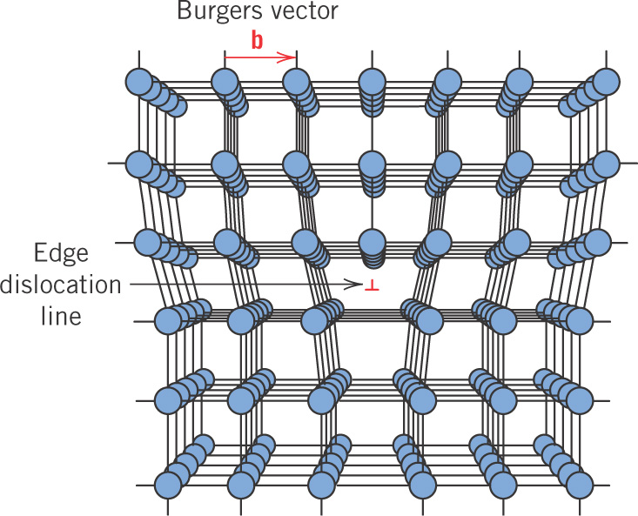
c05f08
Edge dislocation

Slide 7
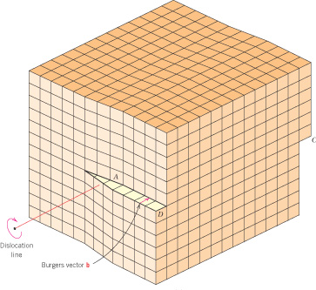
c05f09
Screw dislocation

