Slide 1
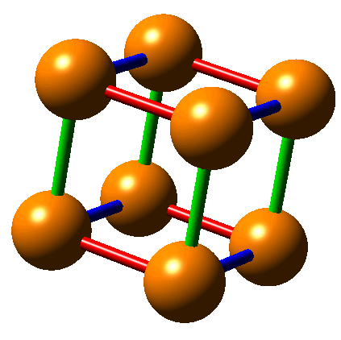
Example: Point Coordinates
Write the fractional coordinates.

Slide 2
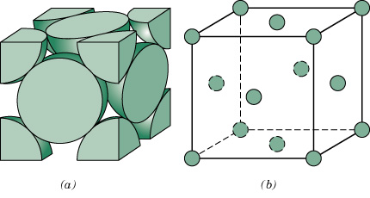
c03f01
In class: FCC crystal structure
Write the fractional coordinates of the atoms
Notes:
Derive APF and lattace parameter relationship given on slide.

Slide 3
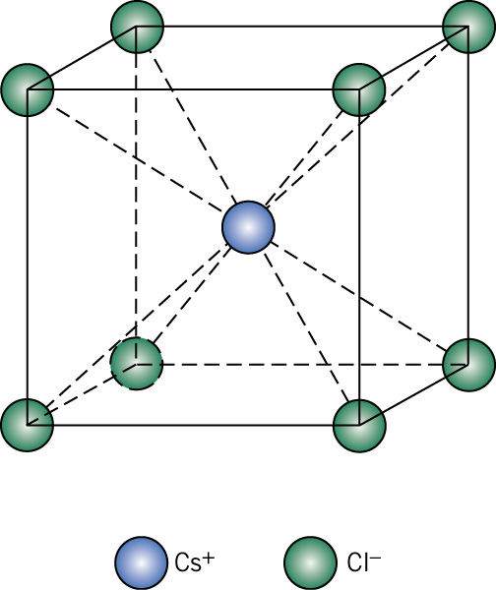
c03f06
In Class: CsCl structure
Write the fractional coordinates of the atoms

Slide 4
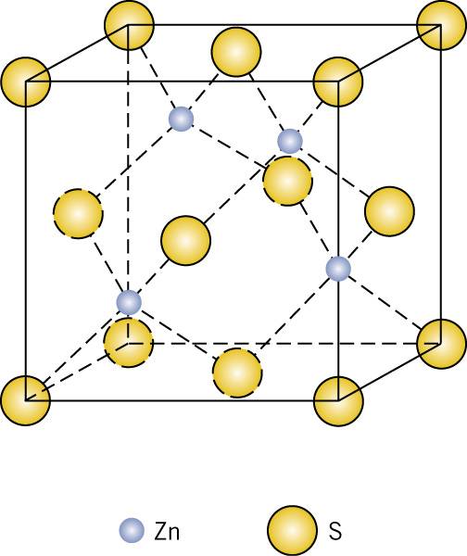
c03f07
In Class: Zn blende structure
Write the fractional coordinates of the atoms

