Slide 1
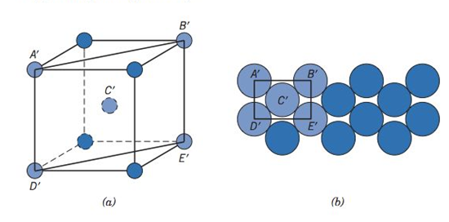
Sketch the (110) plane for the BCC structure

Slide 2
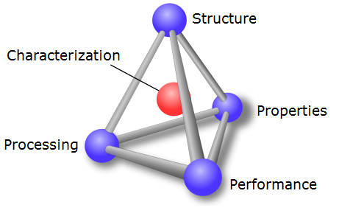
Chapter 4: Imperfections in Solids
In Chap 3, we discussed “perfect” crystalline solids.
In this chapter, we are going to learn about defects that exist in crystalline solids.
Processing can change the number and types of defects in a solid.
Defects often control / alter material properties.

Slide 3
Chapter 4: Imperfections in Solids
Types of imperfections in crystals
- Point (1D): vacancy, interstitial, substitutional
- Line (2D): dislocations
- Interfacial (3D): surface, grain boundary, twin boundary

Slide 4
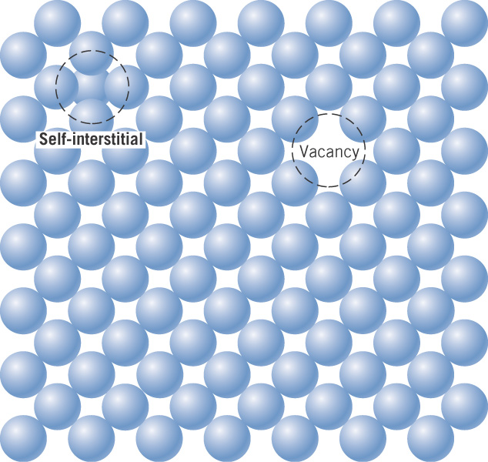
c05f11
Types of imperfections in crystals
point: vacancy, interstitial
line: dislocations
interfacial: grain boundary, twin boundary
Point defects in a metal crystal

Slide 5
Equilibrium number of vacancies
Vacancies spontaneously form in a solid, with the number
increasing with temperature.
This is an example of the Arrhenius equation, with this general
form applying to a variety of thermally activated processes in
materials science and chemistry.

Slide 6
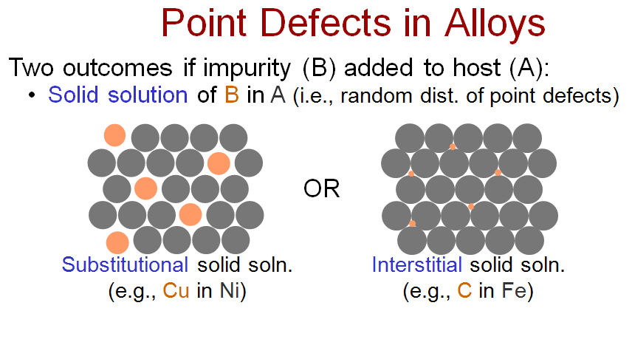
Point defects in a metal or alloy
- the impurity atoms are in solid solution
Substitutional
impurity
Interstitial
impurity
How big are the interstitial sites in a crystal?

Slide 7
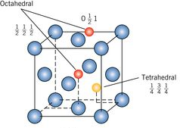
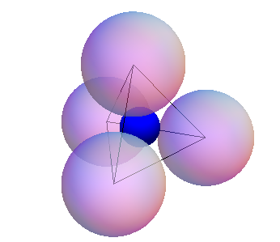
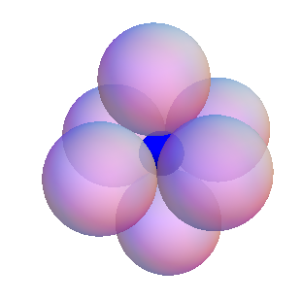







Tetrahedral and Octahedral Interstitial Sites in FCC
Use the Crystalline Solids Program to view interstitial sites in the FCC lattice.

Slide 9
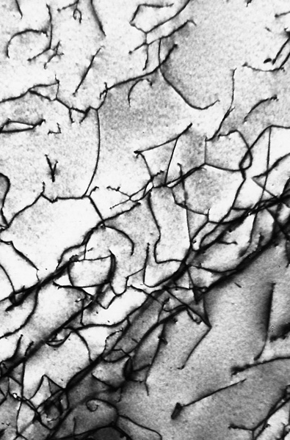
c05f11
Types of imperfections in crystals
- point: vacancy, interstitial
- line: dislocations
- interfacial: grain boundary, twin boundary
Dislocations in a
titanium alloy
at 51,500X

Slide 10
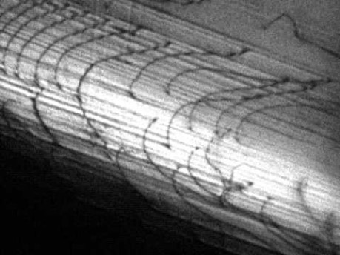

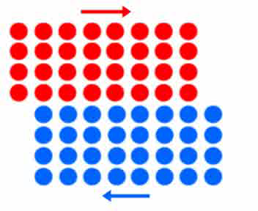
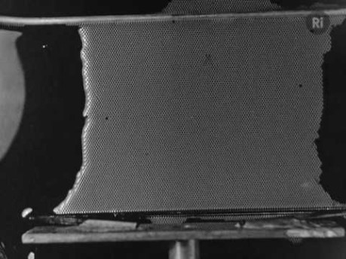
Notes:
John Kacher Dislocation Glide https://youtu.be/EXbiEopDJ_g
Excerpt from a longer film on bubble rafts, possibly made in the 1940s by William Lawrence Bragg. https://youtu.be/P345p7A4IW8

Slide 11
Notes:
John Kacher Dislocation Glide https://youtu.be/EXbiEopDJ_g
Excerpt from a longer film on bubble rafts, possibly made in the 1940s by William Lawrence Bragg. https://youtu.be/P345p7A4IW8

Slide 12
Notes:
John Kacher Dislocation Glide https://youtu.be/EXbiEopDJ_g
Excerpt from a longer film on bubble rafts, possibly made in the 1940s by William Lawrence Bragg. https://youtu.be/P345p7A4IW8

Slide 13
Notes:
John Kacher Dislocation Glide https://youtu.be/EXbiEopDJ_g
Excerpt from a longer film on bubble rafts, possibly made in the 1940s by William Lawrence Bragg. https://youtu.be/P345p7A4IW8

Slide 14
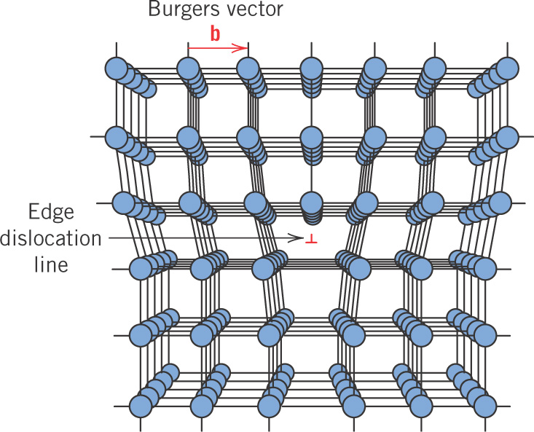
c05f08
Edge dislocation

Slide 15
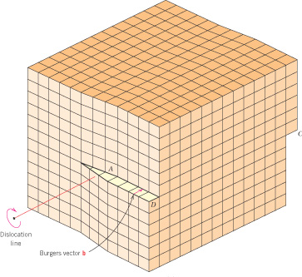
c05f09
Screw dislocation

Slide 16
Here lecture 1 Start lecture 2 (50 min)

Slide 17
Types of imperfections in crystals
- point: vacancy, interstitial
- line: dislocations
- interfacial: grain boundary, twin boundary
Correction on homework problem (110) bcc.

Slide 18
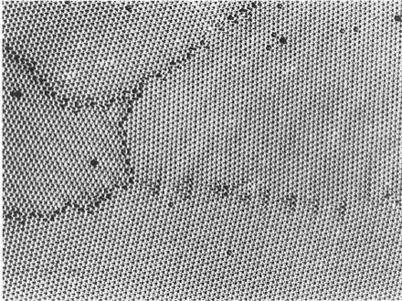
c05f12
Grain
boundaries
High angle grain boundaries
Low angle grain boundary
Notes:
After P.G. Shewmon, Tranformations in Metals, McGraw-Hill, New York, 1969, from C.S. Smith

Slide 19
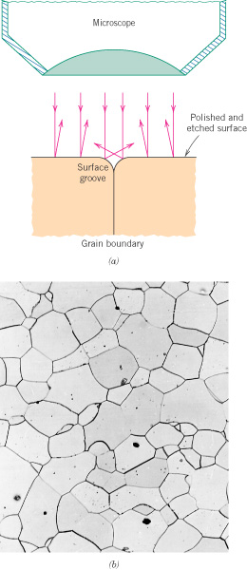
c05f19ab
Grain boundaries in an Fe-Cr alloy at 100X

Slide 20
ASTM grain size number, G
G varies 1 to 10, with 10 being very small grains
n = average number of grains/inch² at 100X

Slide 21
Example
If 62.6 grains/in² are counted on a photograph at 85X, what is
the ASTM grain size number?
We first need N, the number of grains/in² at 100X. Compared
to 85X, at 100X there are fewer grains by the ratio (85/100)².

Slide 22
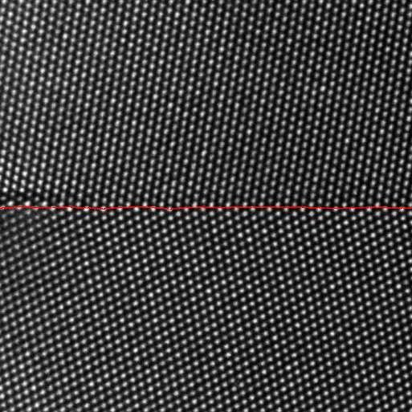
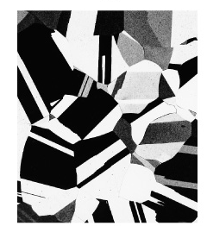
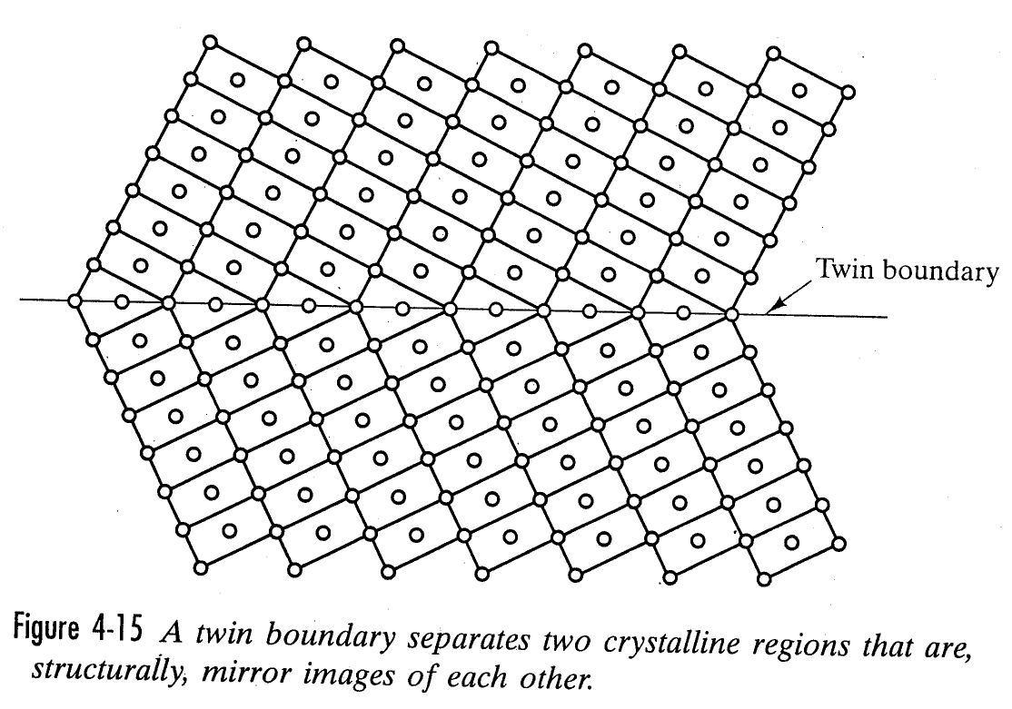
Twin boundaries
Brass at 60x
Notes:
Berkels, Benjamin & Rätz, Andreas & Rumpf, Martin & Voigt, Axel. (2007). Identification of Grain Boundary Contours at Atomic Scale. 4485. 765-776. 10.1007/978-3-540-72823-8_66.
Fig 4-15 from Shackelford, James G. Intro to materials science for engineers, 5th ed.

Slide 23
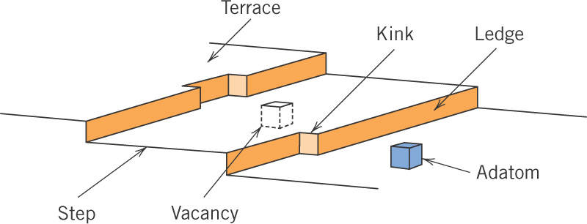
c05f15
Free surface
- Is also considered to be an interfacial defect
The energy of a free surface is directly related to the planar density of atoms.

Slide 24
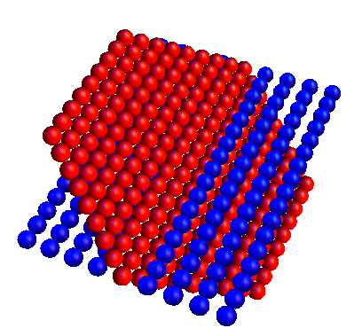
Surfaces
When considering the energy of a surface, higher planar density equals lower surface energy.

Slide 25
End

