Slide 1


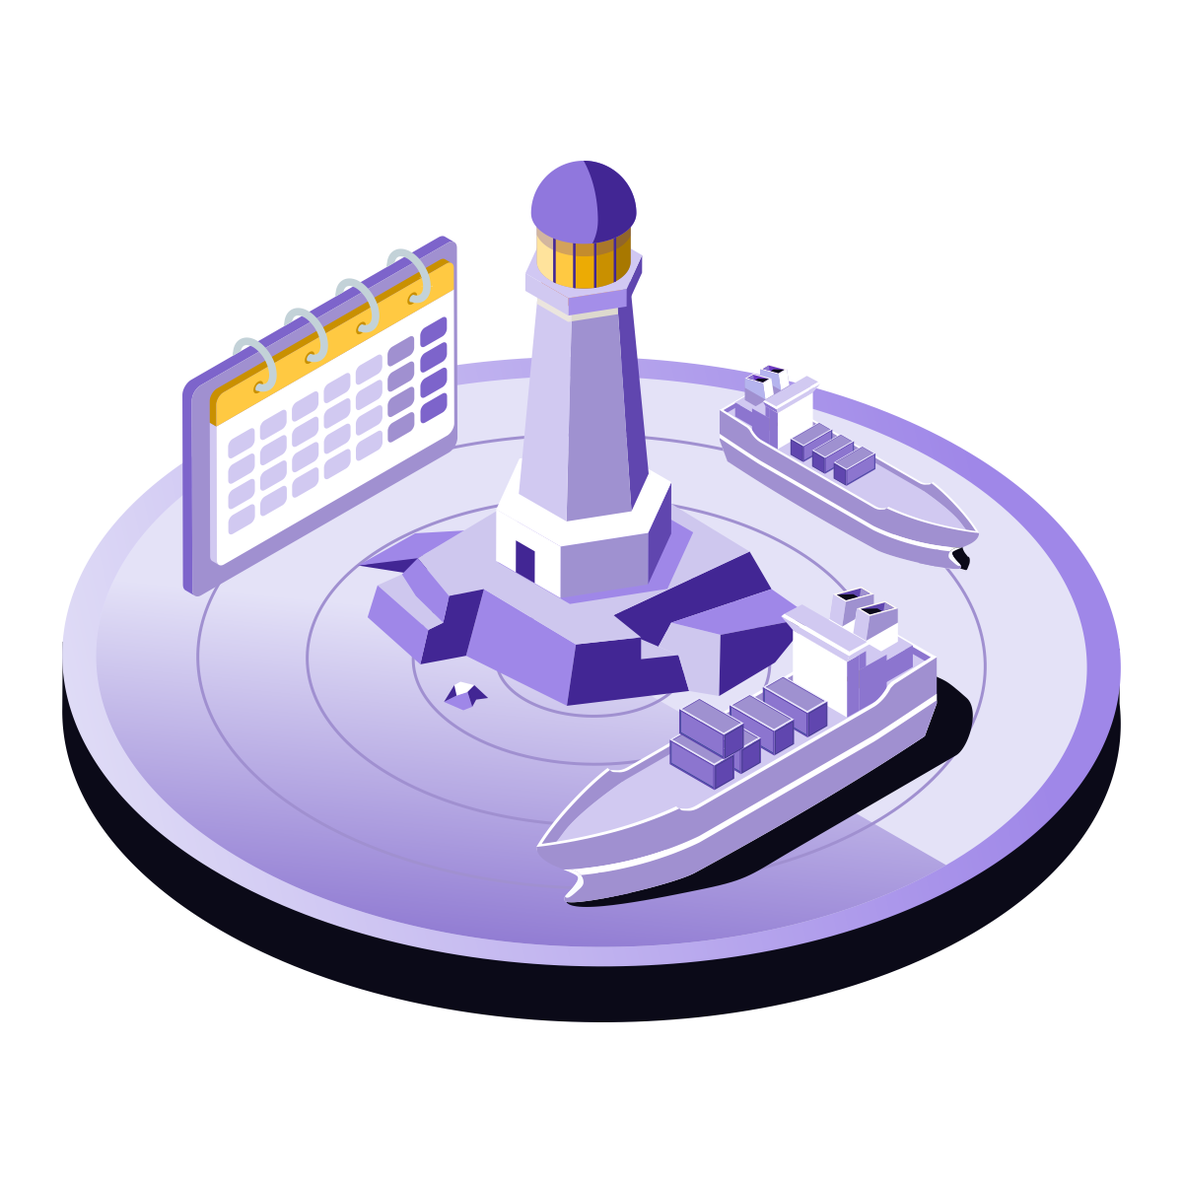
AUTOMATIC
IDENTIFICATION
SYSTEM
Data Gathering, Analytics & Security Analysis
Gene Soudlenkov, GNZ, 2025

Slide 2
Presentation Overview
PART I: Historical Context
Pre-AIS maritime challenges, collision problem, IMO development timeline, SOLAS mandate, post-9/11 security acceleration
PART II: Technical Architecture
VHF radio foundation, SOTDMA protocol, message types, encoding, Class A/B comparison, satellite AIS coverage
PART III: Data Analytics
Maritime domain awareness, predictive analytics, trade flow analysis, illegal fishing detection, dark vessels, environmental monitoring
PART IV: Security & Limitations
Spoofing attacks, GPS vulnerabilities, dark shipping, lack of authentication, data quality issues, privacy concerns

Slide 3
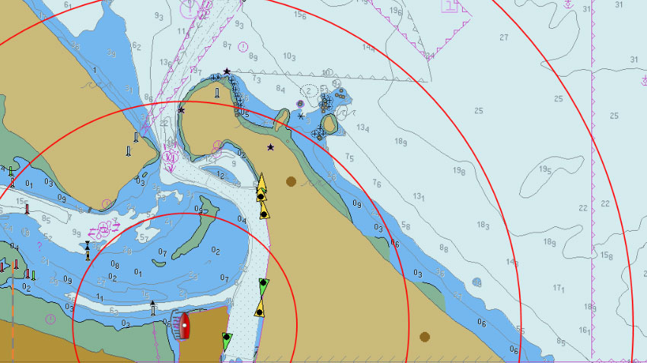
PART I: HISTORICAL CONTEXT
Maritime Surveillance Challenge Before AIS
The Dark Ocean Problem
Before 2002, maritime authorities had extremely limited visibility beyond visual range. The ocean was effectively dark beyond 20-40 nautical miles.
Manual Processes
Limited Range
Voice radio communication required for every vessel identification. Time-consuming and language-dependent
Radar detection without identification. Every contact was unknown

Slide 4
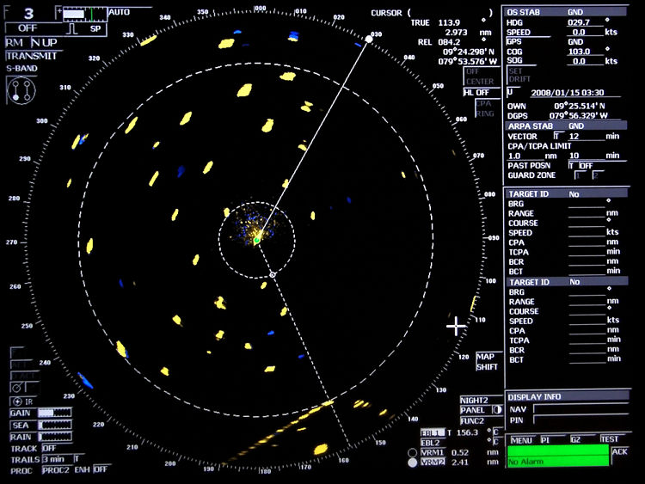
Pre-AIS Maritime Technologies
Marine Radar
Lloyd's Register
→ Detected vessel presence
→ Paper-based database
→ No identification info
→ No real-time data
→ Manual plotting required
→ Manual lookup
VHF Voice Radio
GPS Navigation
→ Channel 16: 156.800 MHz
→ Position known onboard
→ Manual communication
→ No broadcast capability
→ Language barriers
→ Each vessel isolated

Slide 5
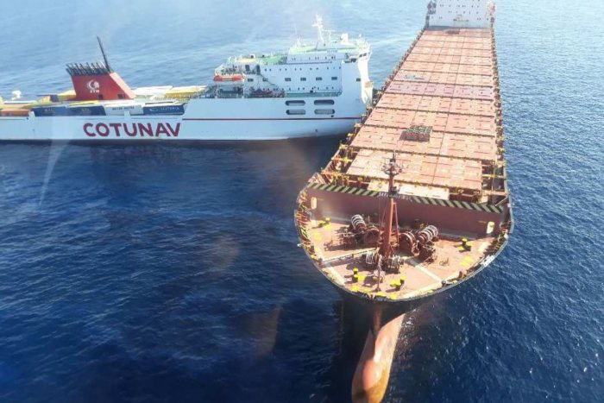
The Collision Problem
Frequent Maritime Collisions (1990s)
Despite radar technology, maritime collisions remained frequent throughout the 1990s. Problem acute in congested waters: Straits of Malacca, English Channel, Singapore Strait.
The Ulysse, a Tunisian ferry (left), collided with the Cypriot registered container ship CLS Virginia around 15 miles off the Corsican coast
•Ships saw radar echoes but couldn't identify vessel type or intentions
•No automated indication of course, speed, or intended maneuvers
•VHF calls time-consuming and language-dependent
•Busy lanes: impossible to contact every nearby vessel

Slide 6
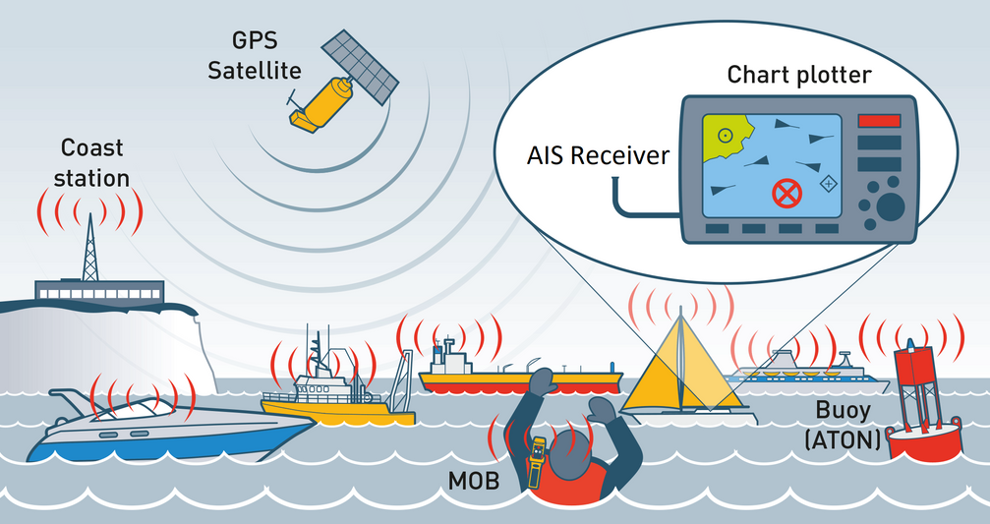
Search and Rescue Challenges
Distress Scenarios Pre-AIS
When vessels sent distress signals, rescue coordinators often had incomplete or outdated position information. Search areas could span hundreds of square nautical miles.
•Response Time: Without automated position reporting, rescue operations delayed by hours
•Position Uncertainty: Vessels drift with currents and wind
•Nearby Vessels: No way to automatically identify closest vessels to assist

Slide 7
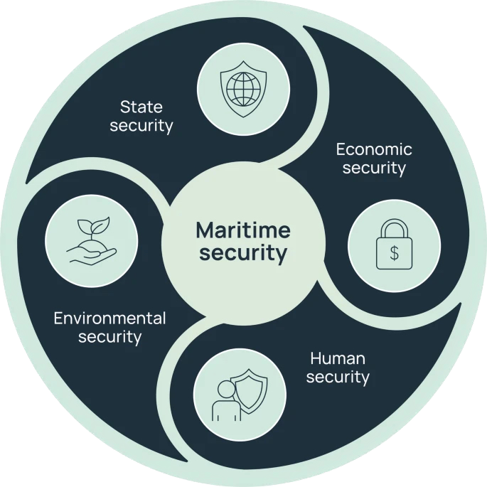
Maritime Security Gaps
•Illegal Fishing: Trawlers operated in protected zones with impunity
•Smuggling: Vessels approached coastlines undetected
•Piracy: Pirate vessels blended into traffic
•Environmental Crimes: Illegal dumping went undetected
•Port Security: Limited advance notice of arrivals

Slide 8
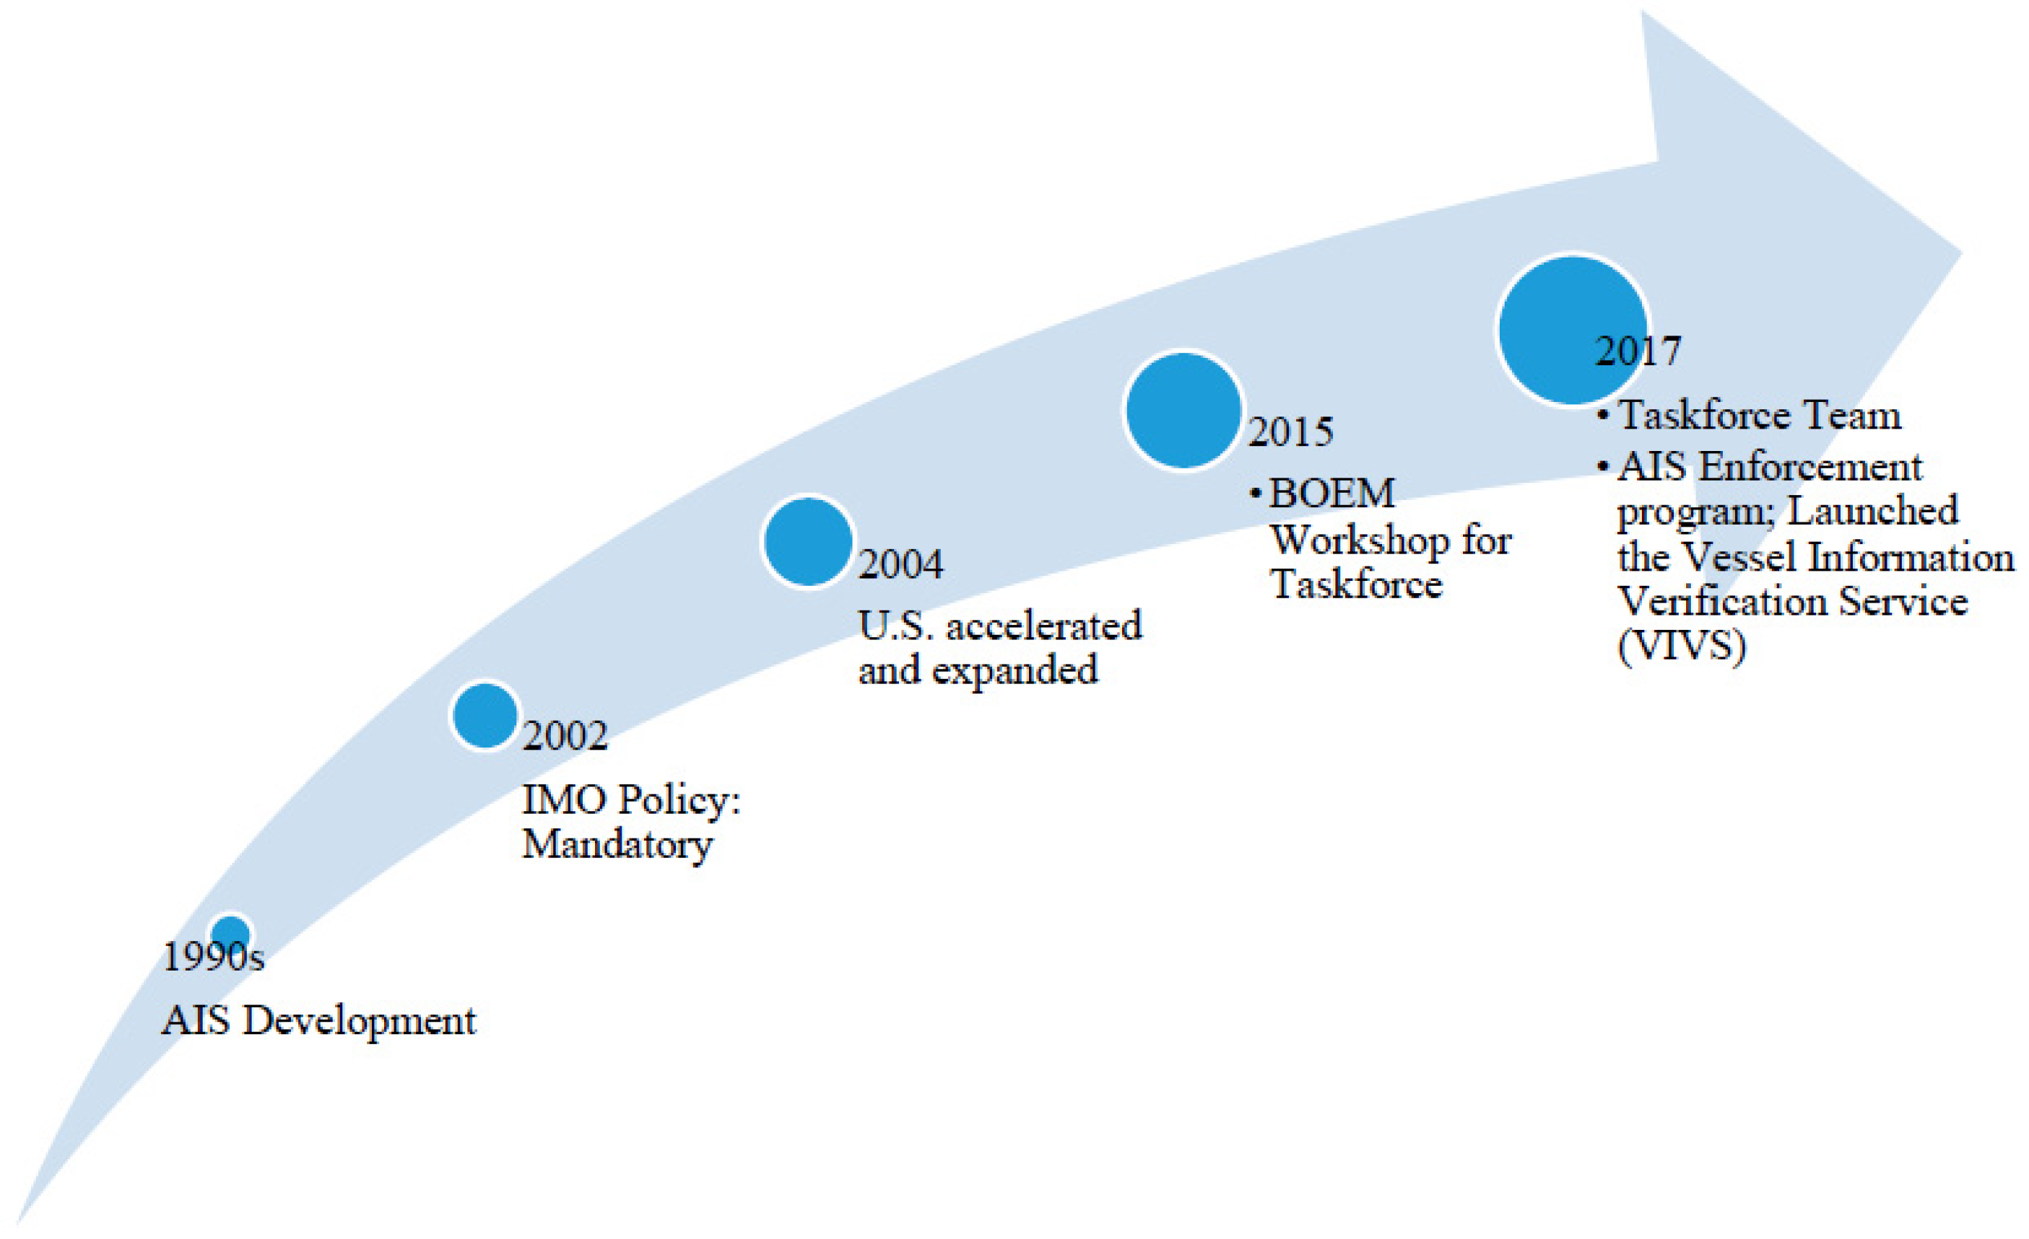
IMO and AIS Development
International Maritime Organization began developing automatic identification standards in early 1990s as part of broader effort to improve maritime safety.
1993
IMO begins evaluation of universal shipboard AIS
1997
Technical specs drafted. VHF frequencies allocated
1998
IMO adopts performance standards for AIS
2000
SOLAS Convention amended to require AIS

Slide 9
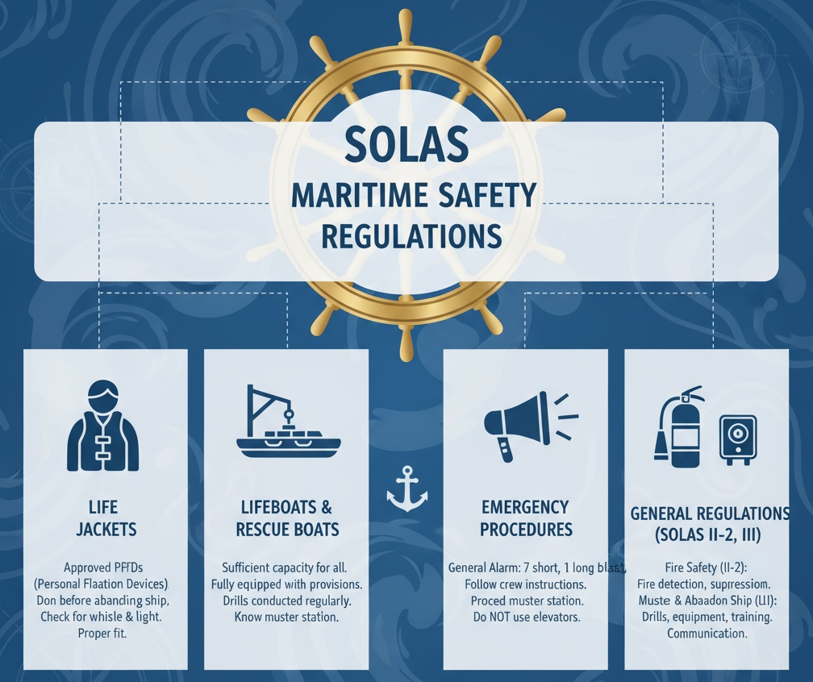
SOLAS (Safety of Life at Sea) Mandate
Safety of Life at Sea Convention
2000 SOLAS amendment made AIS mandatory for ships 300+ gross tonnage on international voyages, cargo ships 500+ GT domestic, and all passenger ships.
Phased Implementation
July 2002 to July 2008 based on ship type and construction date
Global Adoption
By 2008, over 40,000 vessels equipped with AIS transponders

Slide 10

Post-9/11 Security Acceleration
September 11, 2001 attacks dramatically accelerated AIS deployment. Maritime security became national priority for coastal states, particularly United States.
•U.S. Coast Guard mandated AIS on all vessels in U.S. waters
•Maritime Transportation Security Act integrated AIS into port security
•European Union rapidly deployed coastal AIS receiver networks
•AIS data integrated into national maritime domain awareness systems

Slide 11
Early AIS Deployment Challenges
Equipment Cost
Compliance Resistance
Class A transponders $3,000-15,000 USD. Significant burden for small operators.
Some operators resisted due to privacy concerns. Fishing fleets worried about competition.
Installation Complexity
Data Quality Issues
Required integration with GPS, gyrocompass, radar. Professional installation needed.
Early units had configuration errors. Incorrect vessel dimensions, outdated static data.

Slide 12
AIS Deployment Success
By 2012, AIS had become standard on virtually all commercial vessels worldwide. System proved invaluable for collision avoidance, traffic management, and search/rescue.
250,000+
99%
4500
Vessels with AIS by 2012
SOLAS vessel compliance
Messages/min capacity

Slide 13
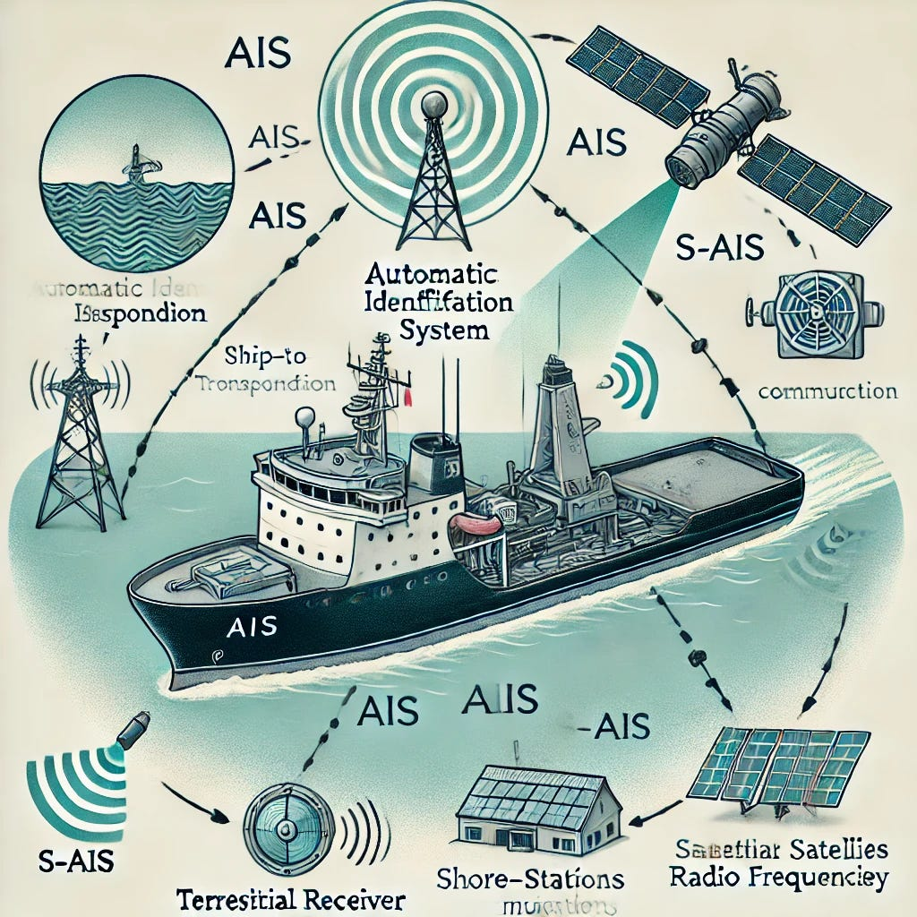
PART II: TECHNICAL ARCHITECTURE
VHF Radio, SOTDMA Protocol, Message Structure
Core Components
Key Technologies
→ VHF transceiver (161.975 & 162.025 MHz)
→ GMSK modulation (9600 baud)
→ GPS/GNSS receiver
→ HDLC packet structure
→ SOTDMA controller
→ CRC-16 error detection
→ Display interface
→ UTC time synchronization
→ Sensor inputs (gyro, log)
→ Self-organizing slot reservation

Slide 14
VHF Radio Foundation
Marine VHF Band (156-162 MHz)
AIS operates on two dedicated VHF channels protected from interference and reserved exclusively for maritime safety.
161.975 MHz
162.025 MHz
AIS Channel 1 / Channel 87B
AIS Channel 2 / Channel 88B
Bandwidth: 25 kHz spacing, 9600 baud GMSK modulation

Slide 15
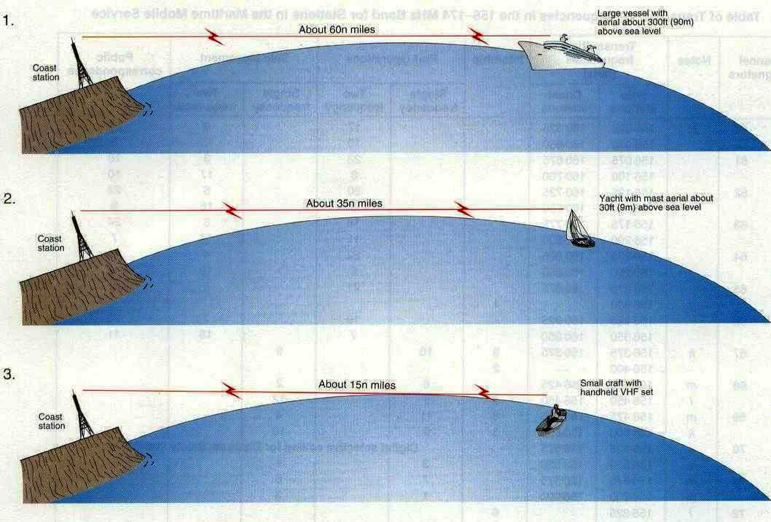
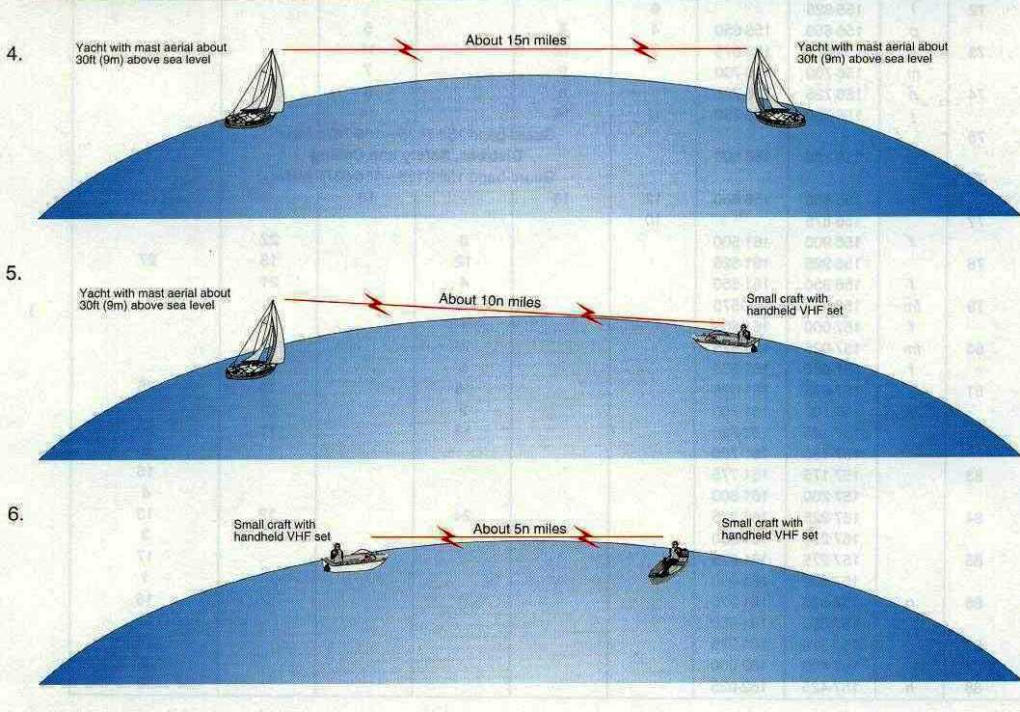
Why VHF for AIS?
✓Excellent Maritime Propagation: VHF signals propagate well over water. Line-of-sight range 20-40 NM depending on antenna height.
✓Low Power Requirements: Class A: 12.5W, Class B: 2W. Enables battery operation, reduces complexity.
✓Existing Infrastructure: Ships already equipped with VHF. Antennas and RF systems familiar to marine engineers.
✓International Allocation: Coordinated through ITU. No licensing fees for end users.

Slide 16
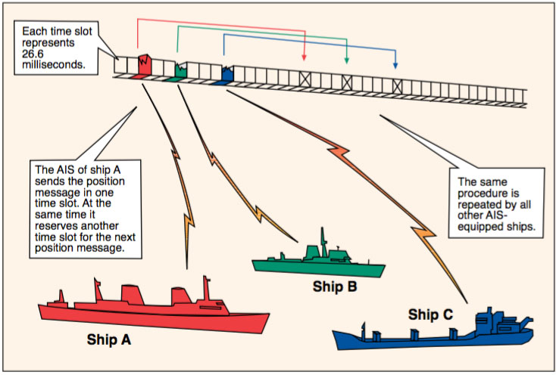
SOTDMA Protocol
Self-Organizing Time Division Multiple Access
SOTDMA enables thousands of vessels to share two VHF channels without collisions or central coordination. Each vessel autonomously selects transmission slots.
1
Listen to all transmissions, build map of occupied slots
2
Select available slot, announce reservation
3
Other vessels hear reservation, avoid that slot
4
System self-organizes, scales automatically

Slide 17
Time Slot Allocation
Frame Structure: Each AIS channel divided into 2250 time slots per minute. One minute frame = 2250 slots × 26.67 milliseconds/slot.
2250
26.67 ms
4500
Slots/min per channel
Duration of each slot
Total transmissions/min
Collision Avoidance: Vessels pre-announce next slot. If collision occurs, both randomly select new slots.

Slide 18
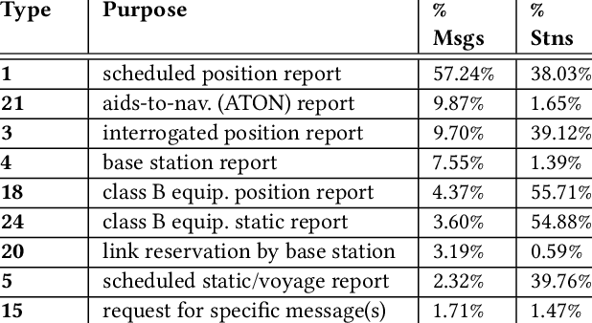
AIS Message Types Overview
Types 1, 2, 3: Position Reports
Scheduled position reports from Class A. MMSI, navigation status, rate of turn, SOG, position accuracy, lat/lon, COG, true heading
Type 5: Static and Voyage Data
Transmitted every 6 minutes. MMSI, IMO number, call sign, vessel name, ship type, dimensions, ETA, draft, destination
Type 18: Class B Position Report
Standard Class B CSTDMA position report with reduced information set. SOG, position, COG, heading, timestamp

Slide 19
Position Report Messages (Types 1/2/3)
Most frequent AIS messages. Broadcast vessel position, course, and speed for collision avoidance.
•Message ID: Type 1 (scheduled), Type 2 (assigned), Type 3 (interrogation)
•MMSI: 30-bit Maritime Mobile Service Identity (unique vessel ID)
•Navigation Status: Under way, at anchor, not under command, moored, aground, fishing, under sail
•Rate of Turn: -720 to +720 degrees/minute
•Position: Latitude ±90°, Longitude ±180°, precision 1/10,000 minute

Slide 20
Static Data Messages (Type 5)
Transmitted every 6 minutes and on request. Contains vessel identification, characteristics, and voyage information.
•IMO Number: 7-digit unique ship identification (permanent)
•Call Sign: Radio call sign (up to 7 characters)
•Vessel Name: Up to 20 characters
•Ship Type: Passenger, cargo, tanker, fishing, pleasure craft
•Dimensions: Distance to bow, stern, port, starboard from GPS antenna

Slide 21
Dynamic Update Rates
Technical specifications for dynamic update rates. AIS uses VHF radio with SOTDMA protocol for coordinated transmission among thousands of vessels.
The system enables automatic vessel identification, position reporting, and navigation data exchange in real-time across maritime VHF radio networks.

Slide 22
Class A Equipment Specifications
Technical specifications for class a equipment specifications. AIS uses VHF radio with SOTDMA protocol for coordinated transmission among thousands of vessels.
The system enables automatic vessel identification, position reporting, and navigation data exchange in real-time across maritime VHF radio networks.

Slide 23
Class B Equipment Specifications
Technical specifications for class b equipment specifications. AIS uses VHF radio with SOTDMA protocol for coordinated transmission among thousands of vessels.
The system enables automatic vessel identification, position reporting, and navigation data exchange in real-time across maritime VHF radio networks.

Slide 24
Class A vs B Comparison
Technical specifications for class a vs b comparison. AIS uses VHF radio with SOTDMA protocol for coordinated transmission among thousands of vessels.
The system enables automatic vessel identification, position reporting, and navigation data exchange in real-time across maritime VHF radio networks.

Slide 25
Message Encoding & Structure
Technical specifications for message encoding & structure. AIS uses VHF radio with SOTDMA protocol for coordinated transmission among thousands of vessels.
The system enables automatic vessel identification, position reporting, and navigation data exchange in real-time across maritime VHF radio networks.

Slide 26
SOTDMA Frame Structure
Technical specifications for sotdma frame structure. AIS uses VHF radio with SOTDMA protocol for coordinated transmission among thousands of vessels.
The system enables automatic vessel identification, position reporting, and navigation data exchange in real-time across maritime VHF radio networks.

Slide 27
Satellite AIS Technology
Technical specifications for satellite ais technology. AIS uses VHF radio with SOTDMA protocol for coordinated transmission among thousands of vessels.
The system enables automatic vessel identification, position reporting, and navigation data exchange in real-time across maritime VHF radio networks.

Slide 28
Satellite Coverage Challenges
Technical specifications for satellite coverage challenges. AIS uses VHF radio with SOTDMA protocol for coordinated transmission among thousands of vessels.
The system enables automatic vessel identification, position reporting, and navigation data exchange in real-time across maritime VHF radio networks.

Slide 29
PART III: DATA ANALYTICS
Maritime Intelligence and Pattern Recognition
AIS generates massive data streams: 30-50 million position reports daily worldwide. Advanced analytics platforms process this data to extract maritime intelligence.
Government Users
Commercial Users
Coast guards, navies, customs, fisheries enforcement, environmental agencies, port authorities
Shipping companies, insurers, commodity traders, logistics providers, market intelligence firms

Slide 30
Maritime Domain Awareness
Analytics applications for maritime domain awareness. AIS data enables comprehensive maritime intelligence through pattern recognition and anomaly detection.
Advanced algorithms process billions of AIS messages to identify suspicious activities and predict vessel movements for commercial and security applications.

Slide 31
Vessel Tracking Platforms
Analytics applications for vessel tracking platforms. AIS data enables comprehensive maritime intelligence through pattern recognition and anomaly detection.
Advanced algorithms process billions of AIS messages to identify suspicious activities and predict vessel movements for commercial and security applications.

Slide 32
Predictive Analytics & ETA
Analytics applications for predictive analytics & eta. AIS data enables comprehensive maritime intelligence through pattern recognition and anomaly detection.
Advanced algorithms process billions of AIS messages to identify suspicious activities and predict vessel movements for commercial and security applications.

Slide 33
Trade Flow Analysis
Analytics applications for trade flow analysis. AIS data enables comprehensive maritime intelligence through pattern recognition and anomaly detection.
Advanced algorithms process billions of AIS messages to identify suspicious activities and predict vessel movements for commercial and security applications.

Slide 34
Illegal Fishing Detection
Analytics applications for illegal fishing detection. AIS data enables comprehensive maritime intelligence through pattern recognition and anomaly detection.
Advanced algorithms process billions of AIS messages to identify suspicious activities and predict vessel movements for commercial and security applications.

Slide 35
Dark Vessel Detection
Analytics applications for dark vessel detection. AIS data enables comprehensive maritime intelligence through pattern recognition and anomaly detection.
Advanced algorithms process billions of AIS messages to identify suspicious activities and predict vessel movements for commercial and security applications.

Slide 36
Transshipment Analysis
Analytics applications for transshipment analysis. AIS data enables comprehensive maritime intelligence through pattern recognition and anomaly detection.
Advanced algorithms process billions of AIS messages to identify suspicious activities and predict vessel movements for commercial and security applications.

Slide 37
Port Congestion Prediction
Analytics applications for port congestion prediction. AIS data enables comprehensive maritime intelligence through pattern recognition and anomaly detection.
Advanced algorithms process billions of AIS messages to identify suspicious activities and predict vessel movements for commercial and security applications.

Slide 38
Environmental Monitoring
Analytics applications for environmental monitoring. AIS data enables comprehensive maritime intelligence through pattern recognition and anomaly detection.
Advanced algorithms process billions of AIS messages to identify suspicious activities and predict vessel movements for commercial and security applications.

Slide 39
Commercial Applications
Analytics applications for commercial applications. AIS data enables comprehensive maritime intelligence through pattern recognition and anomaly detection.
Advanced algorithms process billions of AIS messages to identify suspicious activities and predict vessel movements for commercial and security applications.

Slide 40
PART IV: SECURITY & LIMITATIONS
Vulnerabilities, Attacks, and System Weaknesses
Fundamental Design Limitation
AIS designed in 1990s for cooperative maritime safety, NOT adversarial security. Protocol has NO cryptographic authentication, NO message integrity verification.
Trust Model
Threat Actors
System assumes all broadcasts truthful. Any vessel can claim any identity or report false positions.
Nation-states, organized crime, sanctions evaders, illegal fishing operations exploit AIS vulnerabilities.

Slide 41
AIS Spoofing & Identity Theft
Security vulnerability: AIS Spoofing & Identity Theft. AIS has no cryptographic authentication, making it fundamentally vulnerable to spoofing and manipulation by adversaries.
Threat actors exploit lack of message authentication to broadcast false information, creating serious risks for maritime security, safety, and commercial operations.

Slide 42
Position Manipulation Attacks
Security vulnerability: Position Manipulation Attacks. AIS has no cryptographic authentication, making it fundamentally vulnerable to spoofing and manipulation by adversaries.
Threat actors exploit lack of message authentication to broadcast false information, creating serious risks for maritime security, safety, and commercial operations.

Slide 43
Ghost Ships (Phantom Vessels)
Security vulnerability: Ghost Ships (Phantom Vessels). AIS has no cryptographic authentication, making it fundamentally vulnerable to spoofing and manipulation by adversaries.
Threat actors exploit lack of message authentication to broadcast false information, creating serious risks for maritime security, safety, and commercial operations.

Slide 44
GPS Jamming Impact
Security vulnerability: GPS Jamming Impact. AIS has no cryptographic authentication, making it fundamentally vulnerable to spoofing and manipulation by adversaries.
Threat actors exploit lack of message authentication to broadcast false information, creating serious risks for maritime security, safety, and commercial operations.

Slide 45
GPS Spoofing Attacks
Security vulnerability: GPS Spoofing Attacks. AIS has no cryptographic authentication, making it fundamentally vulnerable to spoofing and manipulation by adversaries.
Threat actors exploit lack of message authentication to broadcast false information, creating serious risks for maritime security, safety, and commercial operations.

Slide 46
Dark Shipping Operations
Security vulnerability: Dark Shipping Operations. AIS has no cryptographic authentication, making it fundamentally vulnerable to spoofing and manipulation by adversaries.
Threat actors exploit lack of message authentication to broadcast false information, creating serious risks for maritime security, safety, and commercial operations.

Slide 47
No Cryptographic Authentication
Security vulnerability: No Cryptographic Authentication. AIS has no cryptographic authentication, making it fundamentally vulnerable to spoofing and manipulation by adversaries.
Threat actors exploit lack of message authentication to broadcast false information, creating serious risks for maritime security, safety, and commercial operations.

Slide 48
Data Quality Issues
Security vulnerability: Data Quality Issues. AIS has no cryptographic authentication, making it fundamentally vulnerable to spoofing and manipulation by adversaries.
Threat actors exploit lack of message authentication to broadcast false information, creating serious risks for maritime security, safety, and commercial operations.

Slide 49
Coverage Limitations
Security vulnerability: Coverage Limitations. AIS has no cryptographic authentication, making it fundamentally vulnerable to spoofing and manipulation by adversaries.
Threat actors exploit lack of message authentication to broadcast false information, creating serious risks for maritime security, safety, and commercial operations.

Slide 50
Questions?
?
Gene Soudlenkov | GNZ | 2025

